Slide 1
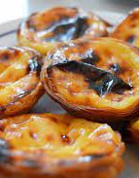

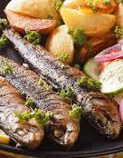
The Portuguese Menu
Inês Azevedo
Notes:
NOTA: Para substituir uma imagem, basta selecioná-la e eliminá-la. Em seguida, utilize o ícone Inserir Imagem para substituí-la pela sua própria imagem!

Slide 2
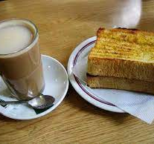
Breakfast
Bread with butter and coffee with milk
The bread can be toasted or not and the type of bread varies.
About the coffee with milk; most people prefer it with an expresso and it is usually sweetened.

Slide 3
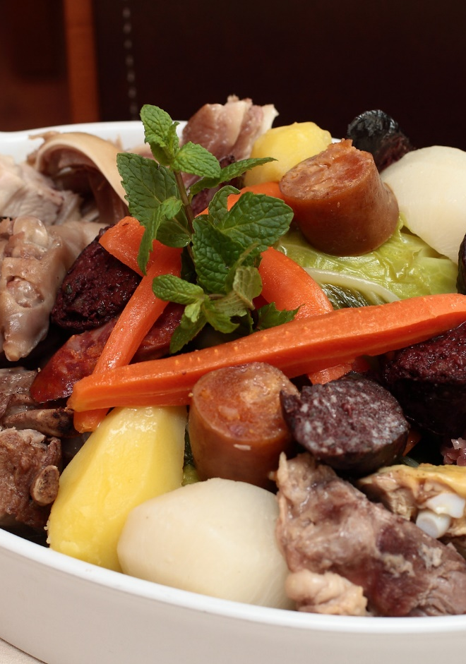
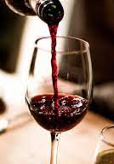
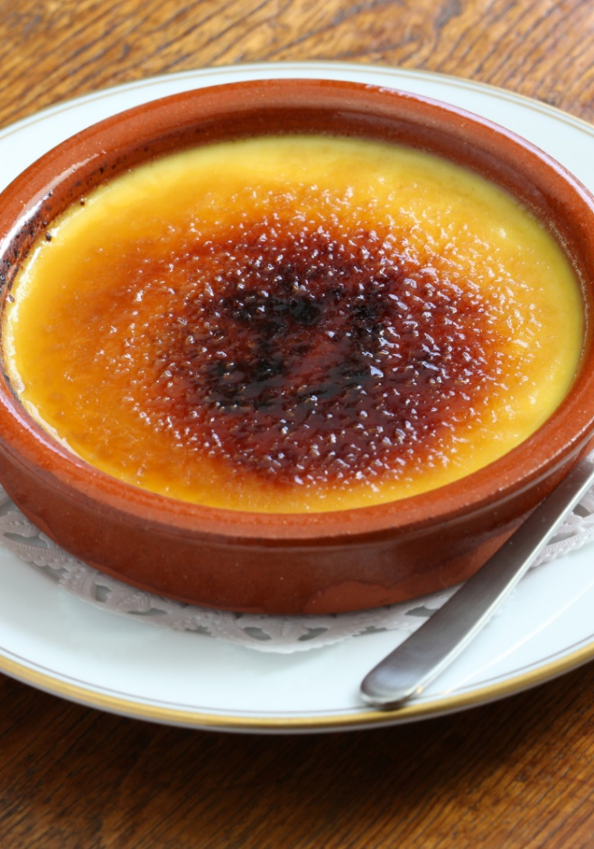
Lunch
“Cozido à Portuguesa” with red wine and for dessert “Leite Creme”
The traditional dish "cozido á portuguesa" is a dish with lots of vegetables (especially cabbage and carrots) and various types of meat. The dessert consists of a custard cream made with milk and egg yolks flavoured with lemon and cinnamon.

Slide 4
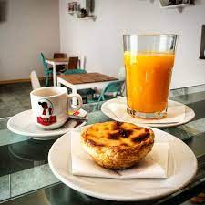
Snack
“Pastel de Nata” with orange juice
This is a simple but very Portuguese snack.
The “Pastel de Nata” is a pastry that those who go to Portugal never forget to eat.

Slide 5
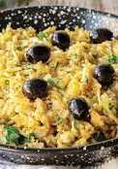

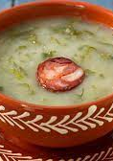
Dinner “Caldo Verde” (soup) and “Bacalhau à Brás” with white wine
“Caldo Verde" is a Portuguese soup traditionally eaten at Christmas but served all year. The soup is made of potatoes, cabbage and sliced sausage. “Bacalhau á brás" is a codfish dish much appreciated by the Portuguese people with potatoes, olives and olive oil.

Slide 6
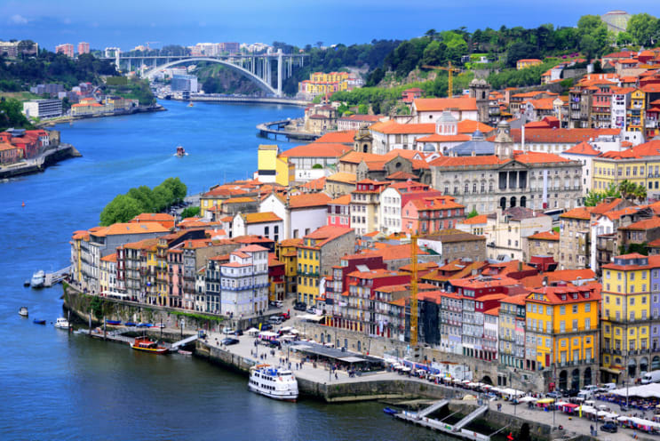
Hope you enjoyed

