Slide 1
Kretinga

Slide 2
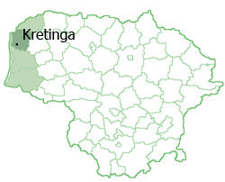
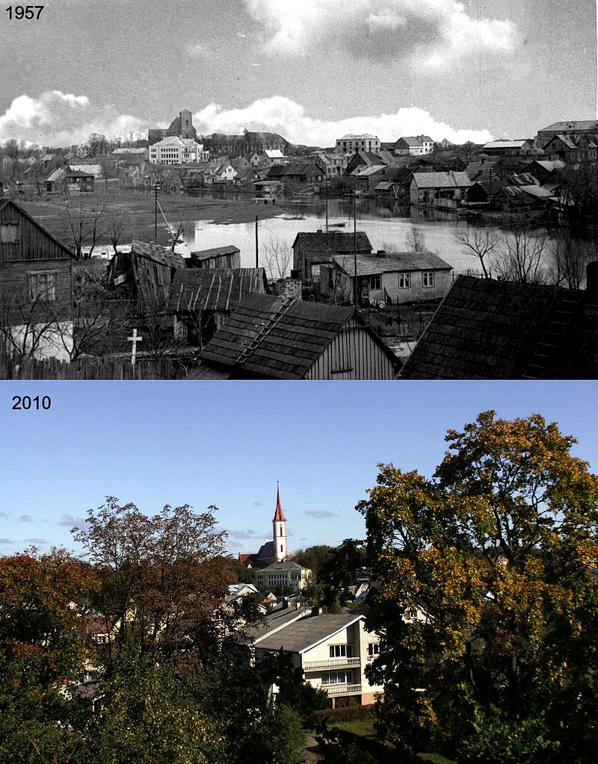
Kretinga
Kretinga is a town in western Lithuania, Samogitia. ( It‘s a region )
It is one of the oldest towns in western Lithuania.

Slide 3
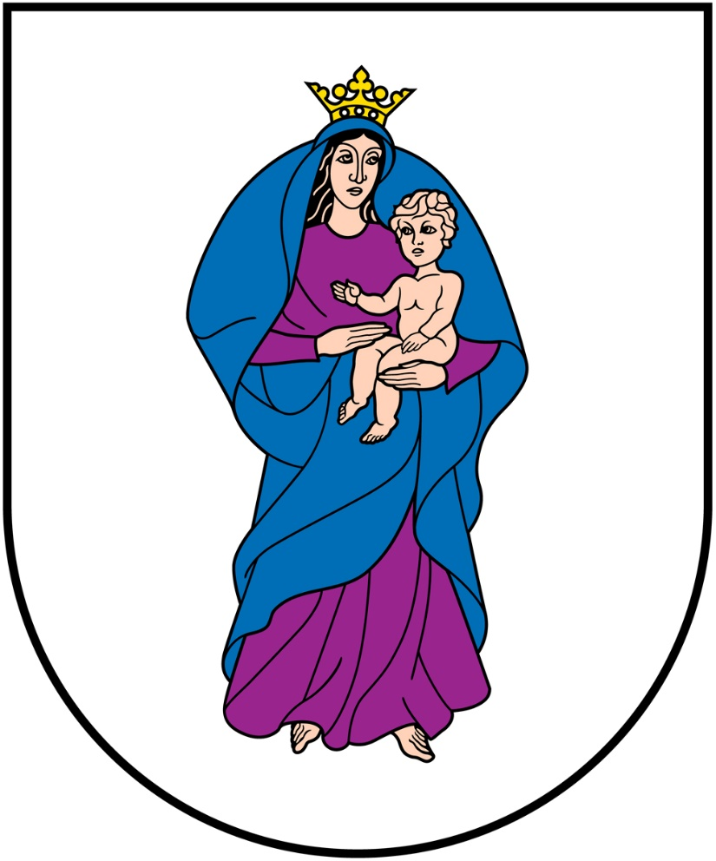
Kretinga
It is founded in 1252
There lives 16 840 people
The symbol of Kretinga →

Slide 4
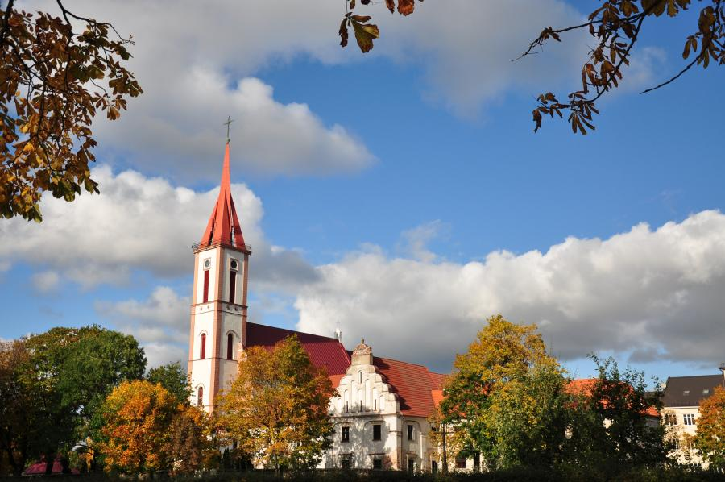
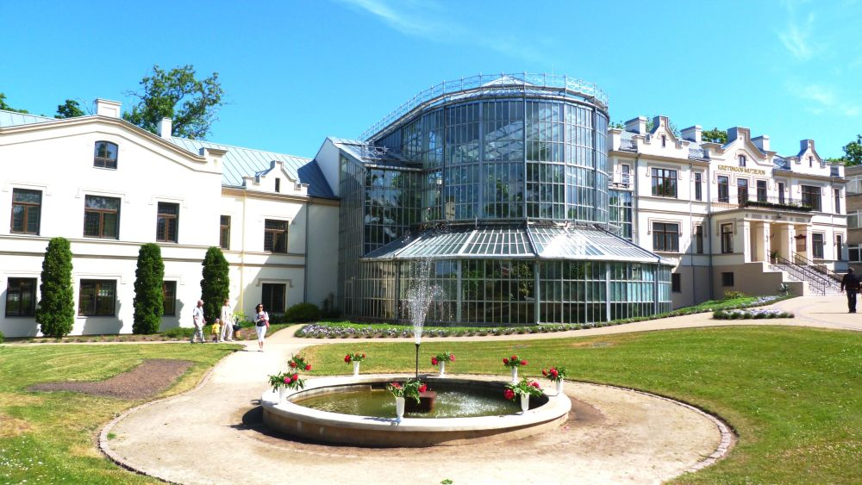
The most visited places in Kretinga

Slide 5
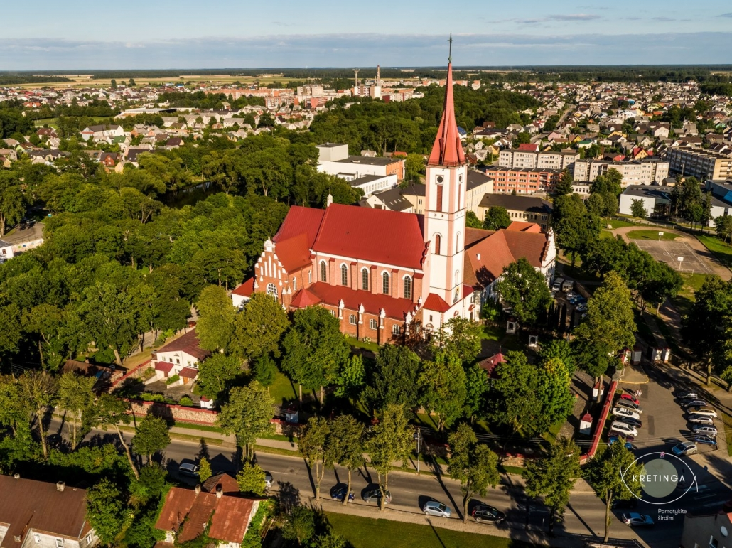
1. A complex of church and monastery.
The church was built in 1610-1617. It is one of the oldest surviving Gothic and Renaissance churches in Samogitia. It has seven altars going back to the 17th century.

Slide 6
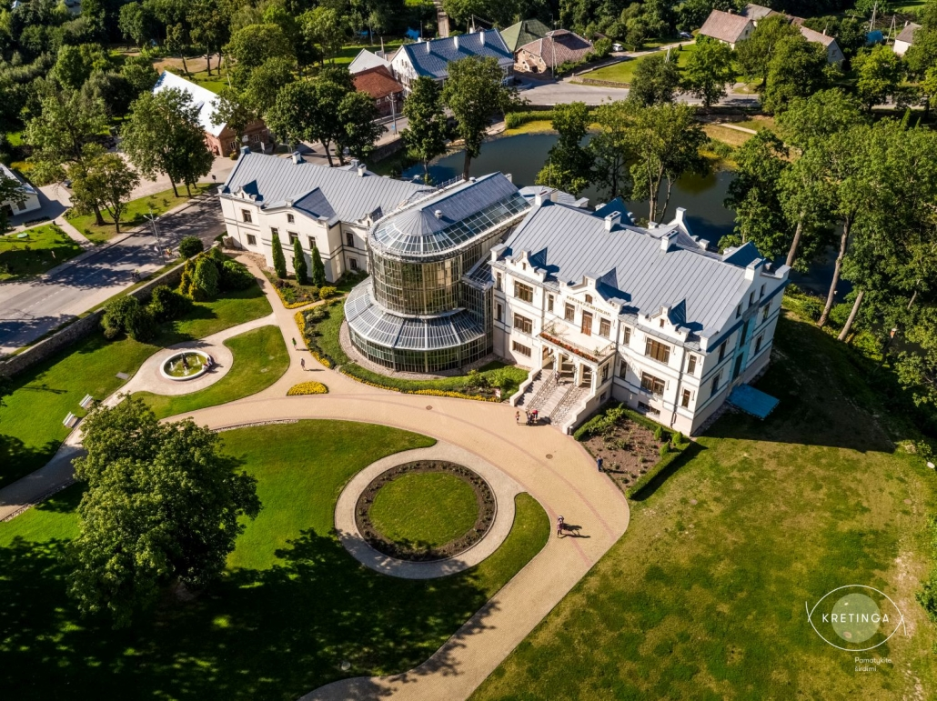
2. Kretinga Tiškevičiai manor with a winter garden
The palace was built in the 19th century. There is a museum in manor . Visitors can get acquainted with the history of the manor, archeological values.

Slide 7
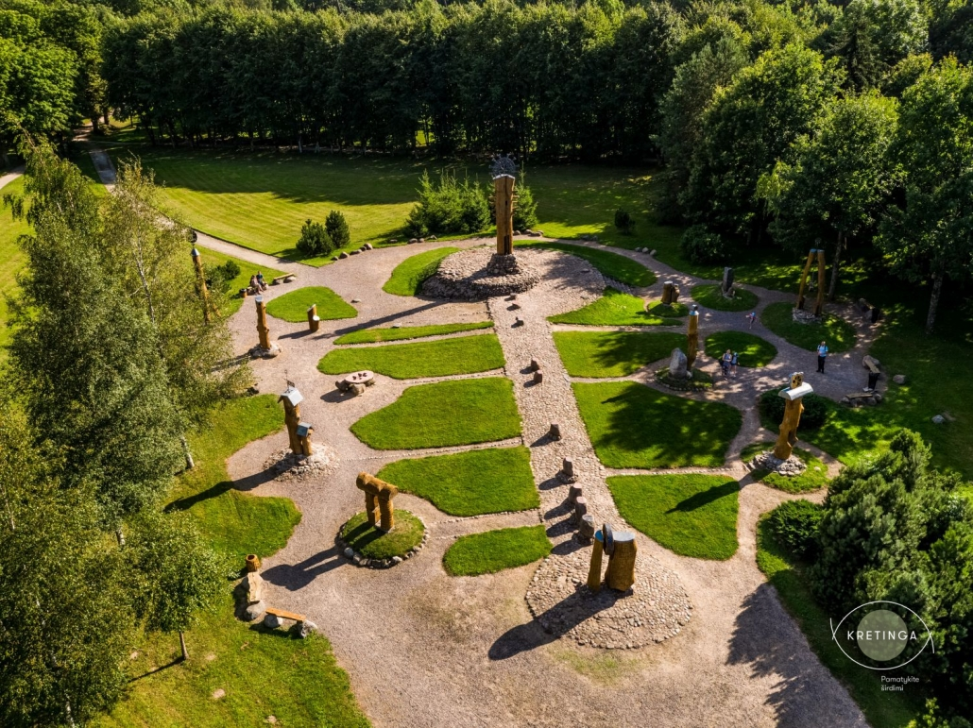
3. Manor park, Astronomical calendar with sun clock.
In the park visitors can walk among the oaks alleyways. There are 13 sculptures representing ancient Baltic cultural traditions and Lithuanian festivals.

Slide 8
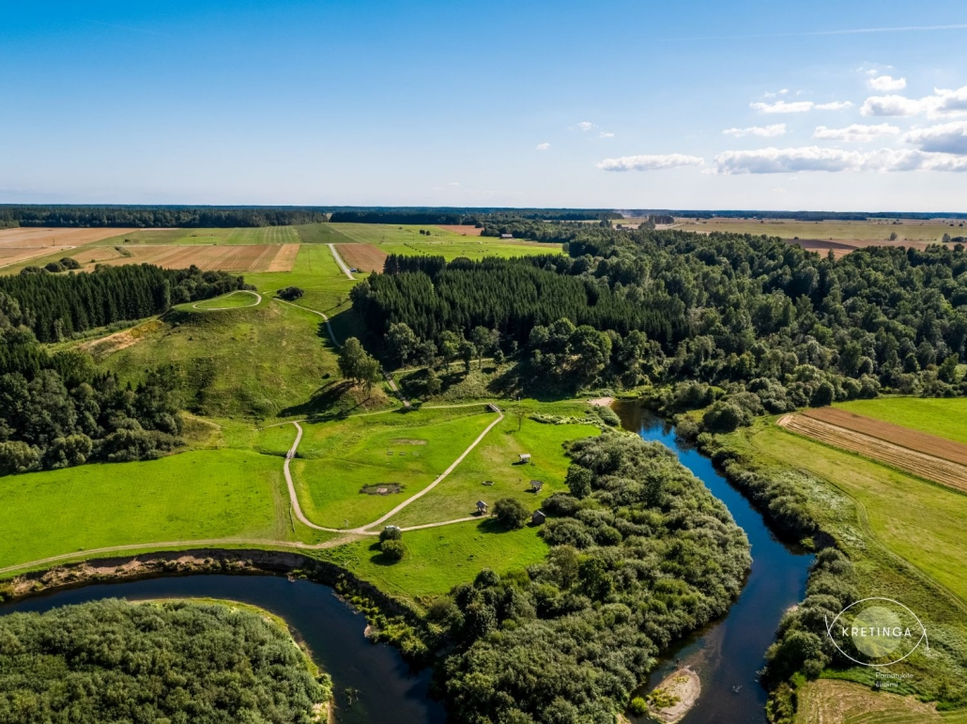
4. Historical-archaeological complex of Kartena Mound
Impressive view from the mound: Kartena town, Minija's bend and valleys. The wooden castle on it was an important defense and administrative center of Cecis land in Curon.

Slide 9
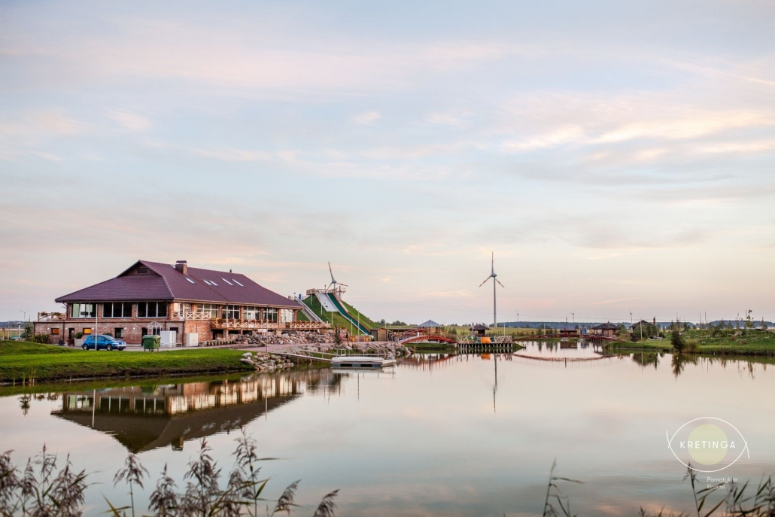
5. "BOOM park"
Here you can relax in the sauna, take a ride in the boats, go down the tires from the mountain, exercise with the simulators, jump on the "airbag", entertain the obstacle course, take a dip in the pool, find your success in the maze, see the sea from the 12 m tower.

Slide 10
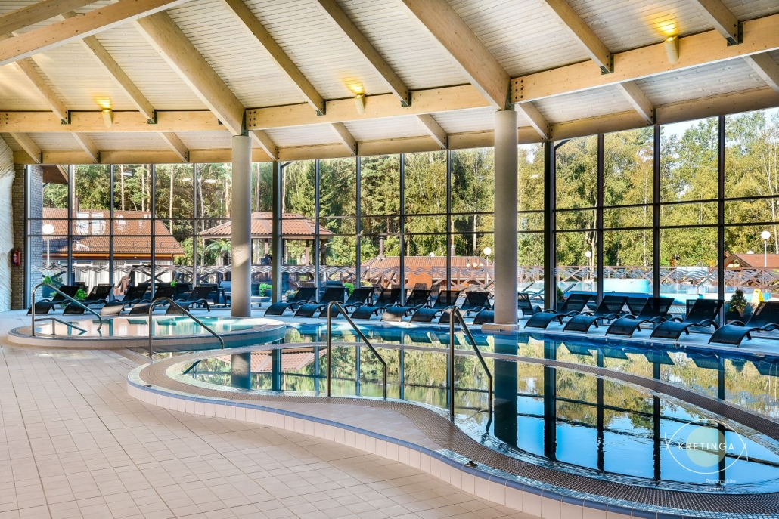
6. Rest and health promotion Complex "Holiday Park"
Here you can enjoy several different saunas: steam bath “Salt bath”, traditional Lithuanian bath “Perenė”, bathhouse “Riauška”, outdoor baths “Širšių lizdas” and “Baths of the Baths”, and many swimming pools: sports, massage, training or just outdoor swimming pools.

Slide 11
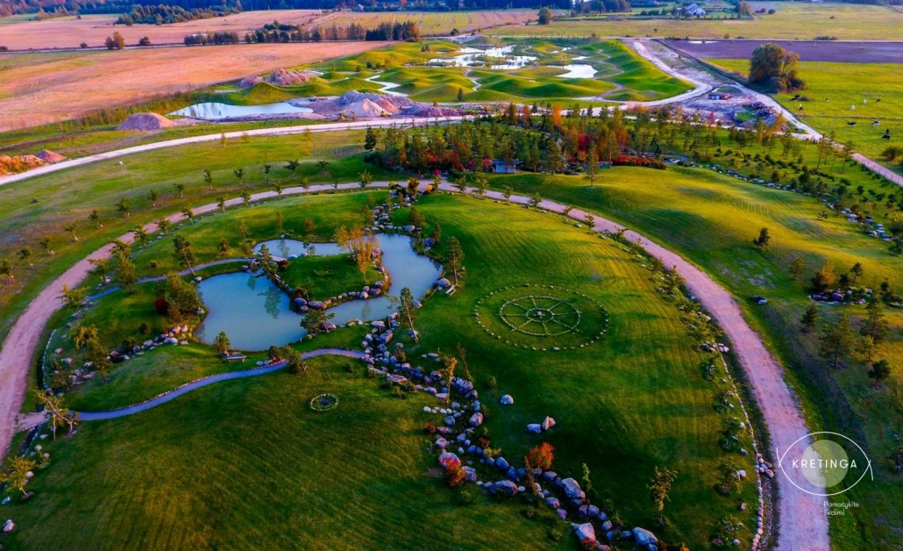
7. Japanese Garden
Japanese Garden is an integral part of Japanese culture. For centuries, he has combined religion, art, and respect for nature. Because our roots are pagan, Japanese love and respect for all elements of nature will not be difficult to understand.

Slide 12
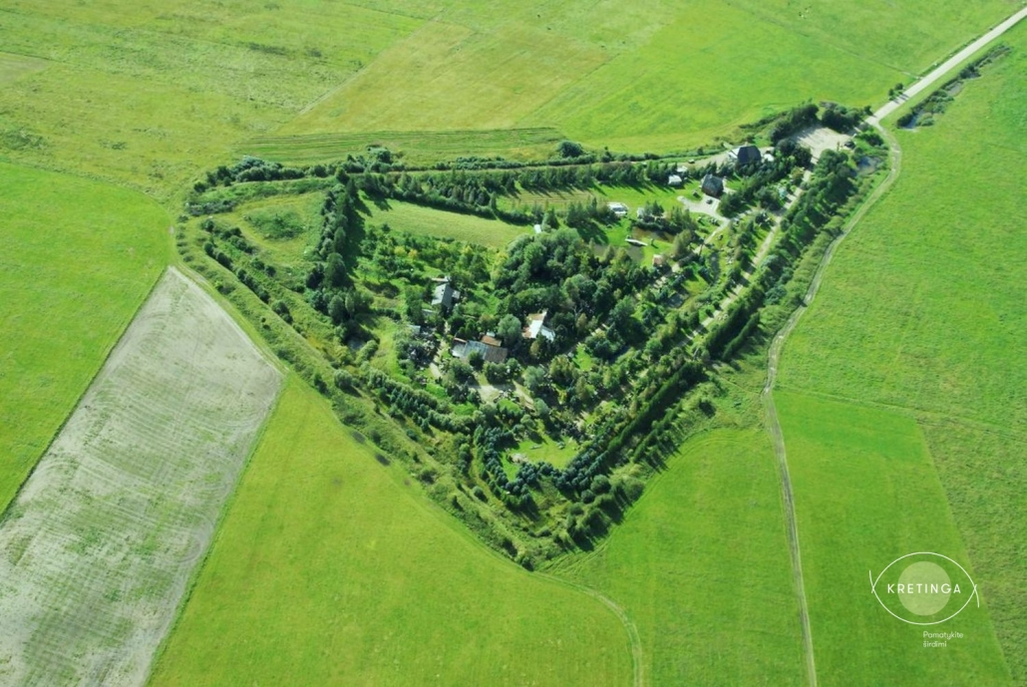
8. Orvidi homestead-museum
Orvidai homestead in Gargždele village, famous for its stone sculpture museum. It was founded by Vilius Kazimieras Orvidas (Franciscan brother Gabriel), with his father Kazimierz Orvid. Orvidi homestead consists of many parts - stones, trees, tank, old things and much more.

Slide 13
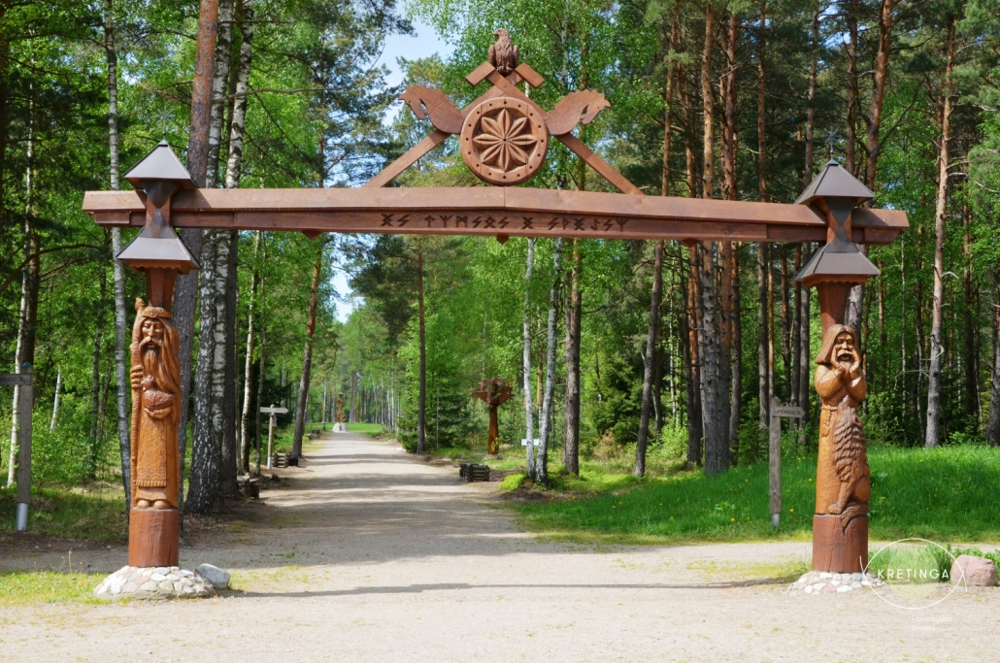
9. Baltic Mythological Park
Baltic mythological park cherishes old Baltic cultural values, educates civic Lithuanian people, promotes patriotism, contributes to state cultural activity, promotes cultural communication between Baltic nations and tribes (regions).

Slide 14
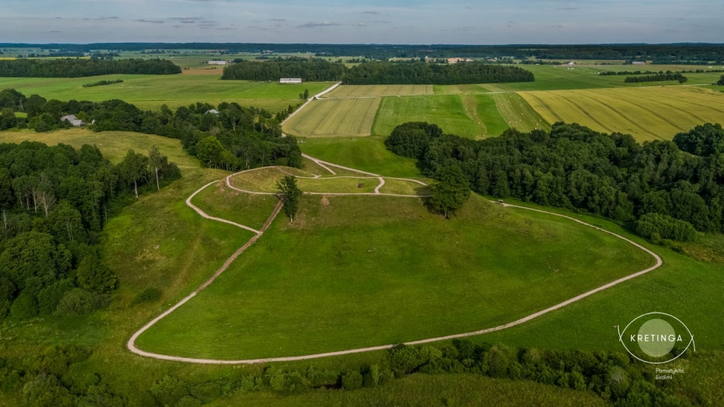
10. Imbare mound
The mound has found flint and metal working tools, arms, jewelery, glued on a slightly dashed, smooth and rough surface, and gilded ceramics, burnt grain. Imbarė castle mound with prefecture and settlement is equipped with 1 thousand. Before Crist. In the second half and lived until the 13th century.

Slide 15
Thank you for your attention!

