Slide 1
Prefecture of Imathia

Slide 2
A heart in the map.

Slide 4
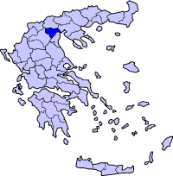
The Prefecture of Imathia is located
in Greece, specifically in Macedonia and
it belongs to the region of Central
Macedonia. It’s capital city is Veroia.

Slide 5
HISTORY

Slide 6
Imathia is one of the oldest inhabited areas in Greece. The prehistoric settlement of New Nikomidia, which is estimated around 6.250 b.C., is one of the oldest rural settlements of Greece and of Europe in general.
Imathia means ‘’sandy area’’ (from ‘’amathos’’ which in Greek means sand).It was the area between the Aliakmonas and Loudias rivers, it was the center of the kingdom and it also included the cities of Veroia and Kition (today’s Naousa).For a certain period of time the whole Macedonia was called ‘’Imathia’’.

Slide 7
During the Byzantine years, Bulgarians, Serbians and Byzantines wanted to possess the city of Veroia, which was conquered by the Turkish in 1386. Imathia was finally free the 16th of October, 1912 due to the victory of the great army. It was added to the Greek territory during the pact of Bucharest in 1913 as a part of the prefecture of Thessaloniki.
The prefecture of Imathia was created in 1946.

Slide 8
Today…

Slide 9
The prefecture of Imathia is 1.701km² long and its population is estimated around 140.611
Important cities: Veroia, Naousa, Alexandria, Meliki, Vergina ,Platy
Mountains: Pieria 2.193m, Vermio 2.052 μ.
Rivers: Aliakmonas 297km, Loudias 60km

Slide 10
Museums- Archaeological Sites

Slide 11
Veroia’s Archaeological museum
The visitor can see important exhibits from the Neolithic to the Hellenistic and Roman age.
Veroia’s Byzantine Museum
It is located in a recently renovated industrial building from the beginning of the century, the mill of Mark, which is at the preservable district of Kiriotissa.

Slide 12
National Museum of Education
The purpose of this building was for the visitor to be informed about learning, education, schools, students and books that come from the older years, when the students where obliged to wear blue uniforms!
Christos Tsolakis

Slide 13
School of Aristoteles -Mieza
Close to Naousa, in a place called Esvoria, in the ancient Macedonian city Mieza, is located Nymfaio where the philosopher Aristotle taught young Alexander the Great approximately in the middle of the 4th century bC.

Slide 14
Cultural Center Mieza’s Theater

Slide 15
Arapitsa, Naousa –Sacrifice space
During the Greek Revolution, on the 10th of October 1822 , the Turkish destroyed Naousa. The women and the children chose to jump into the waterfall of Arapitsa instead of being the victims of the Turkish army.

Slide 16
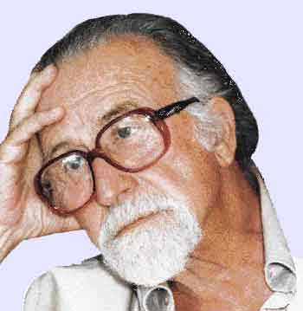
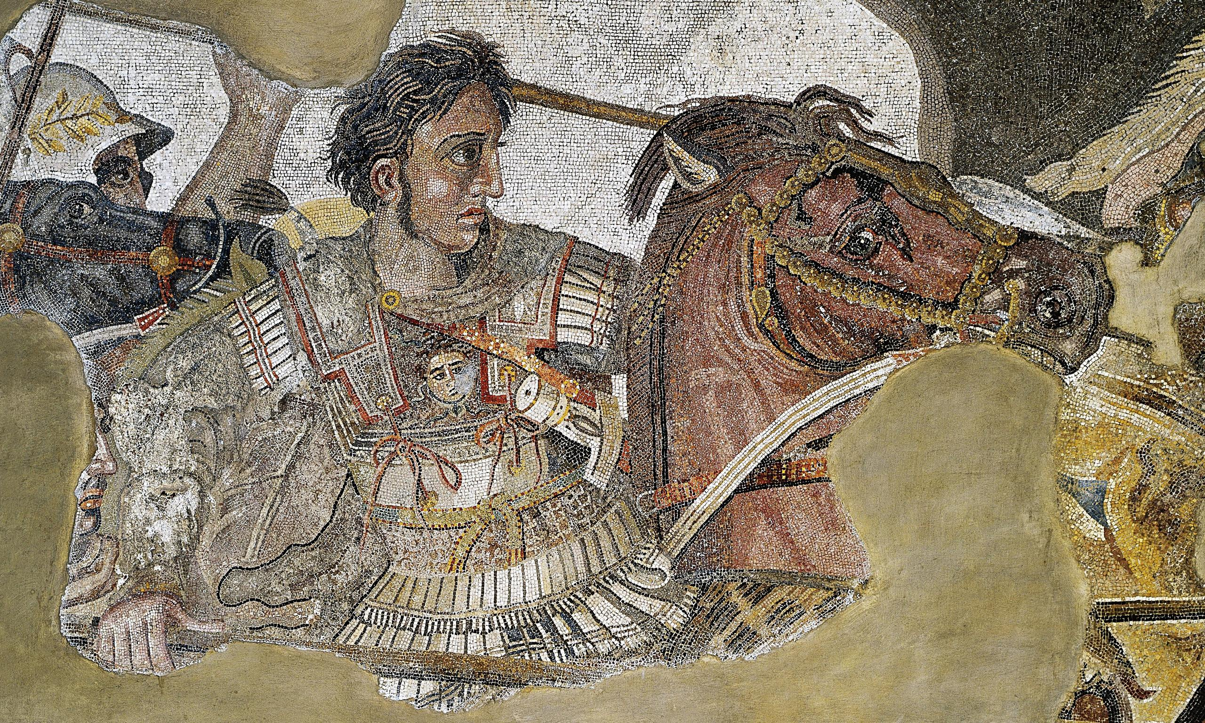
Vergina’s archaeological museum
It’s about an underground building which has the external shape of a tomb made of sand. The treasures, that were found in the royal graves by the archaeologist Manolis Andronikos, are exhibited there since November 1997
Manolis Andronikos
Alexander the Great-mosaic

Slide 17
Vergina - Archaeological site

Slide 18
Filippo’s grave –Gold Larnaka
Vergina’s museum

Slide 19
Nature

Slide 20
Ski Resorts
Three-five wells
Seli

Slide 21
Aliakmonas River
Saint Nikolaos

Slide 22
Peach trees

Slide 23
Veroia the Capital

Slide 26
Veroia’s Library
Elia square

Slide 27
District of Jews

Slide 28
District of Barbouta

Slide 29
District of Kiriotissa

Slide 30
Saint Paul’s step
Saint Paulo the Apostle (apostle of the nations) was in Veroia during the time between 50 and 60 a.C. and he taught Christianity to its residents.

Slide 31
Byzantine church

Slide 32
Holy Mary Soumela church
It’s a very important church for the people in Imathia. It’s an attempt to revive the prominent, of the same name monastery, whose remains are found at the Mela mount, near Trapezounta of Pontos. It has been opened since 1951 and the picture of Holy Mary, drawn by Evangelist Lukas himself, is held in there.

Slide 33
Other cities…

Slide 34
Naousa

Slide 35
Meliki
George Meliki’s Ethnographic museum -
Greek mask’s center

Slide 36
Alexandria
Platy

Slide 37
Customs…

Slide 38
Boules
Every year, Naousa lives under the carnival rhythm. Boules is a famous tradition that has its roots back at the years of the Turkish domination. People wear special masks and traditional customs called ‘’ Foustanela’’

Slide 39
Anastenaria
Anastenaria in Meliki is a traditional dance, where people dance on lit burning charcoal!

Slide 40
LOCAL DISHES
REVANI
Imathia’s local dishes include meat, pork with celery or leek and traditional stuffed pies. Our traditional desert is called ‘’Revani’’.It is delicious, you can find it in every pastry shop of Veroia or you can taste it as a treat at restaurants, after eating your meal.

Slide 41
DIMOTIKO SCHOLEIO PLATEOS IMATHIAS
OCTOBER 2019

