Slide 1
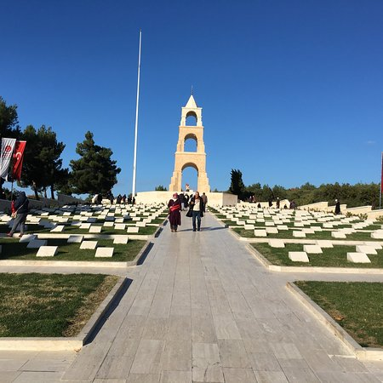
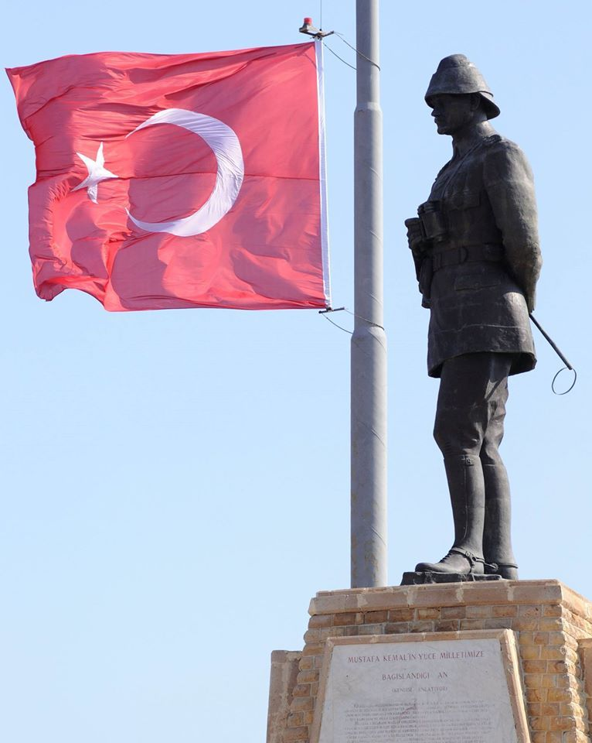
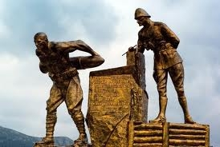
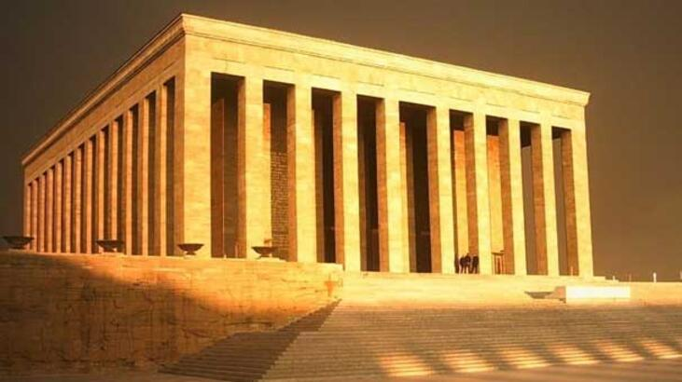
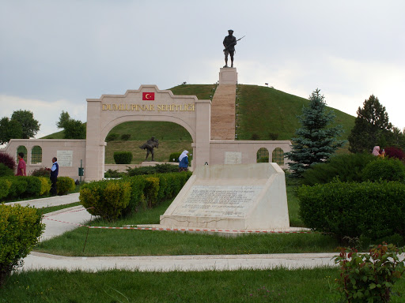
TURKISH MONUMENTS I

Slide 2
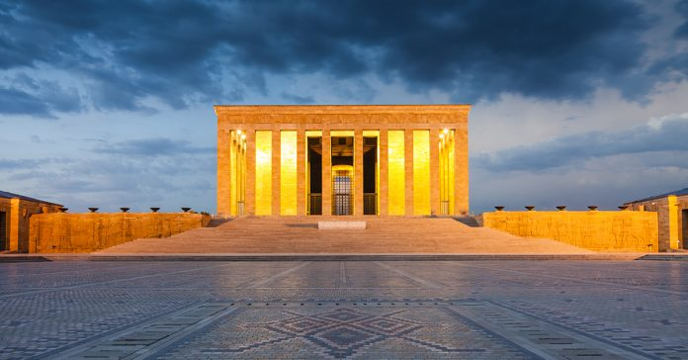
ANITKABİR
It is in Ankara.
It was opened in 10 October 1953.
The reason for opening this monument is to preserve our love and respect for our great leader.
This monument is a mausoleum for our great leader.

Slide 3
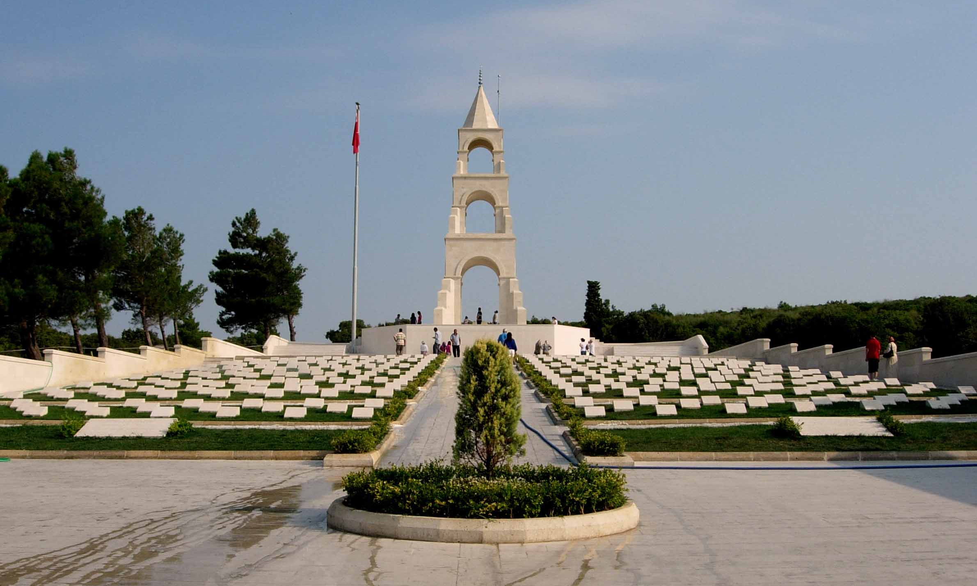
Fifty-Seventh Infantry Regiment Martyrdom
It’s in Çanakkale.
It was opened in 12 December 1992.
This monument tells us that our country is not easily won.
It was built to commemorate the Fifty-Seventh Infantry Regiment and its martyrs who lost all their soldiers in Battle of Dardanelles.

Slide 4
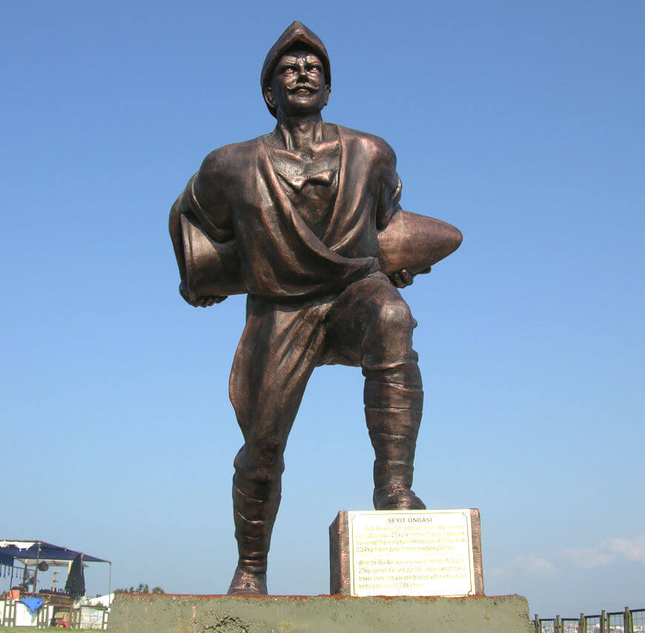
Koca Seyit Monument
It is in Balıkesir.
It was made in 2006.
This monument shows that our country has real heroes.
It was built to commemorate Seyit Corporal (Koca Seyit).

Slide 5
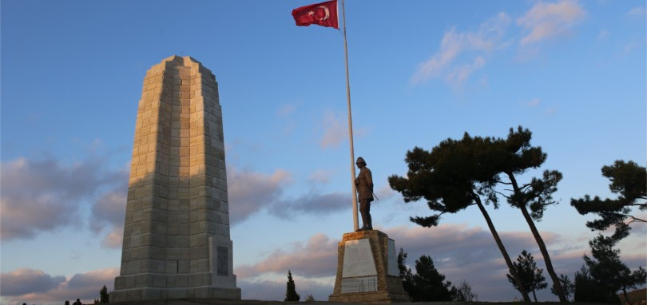
Conkbayırı Atatürk Victory Monument
It’s in Çanakkale.
It was made in 1993.
This monument has been made to tell future generations that our country is precious.
The place of this monument is one of the bloodiest in the Dardanelles War and this monument explains how this battle happened.

Slide 6
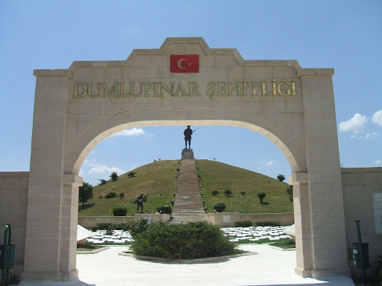
Dumlupınar Martyrdom
It is in Kütahya.
It was opened in 30 August 1992.
This monument tells us that the freedom of our country is not easily won and that we give too much for our freedom.
This monument was built to commemorate the martyrs who died in Dumlupınar.

Slide 7
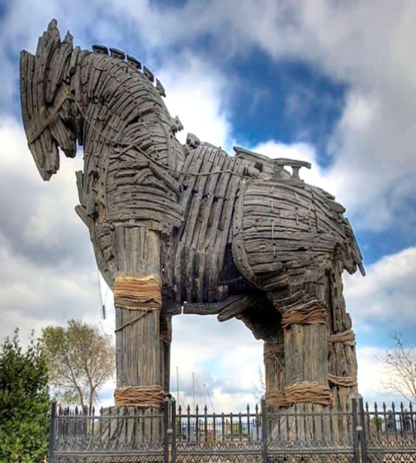
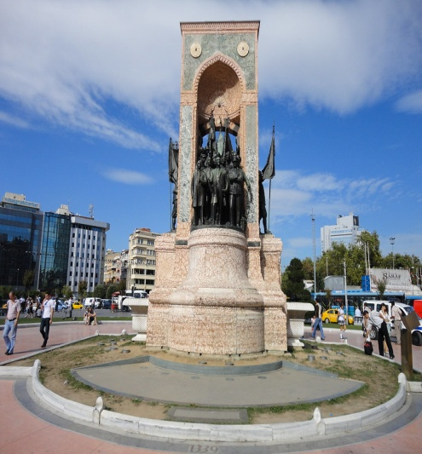
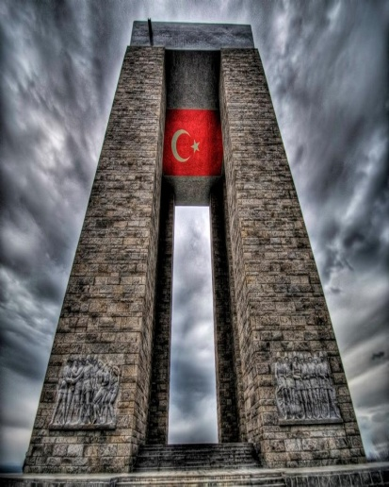
TURKISH MONUMENTS II

Slide 8
TROJAN HORSE
According to the legend, the Akhalis have surrounded the city of Troy for exactly 9 years, but they can not take it. After many attempts, the famous and successful commander Odysseus' mind comes to make a horse on a wooden board one day. Thanks to this clever horse and trick, the Trojan city is dropped. The area where the war was made takes place within the boundaries of Çanakkale today.
In 1973 the Ministry of Culture decided to have a replica of the horse. Wooden Trojan horse which was planted since the war in the region, representing has been ruined, that who came to Hollywood many years later filmed and originally made new and used Trojan horse legend Trojan the region and suitable as a gift to the people of Çanakkale. Hollywood-crafted wooden horse today is exhibited at the center of Çanakkale, near the sea.

Slide 9
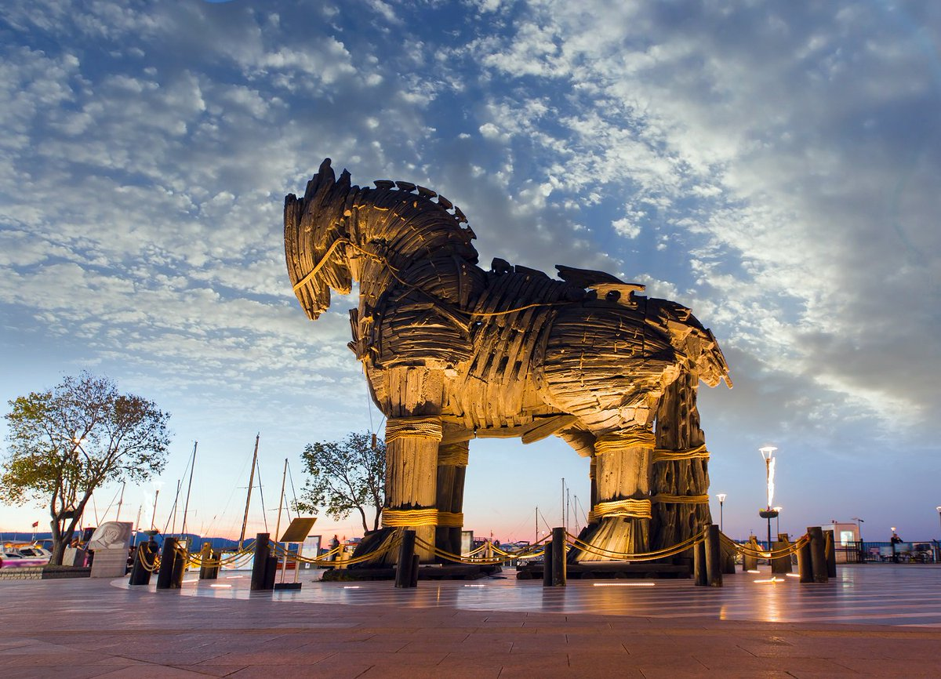

Slide 10
TAKSİM REPUBLİC MONUMENT
Taksim Republic Monument (Taksim Cumhuriyet Anıtı) is a commemorative sculpture group to honor the foundation of Turkish Republic in 1923. The monument is located in the Taksim Square that is the beating heart of Istanbul. In today’s Istanbul, celebrations, protests, official ceremonies, and many other activities take place in Taksim Square. In addition, Taksim Square as well as the Taksim Republic Monument marks the beginning of Istiklal Avenue (Istiklal Caddesi), which is the most popular pedestrian street of Istanbul and approximately three million people pass it everyday.
The monument was erected in 1928 and it portrays the founders of the Turkish Republic as well as the other characters that symbolize the Turkish nation and the military aid of the Soviet Union during the Turkish War of Independence between 1919 and 1923. Taksim Republic Monument is a two sided sculpture group and its one side represents the Turkish War of Independece, whereas the other side represents the modern Turkish Republic.

Slide 11
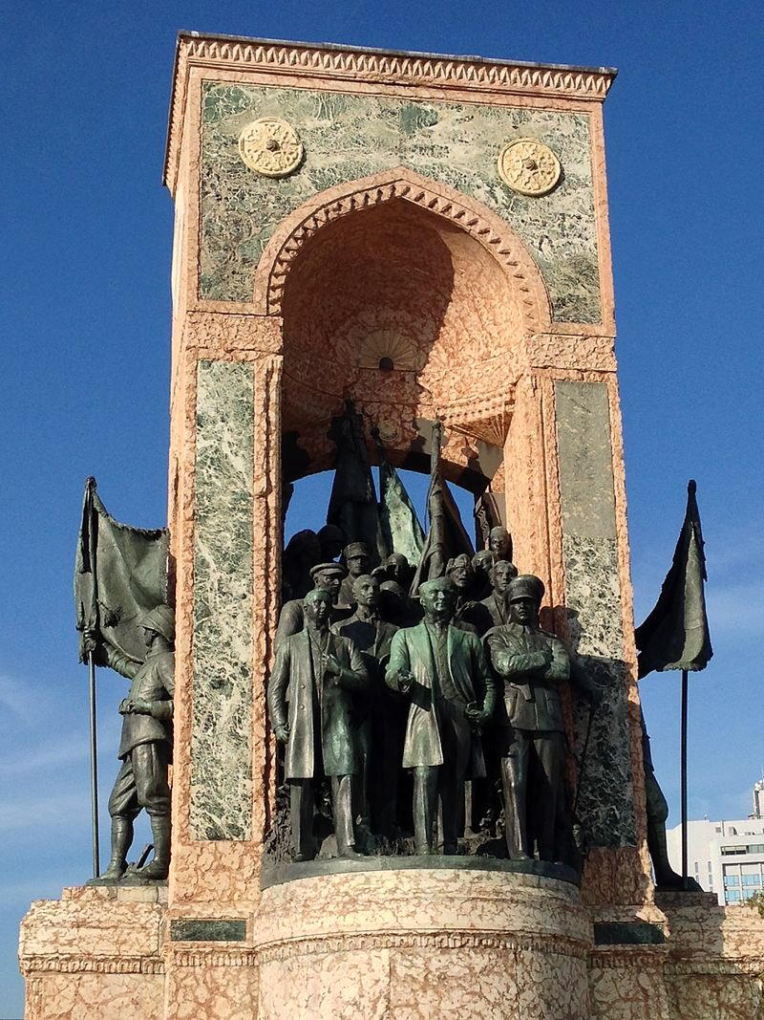

Slide 12
FİRST BULLET MEMORİAL
Created by Sculptor Hakkı Atamalı between 1981-1982 to commemorate the 100th anniversary of Atatürk's birthday.The port where the pier where Atatürk set foot in Samsun on 19 May 1919 was filled with rocks during the construction of Samsun Port.
Today, the pier stands 250m from the coast.This monument was erected in order to determine the location of this pier.This monument symbolizies solidarity by putting at the center Atatürk and his commanders.The statues on both ends of the monument symbolize youth.

Slide 13
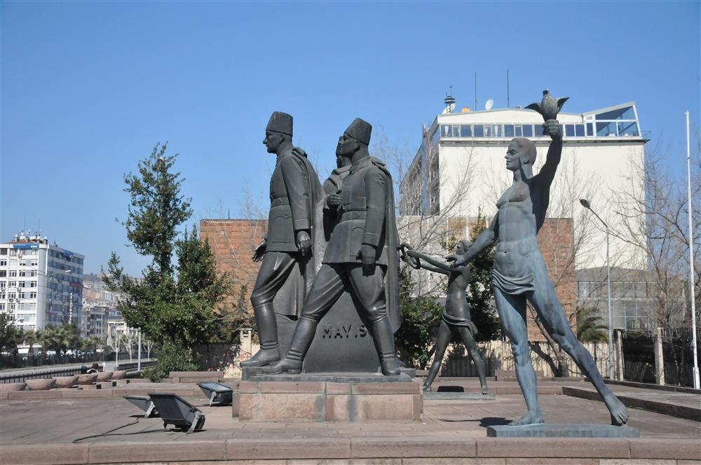

Slide 14
SEYİT ONBAŞI MONUMENT
This monument,located near Kilitbahir opposite Mecidiye Şehitli,was built in memory of Seyit Onbaşı.Seyit Onbaşı came to the world in Edremit in 1889 in the village of Havran-Çamlık and was admitted to the Balkan Wars in 1912 .In 1912 he joined the Balkan Wars. When the war was over, he was not demobilized. He served on the Dardanelles as the protester.
Seyit Onbaşı, 276 kg bullet with the help of his friend Niğdeli Ali'nin with the help of this way out of the top six steps bulleted and fired. After that, by the command of Miralay Cevad Bey,commander of the Turkish Constitutional Areas, he was wearing his rank of corporal. Seyit Corporal participated in the War of Independence and was wounded. In the autumn of 1918, he returned to his village.

Slide 15
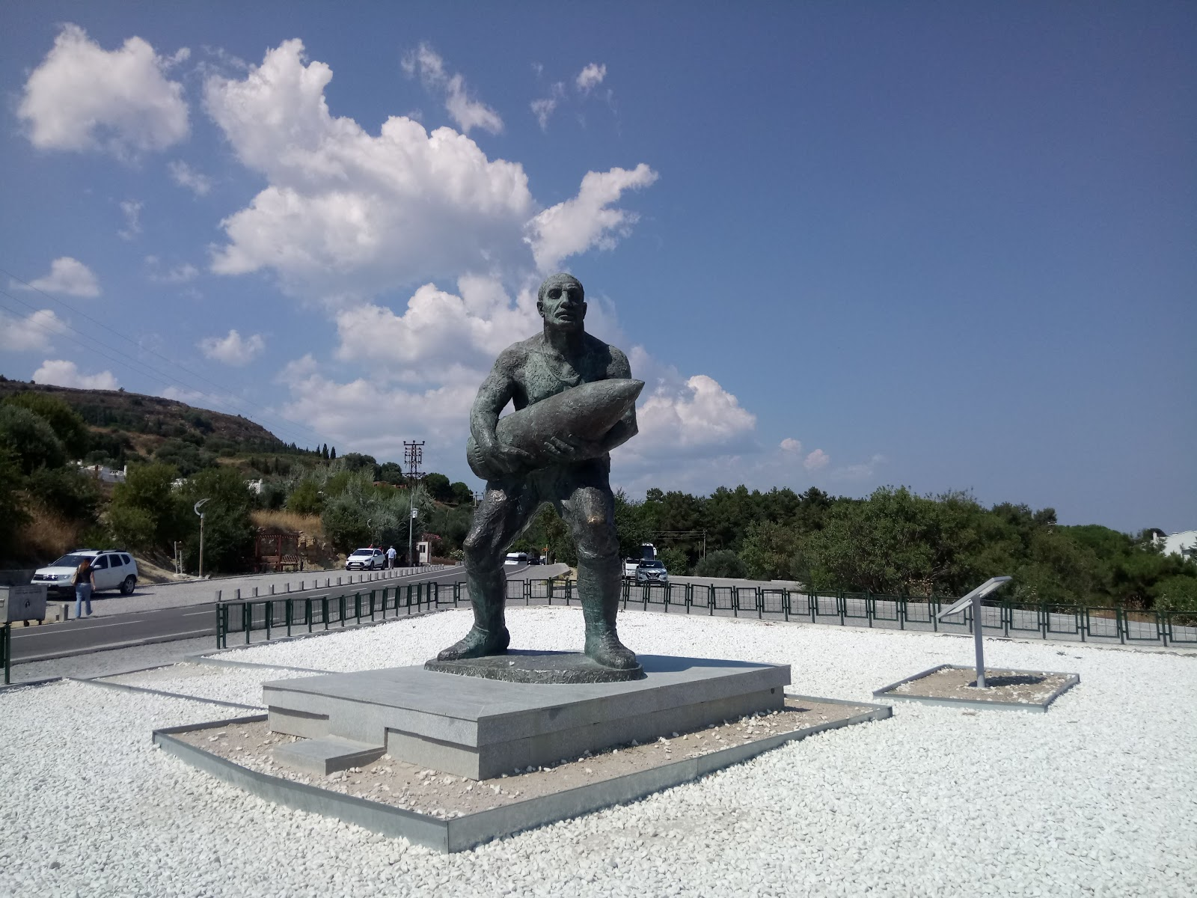

Slide 16
KOCATEPE MONUMENT
20 km from Afyonkarahisar. It is located 8 km from Kültür district. It is located at 1,874 metres. It is a monument symbolizing the climb to reach Kocatepe, where a major offensive operation was launched and led by Commander-in-chief Mustafa Kemal on August 26, 1922.
Due to its geographical location it dominates the plains of Sinanpaşa and Afyonkarahisar. Besides the Atatürk monument, there are also ceremonial sites and trenches in Kocatepe.

Slide 17
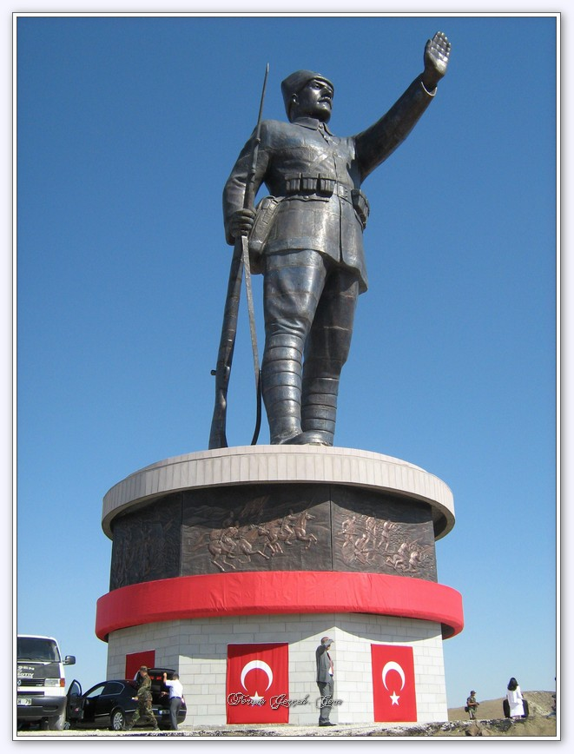

Slide 18
THE FİRST LEAD MONUMENT
It is a monument erected in 1974 on Konak Square in Izmir in memory of Hasan Tahsin, a journalist who was killed during the occupation of Izmir on 15 May 1919. The monument is a symbol of the Turkish resistance against the Greek invasion in 1919.

Slide 19
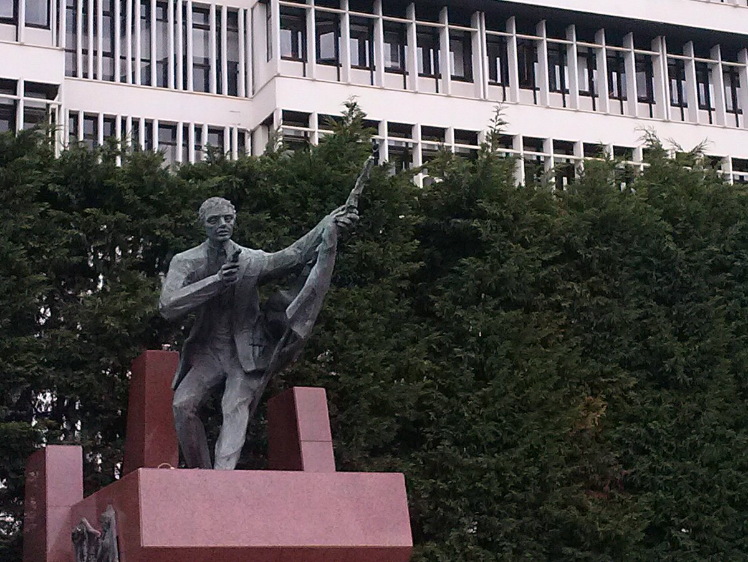

Slide 20
THE WORLD PEACE MONUMENT
The World Peace Monument is a monument built by İzmir’s Karşıyaka Municipality in the memory of 33 intellectuals who died in Sivas Massacre in Sivas, in the General Nafiz Gürman Neighborhood.
It was transferred to Bayraklı Municipality within the scope of the Law No.5747,which was issued before the local elections. World Peace Monument was built by Civil Engineer M.Bülent Kantarcı who was the Mayor of Çaycuma district of Zonguldak province in 2014 elections.

Slide 21
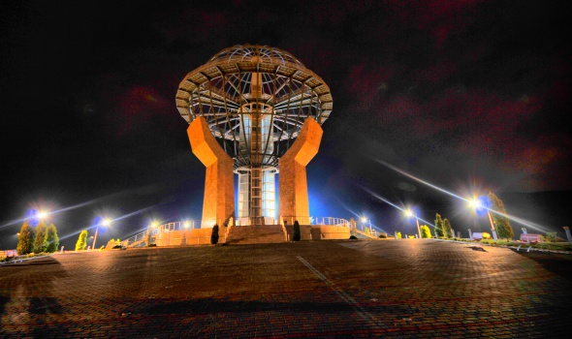

Slide 22
İZMİR ATATÜRK MONUMENT
Izmir Atatürk monument is a monument erected in 1932 to represent the national struggle in Izmir Republic Square.It was built by the governor of Izmir and the municipality to the Italian sculptor Pietro Canonica.
The monument, on a pedestal of dark red colored Afyonkarahisar marble, was written by Mustafa Kemal Ataturk, “armies, your first goal is the Mediterranean!"it consists of an equestrian bronze statue depicting the moment he gave his order. On the three fronts of the pedestal are bronze reliefs on the theme of the Liberation War and victory.

Slide 23
TAYYARE MARTYRS MONUMENT
Tayyare Martyrs Monument (Air Martyrs Monument), a monument erected in 1916 in Istanbul against the old Fatih City Hall (Fatih Sultan Mehmet Vakıf University rectorate building since 2010) in memory of Fethi, Sadiq and Nuri Beys who lost their first lives in Turkish aviation history and are referred to as "martyrs".It is located in Fatih Park in Saraçhanebaşı, Fatih district of Istanbul.
The foundation of the monument, the work of architect Vedat Tek, was laid on 2 April 1914 and its construction was completed in 1916. It consists of a broken column on a marble plinth.I.2,500 km running from Istanbul to Cairo in two planes before World War II.the pilots who died on their way to perform a flight were buried next to the Tomb of Saladin at the Umayyad Mosque in Damascus. The monument is in The Shape of a broken column, symbolizing the half-way flight

Slide 24
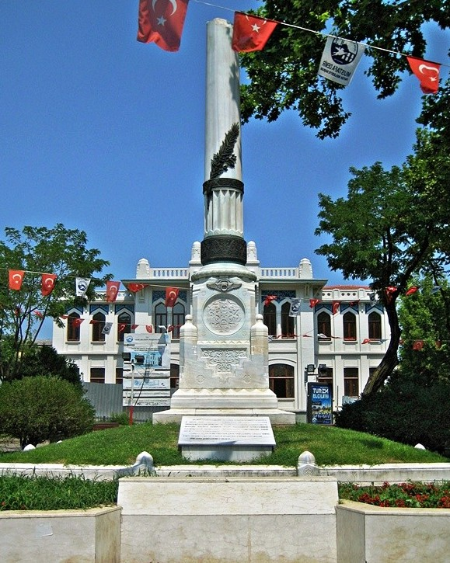

Slide 25
TURKISH MONUMENTS III

Slide 26
Monument of Liberty, Istanbul
The Monument of Liberty or Monument of Eternal Liberty (Turkish: Hürriyet Anıtı; Ottoman Turkish: Abide-i Hürriyet), located in the Şişli district of Istanbul, Turkey, is a memorial in honor of the soldiers killed defending the Ottoman parliament against reactionary monarchist forces during the 1909 countercoup, most notably in the 31 March Incident.
The Tanzimat reforms, which began in 1839, along with other subsequent liberalization processes, were strongly opposed by conservatives in the Ottoman Empire. They hoped to re-affirm the monarchic powers of the Sultan Abdulhamid II as absolute monarch, even though the Sultan himself came to power accepting a Constitution and opening the first Ottoman parliament, the General Assembly of the Ottoman Empire, in 1876 during the First Constitutional Era. Parliament was adjourned in 1878 with the pretext of the Russian War and Abdulhamid II reigned as an absolute monarch for over 30 years until 1908, when Parliament resumed its activities in the Second Constitutional Era, upon pressure of the progressive forces in the Empire. However, a reactionary uprising that began on April 13, 1909 (March 31, 1325 AH in Rumi calendar) caused the democratic process to be interrupted once again. Progressive forces of the "Hareket Ordusu" (Turkish for "Army of Action") that came from the Rumelia, under the command of Mahmud Șevked Pasha, suppressed the countercoup on July 23, 1909. Abdulhamid II was deposed by the Committee of Union and Progress, the foremost constitutionalist party, and sent to exile in Salonica, then part of the Ottoman Empire.
The monument was inaugurated in 1911, at the second anniversary of the 31 March Incident. The complex also holds the graves of four notable Ottoman high-ranked officials, which were moved here in a later time. The monument, seen today as a symbol of modernity, democracy, and secularism in Turkey,[1] serves as a place of some official ceremonies and public gatherings.

Slide 27
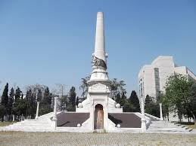

Slide 28
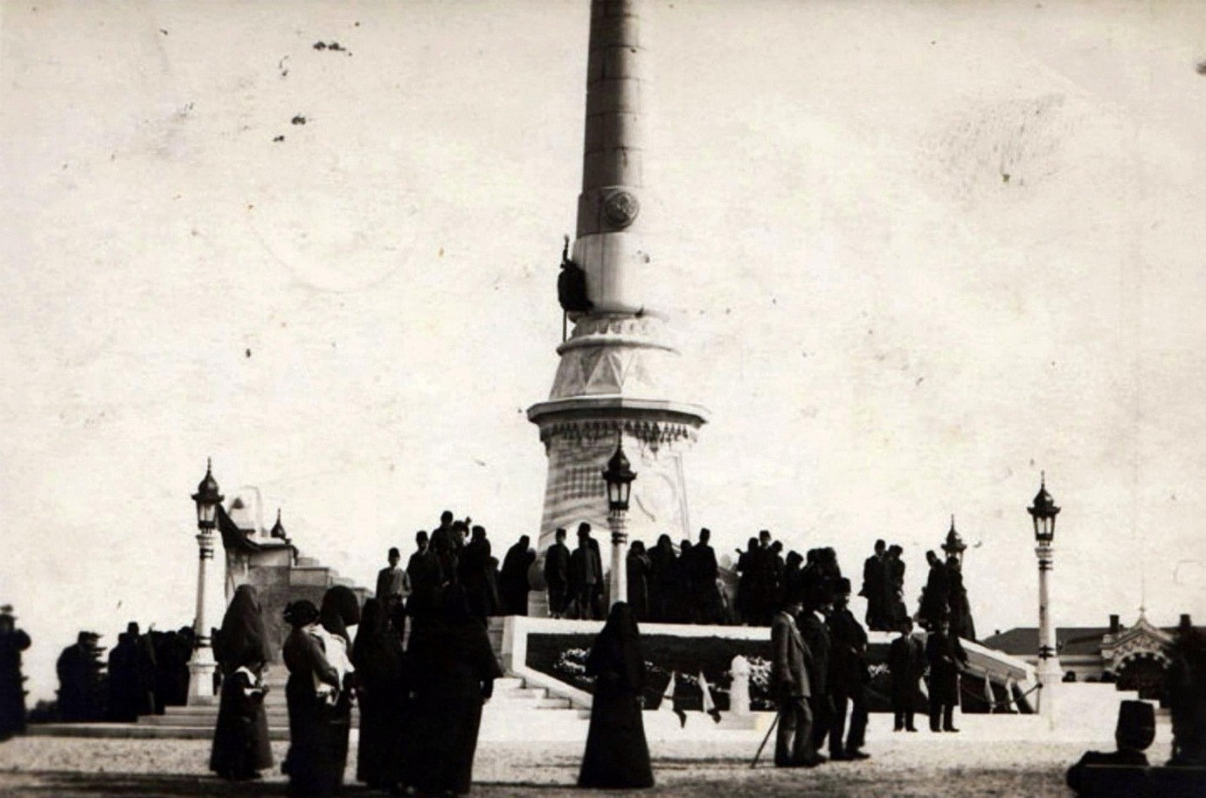

Slide 29
Trust monument
Güvenpark is noted for its "Trust Monument" (Turkish: Güven Anıtı), which was proposed by Austrian architect Clemens Holzmeister (1886–1983), who designed public buildings in Ankara.^{[5]} The monument was created by the Austrian sculptor Anton Hanak (1875–1934). It was completed in 1935 by Austrian sculptor Josef Thorak (1889–1952),^{[5]} who was charged after the death of Hanak on January 6, 1934.^{[1]}
The monument faces Kızılay Square, and was initially named Security Monument (Turkish: Emniyet Abidesi). It is dedicated to the Turkish security forces, which provide security, public peace and order. The bronze sculptures were cast in Erdberg, Vienna, Austria while the bronze reliefs, attached on Mamak stone, were cast in Turkey. The stonemasonary works were carried out by Austrian students of the sculptor and Turkish craftsmen.^{[1]}
The monument's base is 37 m (121 ft) long. The middle block is 8 m (26 ft) high, the side wings 2 m (6.6 ft), and the bronze figures are 6 m (20 ft) tall. On one facade of the composition, apart from the main block, two musician figures are placed above Atatürk's famous phrase "Türk, Öğün, Çalış, Güven!" (literally: Turk, boast, work, trust!). Figures of old people in the background and young people in the foreground symbolize Turkish people's transition from the past to the future. The reliefs depict Turkish villagers carrying weapons to the front, military paramedic teams in the back front, security forces, artists and thinkers envisaged for the new formation of the Republic and craftsmen in various profession groups such as black smiths, miners, potters. On the other side of the monument, Mustafa Kemal Atatürk is portrayed, flanked by youth and looking into a future with hope.

Slide 30
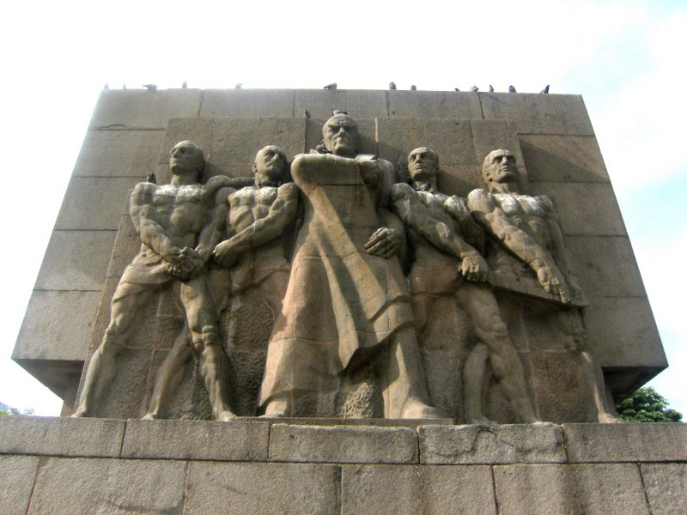

Slide 31
The Midas Monument
The most prominent part of the Midas Monument is a high rock-cut facade with an incised decoration apparently showing a pedimented temple front with acroteria, faced with terra cotta and with a niche at the bottom center. The niche's walls bear graffiti reading Matar (Mother, i.e. the goddess Cybele) and it probably held a statue of Cybele.
The monument carries a dedication in Old Phrygian by Ates son of Arkias to Midas (ΜΙΔΑΙ ϜΑΝΑΚΤΕΙ), and probably dates from the 7th or 6th century BCE.^{[3][8]} The inscription mentions Midas in the dative with titles: "Midai lavagtaei vanaktei", probably meaning "leader of the people" and "ruler".^{[9]} The inscription is:

Slide 32
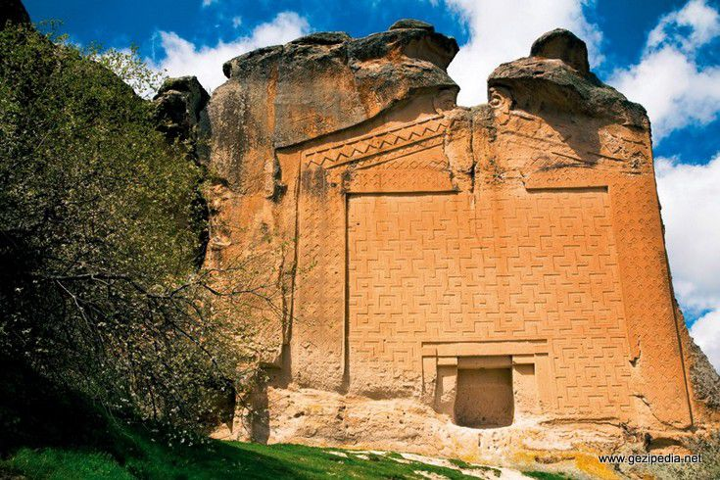

Slide 33
Atatürk Monument (İzmir)
Geography
The monument is in the Cumhuriyet Sqıare (“Republic square”) in İzmir. at 38°25′45″N 27°08′04″E. The square is located in the seaside and the monument is located about 60 metres (200 ft) to southeast of the İzmir Bay (i.e., Aegean Sea).
History
The municipality and governorship of İzmir decided to build a monument dedicated to Atatürk, the founder of modern Turkey. In 1929, the statue of the monument was commissioned to Pietro Canonica an Italian sculptor who had formerly created another Atatürk statue in İstanbul in 1928. The base of the statue was designed by Turkish architect Asım Kömürcü and the statue was erected on 27 July 1932.^{[2]}
Technical details
Technical detailsThe marble used in the base is the red marble of Afyonkarahisar and the material of the statue is bronze. The statue shows equestrian Atatürk in the Turkish War of Independence. There are also reliefs on the base showing scenes of war. Atatürk’s famous quotation “Armies your first target is the Mediterranean Sea. Forward!” has been inscribed in front of the base marble.

Slide 34
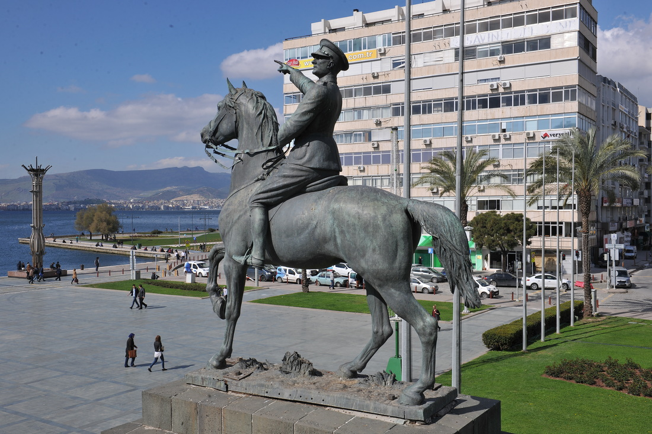

Slide 35
Gazi Umur Bey Monument
Currently, Birgi is a small town in Ödemiş ilçe (district) of İzmir Province. But it was an important city in the middle ages and it was the capital of the Aydınids in the early 14th century. Umur Bey (r.1334-1348) was the second bey of the Aydınıds and was one of the earliest seamen of Turkish history. His ephitet Gazi (Ghazi) means veteran.
His statue was erected in 2008 next to Ulu Cami (mosque) in Birgi at 38°15′24″N 28°04′03″E. Its height is 3 metres (9.8 ft). It was commissioned by the municipality of Birgi and İzmir branch of Turkish Naval Forces. It was also sponsored by the Ministry of Culture and Tourism. Its creator was Eray Okkan.

Slide 36
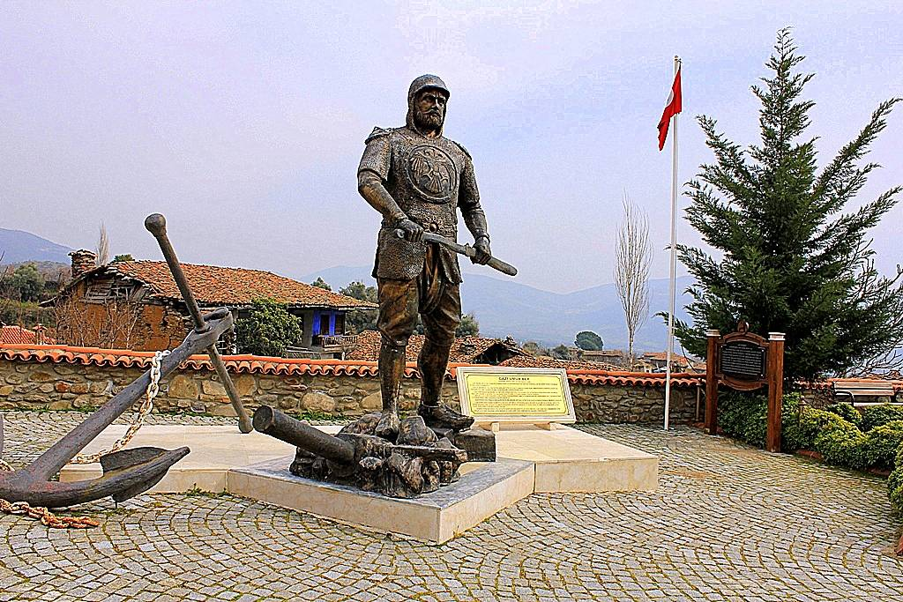

Slide 37
THANKS FOR LISTENING….

