Slide 1
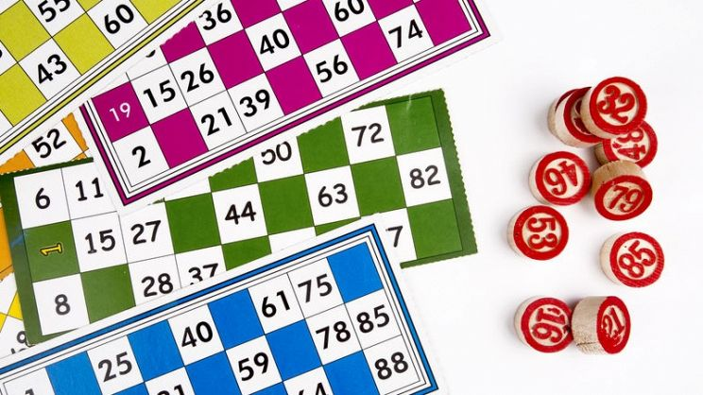
GAME TOMBOLA A P P L E T E A M by Nicole, Alberto e Filippo
-introduction:Bingo is one of the most popular board games in Italy and used during Christmas; suitable for both children and adults.
-tools: for the game of bingo you need a large board in which the numbers from 1 to 90 are shown, and a bag containing the numbers to be placed on the board. Then you need folders with 15 numbers for each one and stamps to cover them.

Slide 2
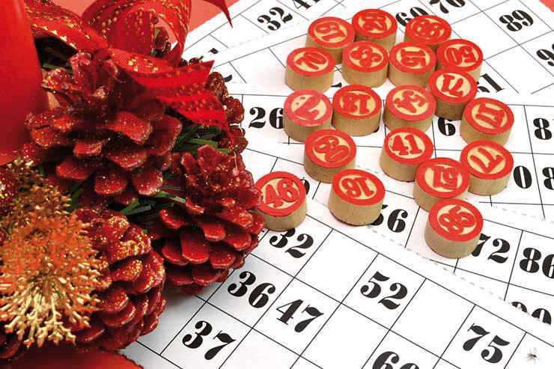
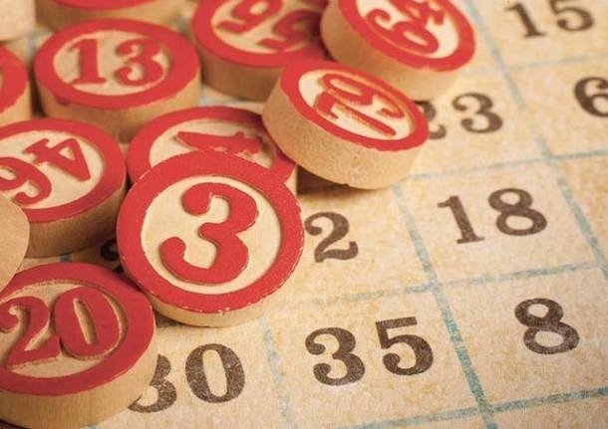
rules:
Each of us has one or more tables of his choice with overwritten numbers. A person in charge of extracting numbers will prevent them from the bag and read them aloud. If a number is read in the table it will be covered by a stamp to indicate that it has already been called .
There are various levels, the first is the two which consists of having two neighboring numbers obscured, on the same lime then we have the “terno”, “quaterno” and “cinquina” and which consists of having three, four, five neighboring numbers covered by the stamp. In the end the most important is the bingo which consists of having all the numbers with the card covered by the stamp. At the end of each winnings, a prize is generally, withdrawn in cash, which gradually increases with the levels at the peak with the raffle.

