Slide 1
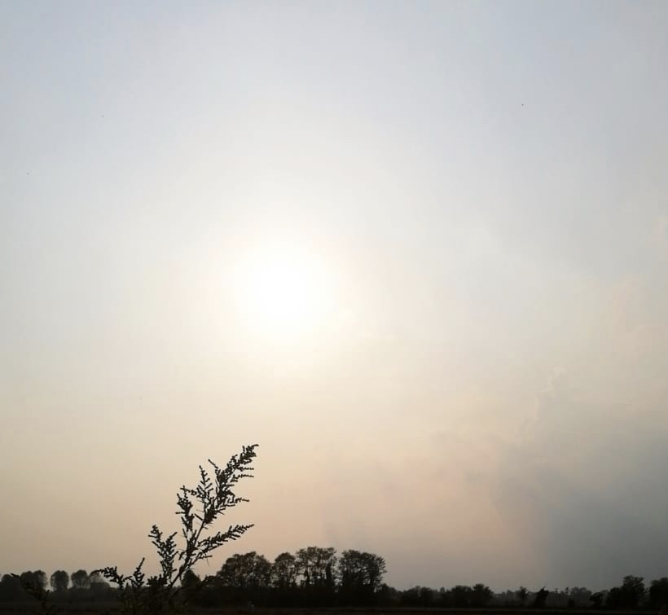
COCONUT
Hii, we are coconut group, and we thought about introduce ourselves by letting you all know our passions.
We attend an art school which in italian we call ‘'liceo artistico obici’’ and is somehow similar to high school and this allow us to express who we are. We hope that you would like that.

Slide 2
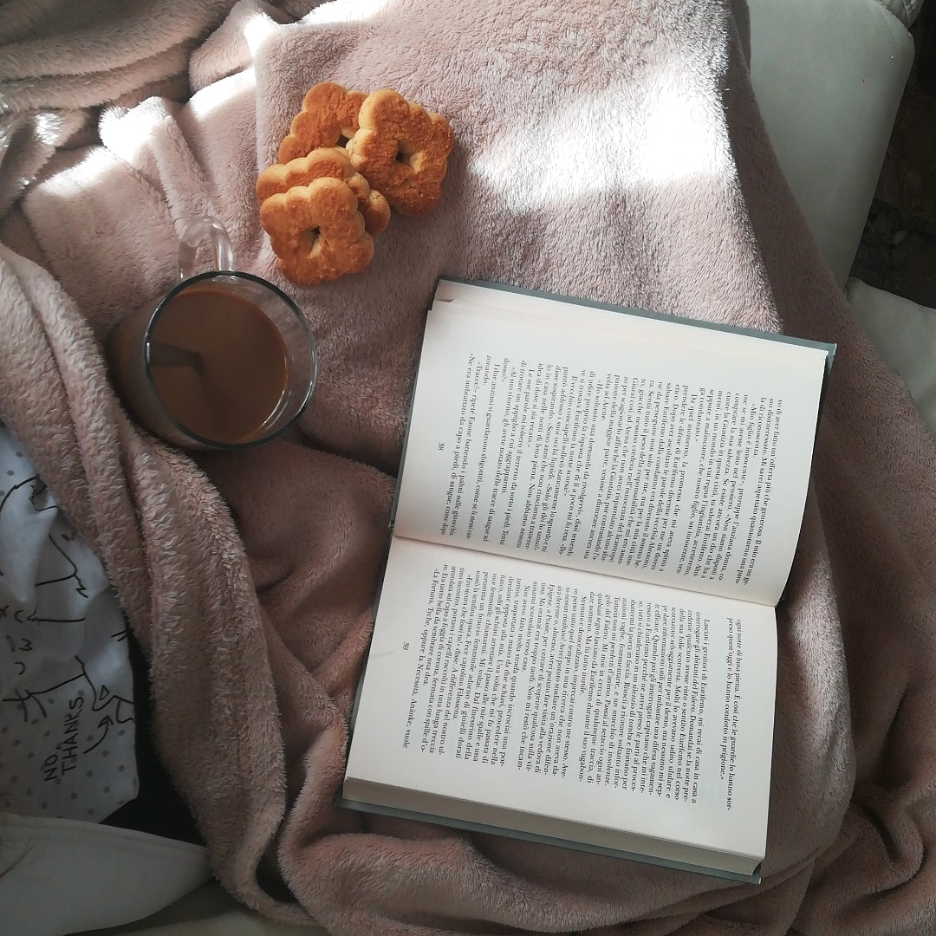
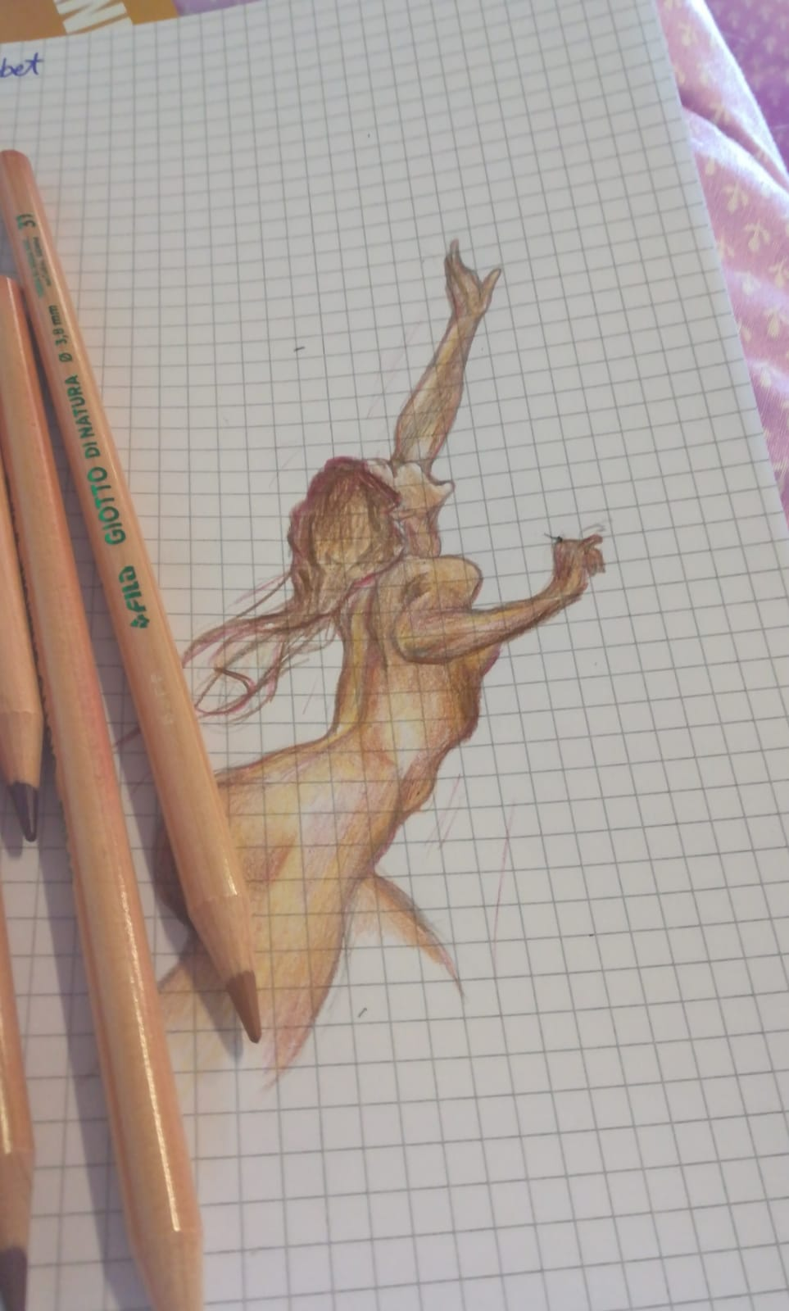
What’s up, i’m Francesca (for just one person Teresa, don’t call me by that please). I am a student of this art school because obviusly i love art and i search it everywhere, also because I think that art is in everything. But i have to say that i don’t only love art, infact another things that i’m obsessed with is psicology and filosofy. I may seem boring af but i can bring joy around and have fun, even if i don’t talk too much. With the hope of giving you good impression i let my other
friends present their selfs.
Byyy<3
One of my drows
@_.mazzerfrancesca._

Slide 3
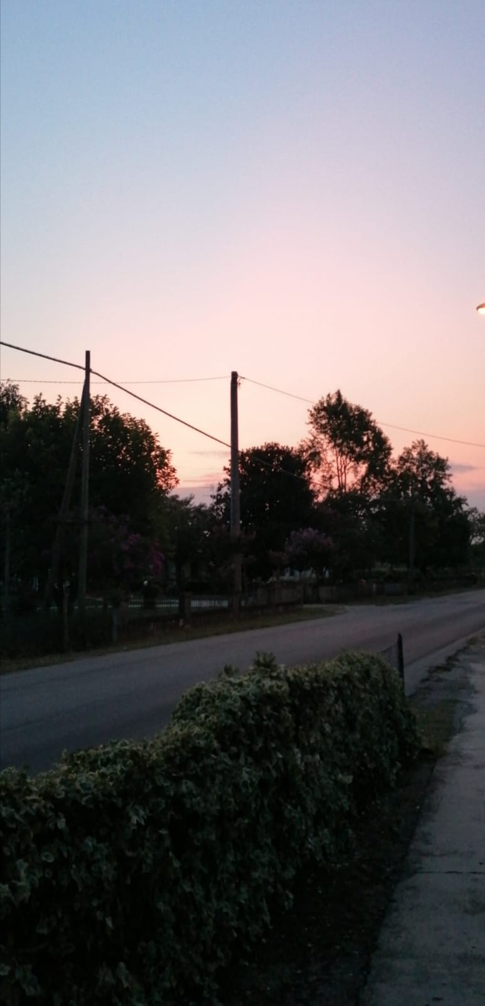
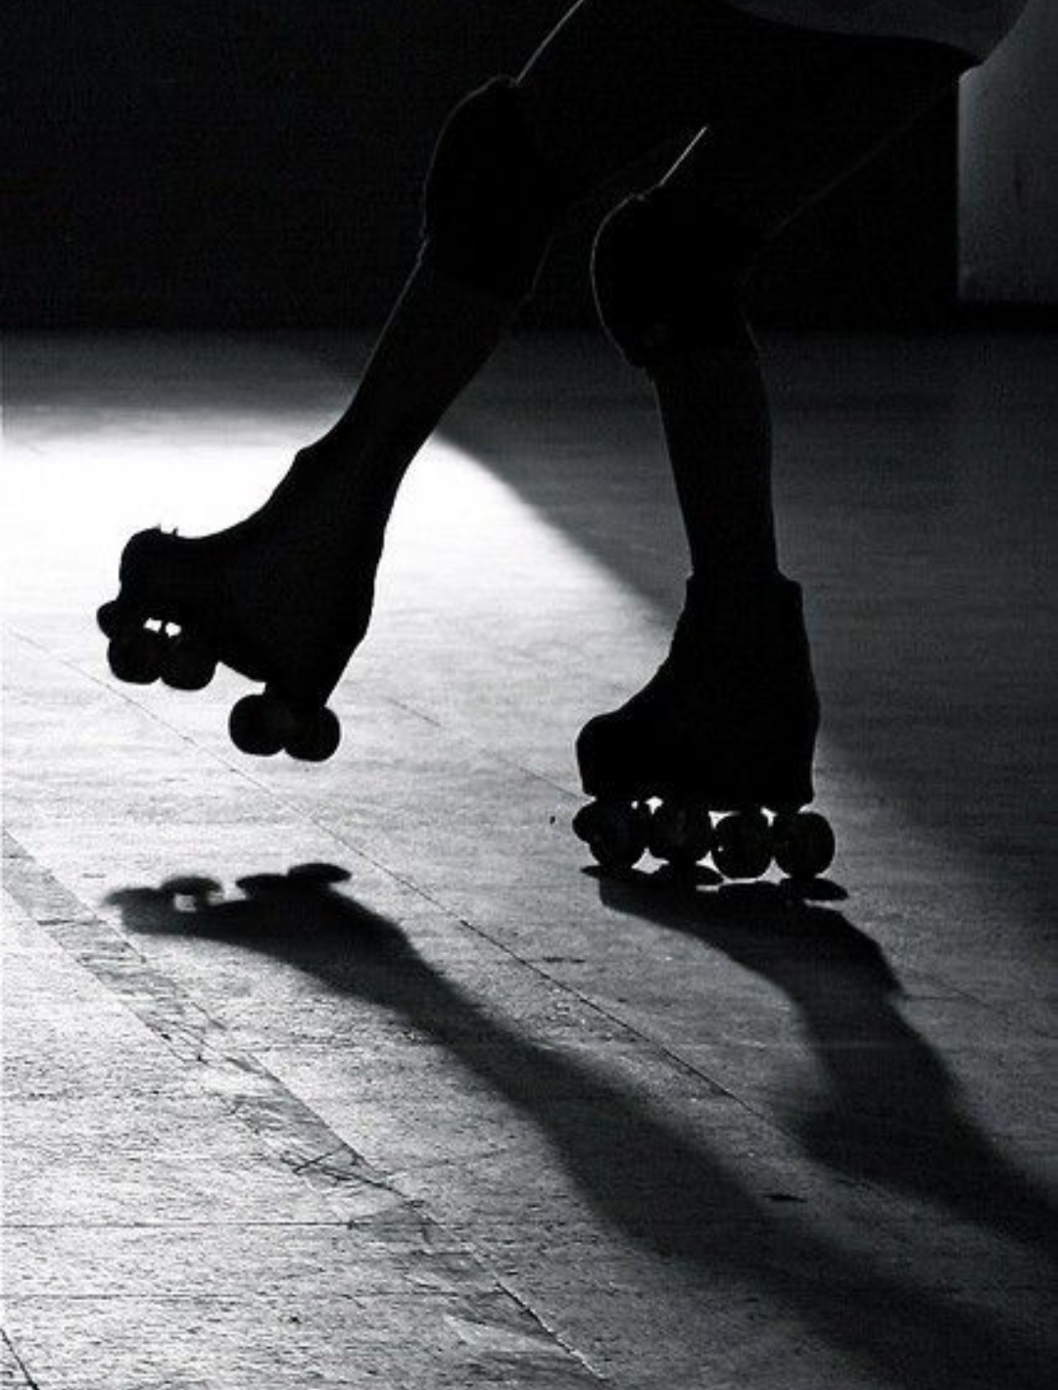
Hii i’m Martina and i’m a student, like my friends of this school, based on art. I choosed this school because i love drawing, progetting and make photo and video. Another passion of mine is skating. I have been practice figure skating from around 8 years. I’m a really creative and solar person, and I like making people smile. This is me, I hope I haven’t bored you too much but instead give you all a really good impression. XOXO <3
Lisa turn:
->
->
->
@martina_dallalibera

Slide 4
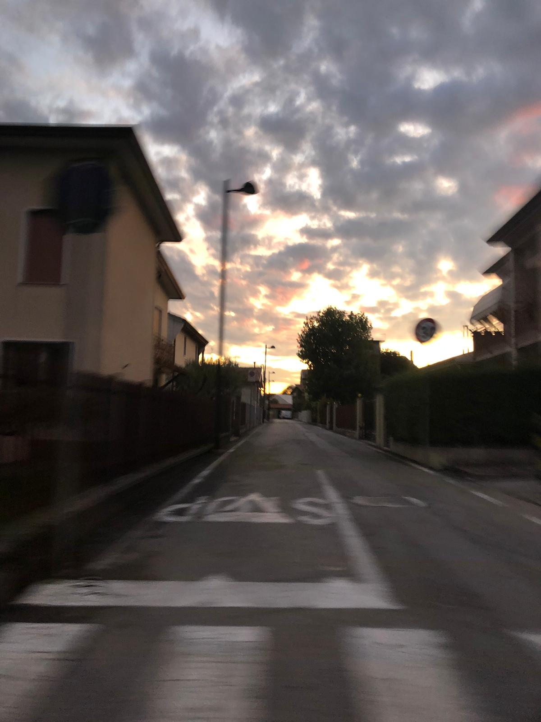
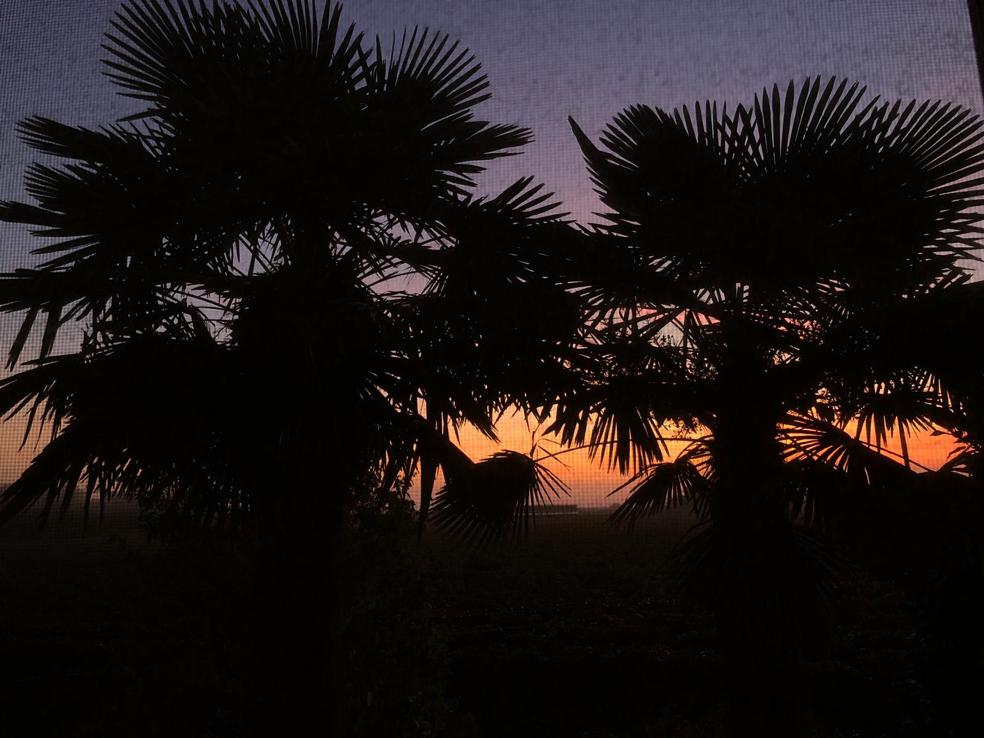
Hiii, how is it going my friends, i am Lisa and apart that i attend this art school i love take picture, but i have to admit that i like the whole photography thing. Also i like watching A LOT of series TV and anime, because these things trasport me in my ‘’immaginary world’’ in which i feel more like my self. I even like reading, always for that motivation, infact i can run away from reality thanks to that.
Byy u.u

Slide 5
We hope that we hit you in any way possible.
we even thought about ending with stile:
…

