Slide 1
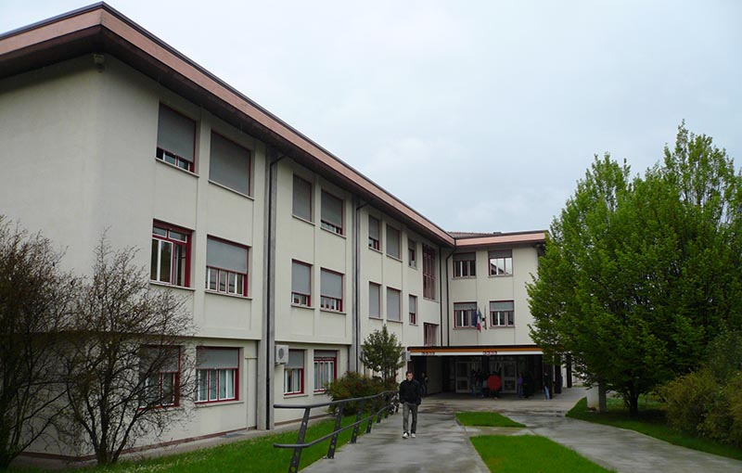
LICEO ARTISTICO
Anno Scolastico 2019 - 20
Classe 2^ AL
Oderzo, 28 ottobre 2019

Slide 2
PROGETTO ETWINNING
Gruppo Pera
LORY
CLAUDIA
ELISA

Slide 3
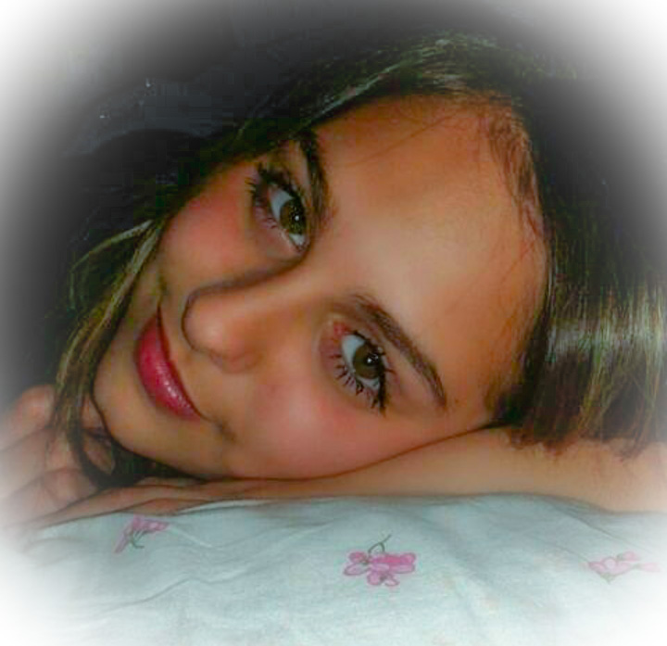
PROGETTO ETWINNING
Lory Di Maio
Hi, I’m Lory. I’m 14 years old and I’m in the second year of secondary school and I attend art school.I was born on November 9th 2004 in Nocera Inferiore (SA).
I have many passions including art, music and psychology.
I would describe myself this way: moody, anxious and very mad.
Currently i don’t practice sports but from 6 years up to 13 I practied Taekwon-Do, a Korean martial art.

Slide 4
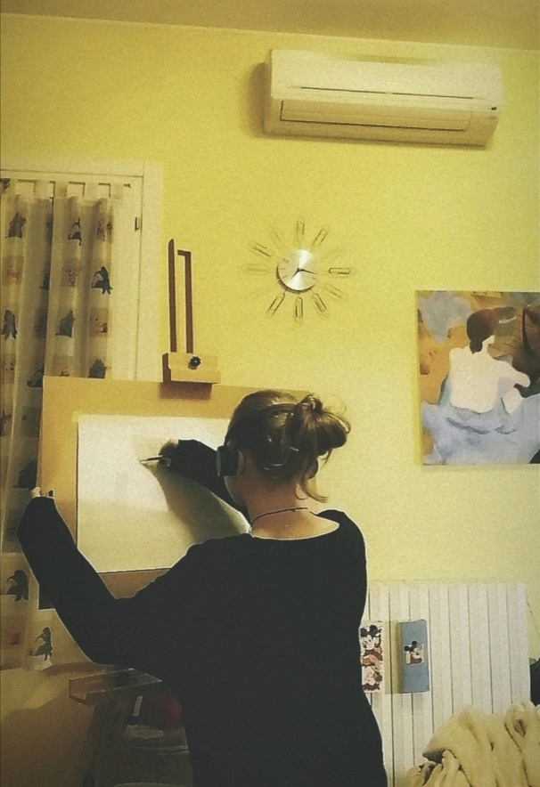
PROGETTO ETWINNING
Claudia Candosin
Hi, I’m Claudia. I’m 15 years old, and I’m in 2° at art school.
My greatest passion are art and music, without i don’t know what i’d do, it’s my life.
If I had to describe myself I would say : introverted, sensible and very stubborn, in fact anything I put in my head to do is difficult to make me change my mind.
Precision is the fourth adjective, when I have to do something or i do it well or I don’t do i at all.

Slide 5
PROGETTO ETWINNING
Elisa Angi
My name is Elisa and I'm 15 years old, I'm in the 2nd at School art.
My greatest passions are dancing and drawing: dance for 3 years, modern dance and classical dance without I could not stay.
I have a very particular character and many times I tell myself that I also struggle to put up with it,
but in any case I call myself a very sweet extrovert and melancholic I am also very sensitive.

Slide 6
PROGETTO ETWINNING
Our School
In our school there are 4 addresses: Mechanical, commercial, socio-sanitary e the artistic high school,
that is divided into a common two-year period and a three-year course that offers the ‘’graphic-advertising’’and ‘’audiovisual and multimedia’’ addresses.
The subject that aren’t in common withother addresses are:
Artistic Laboratory, Graphic and Pictorial Disciplines, Plastic and Sculptorial Disciplines, and Geometric dispiplines.

