Slide 1
GRAphic design
Job profile and its studies

Slide 2
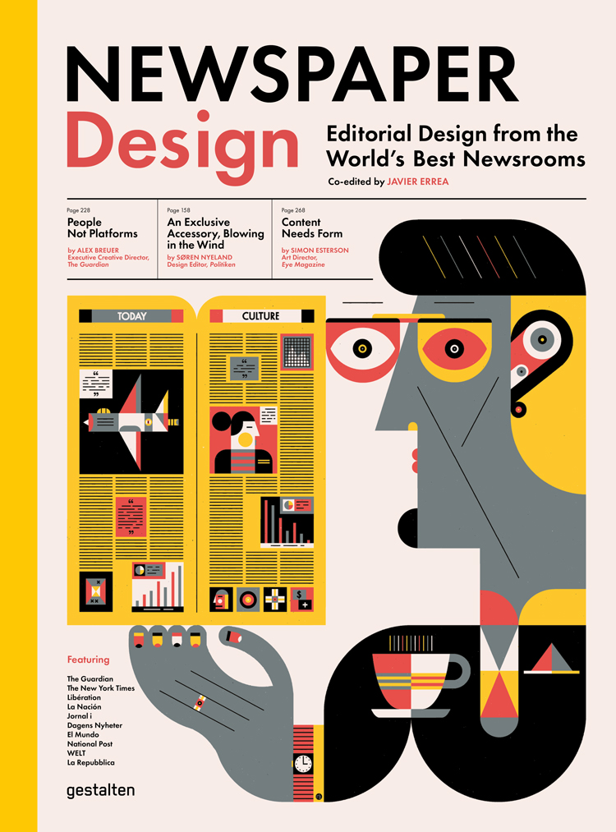
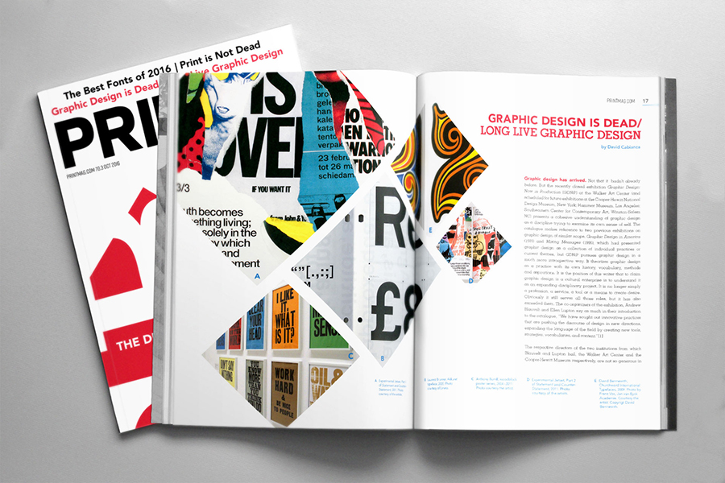
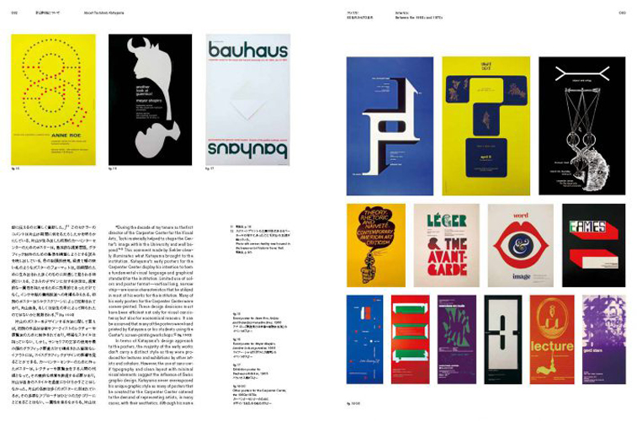
Overview
1.What‘s the job about?
2. Requirements
3. Education
3.1. Macromedia UAPS
4. Essentials
5. Why you should or shouldn‘t be a graphic designer
6. Sources

Slide 3
so, what‘s the job about?
the visual communication ideas and messages with the use of typography, photography and illustration
It usually comes in form of logos and brandings in business and corporal design but also in editorials such as magazines and newspapers
Graphic designers work in different fields such as print media or electronic media
Income: no precise number given that there are different factors adding up to what the ultimate income will be – starts at approx. 2250€ for academic designers
Average at 1500€-3300€

Slide 4
Requirements
Key skills: artistic, creative and communicative capabilities (verbally and drafted in any way shape or form), ability to work independently and meet deadlines
If self-employed/freelance – business and sales skills
Certificate or associate‘s degree in graphic design for assistant or technical support positions – however, most graphic design positions require at least a bachelor‘s degree

Slide 5
Graph-Ed
Admission may involve submissions of sketches and artworks
On average about 8 semesters on average
Both Bachelor‘s and Master‘s degrees
Content in a bachelor‘s programme: basics of layout, visual communication, illustration and collages, digital media, print design, typography, corporate design, film etc. – however the studies can also include management, digital economy, media law as well as foreign languages
Schools in Germany: CODE University of Applied Sciences
SRH Hochschule der populären Künste
Technische Akademie Wuppertal

Slide 6
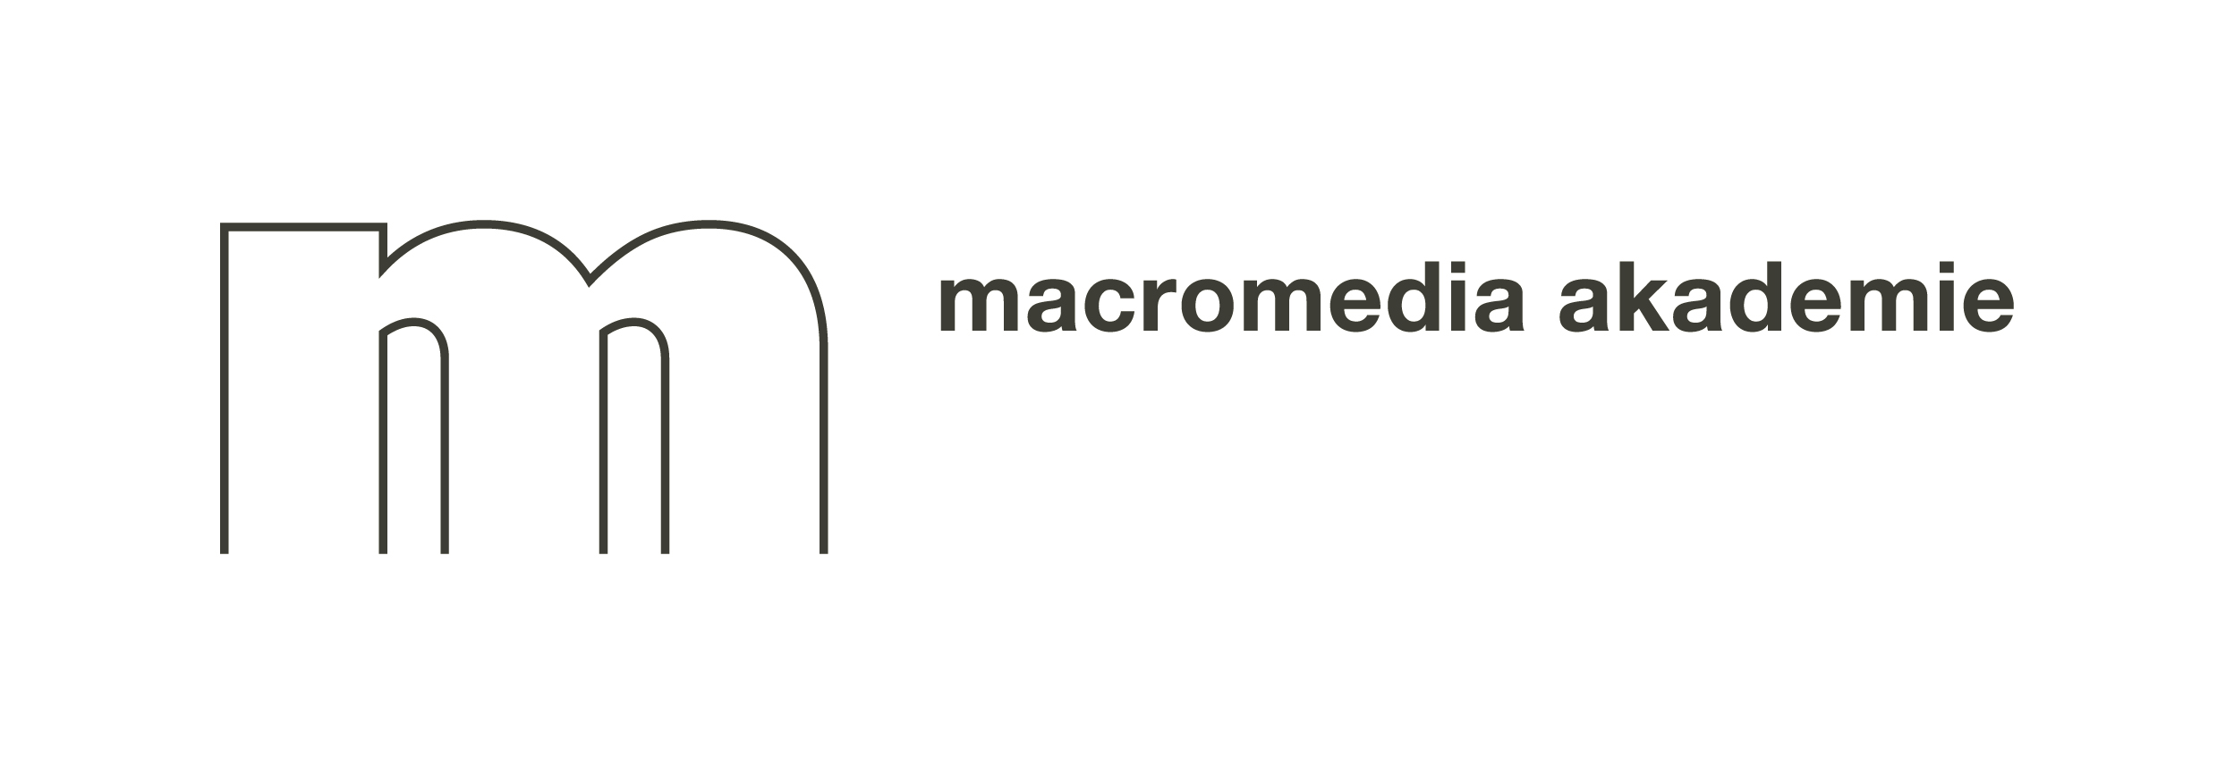
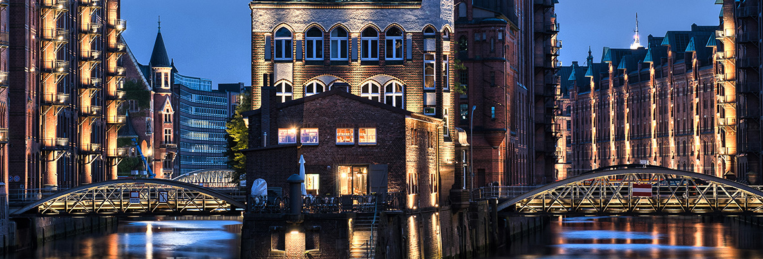
EX. Macromedia University of Applied sciences
Design B.A. with the Bachelor of Art
Takes about 6-7 semesters including practice semester
Locations in Berlin, Freiburg, Leipzig, Hamburg
Tuition fee 690€ per month though possible scholarships for financial support
For more info visit https://creative.macromedia-fachhochschule.de/studienangebot-bachelor/design/kommunikationsdesign/?gclid=EAIaIQobChMIqNTeh_CI4gIVlemaCh0uYA6-EAAYASAAEgJZfvD_BwE

Slide 7
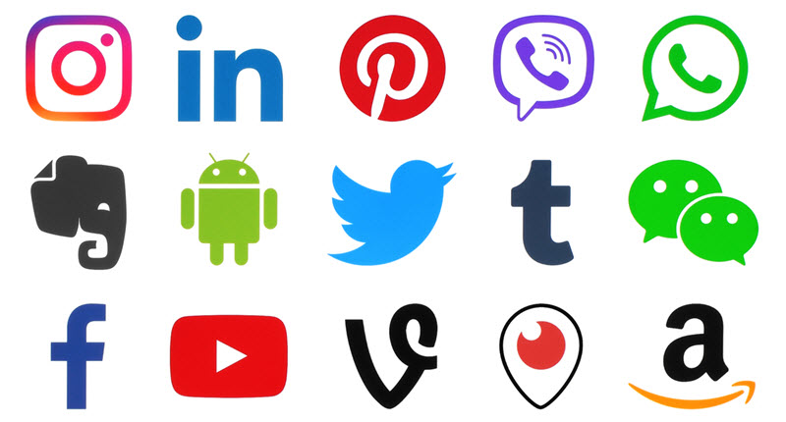
Essentials
Bachelor’s degree, Master’s degree with an extension of the previous programme
fields: art, graphic design, other related fields
Experience: portfolio, sample work
Skills: artistic, creative and communicative skills

Slide 8
Maybe You should become a graphic designer if…
You‘re creative and talented at the given artistic task and want to make it your job for the rest of your life
The computer is your most frequent workspace
Communication is one of your greatest skills
You easily deal with pressure and have the capability to use it to your advantage

Slide 9
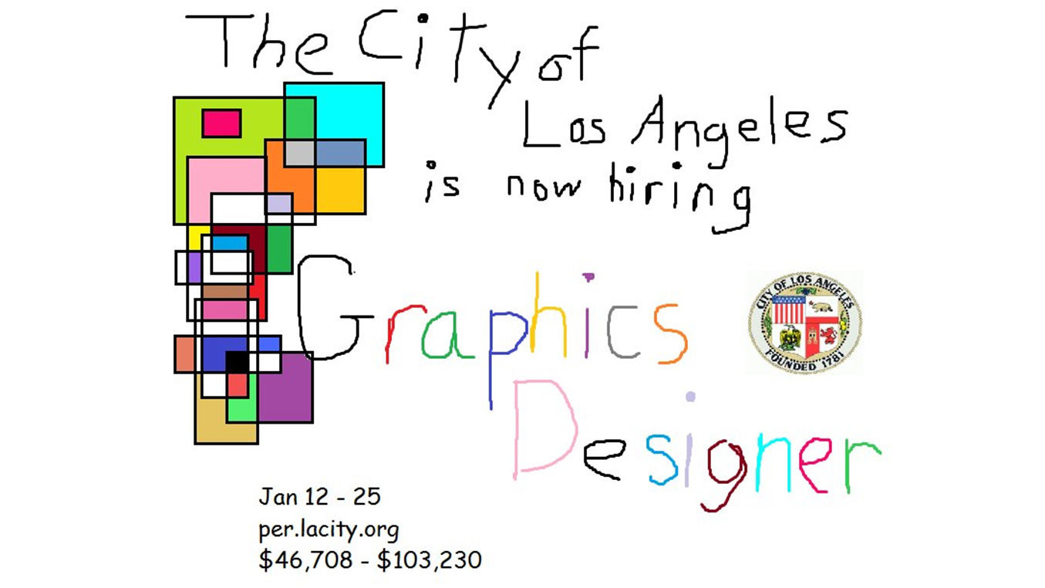
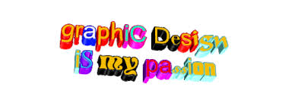
Maybe not if…
You can‘t deal with pressure from the client and restricting your creativity in the process
You can only be creative and productive at any given time
The thought of having a deadline stresses you out
You‘re not very fond of desk jobs

Slide 10
sources
https://www.medien-studieren.net/studiengaenge/grafikdesign/
https://creative.macromedia-fachhochschule.de/studienangebot-bachelor/design/kommunikationsdesign/?gclid=EAIaIQobChMIqNTeh_CI4gIVlemaCh0uYA6-EAAYASAAEgJZfvD_BwE
https://de.wikipedia.org/wiki/Grafikdesign
https://www.medienstudienfuehrer.de/studiengaenge/grafikdesign/
https://www.mediencampus.de/
https://www.macromedia-fachhochschule.de/hochschule/standorte/campus-hamburg.html
https://www.freelogoservices.com/blog/2017/12/14/what-are-the-best-colors-for-a-company-logo/
https://justcreative.com/2018/03/12/learn-graphic-design-resources/
https://mashable.com/shopping/nov-17-graphic-design-online-course-sale/?europe=true
https://www.popwebdesign.net/popart_blog/en/2018/02/top-10-graphic-design-magazines-from-around-the-world/
https://www.templatemonster.com/blog/best-graphic-design-magazines/
https://www.designweek.co.uk/issues/2-8-july-2018/a-newspaper-is-not-a-magazine-newspaper-design-gestalten-mark-porter/

