Slide 1
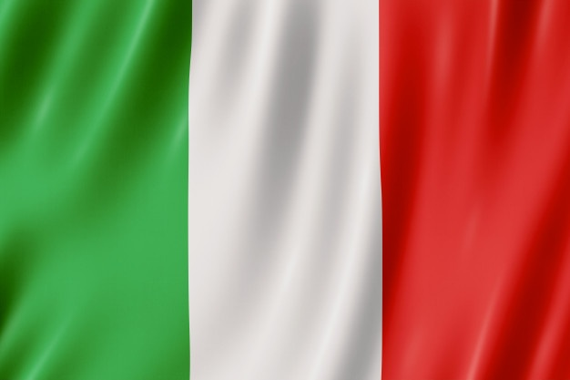
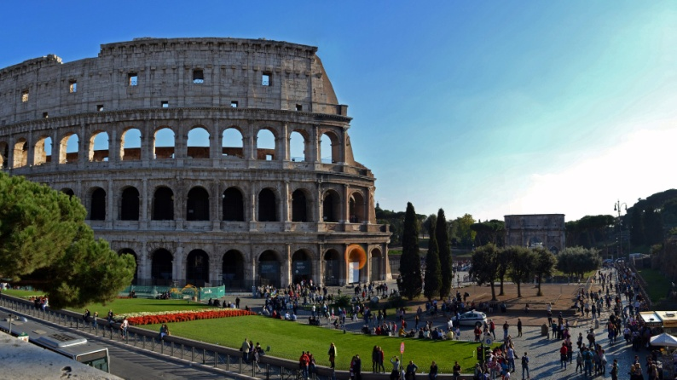
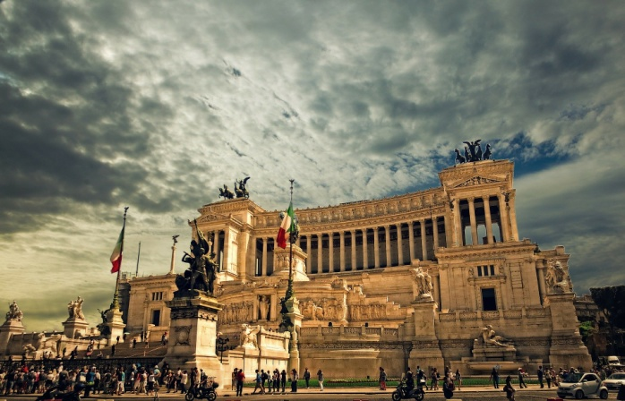
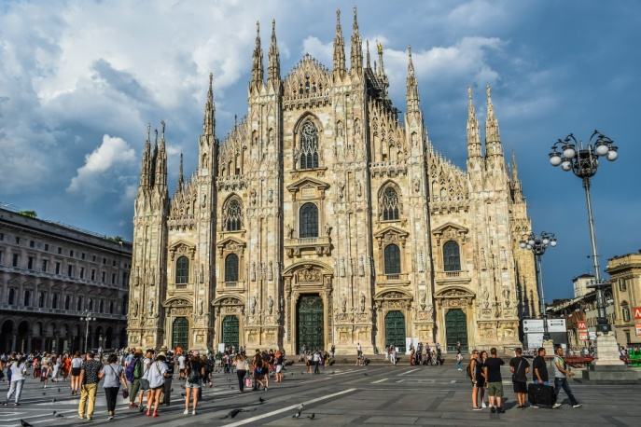
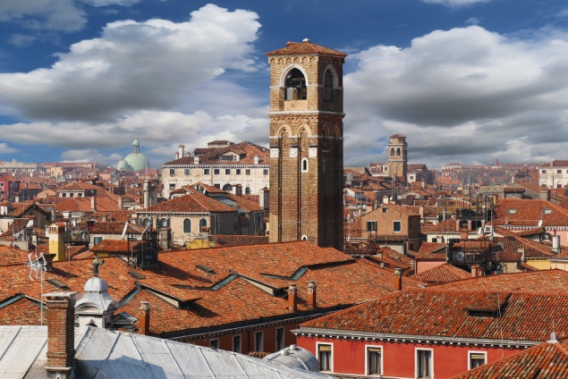
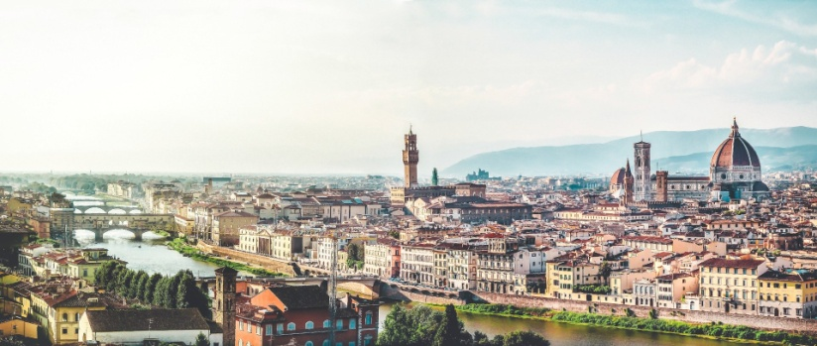
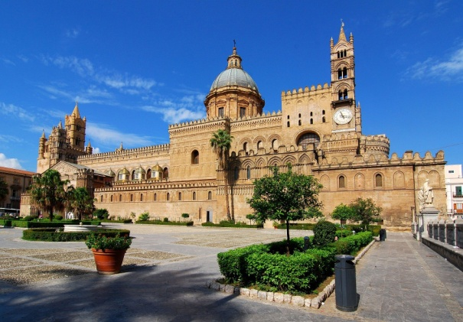
DIFFERENT BUT TOGETHER

Slide 2
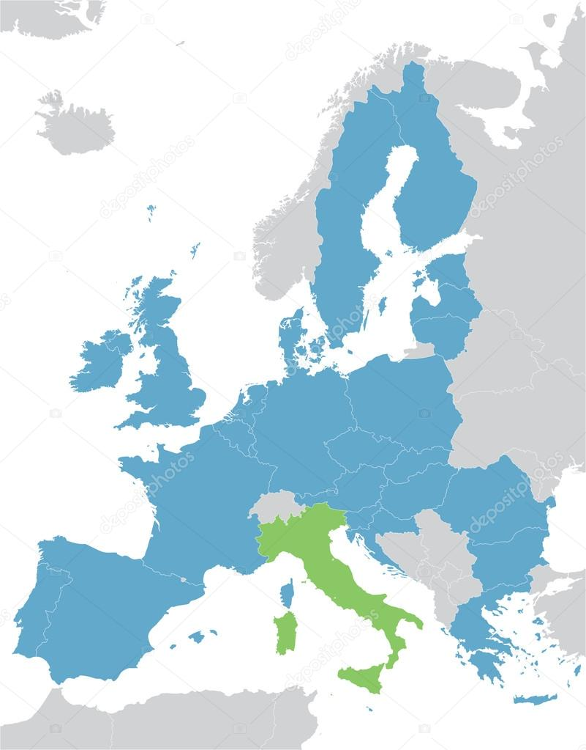
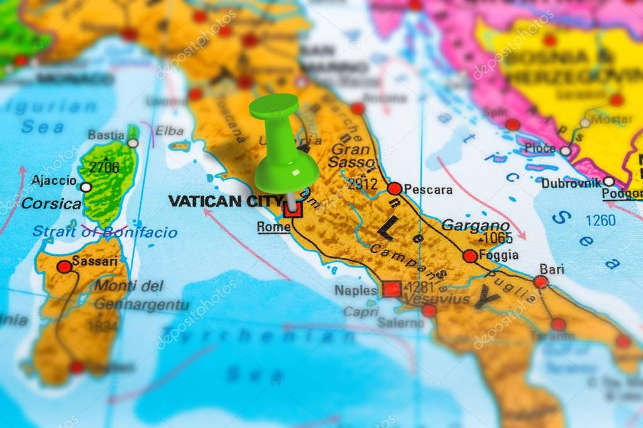
ITALY
Italy is a Parliamentary Republic. It is located in the Southern Europe. It has a population of around 60.4 million inhabitants. The capital is Rome.

Slide 3
our flag
The Italian flag consists of three equal-sized bands of green, white and red. The color of each band has a precise meaning. The green band represents Italy’s land, the white band the snow, while the red band represents the blood of the patriots who died during the War of Independence.

Slide 4
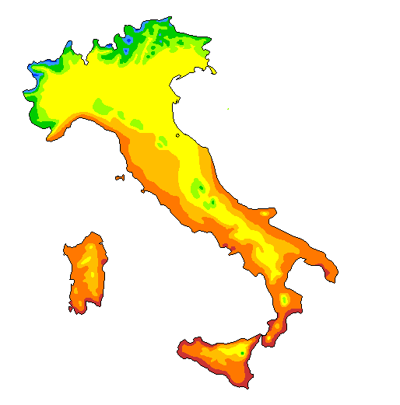
Climate in italy
Most of Italy is in the domain of warm temperate climates, of a Mediterranean type, while in the Northern Italy there are some continental aspects. In fact it presents many contrasts between Northern and Southern regions (precisely due to the elongated shape of the Peninsula), between internal and coastal areas. Therefore we can divide Italian climate zones into:
subtropical
warm temperate
sublittoral
continental mediterranean
cool temperate
cold temperate
cold
glacial

Slide 5
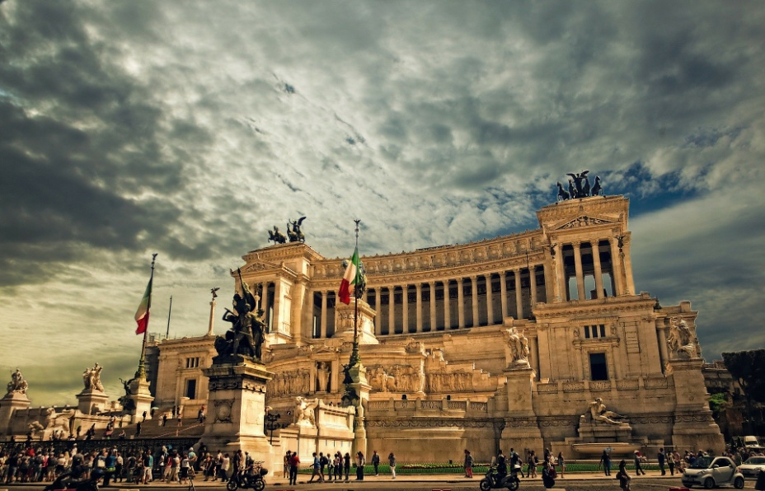
rome
Rome, capital of Italy, is a big cosmopolitan city with an artistic, architectural and cultural history that has influenced the whole world and dates back to almost 3000 years ago. The ancient ruins like the Forum and the Colosseum testify to the power of the ancient Roman Empire. It has a population of almost 3 million inhabitants.

Slide 6
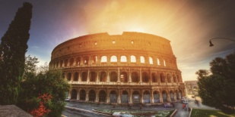
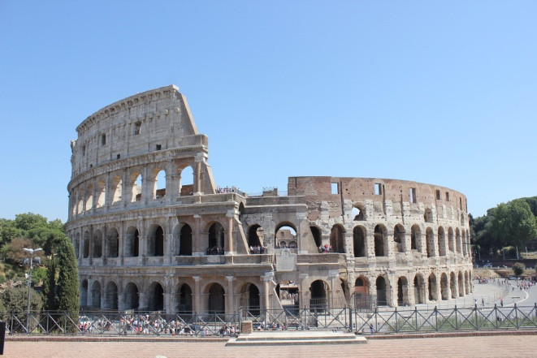
Colosseum : the italian symbol
The Colosseum, originally known as the Flavian Amphitheater, is the largest in the world and is located in the center of Rome. It could contain between 50 thousand and 75 thousand units, is part of the list of UNESCO World Heritage Sites and since 2007 is also among the New Seven Wonders of the World. The amphitheater was built in the Flavian period on an area on the eastern edge of the Roman Forum. Its construction was started by Vespasian in 71 AD and inaugurated by Titus in 80, with further modifications made during the empire of Domitian in 90. The building forms an ellipse of 527 m of perimeter, with axes that measure 187.5 and 156.5 m. The arena measures 86 × 54 m, with an area of ​​3,357 m². The current height reaches 48.5 m, but originally it reached 52 m. The structure clearly expresses the Roman architectural and construction concepts of the early Imperial Age.

Slide 7
Greetings in italian
Buongiorno = good morning . It is a formal greeting, normally used until the early afternoon
Buon pomeriggio = good afternoon . It is a formal greeting, normally used when we meet someone in the afternoon .
Buonasera = Good evening . It is a formal greeting, normally used when we meet someone in the evening , but it can be used from late afteroon .
Buonanotte = Good night . It is a formal and unformal greeting, used before going to sleep.

Slide 8
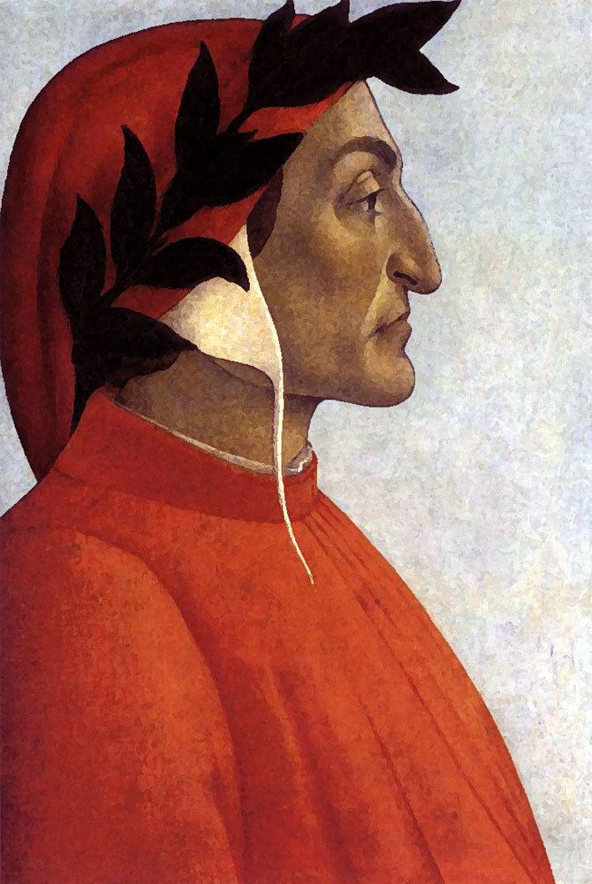
Famous italian
Dante Alighieri was one of the greatest Italian writers . He is considered the Father of Italian language. He was born in Florence in 1265 . He was educated in Literature ,Greek ,History, Philosophy, but also scientific subjects such as Mathematics , Music and Astronomy. His fame is mainly due to the “Divine Commedy”, an allegorical poem that has been translated into English , French, German, Latin and Spanish.
Dante alighieri
1265 - 1321

Slide 9
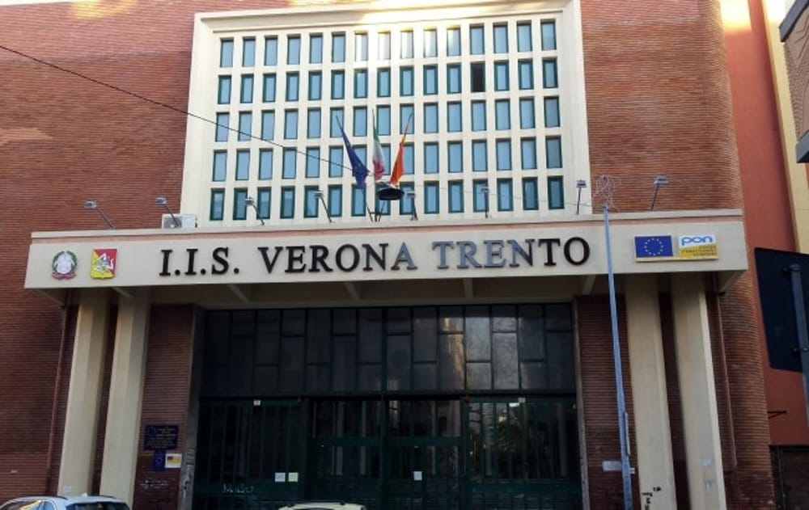
Our school
Our school is a Technological and Vocationaaal institute, and it is part of the secondary education system. The task of our school is to train competent technicians in various fields,without forgetting subjects such as History and Literature and the Enghlish language.

Slide 10
SCHOOL COURSES
Mechanics, Mechatronics and Energy
Chemistry, Materials Science and Biotechnologies
Graphics and Communication
Electronics and Electrical Engineering
ICT and Telecommunication
Building Technologies, Environment and Territory
Maintenance and Technical Assistance
Three-year professional qualification – I and PF

Slide 11
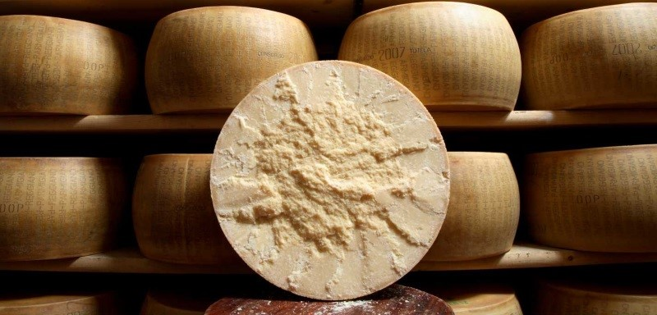
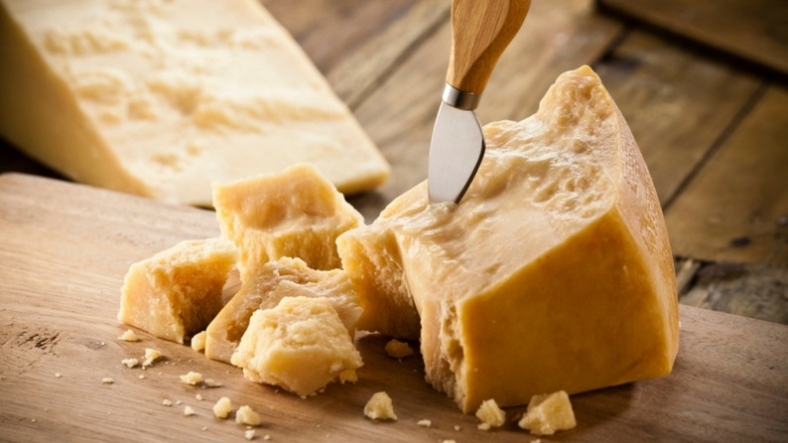
Italian famous products
One of the most famous Italian products is “Parmigiano Reggiano”.It is made with cow’s milk . Parmesan is exported throughout the world and for this reason it is one of the most counterfeit cheese in the world. The European regulation 1107/96 has included parmesan in the list of products of Name of Origin.

Slide 12
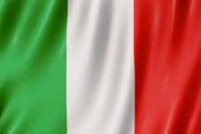
Thank you!!

