Slide 1
Traditional crafts, meals and other traditions in the Czech Republic
Erasmus+ KA229 - School Exchange Partnerships
Project: 2019 – 1 – RO01 – KA229 – 063163 “Different but together“

Slide 2
“Different but together“

Slide 3
Cornhusk doll
Corn lady is regarded a traditional product that comes from Slovacko region in the Czech Republic. Corn leaves are a traditional material, which started spread in the 17th century.

Slide 4
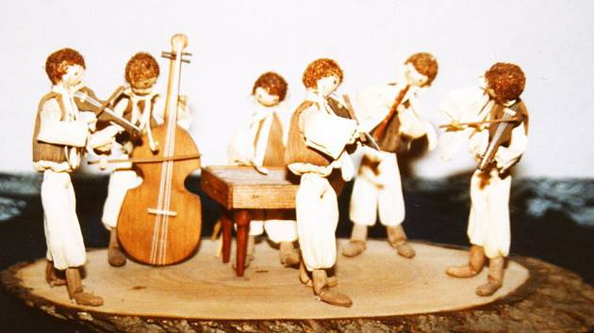
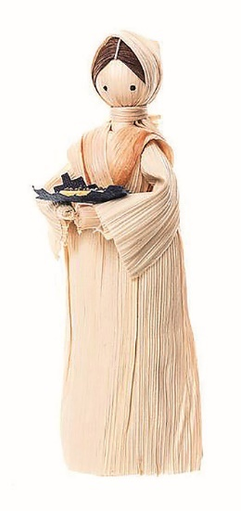
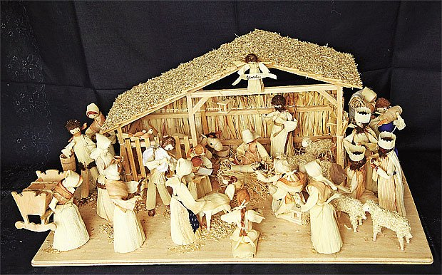
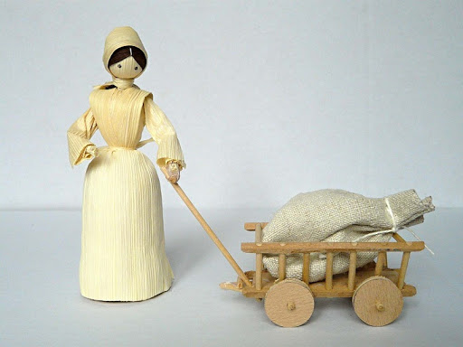
Typical products

Slide 5
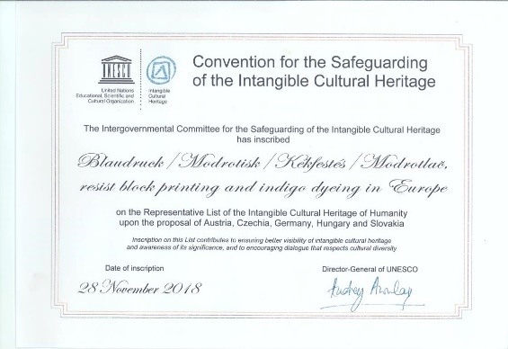
Indigo print products hand-made textile goods
Blaudruck / Modrotisk / Kékfestés / Modrotlač, which is translated as blueprint or blue-dyeing, refers to the practice of printing a dye-resistant paste onto a cloth before it is dyed indigo.

Slide 6
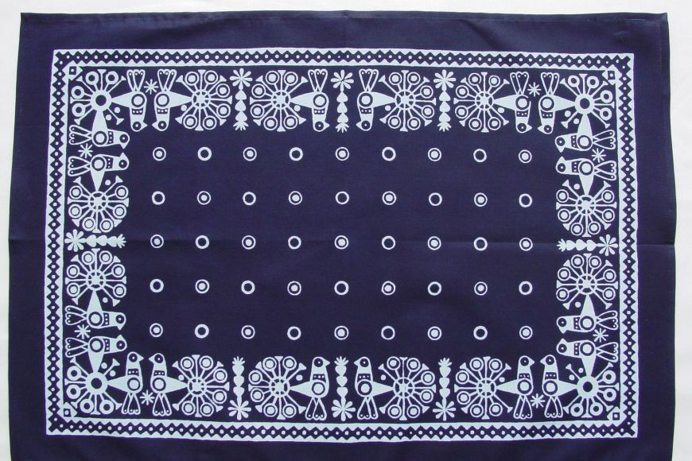
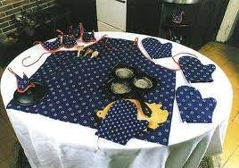
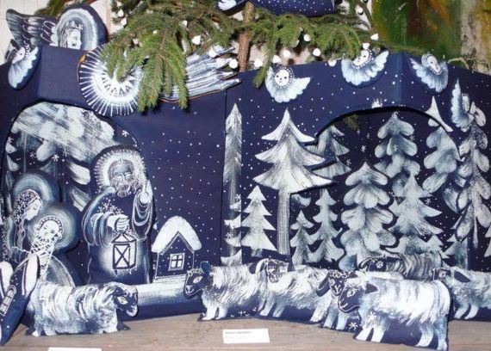
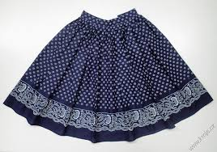
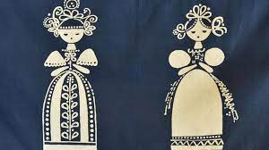
Typical products

Slide 7
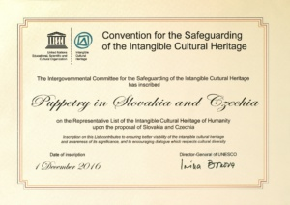
Puppetry in the Czech Republic
The joint Czech-Slovak nomination "Puppetry in Slovakia and the Czech Republic" was entered into the UNESCO Representative List of the Intangible Cultural Heritage of Humanity on December 1, 2016. The puppet theatre is an inseparable part of the theatrical tradition in Slovakia and the Czech Republic.

Slide 8
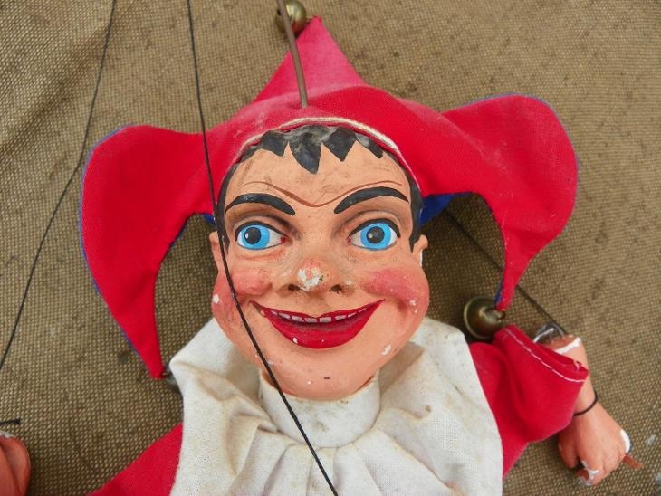
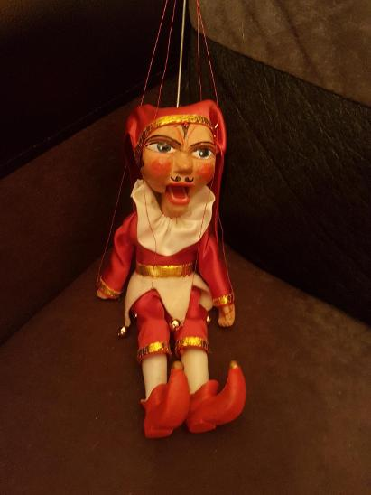
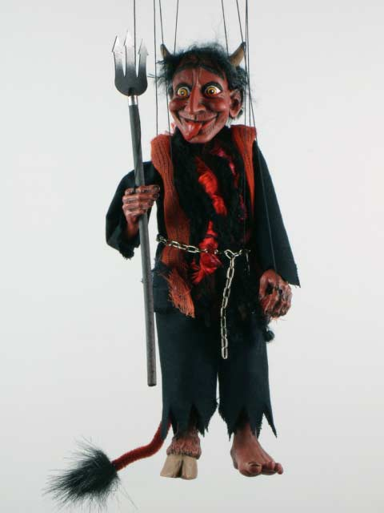
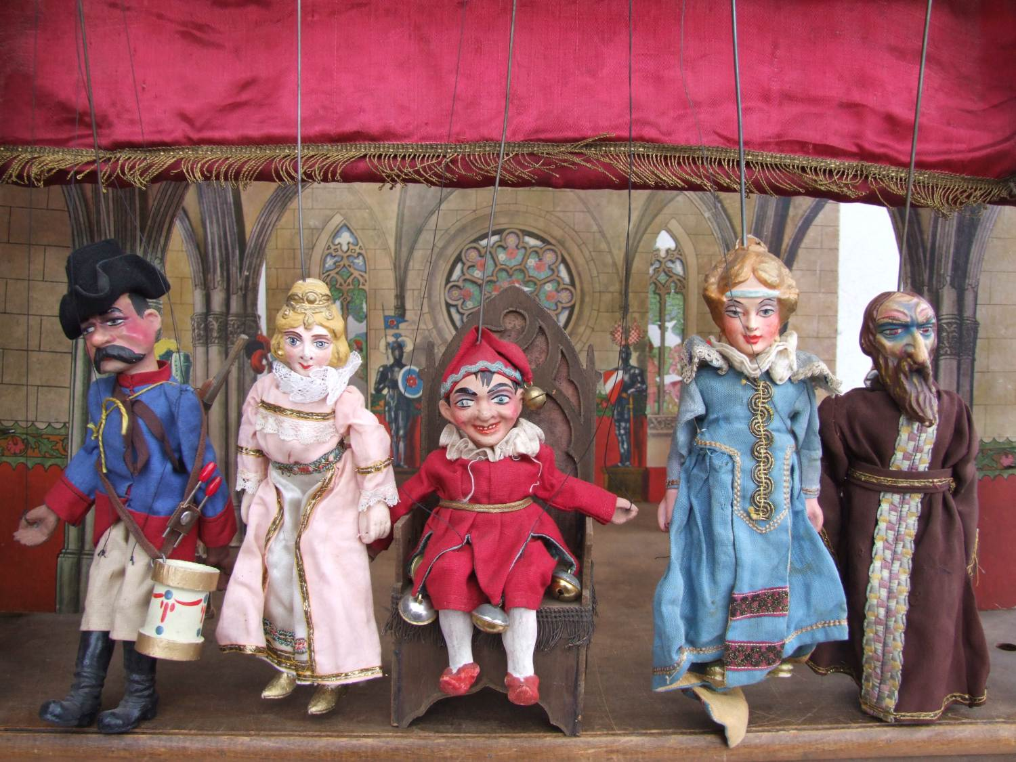
Typical Czech puppets
Kašpárek – Prankster and Čert - Devil

Slide 9
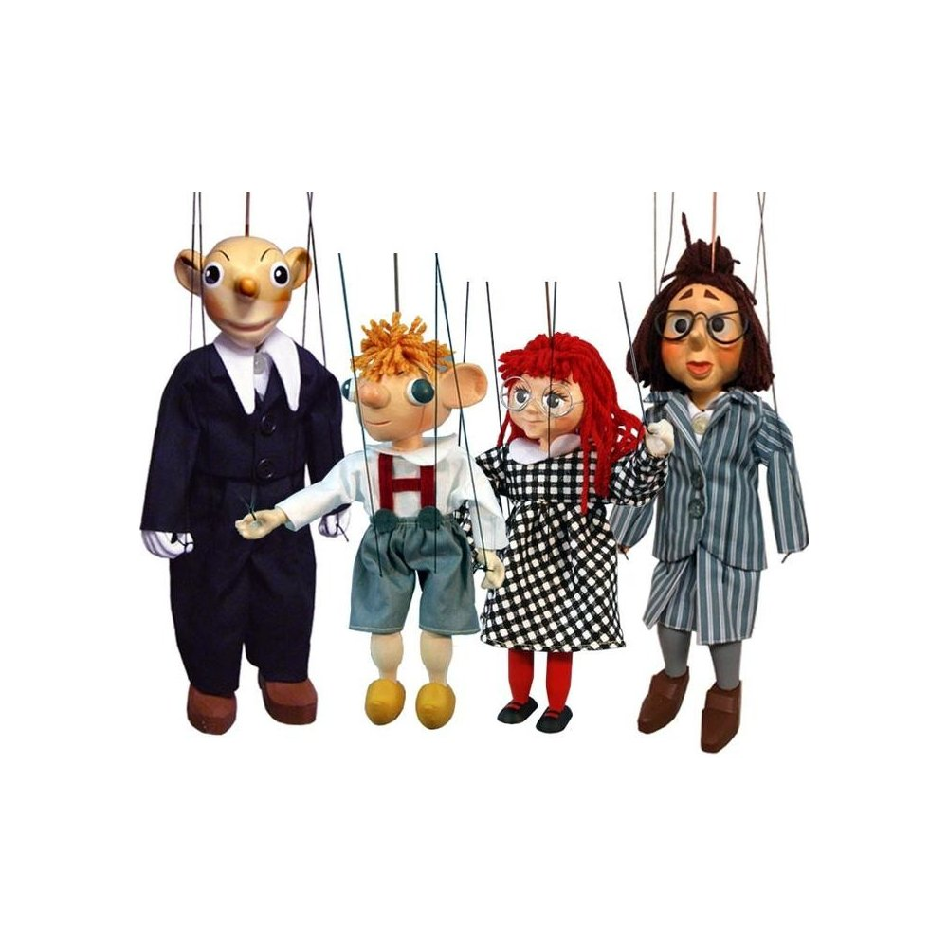
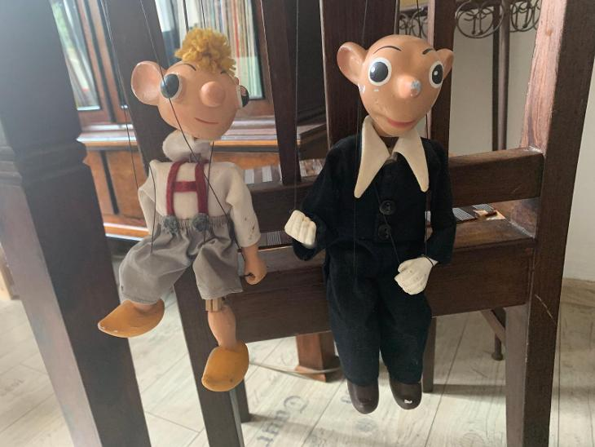
Typical Czech puppets
Spejbl and Hurvínek

Slide 10
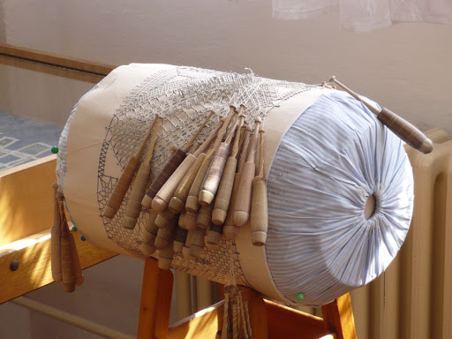
Bobbin lace from the town Vamberk Eastern Bohemia
The town Vamberk is a special place for lace makers. This city has been known for lace production since 17th century.

Slide 11
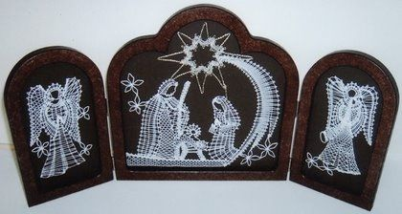
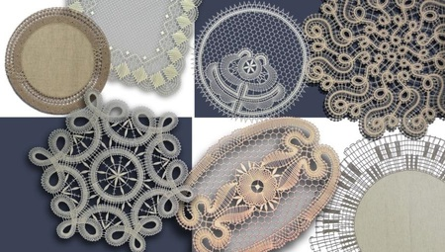
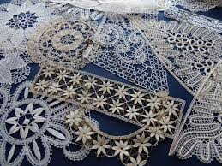
Typical products
Traditional:

Slide 12
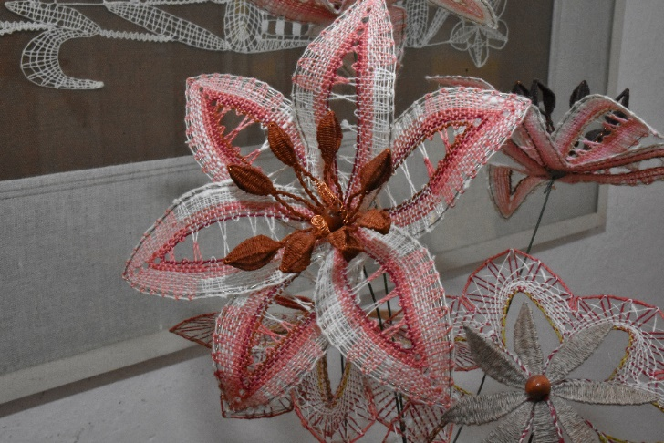
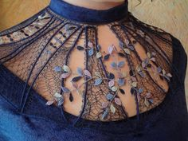
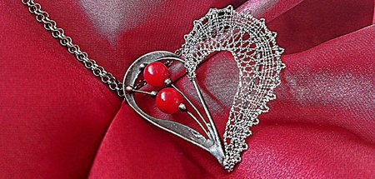
Typical products
Modern:

Slide 13
Traditional meals
Soap Kulajda
made of mushrooms, potatoes, sour cream, eggs

Slide 14
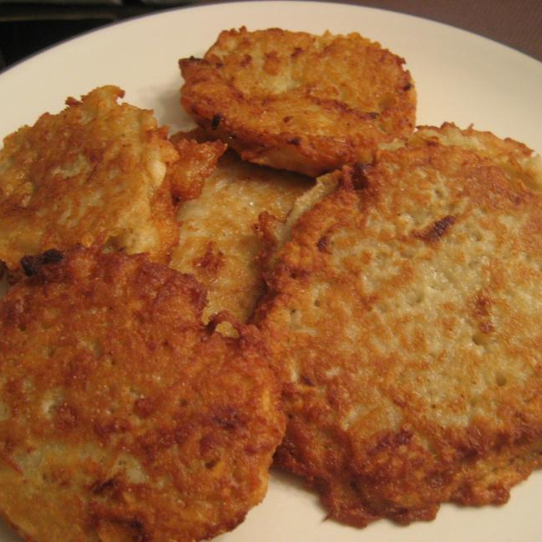
Potatoe pancakes bramboráky
Bramboráky are Czech potato pancakes. They are prepared from raw grated potatoes, with a lot of garlic, marjoram, eggs, flour and hot milk added.

Slide 15
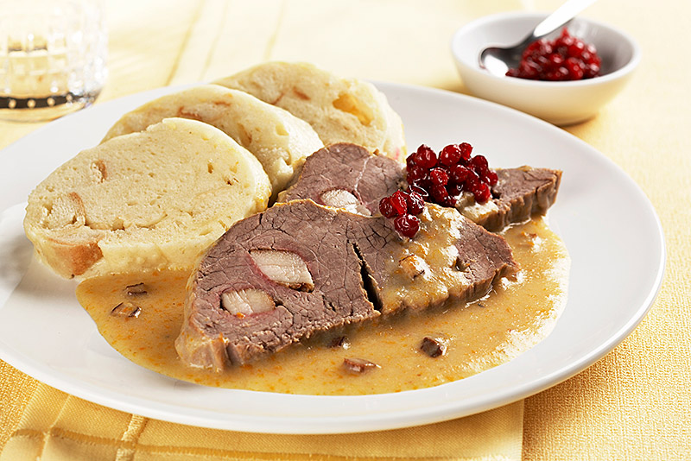
Sirloin with creme sauce Svíčková na smetaně s houskovým knedlíkem
Creamy sauce flavoured with root vegetables, soft beef sirloin is served with breaded dumplings.

Slide 16
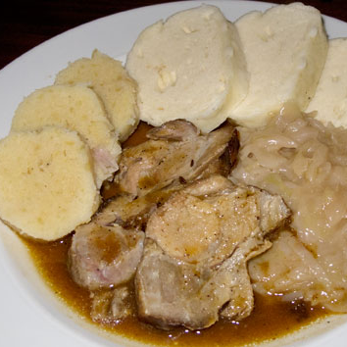
Czech roast pork Vepřo – knedlo - zelo
Czech roast pork served with cabbage, potatoe or/and breaded dumplings

Slide 17
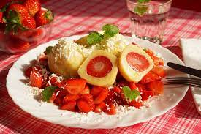
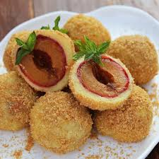
Fruit dumplings (sweet main meal) Ovocné knedlíky
Fruit dumplings filled with blueberries, strawberries, plums, apricot … with sugar, butter, Cottage cheese

Slide 18
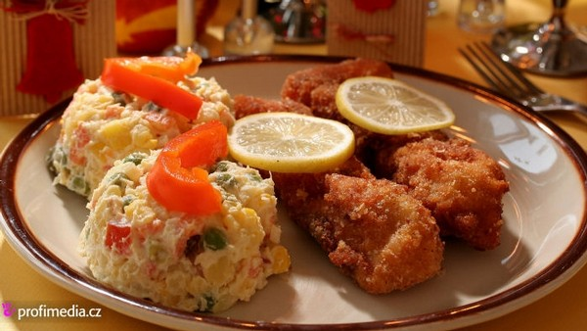
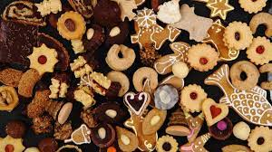
Czech traditions
Christmas – celebtated in the evening on December 24, Christmas tree, carols, Christmas dinner – potatoe salad, carp, sweets

Slide 19
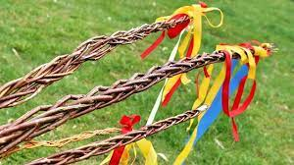
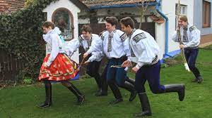
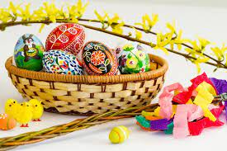
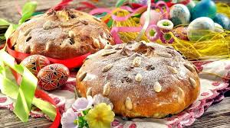
Czech Easter
Hand painted and decorated eggs,
pussywillow (pomlázka) – young boys go carolling on Easter Monday and symbolically whip girls on leg (to be youth and health)

Slide 20
"The European Commission support for the production of this publication does not constitute an endorsement of the contents which reflects the views only of the authors, and the Commission cannot be held responsi­ble for any use which may be made of the information contained therein."

