Slide 1
Traditional music from the Czech Republic
Erasmus+ KA229 - School Exchange Partnerships
Project: 2019 – 1 – RO01 – KA229 – 063163 “Different but together“

Slide 2
“Different but together“

Slide 3
The Czech Republic
is a landlocked country lying in the centre of Europe.
The country borders with Poland, Germany, Austria and Slovakia.
As a result, Czech traditional music is influenced by its neighboring countries.

Slide 4
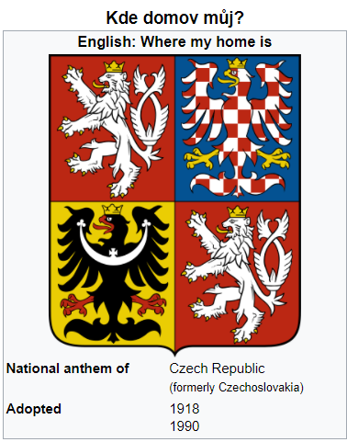
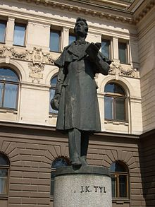
" Kde domov můj"
Is the national antemn of Czech Republic
It was created by Josef Kajetán Tyl
and František Škroup in 1834.
Czech National Antemn
Where is my home, where is my home?
Over leas are waters streaming,
On the hills blue forests dreaming,
Flowery wolds Spring‘s happy skies,
Like as earthly Paradise:
There‘s the land so full of beauty,
Čechia, my fatherland!.....

Slide 5
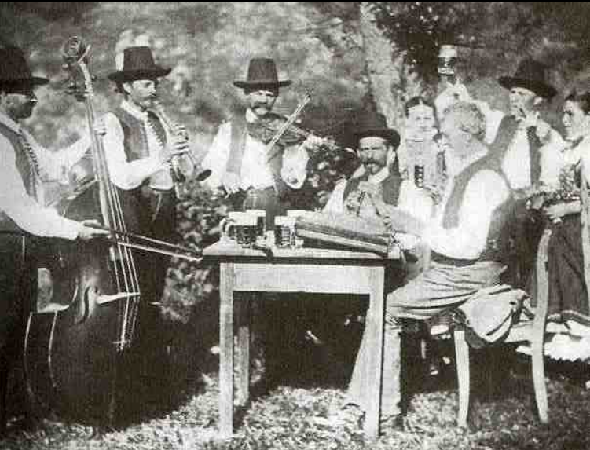
Czech Folklore Public Music Life after 1860
Czech folklore
The authentic folk music of the Czech Lands can be divided into two areas
Bohemian and Moravian.

Slide 6
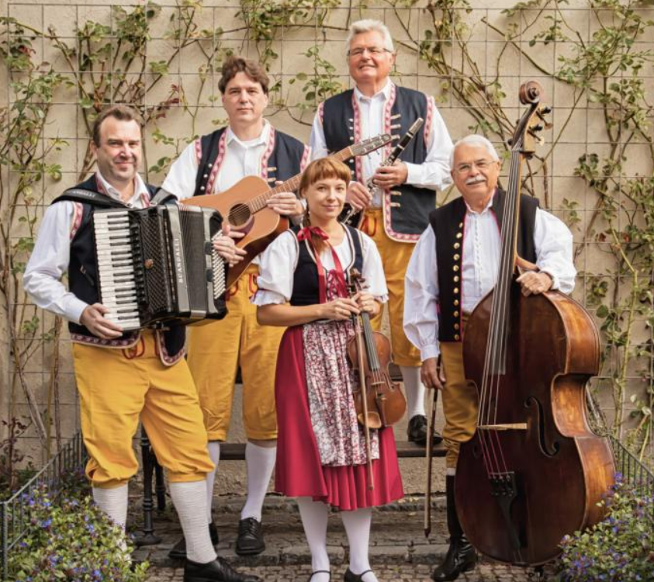
Bohemian folk music
The folk music of Bohemia is more instrumental and similar to the music of Austria and Germany.

Slide 7
Czech bagpipes
Bagpipe music
Unique folk cultures can be found especially in the South and the West of Bohemia (Chodsko) with a tradition of bagpipe music.

Slide 8
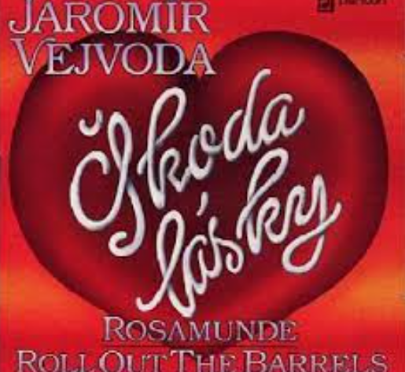
Škoda lásky
The Bohemian polka
is the most famous European dance.
Polka has become popular in the whole world in the early 20th century.
The famous example is Škoda lásky (Wasted Love) of 1927, known as Beer Barrel Polka.
Beer Barrel Polka

Slide 9
Moravian traditional music
represents a part of the European musical culture connected with the Moravian region of the Czech Republic.

Slide 10
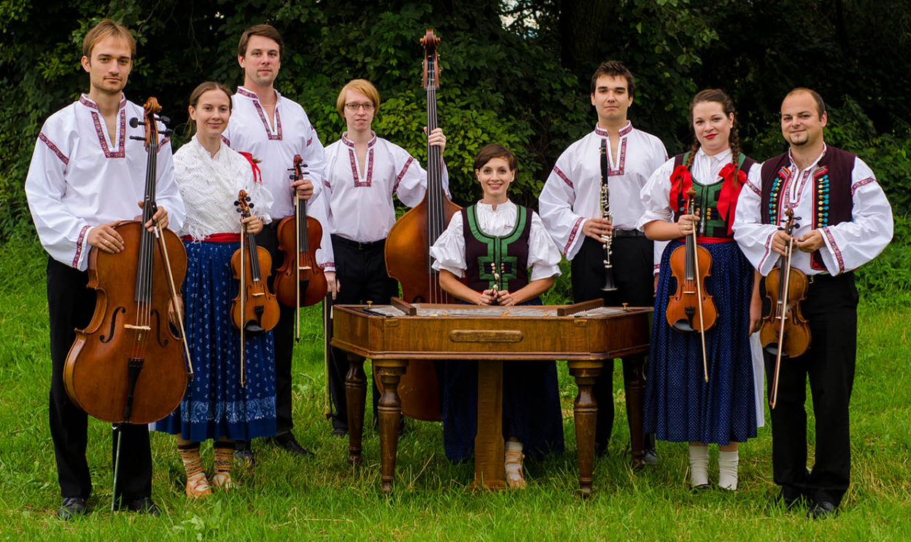
Moravian music
Moravian folk music
The folk music of Moravia and Silesia is closely related to the music of Slovakia, Hungary and Poland.

Slide 11
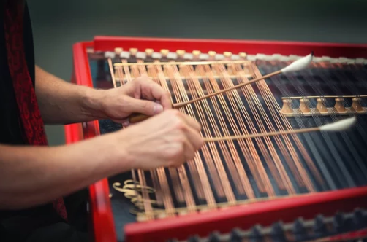
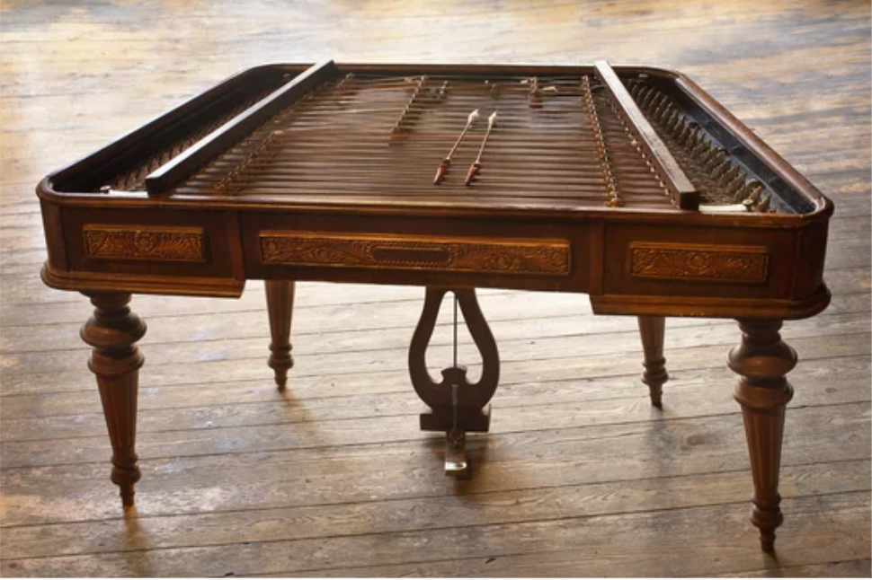
Cimbalom
Cimbalom
Moravian folk bands are mainly centered on a string section and a large cimbalom, which are often complemented by other instruments.

Slide 12
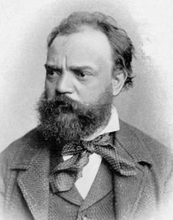
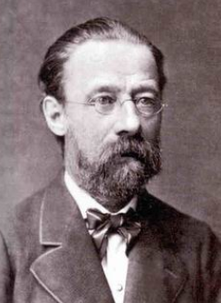
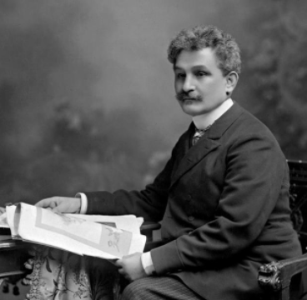
Famous Czech composers
Moravian traditional music influenced Czech classical composers, such as Antonín Dvořák, Bedřich Smetana and Leoš Janáček.
Bedřich Smetana - Má vlast

Slide 13
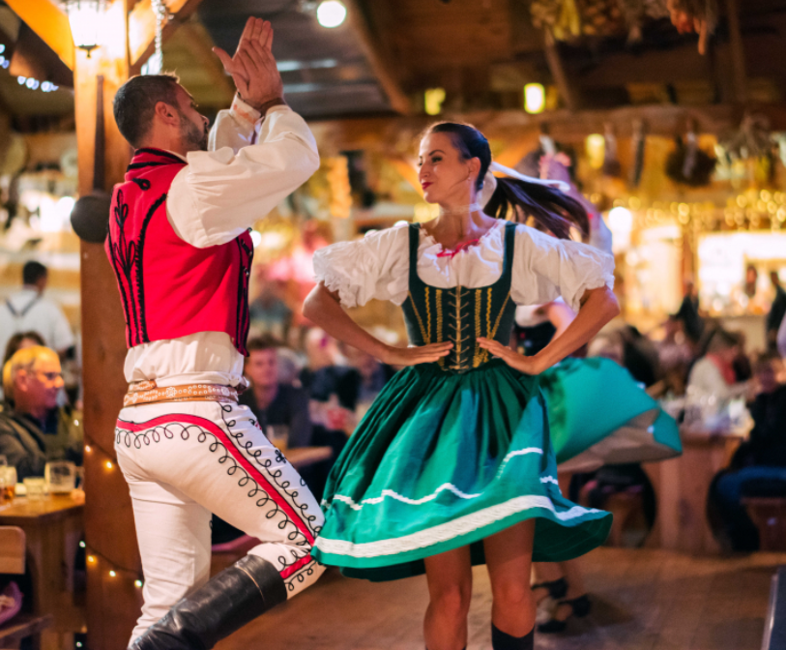
Traditional music and dances
Dance songs
they make up a large part of the repertoire in both Bohemia and Moravia.

Slide 14
Music festivals
A lot of music festivals take place in the Czech Republic because it is a multicultural country in the heart of Europe.
There are many different music festivals.
Modern music - rock, heavy metal, electronic music.
This makes the Czech Republic a great place to listen to all genres of music.

Slide 15
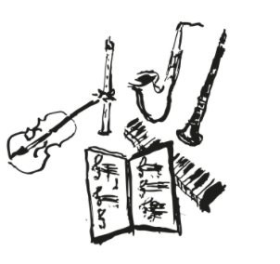
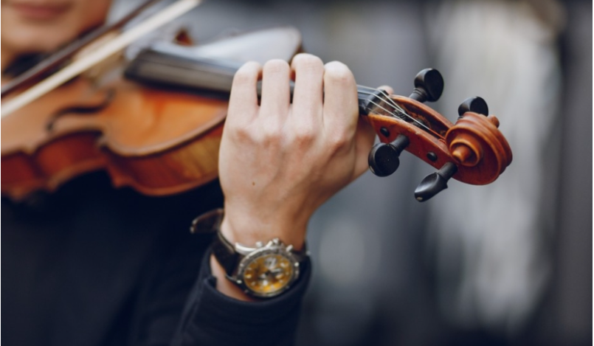
Music education in the Czech Republic
Music education in Czech land has a very long tradition.
One of the parts of the educational system are the music schools.
These music school are able to find the talented students at a very young age.
The music schools help to prepare students for unprofessional music activities or for further studies.

Slide 16
"The European Commission support for the production of this publication does not constitute an endorsement of the contents which reflects the views only of the authors, and the Commission cannot be held responsi­ble for any use which may be made of the information contained therein."

