Slide 1
Spring celebration Easter traditions in the Czech Republic
Erasmus+ KA229 - School Exchange Partnerships
Project: 2019 – 1 – RO01 – KA229 – 063163 “Different but together“

Slide 2
“Different but together“

Slide 3
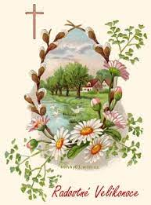
Spring celebration Easter
Christian meaning of holiday
Today mainly cheerful and fun

Slide 4
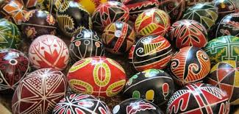
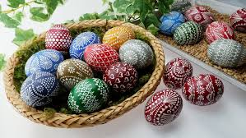
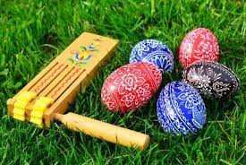
Easter tradition
Hand painted eggs
Girls give them to boys on Easter Monday

Slide 5
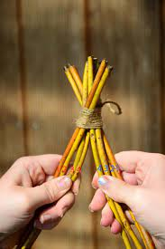
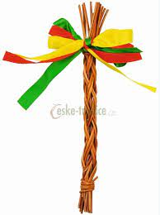
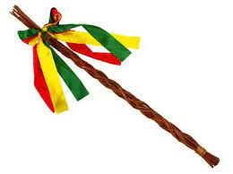
Easter tradition
Pussywillow
Czech traditional belief is that young, live pussywillow twigs are thought to insist youth and health to anyone who is whipped with them.

Slide 6
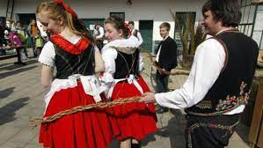
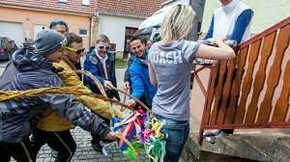
Easter tradition
It is common practice to make a pomlázka (from the word pomladit meaning to make younger), which is a braided whip constructed of pussywillow twigs. For centuries, young boys go caroling on Easter Monday and symbolically whip girls on the legs.

Slide 7
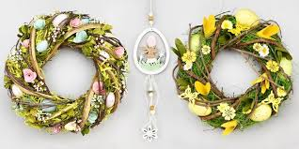
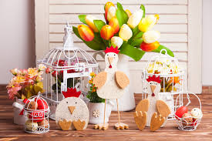
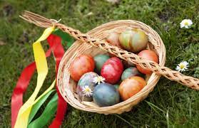
Easter holiday
The reason behind this ritual is to chase away illness and bad spirits and bring good health and youth to everyone who gets whipped.

Slide 8
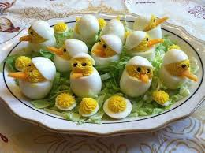
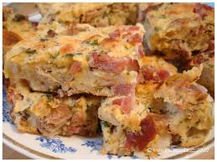
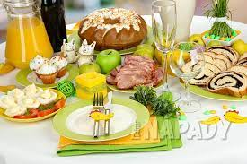
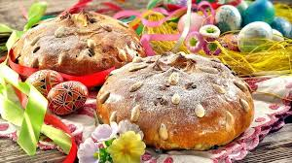
Czech Easter
Traditional food

Slide 9
"The European Commission support for the production of this publication does not constitute an endorsement of the contents which reflects the views only of the authors, and the Commission cannot be held responsi­ble for any use which may be made of the information contained therein."

