Slide 1
Traditional table games in Greece
4th EPAL KAVLAS

Slide 2
Tavli
In every kafeneio around Greece and many Greek run cafes worldwide you are guaranteed to find people playing the beloved game of ‘Tavli’. Although it looks like the ‘western’ game of backgammon, there are different rules to Tavli, Greece’s longest running and favourite board game, which dates back to ancient times.
Tavli means “board” in Greek and there are three games of Tavli commonly played:
Portes – most similar to Western backgammon
Plakoto – a game where one checker can trap another checker at the same point
Fevga –where one checker by itself can block a point
These games are played one after another, in matches of three, five, or seven points.

Slide 4
The games of Tavli have the following rules in common:
Only one pair of dice is used, and they are shared between the players.
In the first game, each player rolls one die and the higher number goes first. That player then rolls the dice again to begin his first turn.
After the first game, the winner of the previous game goes first.
The first player to bear off all his checkers gets one point, or, if the winner bears off all his checkers before the loser has borne off any, he gets two points. There is no triple game.
No doubling cube is used.
Pace of play:
Tavli is played very quickly. You do not need to wait for your opponent to pick up the dice—you pick them up yourself while he is making his move.

Slide 5
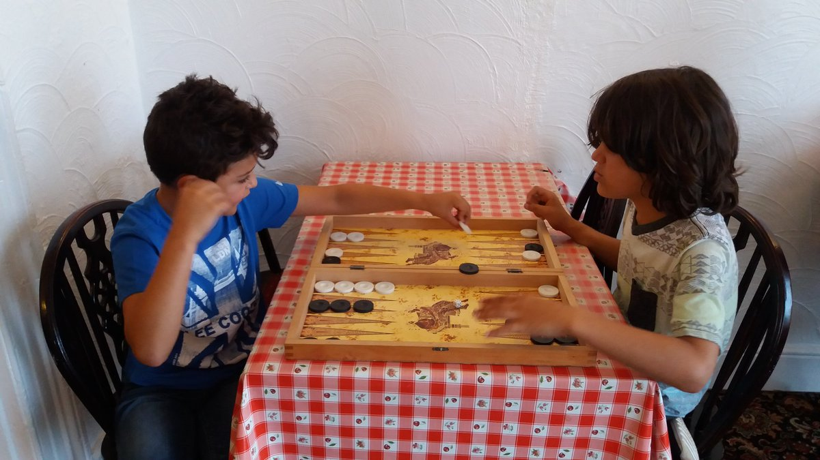

Slide 6
Rolling too early:
However, you must not roll the dice while the opponent is still making his move. As long as he has a checker in his hand, or even still has his finger on it, you must wait. If you throw too early, the roll does not count and you have to roll again.

Slide 7
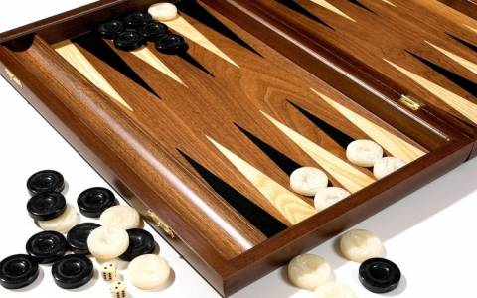

Slide 8
Diloti Card Game
Specially during the winters in people play cards in the local tavernas. The favourite game is Diloti, an intriguing game of collecting, or fishing, cards to gain points...and money. Sometimes really a lot of money: thousands of Euros!
The game is played by men of all ages, and games can go on for hours. It's a fascinating sight to see four men gathered around a table, with sparse light, heavily smoking, and the nervous tension building up, to the final count of points, and wallets being pulled. It's also played in a more relaxed style, with a lot of noise and showing of courage, bravoure and machismo, just for fun and honor.

Slide 9
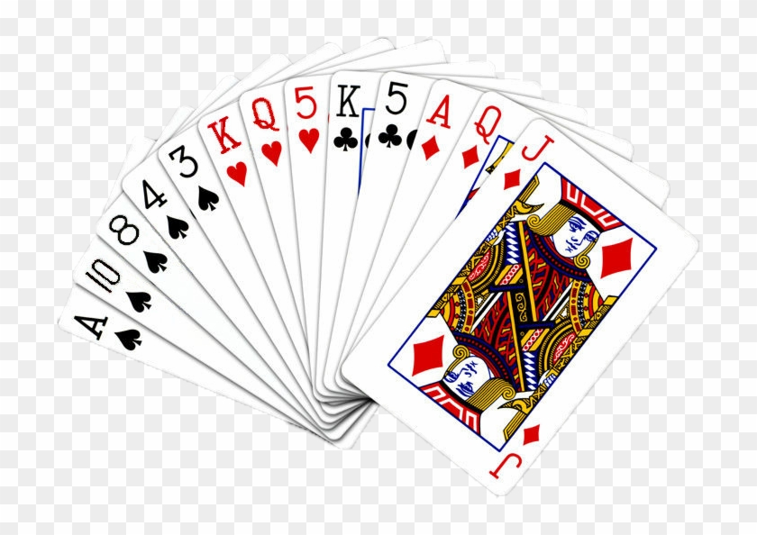
The game is very similar to that of Casino, more widely known in the West. Diloti is a kind of 'fishing game', trying to take cards from the table to gather points.

Slide 10
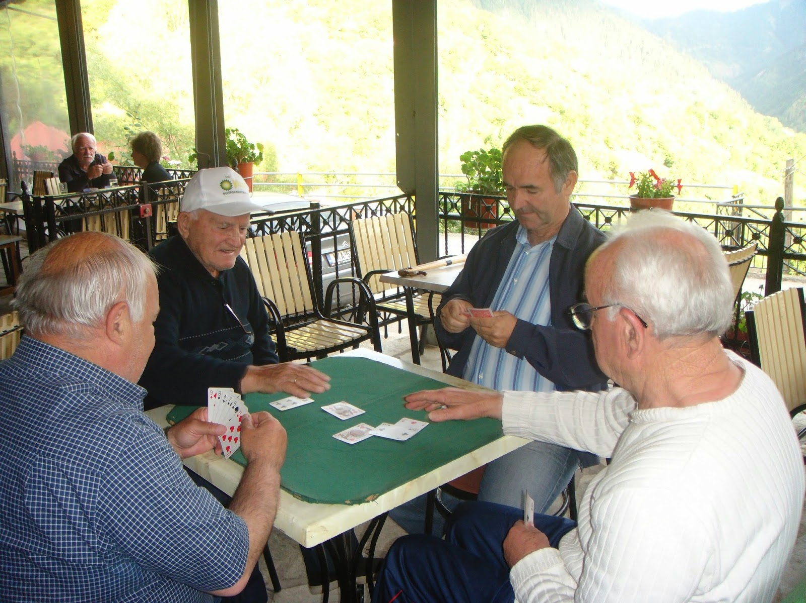

Slide 11
Diloti: How to play
Objective
To obtain more points than your opponent.
What counts as points? By the end of a round, having more cards than your opponent counts as 4 points towards your score.
Having the 2 of clubs and each ace count as one point each. Having the 10 of diamonds counts as two points towards your score.
Having a xeri (sweep) counts as 10 points towards your score.
Game Play
The dealer deals each player 6 cards to start and places 4 cards on the board. The non-dealer player goes first.
Players alternate turns. Each turn involves choosing a card from your hand and doing either a drop, take, or a join with it and with cards on the board. When each player has used all of their cards in their hand, the dealer deals a new set of 6 cards to each player and game play resumes. This occurs until all of the cards in the deck are gone. This indicates the end of the round and the score is tallied.

Slide 12
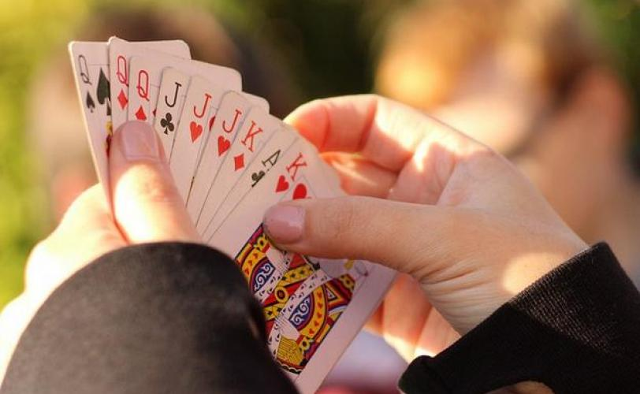

Slide 13
More Greek card games:
• Pilota - similar to the French game Belote, played with 32 cards. Bourloto may be the same or a similar game.
• Koltsina (or Koultsina), also known as Pastra - a fishing game, which may possibly be similar to the Arabian game Basra.
• Kseri is another fishing game, said to be similar to the Turkish game Pishti.
• Biriba - a two pack rummy game in which the aim is to make "biribas", which are sets of at least seven cards of the same rank or seven cards in sequence in suit.
• Koum-kan - sometimes written Kum-kan or Kun Kan - is a two deck rummy game in which each player is dealt 11 cards.
• Thanassis is another Rummy variation.
• Prefa - a variation of Russian Preference, highly valued among university students and old village people!
• 66 - the Greek version of the German game of 66.
• Agonia (Agony) is the Greek version of Crazy Eights, as usual with lots of variations.
• Koupes, the Greek version of Hearts is becoming more and more popular lately, mostly among younger people.

Slide 14
