Slide 1
TRADITIONAL CHILDREN’S GAMES
4TH EPAL KAVALAS GREECE

Slide 2
LONG DONKEY
Long donkey (μακριά γαϊδούρα) is an old game that young boys used to play when they were gathered together out on the streets. Although technology has taken much of children’s time, some kids still play in the schoolyards or in the parks their grandparents’ games. Nowadays girls also take part in this game
How to play:
Children divide into two groups (teams). One member of a team sings “eeny, meeny, miny, moe” in order to decide which team will “bend” and which one will “jump”. Then one member of the “bend” team will stand against a wall or if there is no wall they bend over and wrap their arms around a tree or something else. The other members of the “bend” team, one by one, bend over and wrap their arms each time around the last kid’s waist…forming a “long donkey”.
Then, the members of the “jump” team, one by one, run and jump on the “long donkey’s” back. After a few jumps eventually the “long donkey” breaks. The winning team is the one that holds up the largest number of children.

Slide 3
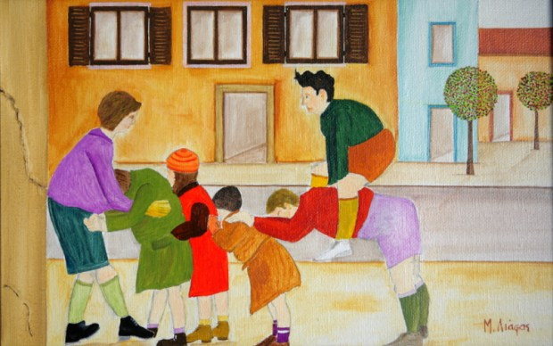

Slide 4
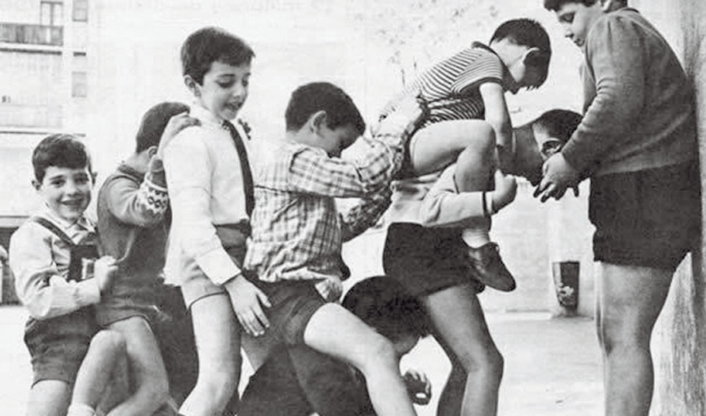

Slide 5
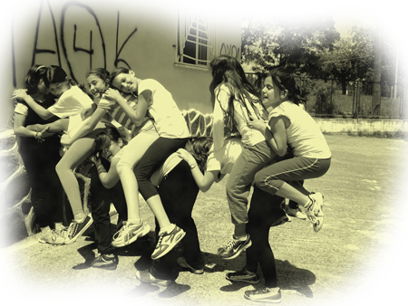

Slide 6
Apples
Apples: In this game children are divided into two groups. Two players of one group stand opposite one another and the players of the other group gather between them. The two players throw a ball at each other trying to hit one of the children of the rival group. If the ball hits a player then they get “burned” and exit the game. However, if a player catches the ball, he wins an “apple.” The goal of this game is to get as many “apples” as possible. Each “apple” gives the player an extra “life” he can use in case he gets “burned.”

Slide 7
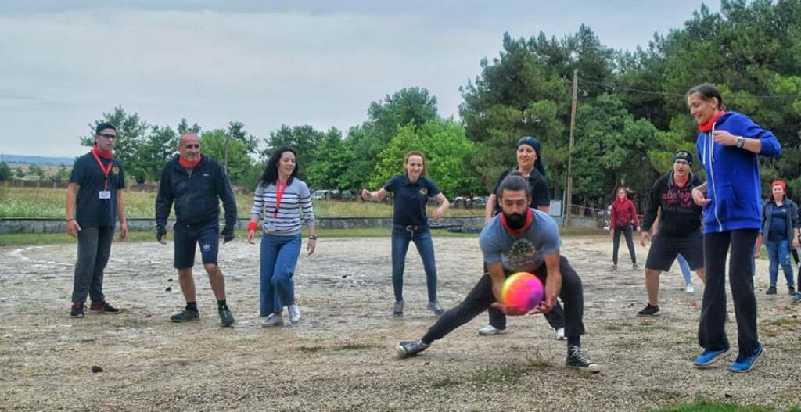

Slide 8
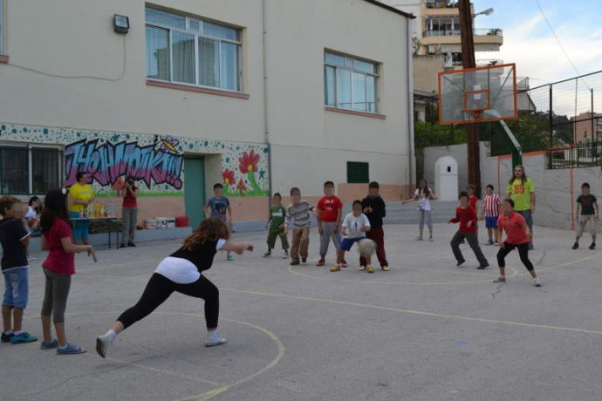

Slide 9
Abariza
Abariza: The game is played by two groups. Each group draws on the ground an “abariza“, a 3-4 diameter circle and a square used as a “prison.” Between the two “abarizas“ there is a distance of 20-40 meters. A random player of the first team starts running between the two “abarizas“ and a player of the other team tries to catch him and put him in “prison.” The winner is the team that manages to imprison all the opponents.

Slide 10
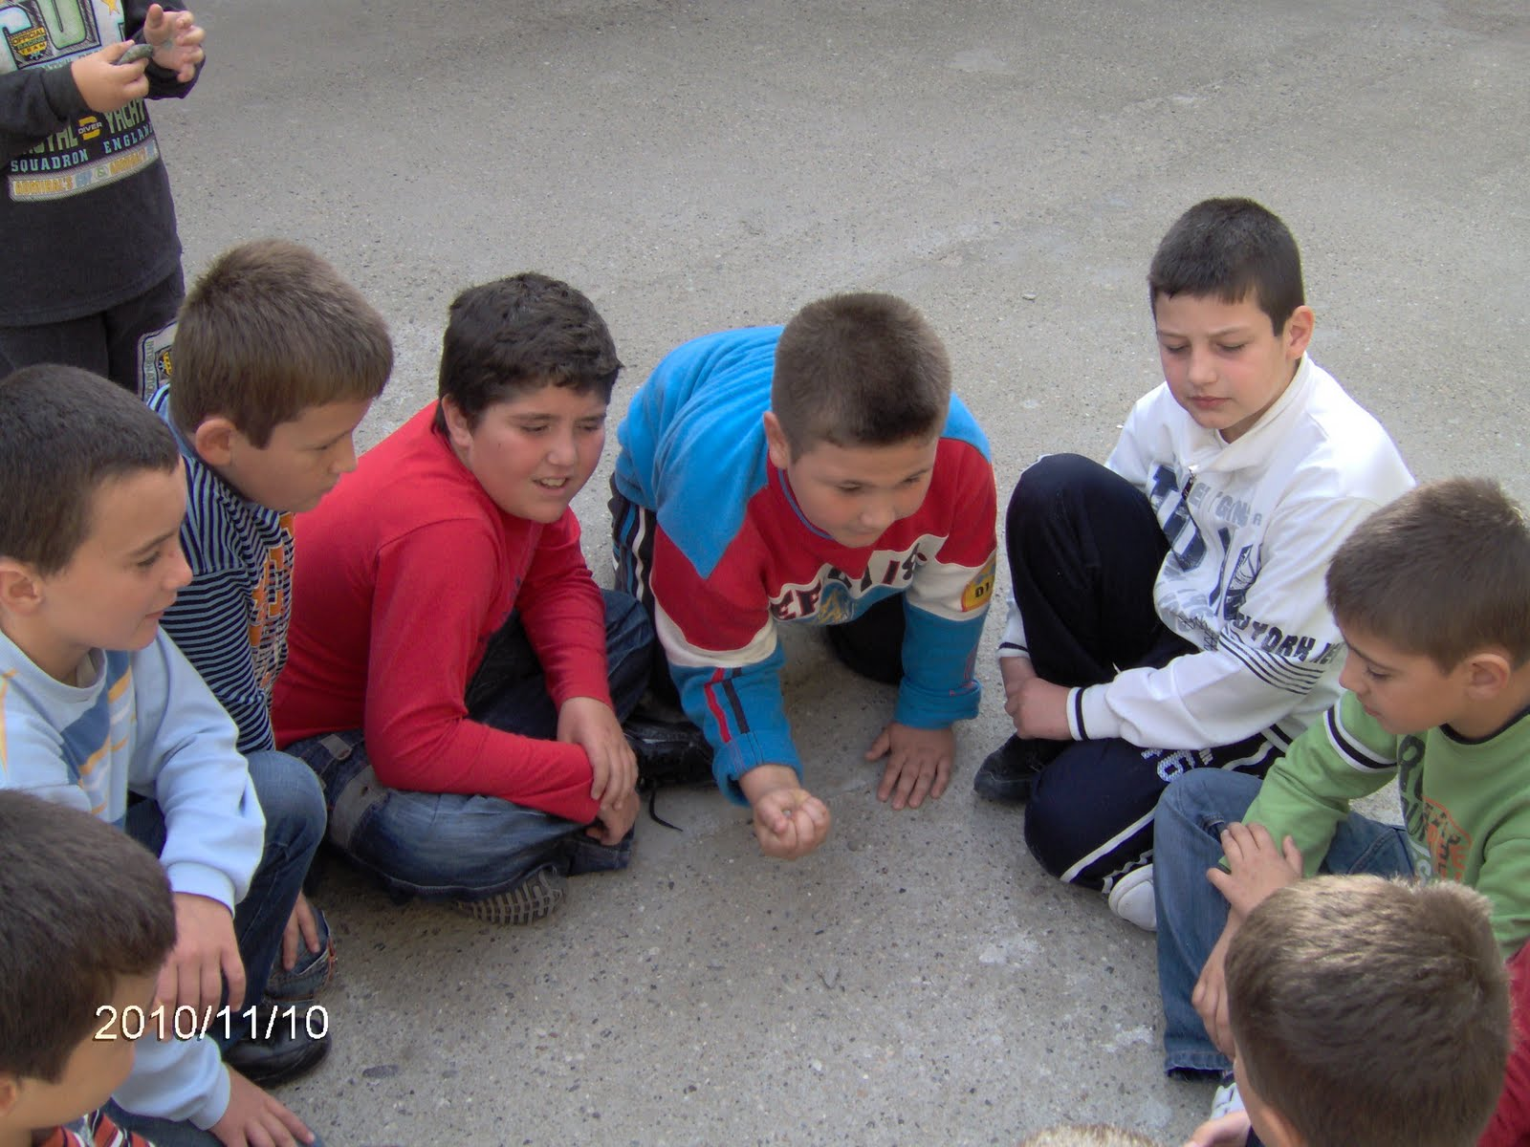

Slide 11
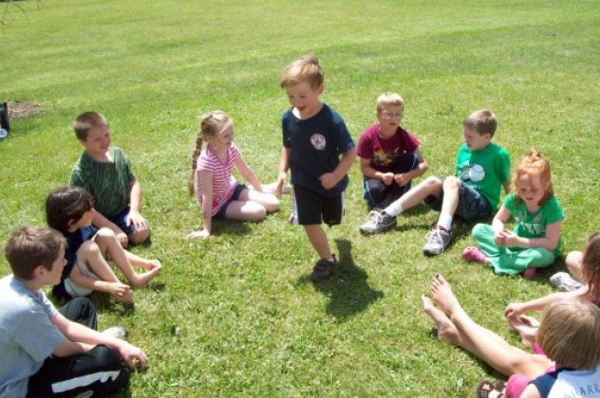

Slide 12
Broken telephone
Broken telephone: The children are sitting next to each other in a row. The first child quickly says a word in the ear of the second, the second to the third, and so it goes until the word reaches the last child of the row. The latter has to say the correct word out loud so that the game continues with a new word.

Slide 13
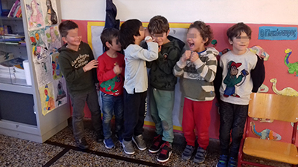

Slide 14
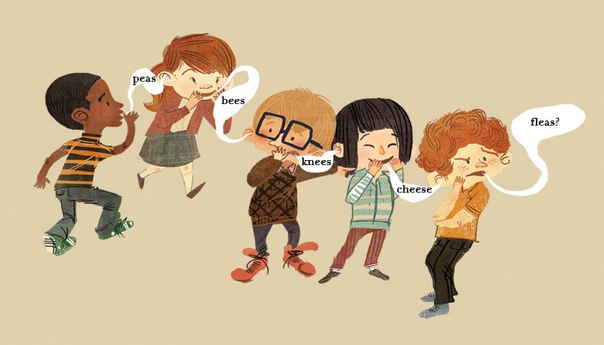

Slide 15
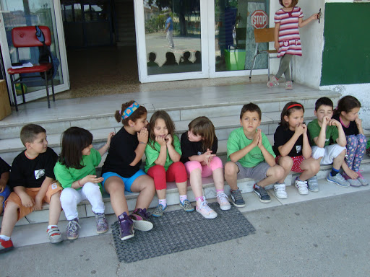

Slide 16
Coarse Salt
Coarse Salt The game is played by many children gathered together. They make a circle and sit down cross-legged keeping their hands behind them. One of them is chosen to be the “Mother” and starts the game.
Mother stands outside the circle and holds a handkerchief (or any other object). She starts walking around the circle and sings: Fine salt, coarse salt, I lost my mother and I'm going to find her I want to go to the prom but she gave me no shoes.
While singing around the circle, she puts the handkerchief behind a child and continues until the children understand that she no longer holds the handkerchief. They look back and the child who finds the handkerchief gets up and starts chasing Mother. When the child catches Mother, she sits in the child’s place along with the other children.
The boy/ girl who has the handkerchief now becomes the new Mother and begins the song.

Slide 17
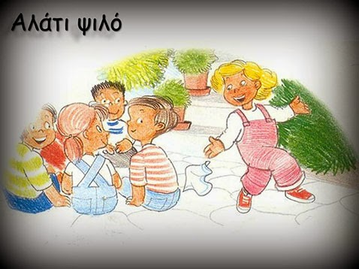

Slide 18
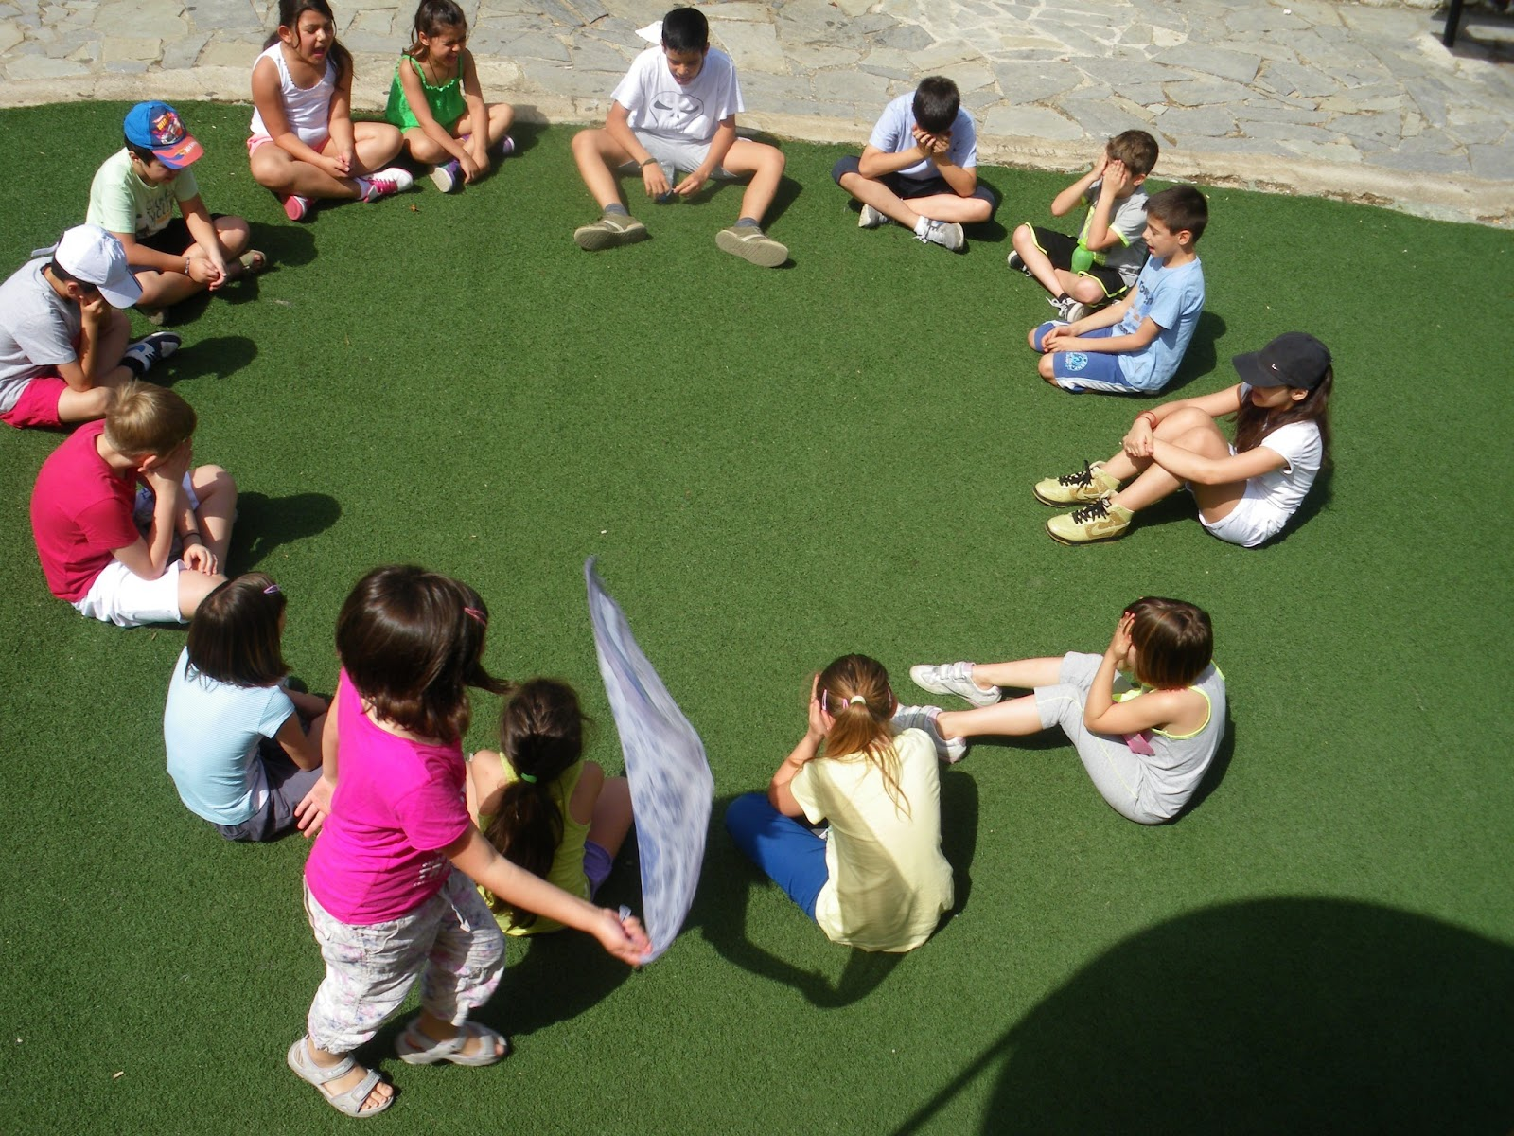

Slide 19
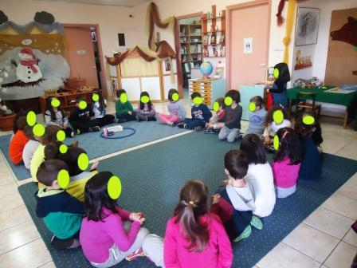

Slide 20
Tzami (Tower)
Tzami (Tower)
We need:
● two groups of children-players
● a tower of tiles
● a ballAim of the game:
● Group A to form the tower of tiles again
● Group B to ‘shoot’ with a ball the players of group A in order to keep them from forming the tower of tiles.
Instructions: Children put seven tiles (7) one on top of the other forming a tower in the middle of a circle. You can draw a circle either with a piece of chalk in the schoolyard or with a small stick on the ground. They form two groups: A and B. The players of each group start shooting the ball in order to break the tower. If the first player of group A does not succeed, the first player of group B tries next. Every child tries in turns until someone manages to throw at least three tiles down. When one group (A) throws at least three tiles down, the other group (B) spreads the tiles all over the circle and takes the ball. B throws the ball at any player of A who tries to put the tiles one on top of the other and form the tower again. Players of B throw the ball to each other depending on who has the chance to hit a player of group A. When a player is hit , s/ he is out of the game. If group A manages to put the tiles back forming a tower, they call out “tzami” and they are the winners. Then, groups change roles.

Slide 21
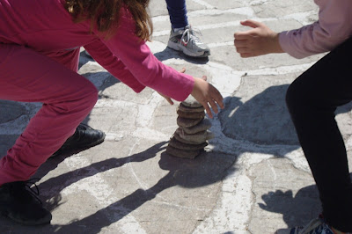
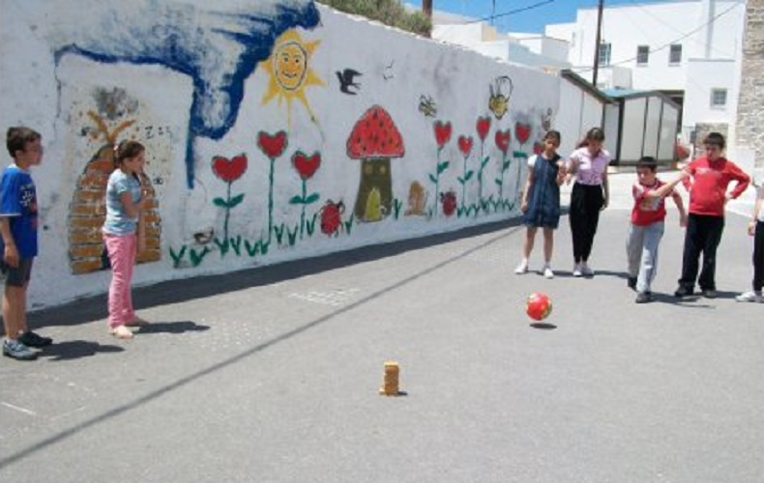

Slide 22
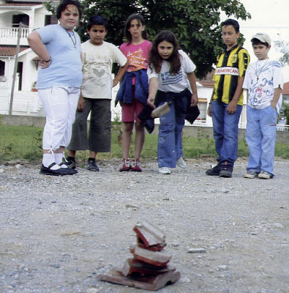
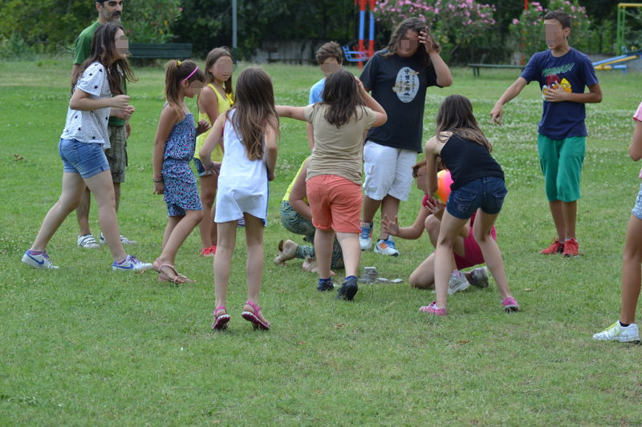

Slide 23
1,2,3 Red Light
1,2,3 Red Light
One child (Mother) stands at the end of the playing field, with the rest of the players at the other end. Mother turns her back to the others and calls out the phrase ‘1,2,3 Red Light’. The players, then, run as fast as they can towards her.
At any time Mother can face the players, and they must freeze in their place. If anyone fails to stop, they are out of the game or they must return to the starting line. The players are allowed to move as long as Mother does not see them.
Mother keeps repeating the same phrase ‘1,2,3 Red Light’ until one player manages to hit her in the back and then everybody starts running away from her. Mother starts chasing them in order to catch one of the kids. If she makes it, this kid is the new Mother.

Slide 24
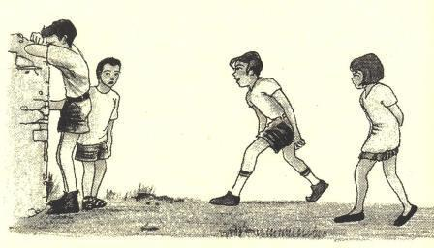

Slide 25
