Slide 1
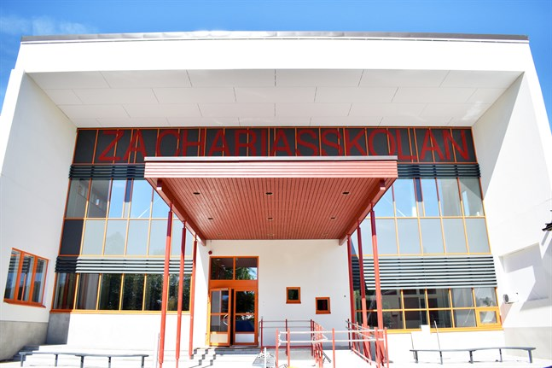
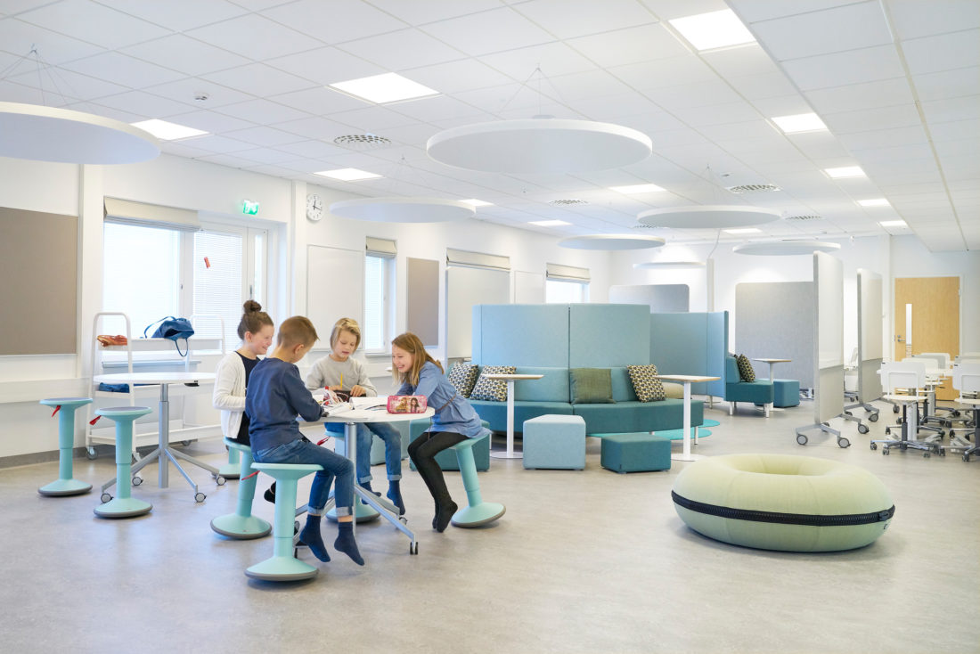
Welcome to Zachariasskolan!
Zachariasskolan is a cohesive comprehensive school from preschool to grade 9. There are about 550 students in the school. Zachariasskolan has both traditional classrooms and an open environment. From fall 2019 we have a lot of new space in the school. The students at Zachariasskolan are well-read and learn important values that are needed. The school year 2019-2020 focuses especially on creating peace and time for learning. https://www.nykarleby.fi/zachariasskolan/home/om-oss/ http://www.main-interiors.fi/portfolio_page/zachariasskolan-nykarleby/

Slide 2
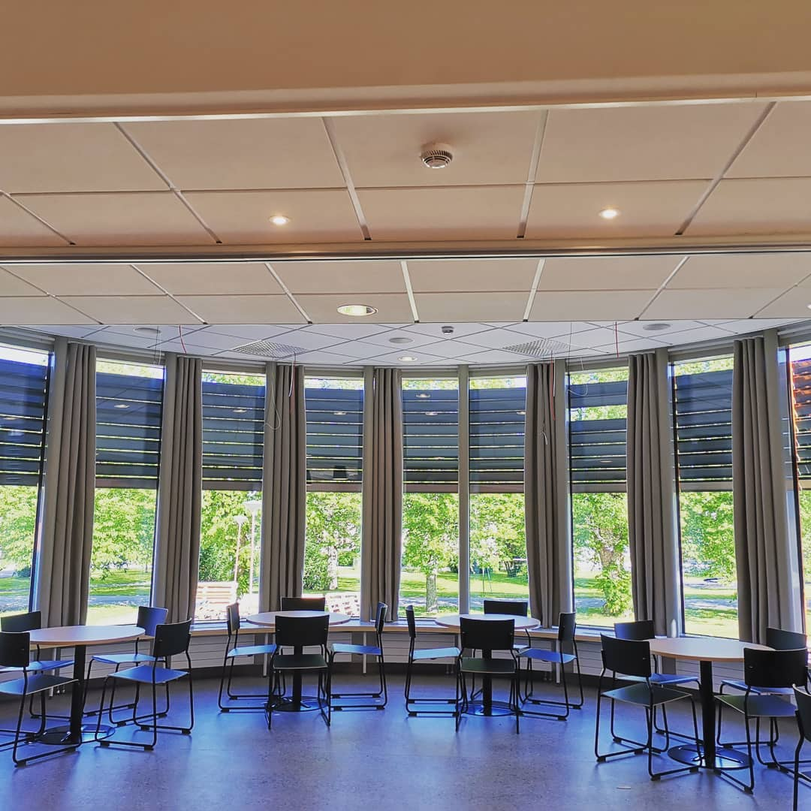
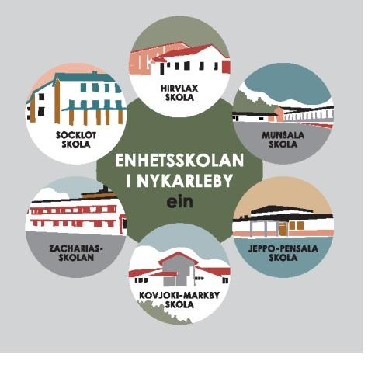
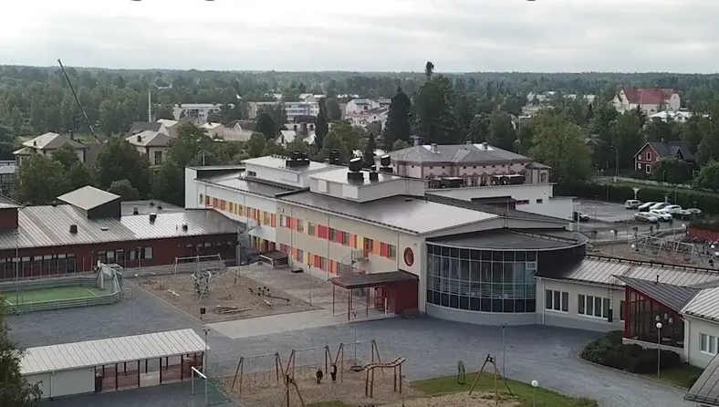
“There is no bad weather, only bad clothing.” In Finnish schools, students have outdoor recess between every lesson up until grade 6. If it is colder than -15 degrees, students can stay inside. In grades 7-9, students can choose if they want to go out or stay indoors. For students in grades 7-9 there is a school library, a students’ hall and sports activities during breaks. In Zachariasskolan, we have P.E. in the gymnasium, outdoors or in the sports center Stjärnhallen (“Star Hall”). We also have access to an indoor ice rink.
School lunches are served in the new school canteen, which was opened in August 2019. Since 1948, every Finnish child has been served a free lunch every school day. School meals are considered part of the education and could be one of the success factors in the Finnish educational system.
In Nykarleby municipality, there are six Swedish-speaking schools for grades 1-6. In grades 7-9, students from all the schools come together in Zachariasskolan in the centre of Nykarleby.

Slide 3
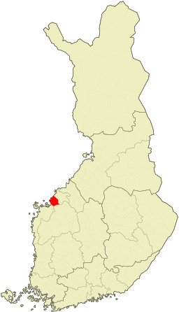
WELCOME TO NYKARLEBY! Nykarleby is a small town in the district of Ostrobothnia in Western Finland. The town is bilingual, with a vast majority of Swedish speakers. The population of the municipality is about 7,500 inhabitants. In 1995, the town was ranked “the happiest town in Finland”.

