Slide 1
Hungarian meeting
19-23 May, 2019

Slide 2
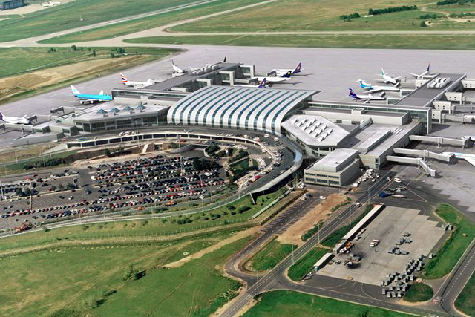
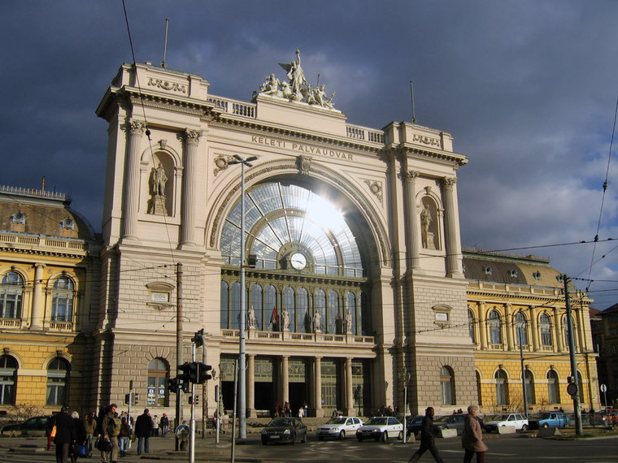
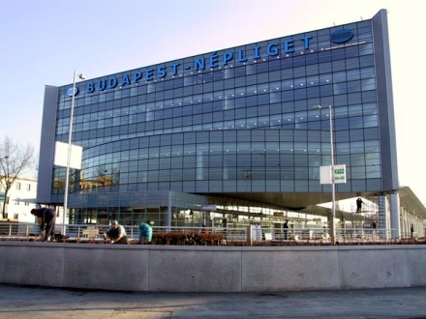
Arrivals on 18/ 19 May (Saturday/ Sunday)
By plane: Liszt Ferenc International airport, Terminal 2
By train: Eastern Railway station
By bus: Népliget international coach station

Slide 3
How to get to the city centre?
By taxi: use licensed taxis, please, avoid the taxi hyenas
From the airport use Főtaxi (there is a stand for them) 20-24 euros to the centre
By public transport: 6 euros for a daily ticket (if you like challenges)

Slide 4
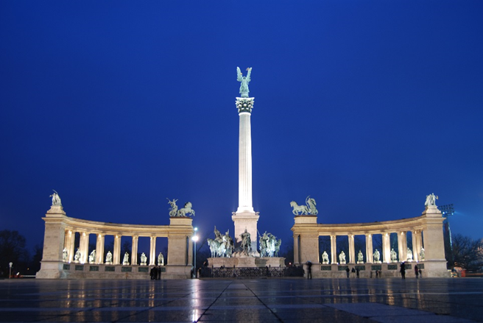
Saturday night in Budapest( if you want) Ibis Hotel Heroes’ Square Booking individually, around 40 euros/ double room

Slide 5
19 May (Sunday) The official arrival day
Sightseeing by the hired bus
Collecting the partners
Travelling to Tiszafüred by bus

Slide 6
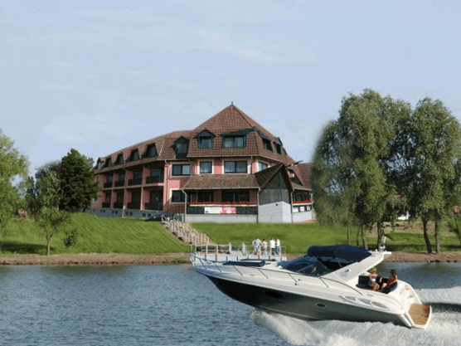
Our hotel in Tiszafüred: Hotel Hableány
Arriving in Tiszafüred in the evening
Dinner together

Slide 7
The prices of the hotel (at the moment 1 euro is 310 forints):
Single room: 13,450 ft (43 euros for the room/ night)
Double room: 22,900 ft (74 euros for the room/ night)
Triple for kids: 28,000 ft (90 euros for the room/ night)
Quad: 34,000 ft( 110 euros for the room/ night)
The apartment for 5 members of the Turkish team: 38,000 ft (123 euros for the whole apartment/ night)

Slide 8
20 May: (Monday) school visit in the morning
Getting to know about the Hungarian education system, performances, watching your presentations to our pupils about your schools, regions and countries
Lunch
Visiting the ecocentre in the afternoon (informative day)

Slide 9
Visiting the Ecocentre in the afternoon

Slide 10
21 May, (Tuesday)
-Dealing with informative texts (reading comprehension in groups)
Meeting of coordinators/ sport activities for the pupils
MotorBoating on lake Tisza, canoeing and treasure hunt or something like that
Playing together (the war of numbers)
Dinner

Slide 11
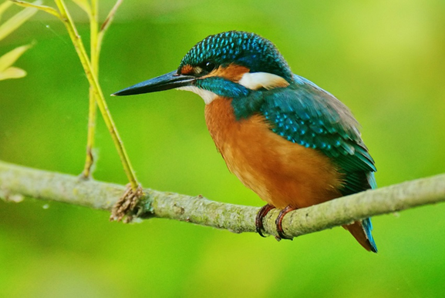
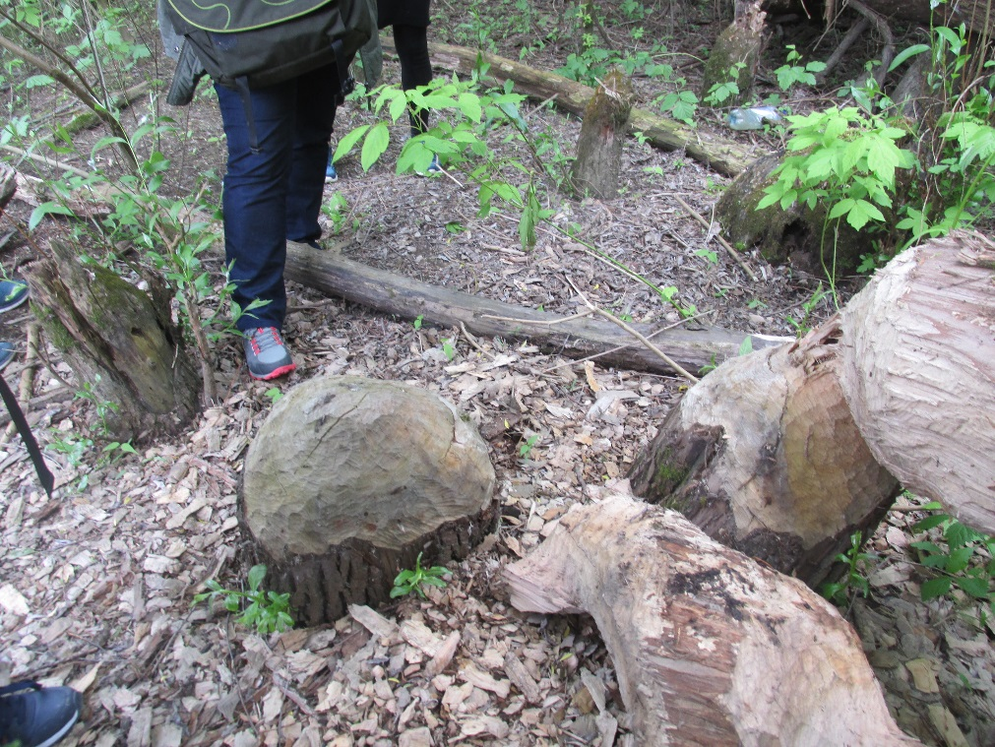
Going canoeing/ boating on our lake: learning about our flora and fauna

Slide 12
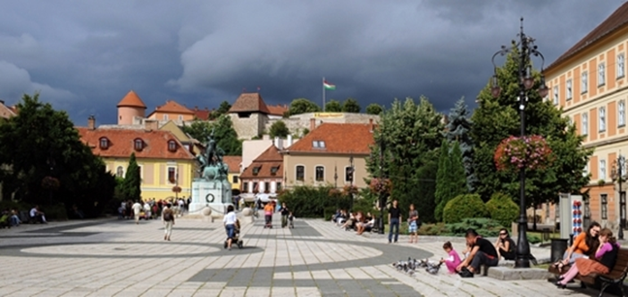
22 May, (Wednesday)
Going to Eger, a lovely town from the Turkish times: Basilica, fortress, shopping for souvenirs
FREE TIME!!!

Slide 13
Visiting Salt hill spa (swimsuit is needed) Informative texts about thermal springs of Hungary

Slide 14
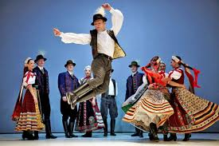
Karaoke, dances of the different nations together in the evening

Slide 15
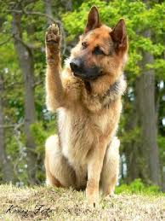
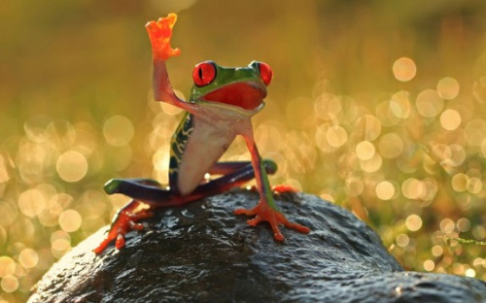
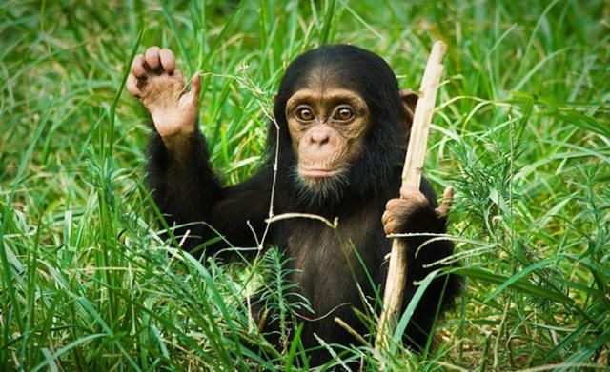
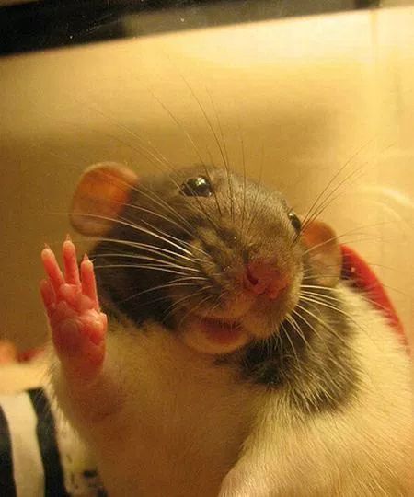
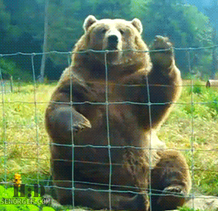
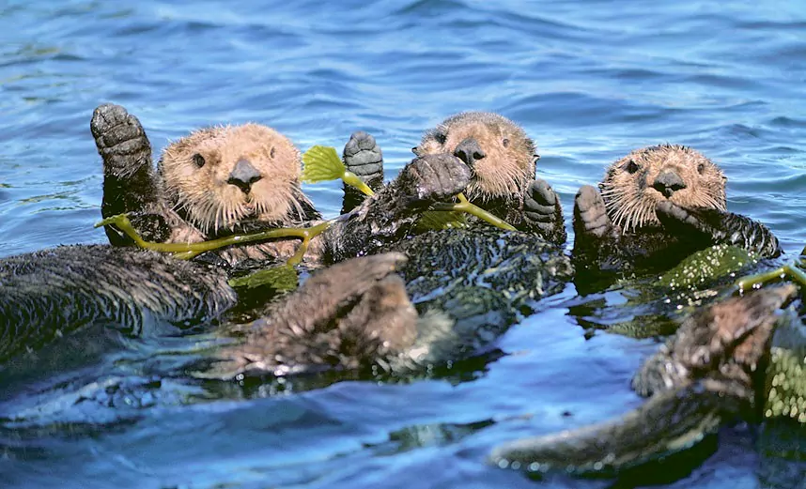
23 May, departure day
Departure: a hired bus, if possible

Slide 16
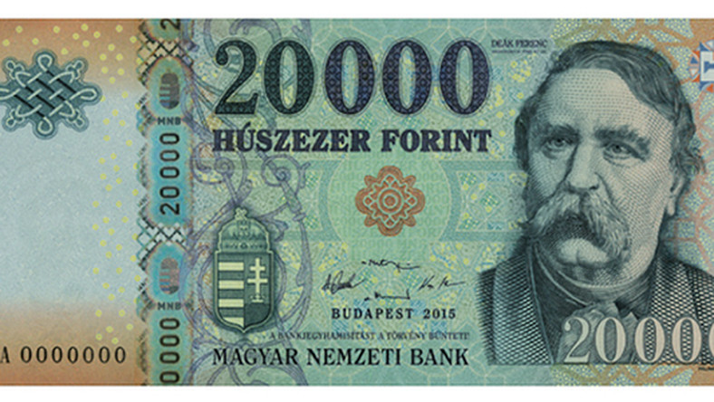
The Hungarian currency is Forint
1 euro is approximately 310 Ft

Slide 17
Budget details/ person
Taxi from the airport: around 24 euros/ taxi
Hotel: 43/ 37/ 30/ 28 euros depending on the room type
Transfer from Budapest and back: around 30 euros (depending on the number of people travelling together
Transportation in the neighbourhood: around 15 euros
Meals:around 35 euros
Programmes: around 21 euros for adults, around 15 euros for pupils

