Slide 1
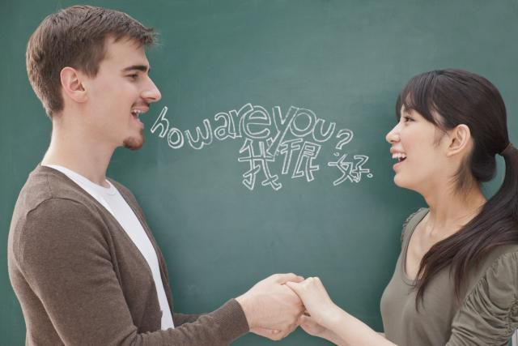
Conversation strategies
1º TASOCT

Slide 2
INDEX
Rejoinders Page 3.
Video Involving
someone in a conversation Page 4.
Ford Page 5.
Ask for Clarification Page 6.
Keeping the conversation
going Page 7.
Body language Page 8.

Slide 3
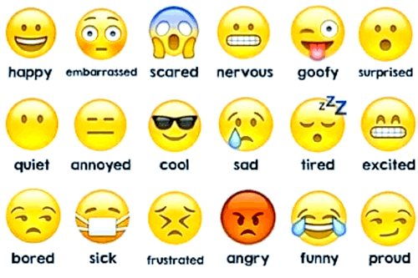
Rejoinders
A reply, especially a sharp or witty one.
"she would have made some cutting rejoinder but none came to mind”
Is a reply, especially a quick, witty, or critical one, to a question or remark.
Basic, agree/disagree, cognates and emotions
Inquire – Ask a sincere question
Follow-up – Ask a follow-up question
Relate – Share something about you to break up your questions and keep the
EXAMPLES:
You (follow-up): So living here in LA must be way too warm for you?
Your friend (follow-up) : Yeah, I use the AC a lot!
You (relate): I like it when it’s hot but only on holidays. On workdays, I like it
cool so I can think better.
You (inquire): What’s your ideal kind of weather?
Your friend (inquire): Hmm, I think around 65 so I don’t sweat.

Slide 4
Video Involving someone in a conversation
Rejoinders in this video:
-Oh really?
-Hmmm yeah
-Are you joking?
-I’m feeling under the weather
-Oh sorry to hear that!
-What a pitty
-Things couldn’t go worse
-Oh, thank God!
-Cool!
Video:

Slide 5
Video Involving someone in a conversation PT. 2
Rejoinders in this video:
-Seriously?
-No way!
-What?
-Are you kidding?
-Awww!
-For real?
Video: (Carlota y Clara)

Slide 6
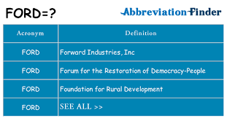
Ford
Use the rule
Talk about Family, Occupation, Recreation, and Dreams. These are safe topics that work in most situations.
To me, family, occupation, and recreation are topics for small talk. The really interesting conversations are about passions, interests, and dreams. But you need to make small talk before people are comfortable enough to dive deeper into more fascinating topics.
Article continues below.
Take this quiz and see how you can improve your social life.

Slide 7
Ask for Clarification
Can Formal
Could More Formal
Would More formal than Can and Could
Example
Can= Can you say that again?
I mean…
Could= Could you repeat that again?
My point is…
Would= Would you mind repeating that again?
In other words…
Informal example:
What do you mean by that?
What did you say?
One more time?
I am sorry, what was that?
Answers:
I didn't get it
Now I understand
Ah, I see. Thanks for clarifying

Slide 8
Keeping the conversation going
For example, we have:
Is this your first trip to Spain?
What do you do for live?
How much do you earn?
Would you like to live in another place? Where?
What place would you like to visit?
What do you want to study when you grow up?
What do you do on your free time?
Do you practice any sport?
Do you want to start a family in the future?
Examples to start the conversations:
Where are you from?
How many brothers and sisters have you got?
Where do you live?
What is your favorite song?
Have you got any pets?
What is your favorite drink?
How are you?
How old are you?

Slide 10
1º TASOCT
Jose Alemán Guerra
Michael Arencibia Romero
Enrique Arroyo Mateos
Carla Batista Martín
Iris Benítez Silva
Esther Castillo Santana
Nayara González Ramírez
María Henríquez Santana
Mirian Hernández Alonso
Tania Hernández García
Clara Morales González
Javier Ojeda Espino
Sara Rodríguez Hernández
Neizan Rodríguez Santana
Carlota Ruano Ponce
Salem Santana
Nira Tapia Hernández
Elisa Viera Ramírez

