Slide 1
How did Covid 19 impact my life?
Leonora Vereš

Slide 2
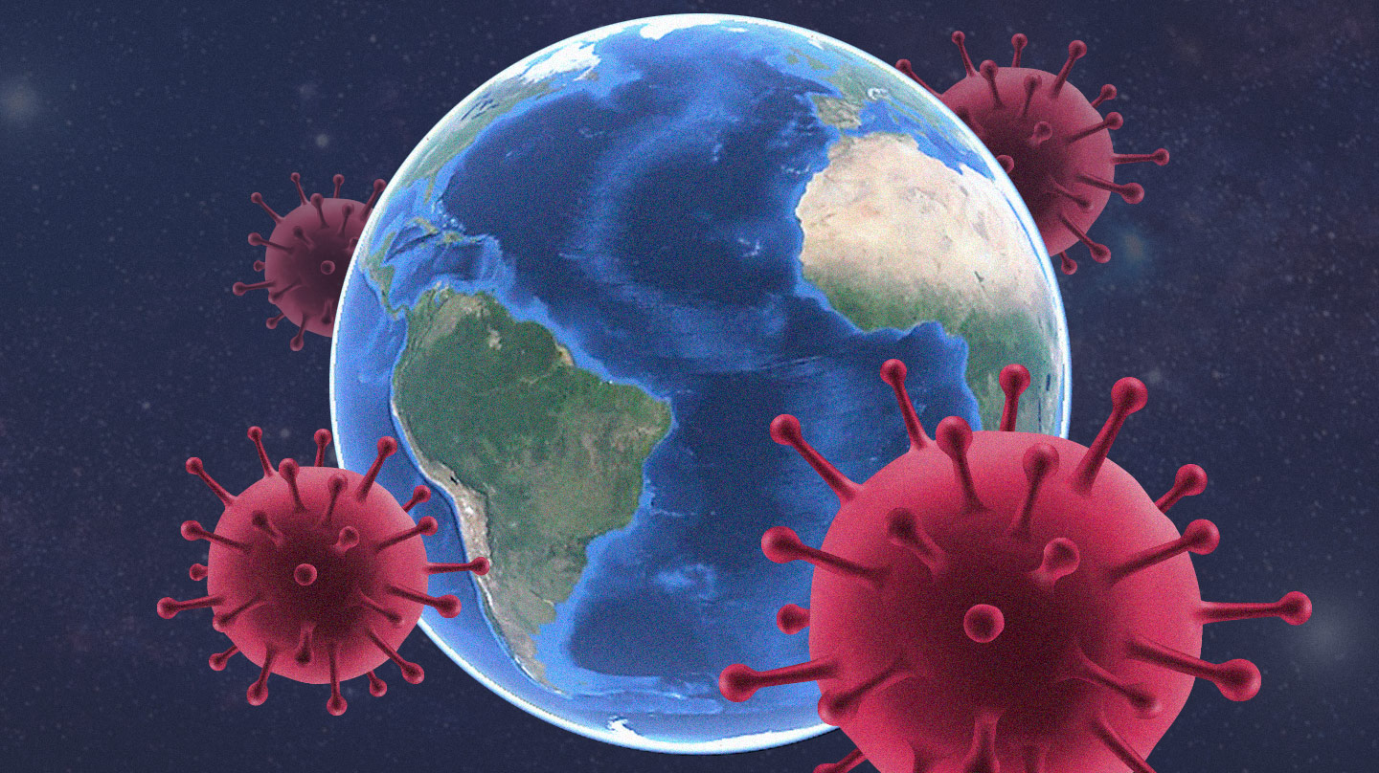
When coronavirus first appeared in the world I wasn't afraid because it was far away from my country but when it appeared in my country I was really worried

Slide 3
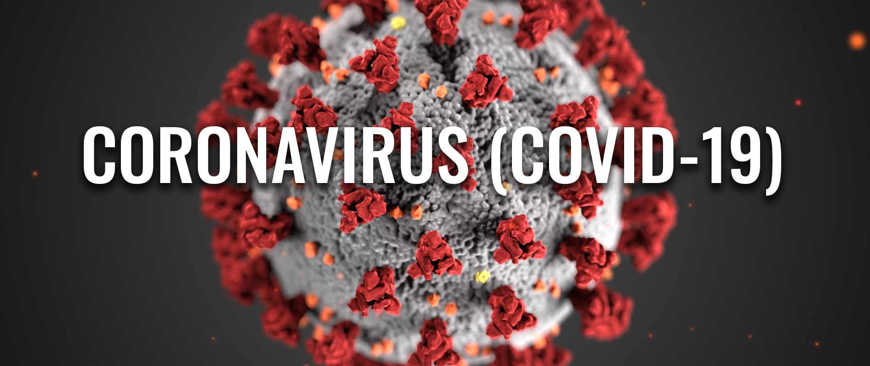
As time flew, the number of infected people increased quickly and we had to be quarantined

Slide 4
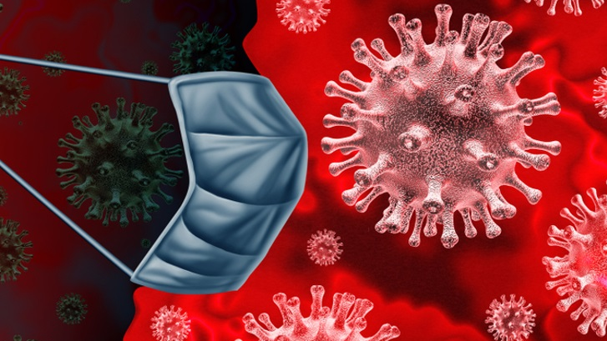
We started online schooling and everything changed
All the cafes and malls closed due to the coronavirus and we had nowhere to go and to nowhere to hang out

Slide 5
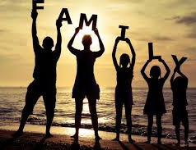
I was sad because I couldn’t hang out with friends but that’s why I spent a lot of quality time with my family

Slide 6
This situation is very difficult for all of us, but if we adhere to the measures, it will be better
I hope that all this will soon disappear and that we will return to normal life

