Slide 1
«The future begins today» Interpersonal relations - workshops in Croatia Leonora Vereš,Vanessa Babić,Tea Antunović,Ivano Rohtek
Project Erasmus+ 2018-1-PL01-KA229-050749

Slide 2
1st workshop: Show me how you feel today!
Grade: 5th (10 and 11 year-old pupils)
We started off with a simple workshop
We had to show different emotions and the others reacted to them
Some of the emotions we showed were: sadness, happiness, worry, anger, fear, playfulness
While doing this the we felt joy and happiness
We learned how do deal with different emotions and help our friends deal with emotions

Slide 3
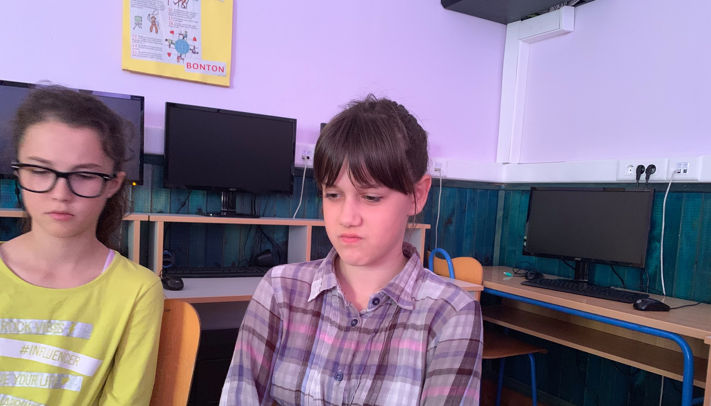
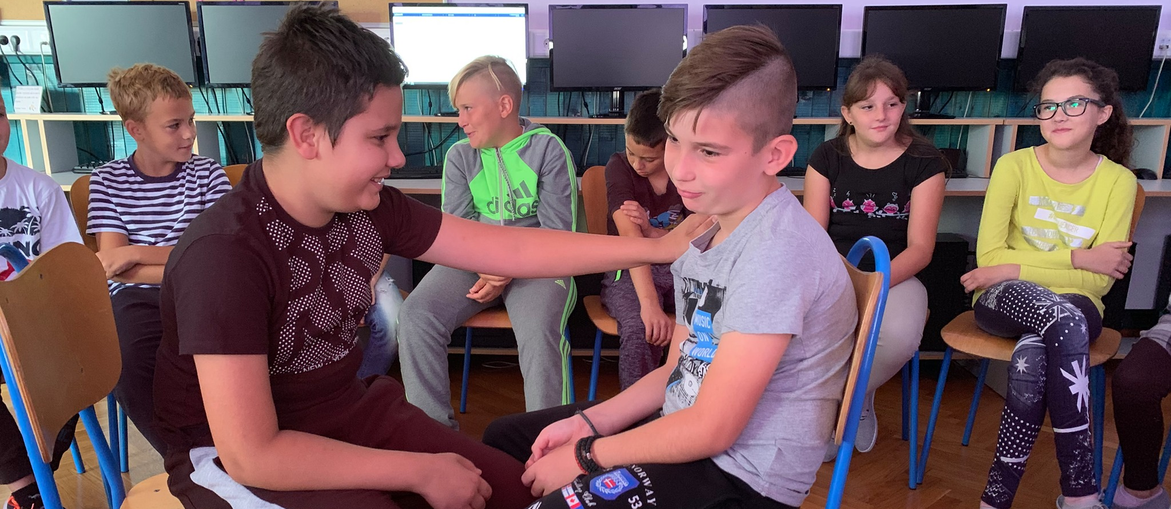
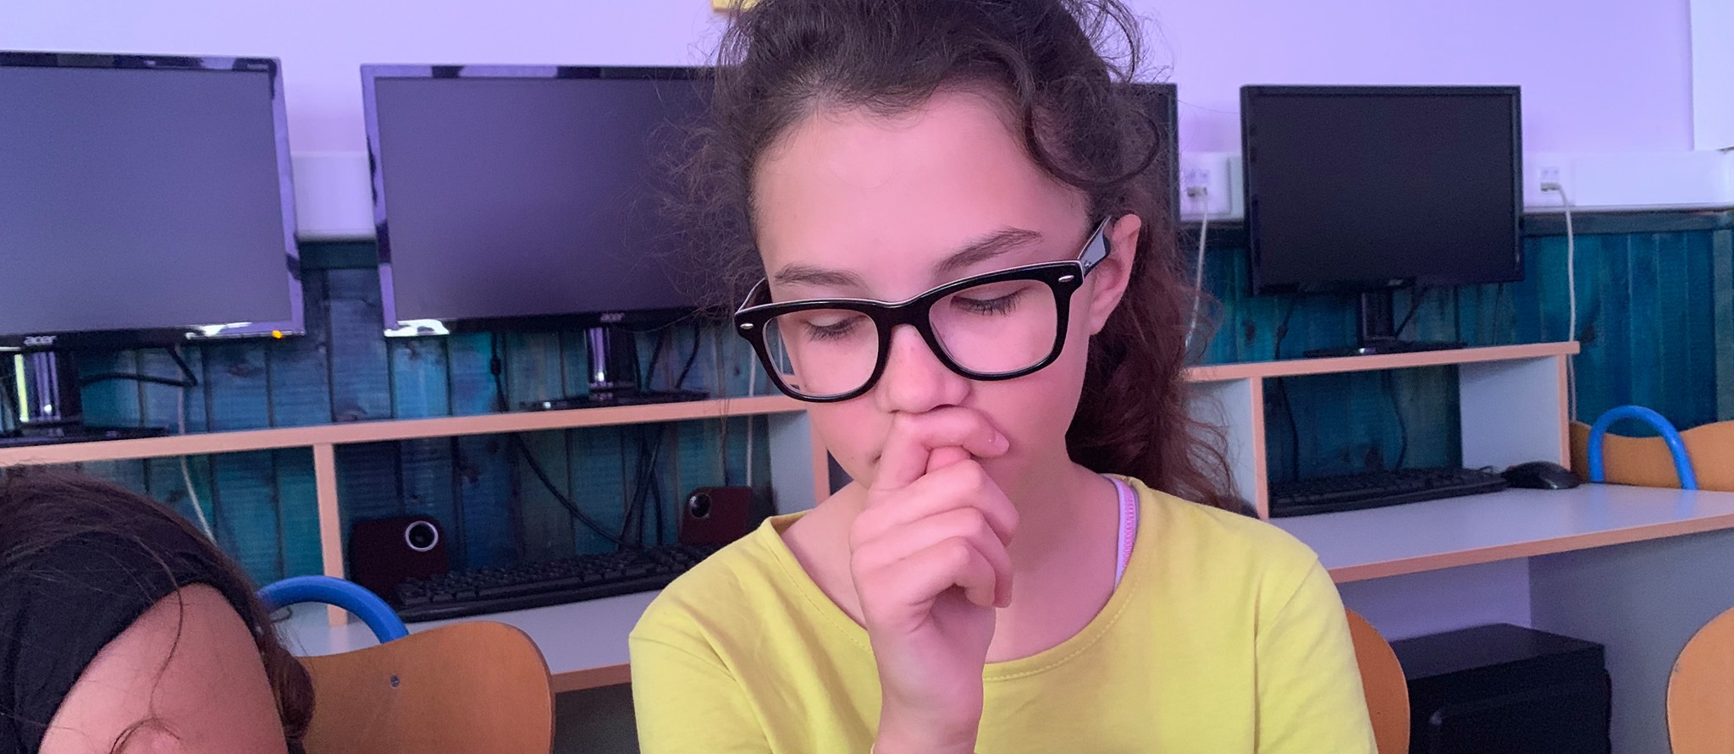
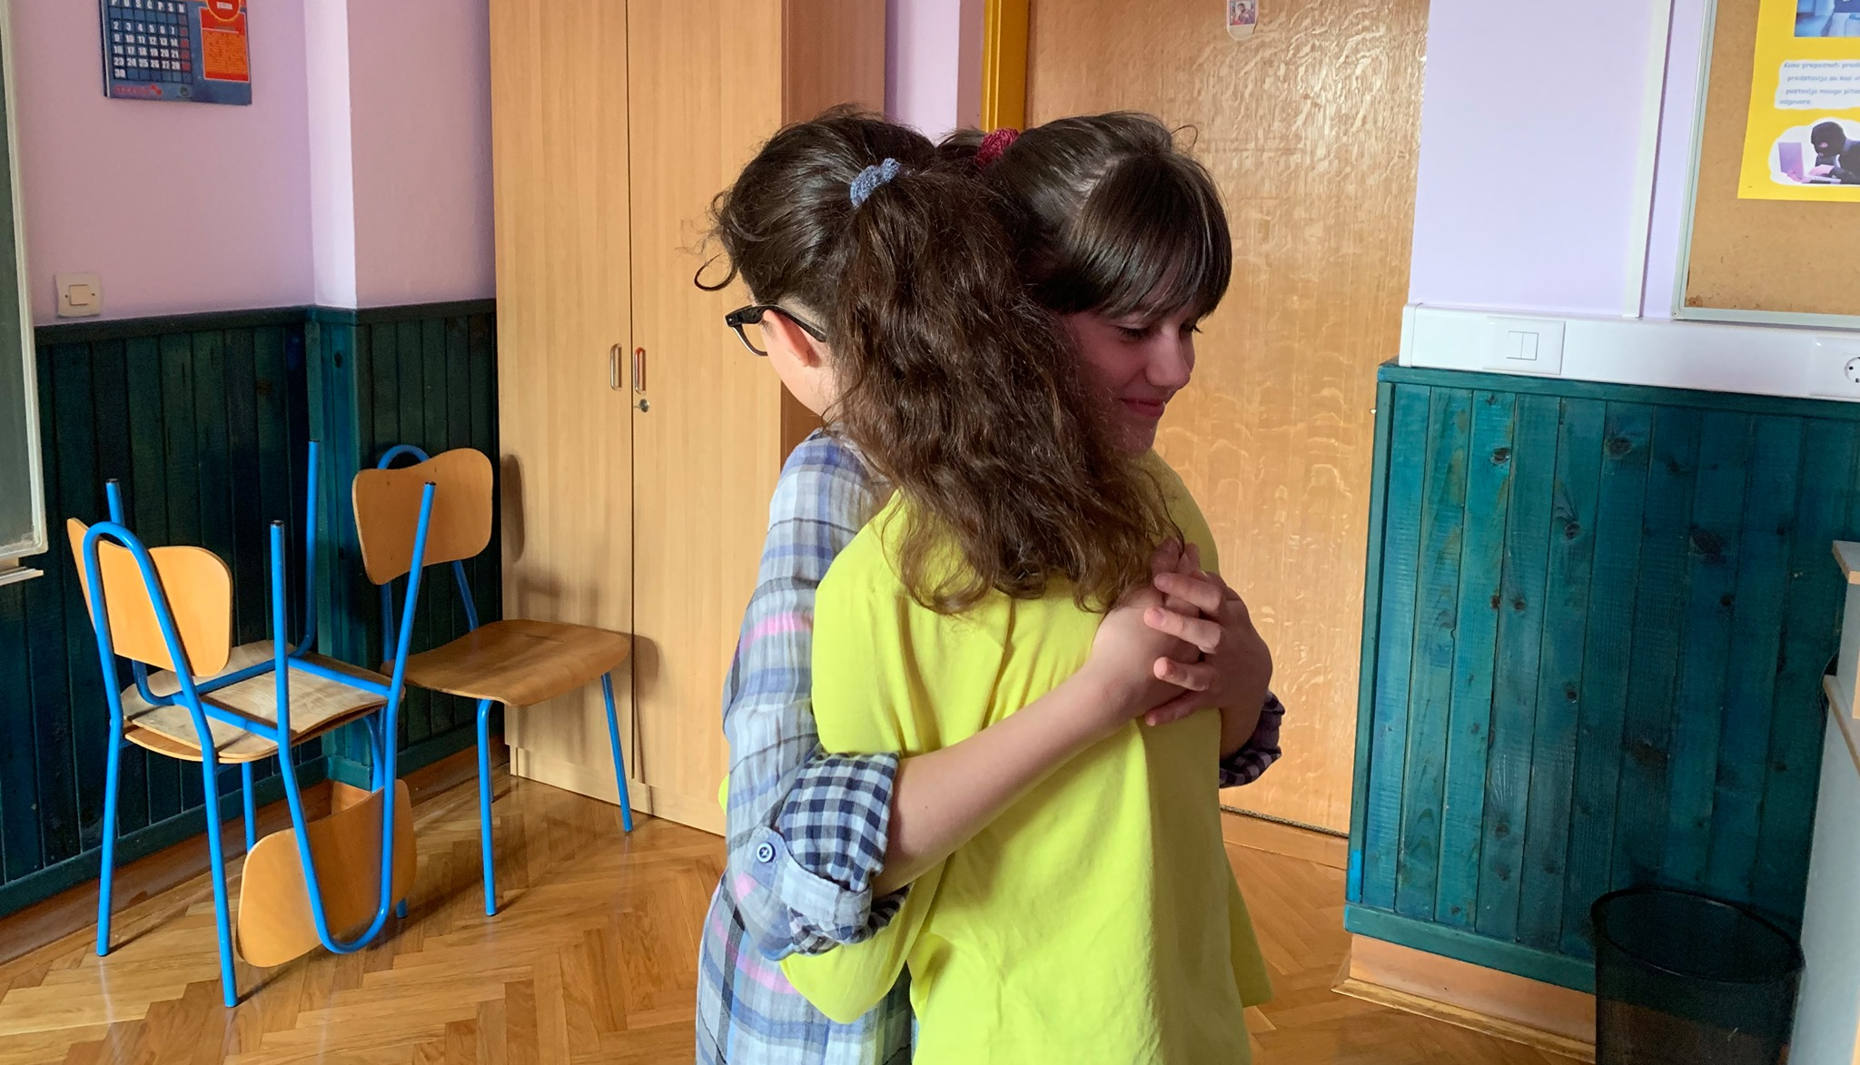

Slide 4
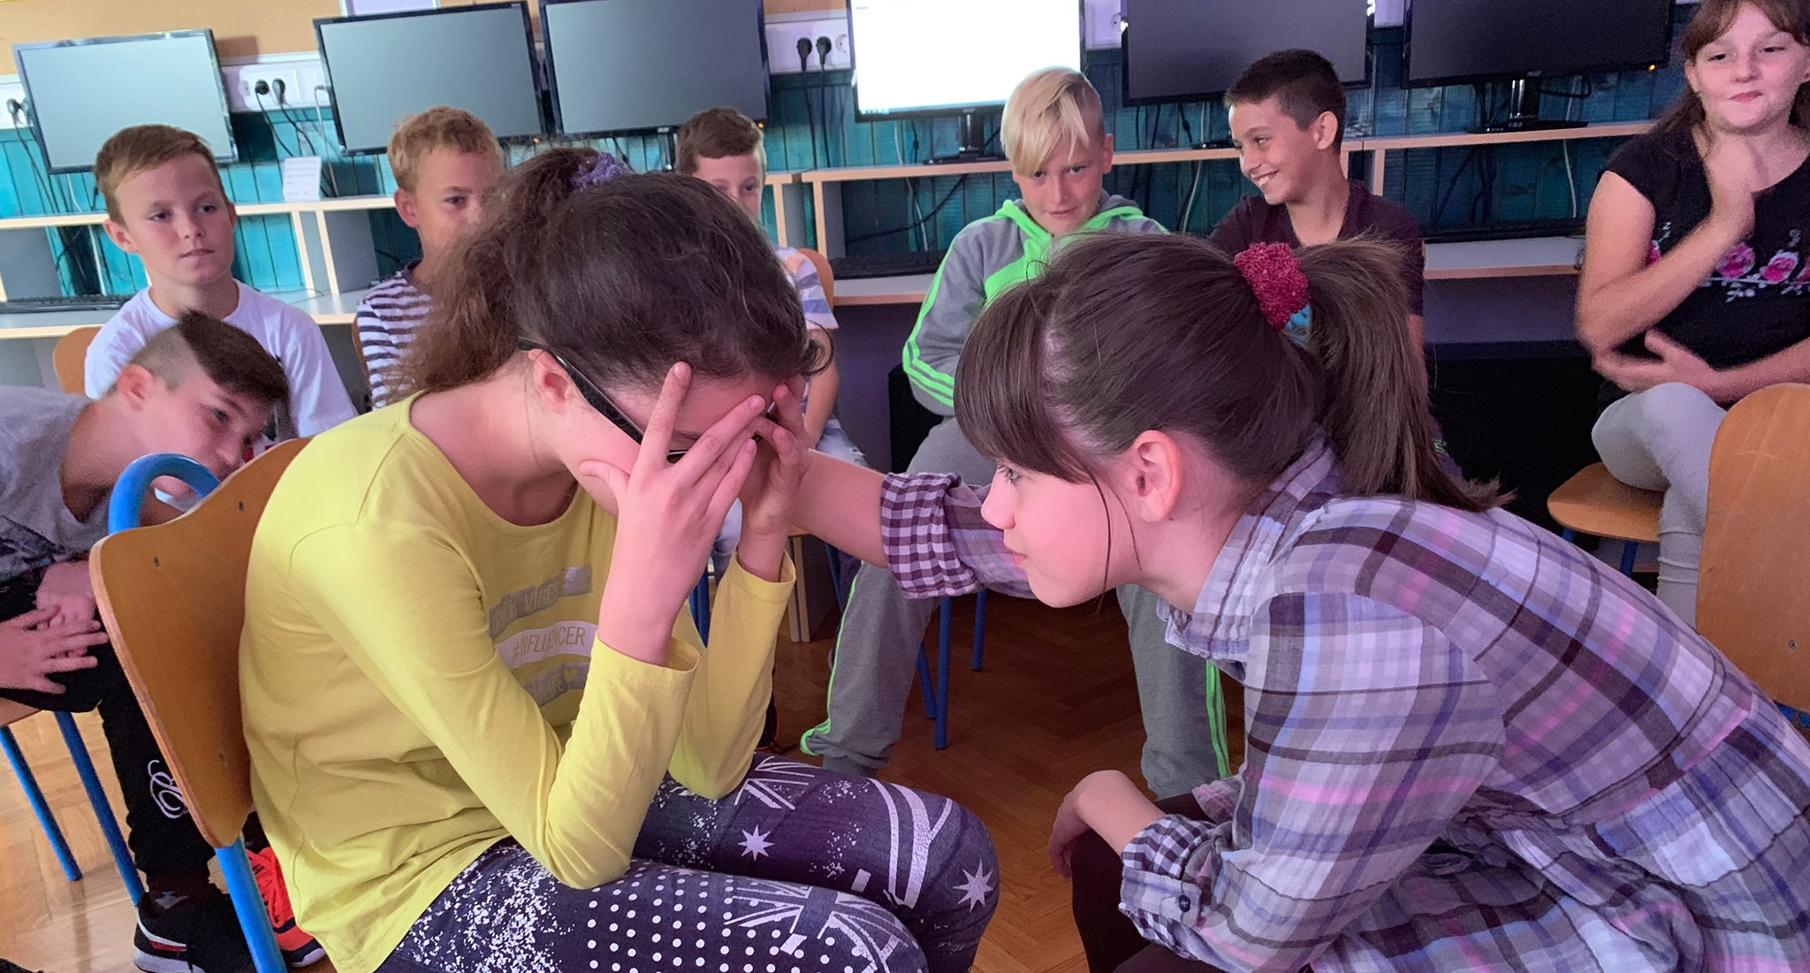
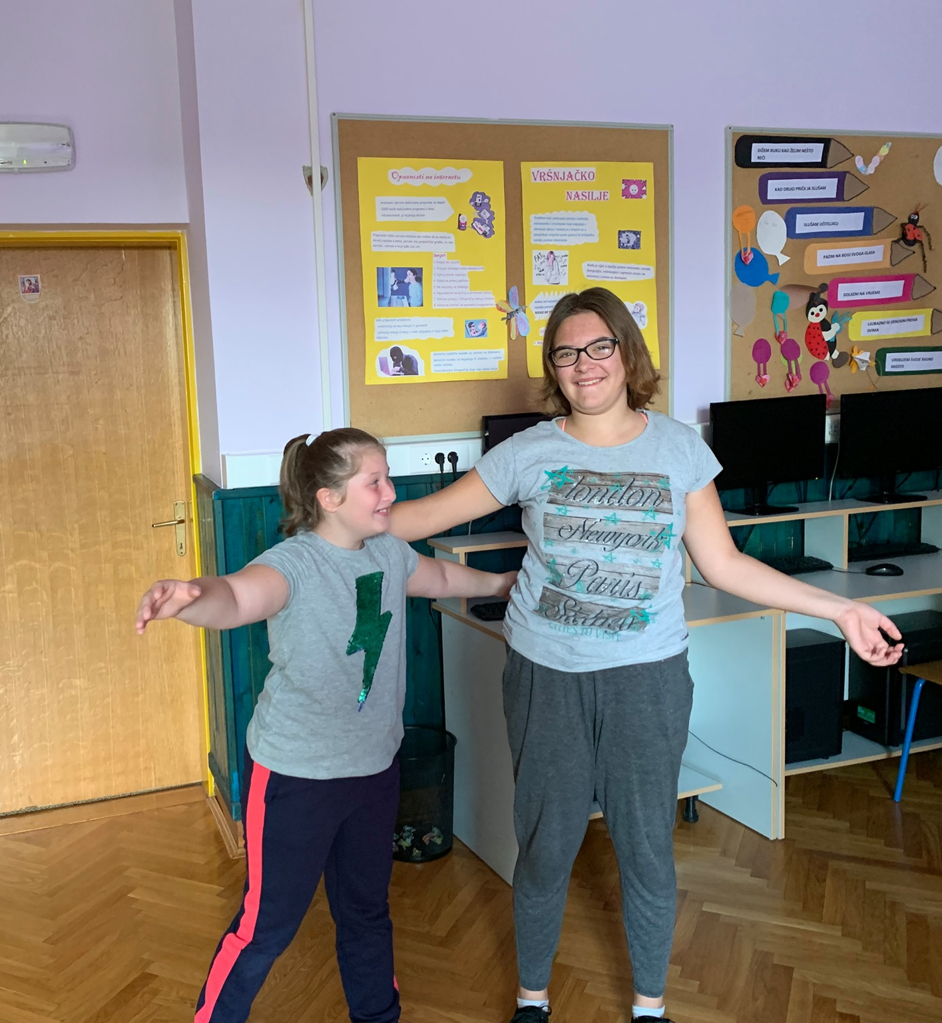

Slide 5
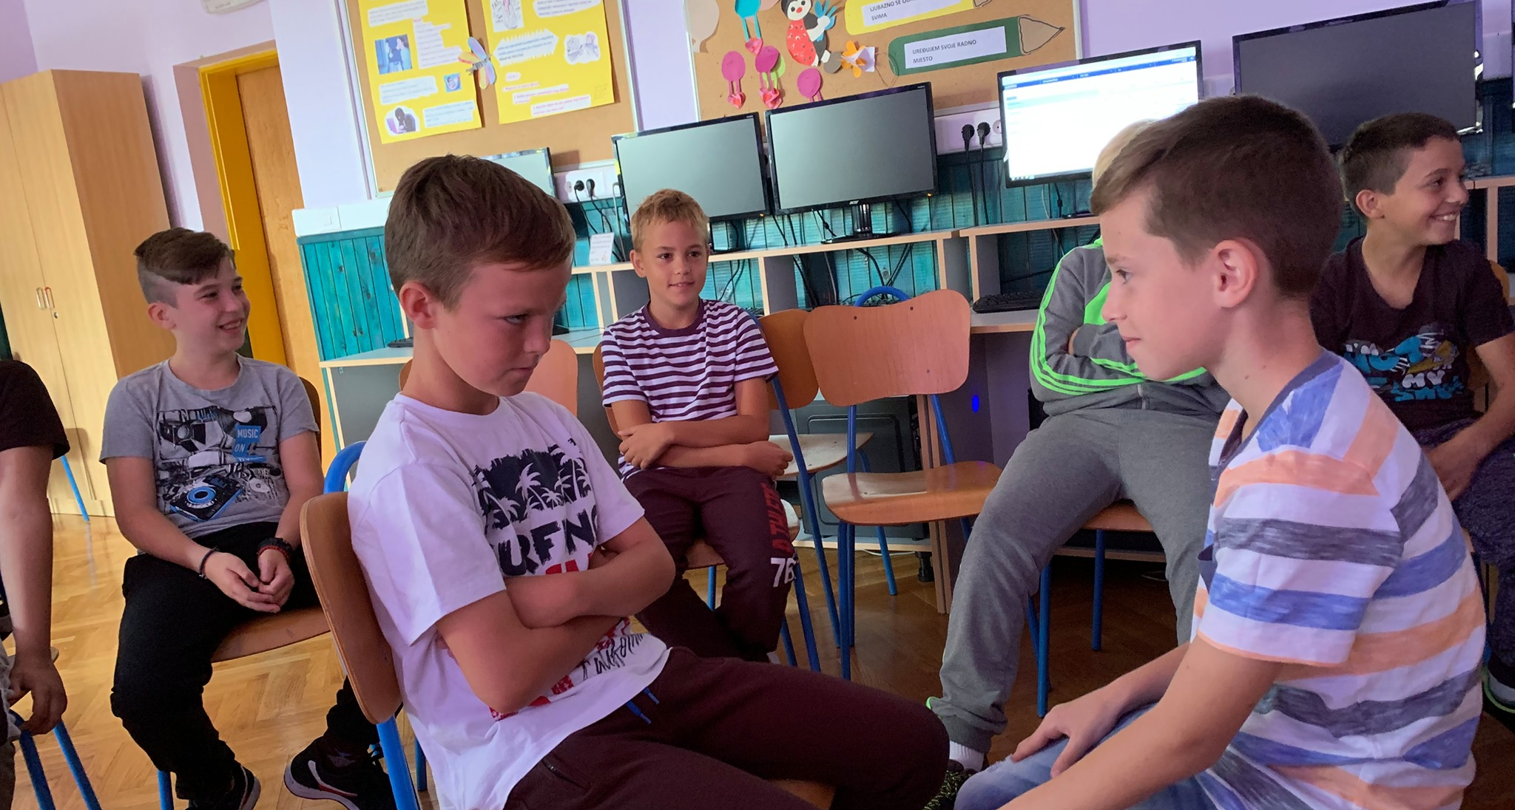
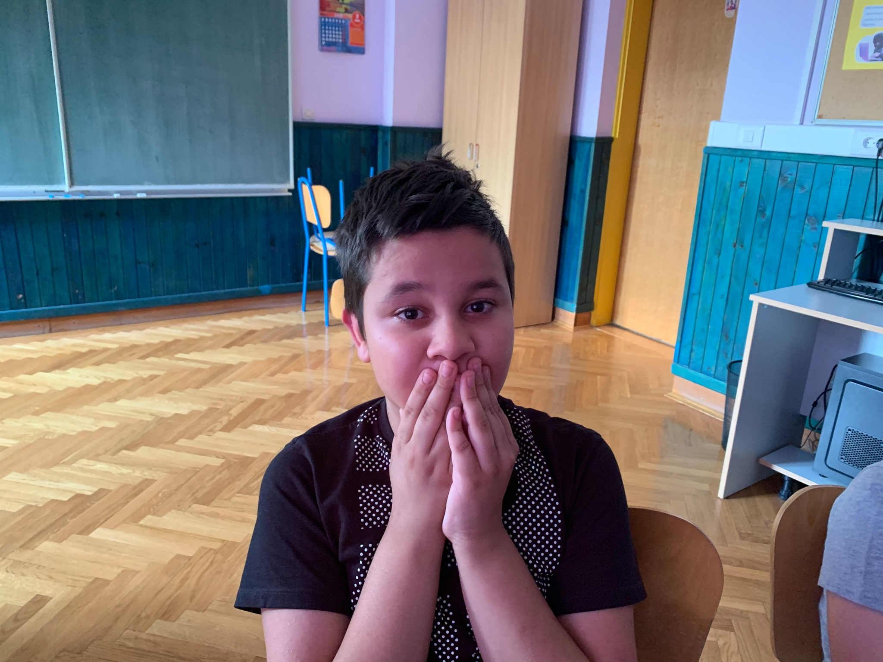
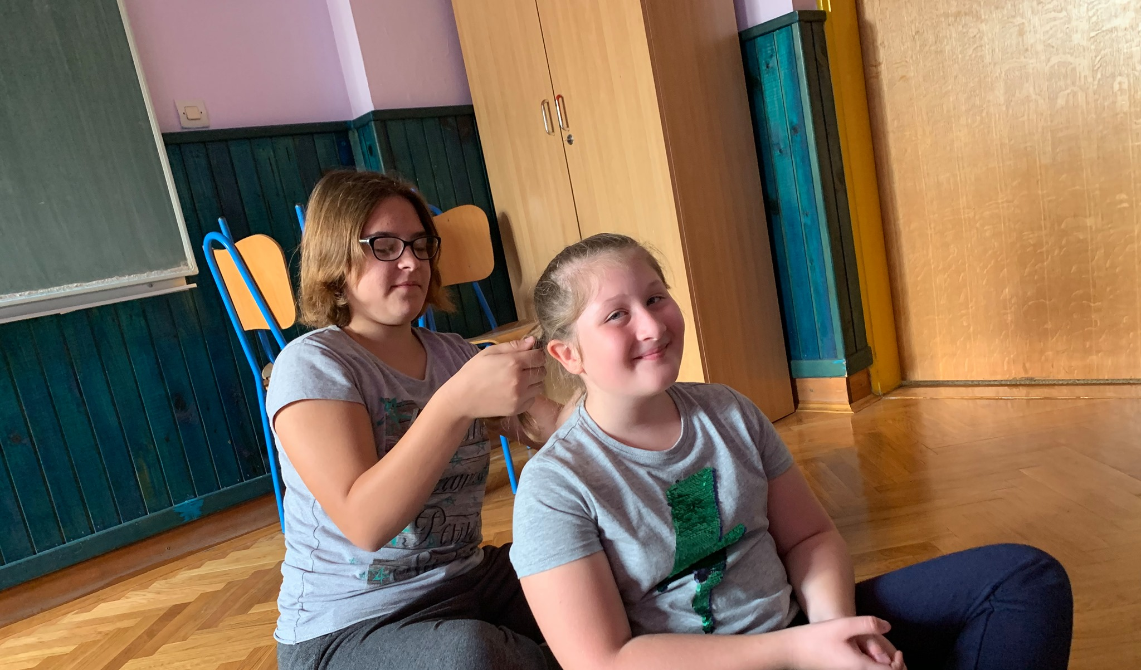
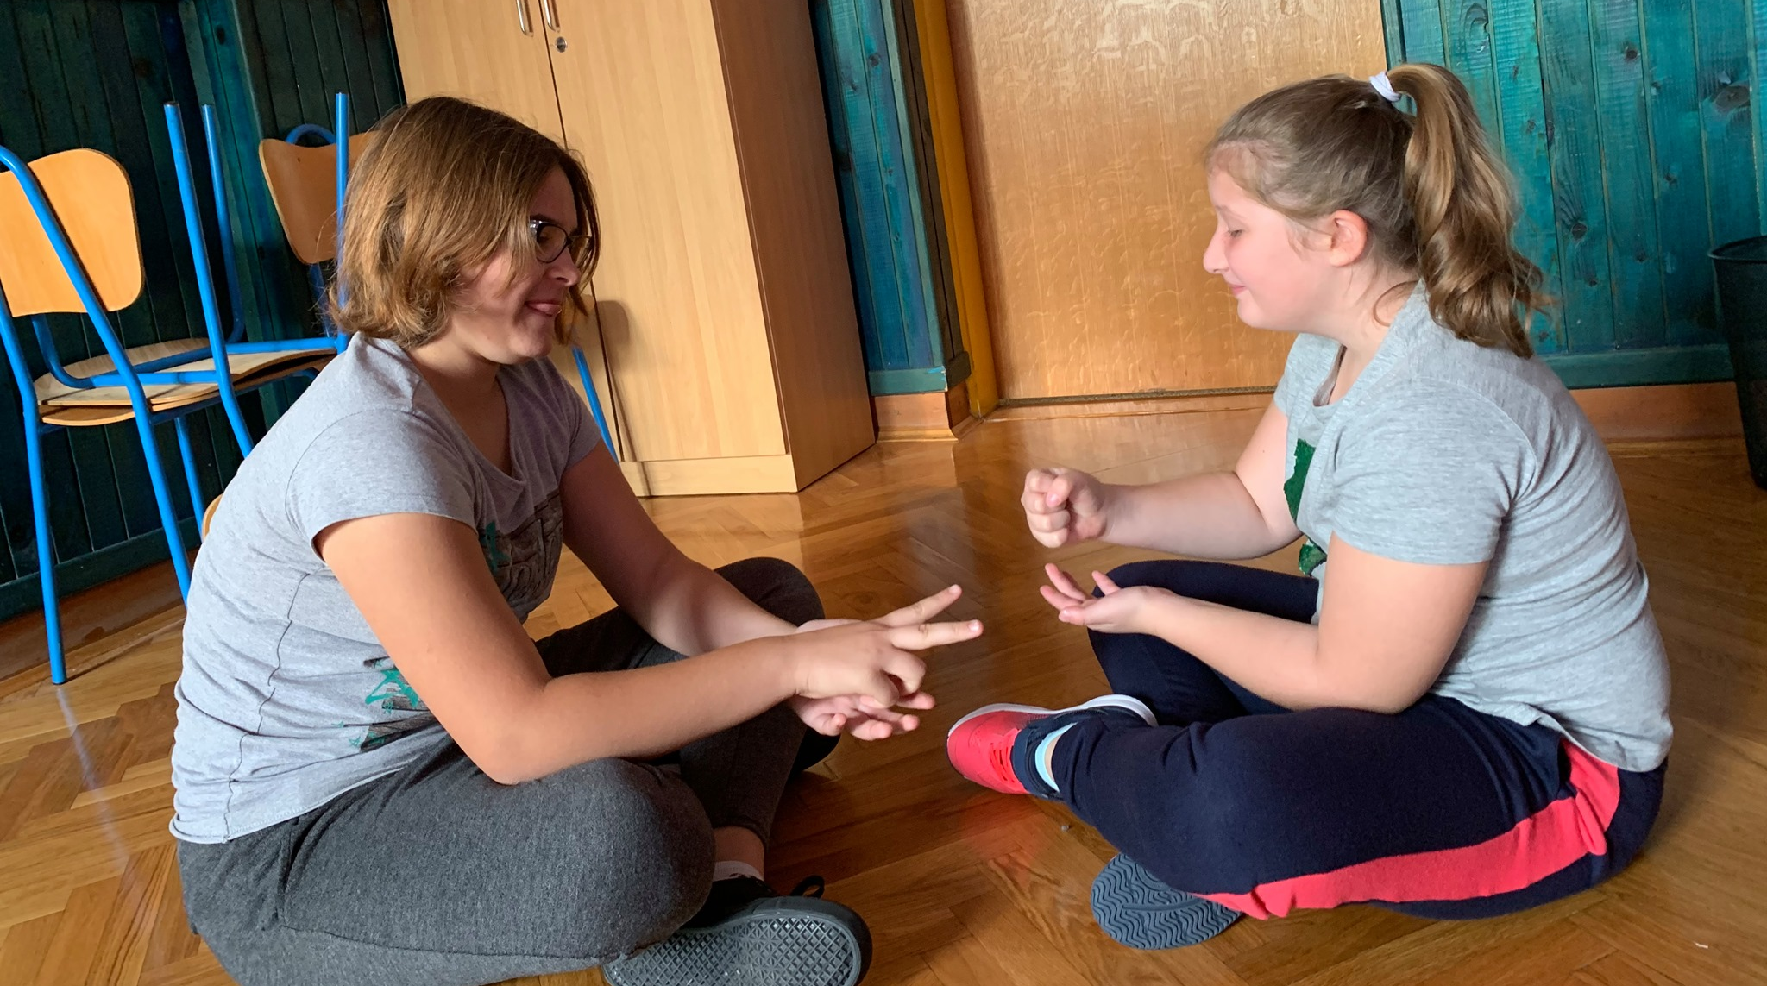

Slide 6
2nd workshop on interpersonal relations in Croatia Title: Friendship grade: 6th (11 and 12 year-old pupils) we had to: - define friendship - name, recognize and define human characteristics - recognize feelings connected with friendship - realize the importance of friendship in everyday relations - define desirable traits of friends - identify a way to choose a friend

Slide 7
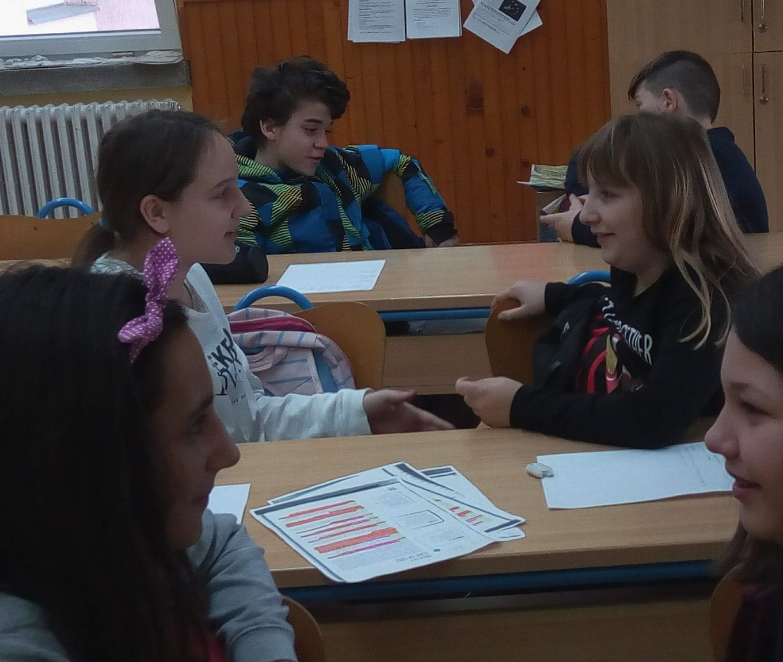
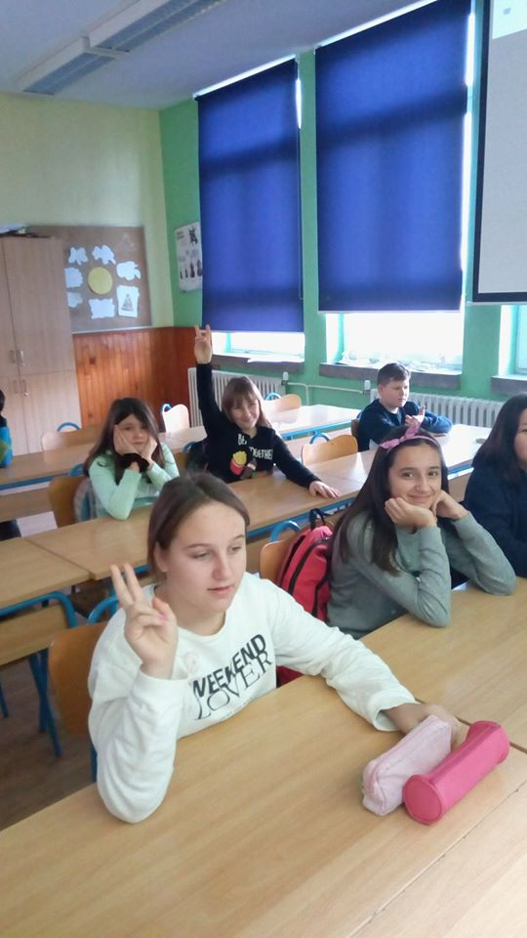

Slide 8
How did you feel during the workshop? What did you learn? „ I liked it, I found out more about my classmates.” „I liked the oportunity to find out what others think of me” „I liked the fact that we were honest to each other” „ It was useful because I found out how to approach people” „ I didn’t like speaking about myself”

Slide 9
3rd workshop on interpersonal relations in Croatia Title: Who am I? Grade: 7th (12 and 13 year-old pupils) Some of the questions that we had to answer were: -Who am I? -What do I think about myself? - What do others think about me? - How does my opinion differ from the other’s? - What can I do to change?

Slide 10
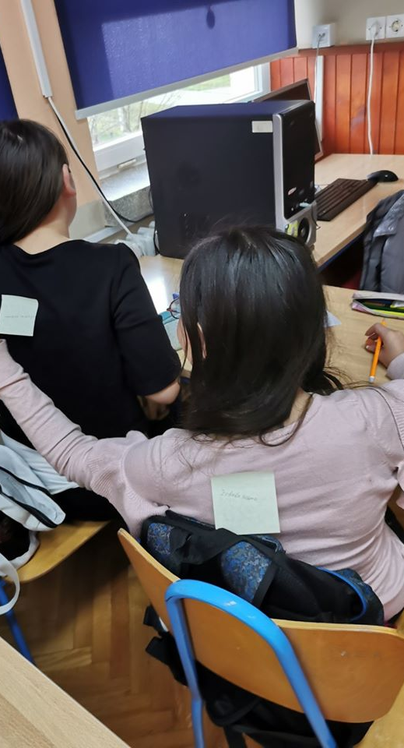
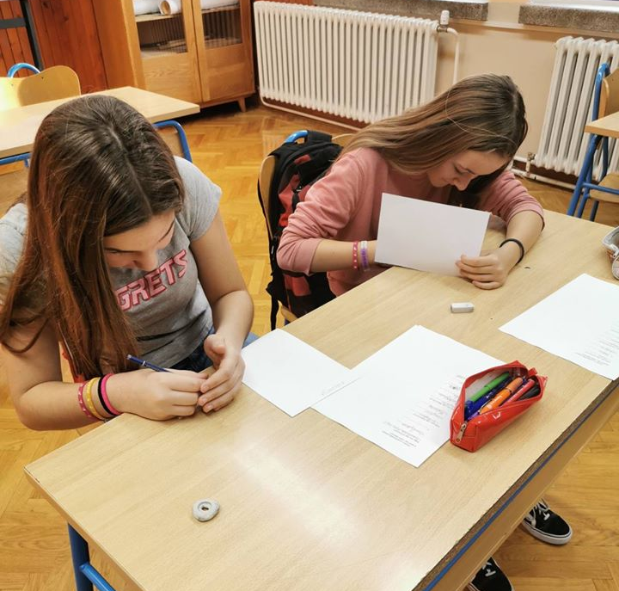
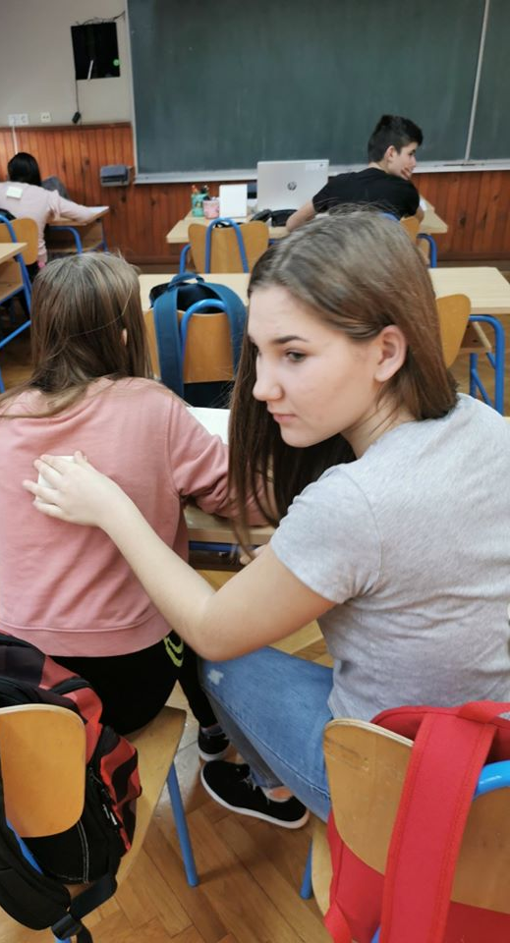

Slide 11
How did you feel during the workshop? What did you learn? „ I liked it, I had fun while doing it. ” „I learned many things about myself” „I would like to do it again” „ My favoutite part was when we had to write our friend’s feature on a piece of paper and paste it to his back ”

Slide 12
4th workshop on interpersonal relations in Croatia Title: Interpersonal relations/resolving conflicts grade: 8th (13 and 14 year-old pupils) The outcomes of this workshop are: - to identify and describe basic emotions - to understand and distinguish between useful and harmful emotions on the context of interpersonal relations - to be able to identify and use skills that contribute to interpersonal relations

Slide 13
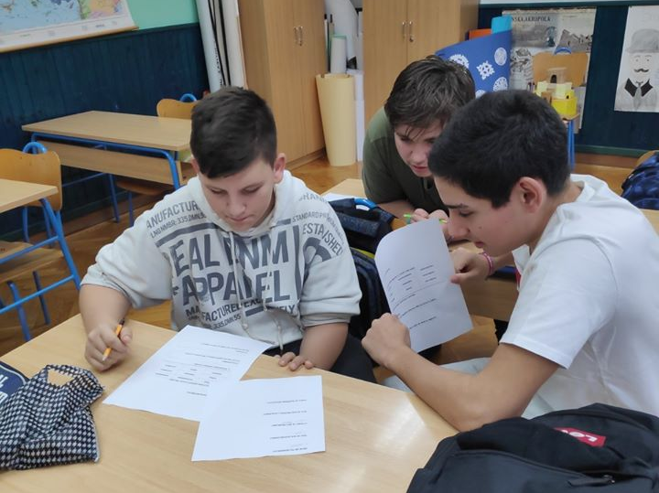
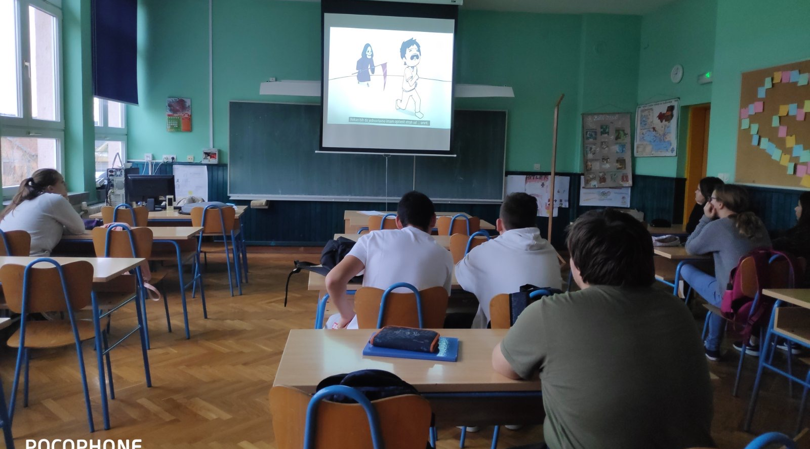
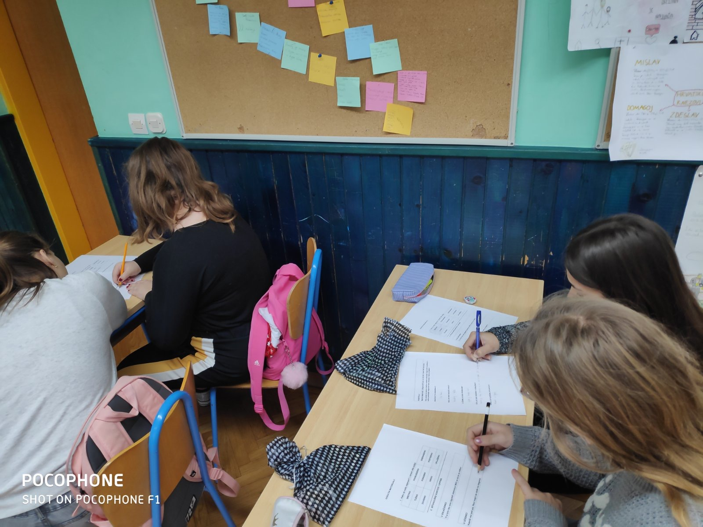

Slide 14
How did you feel during the workshop? What did you learn? „ This workshop helped me with resolving some problems. I found out how to cope with problems” „I learned to control my feelings which I was not able to before” „ We don’t need to get nervous about irrelevant things ” „ A very useful workshop!! I learned how to resolve a problematic situation. It's not worth ruining a friendship for stupid things.” „ It was very interesting and fun. My favourite part was when we talked about feelings. We don’t need to be afraid of anything, we just need to lear how to cope with it.” „I learned how to recognise other people’s feelings and that anger is not always necessary. We should do our best to resolve problems”

Slide 15
5th workshop on interpersonal relations in Croatia Title: Tolerance grade: 6th and 7th (11 and 12 year-old pupils) Aim: to help us recognize and respect others' needs without prejudice and learn to express our opinions clearly and reasonably. We had to: - write one positive characteristic of the person sitting next to us - think of and name the characteristics we would like our friend, neighbour, classmate, boyfriend/girlfriend to have

Slide 16
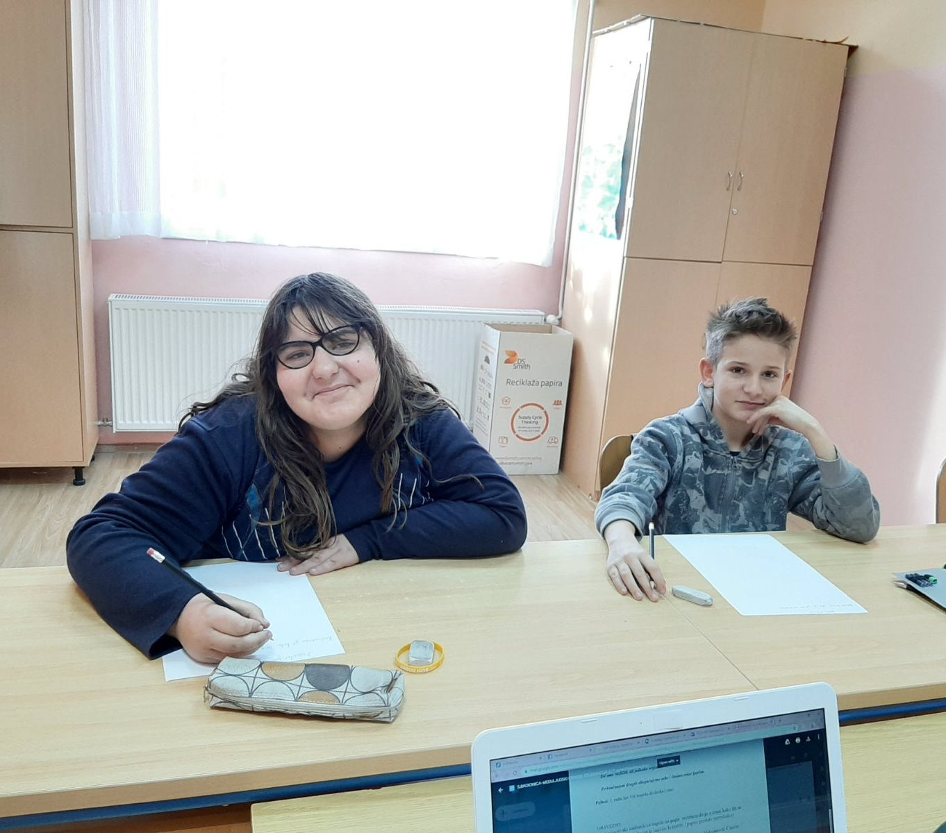
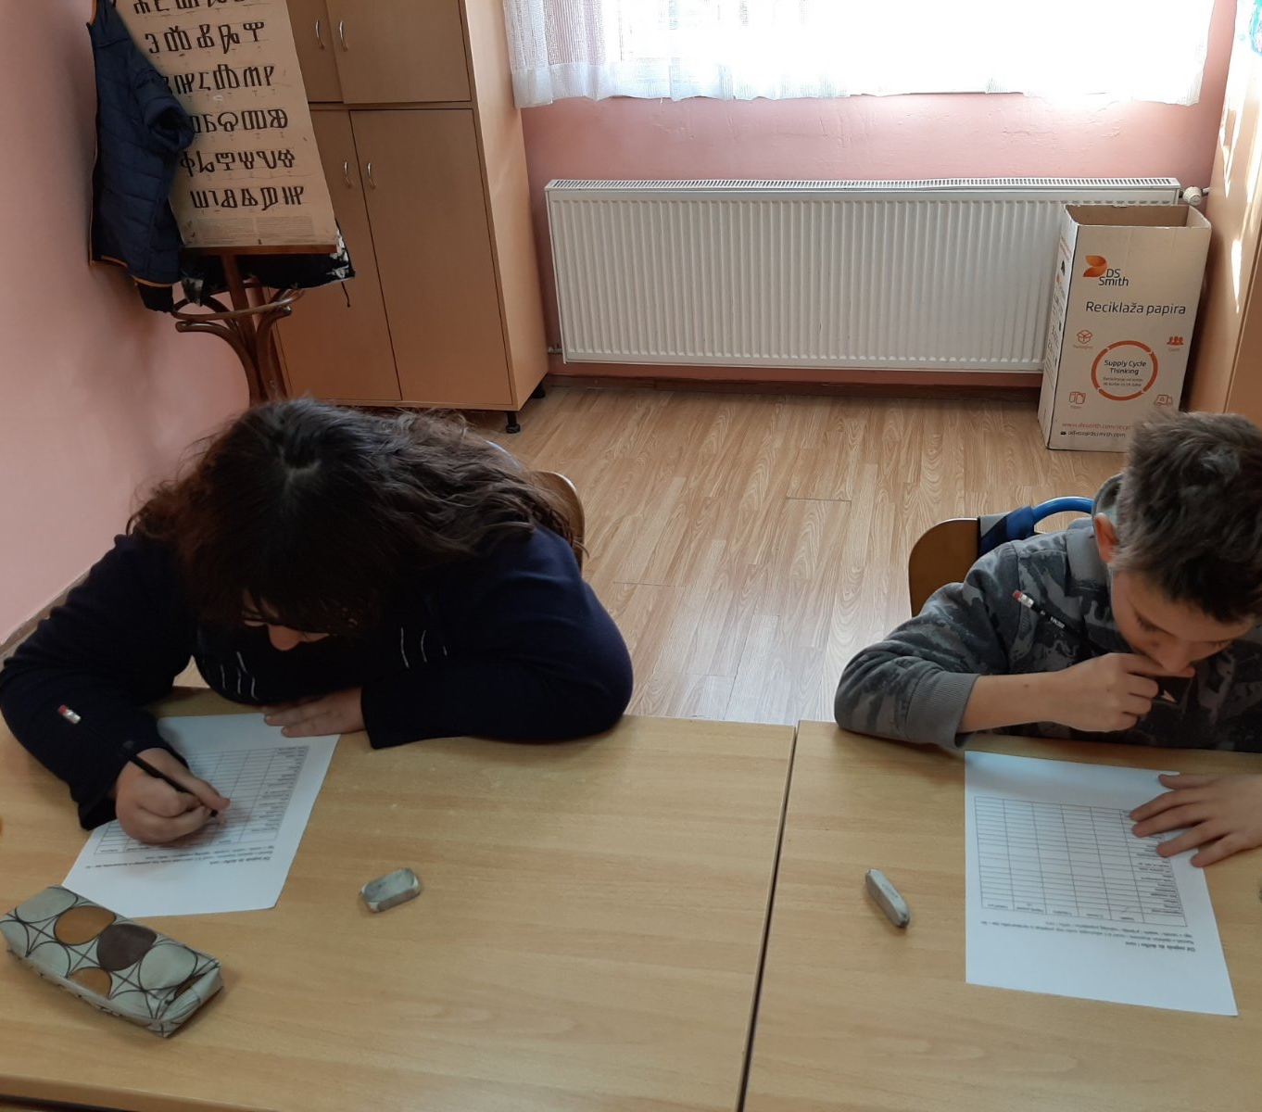

Slide 17
How did you feel during the workshop? What did you learn? „It was great! It helped me understand that we are all equal.” „I liked it very much! I learned that every one of us is special.”

Slide 18
6th workshop on interpersonal relations Title: What can I do when I'm having a hard time? Grade: 8th (13 and 14 year-old pupils) Some of the questions that we answered during the workshop: - What do you do when you are having a hard time? - What do people do to reduce pain? - Who can you talk to when you feel bad?

Slide 19
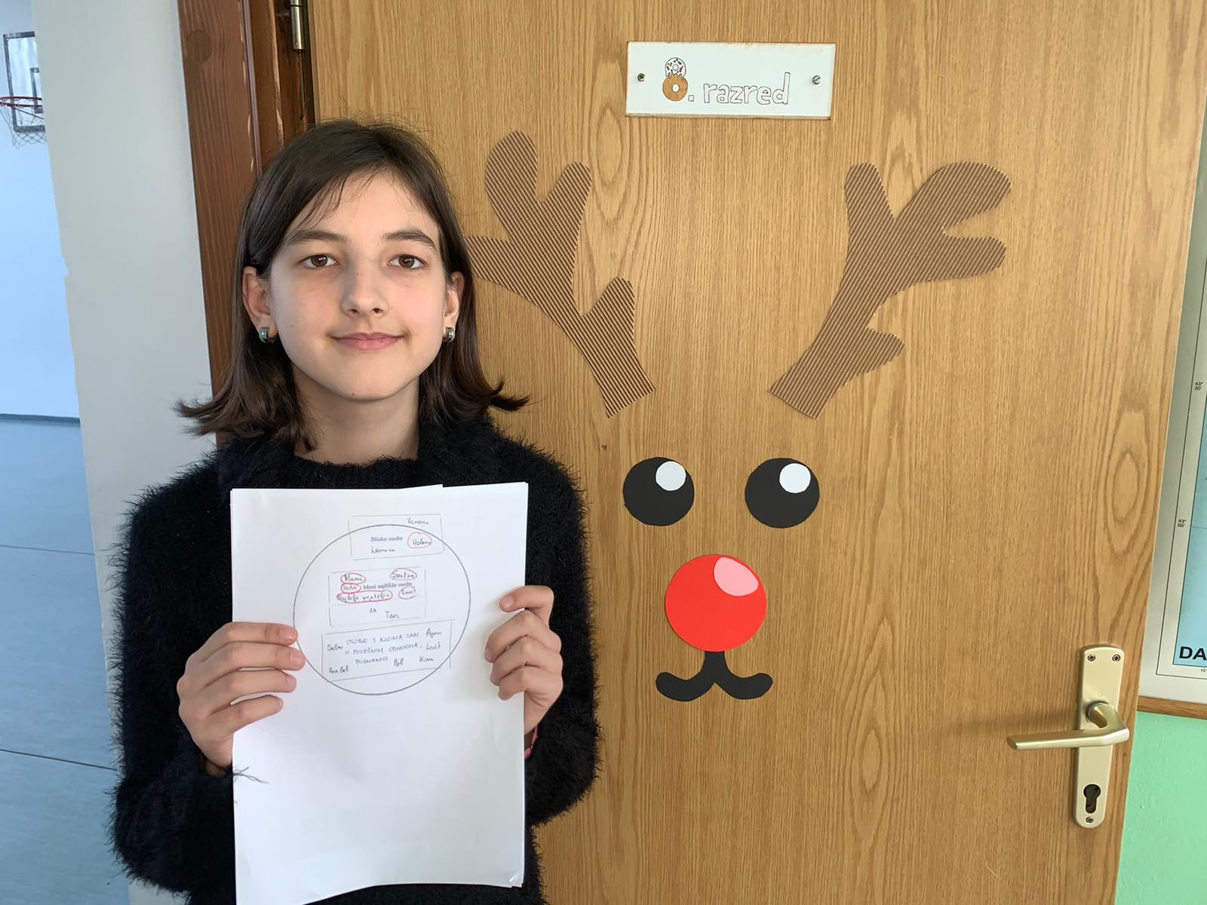

Slide 20
How did you feel during the workshop? What did you learn? „ I liked this workshop very much because it gave me useful advice what to do when I am having a hard time. I think that the best advice is to pray.”

