Slide 1
How did Cover 19 impact my life
Patrik Štainer

Slide 2
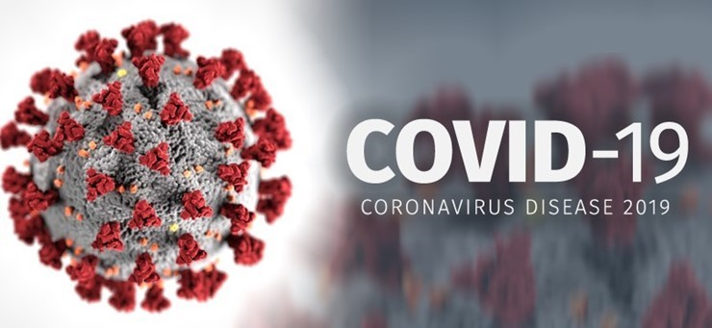
At first Covid 19 sad in China and i didn’t really worry

Slide 3
But when he arrived in Croatia we all had to be quarantined

Slide 4
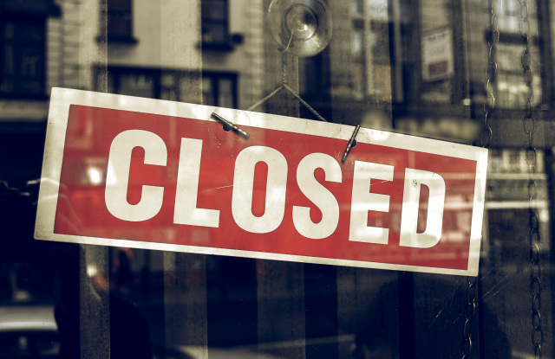
All shops, schools and cafes are closed,but se have school online

Slide 5
I was sad because we couldn’t go hanging out with friends but we spent more time our parents

Slide 6
In this situation we all need to stay home and stay safe

