Slide 1
,,The Future Begins Today”
Workshops – interpersonal relation
SOSW in Sieradz, 09.2019 - 01.2020

Slide 2
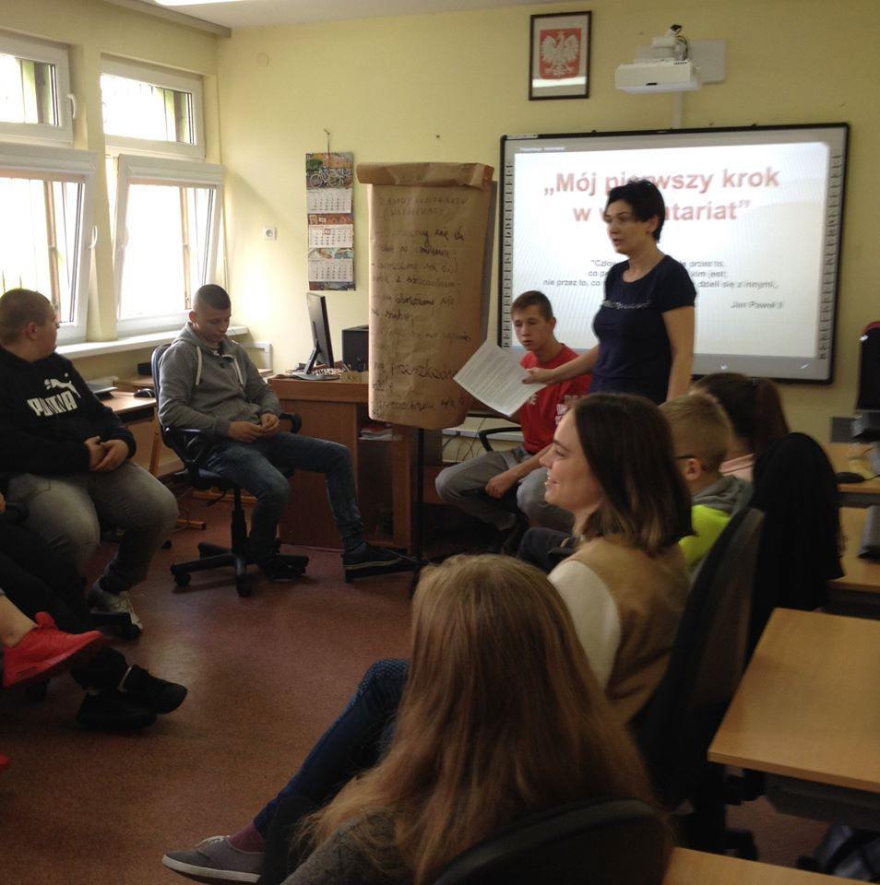
The 1st workshop We were learning trust and cooperation.

Slide 3
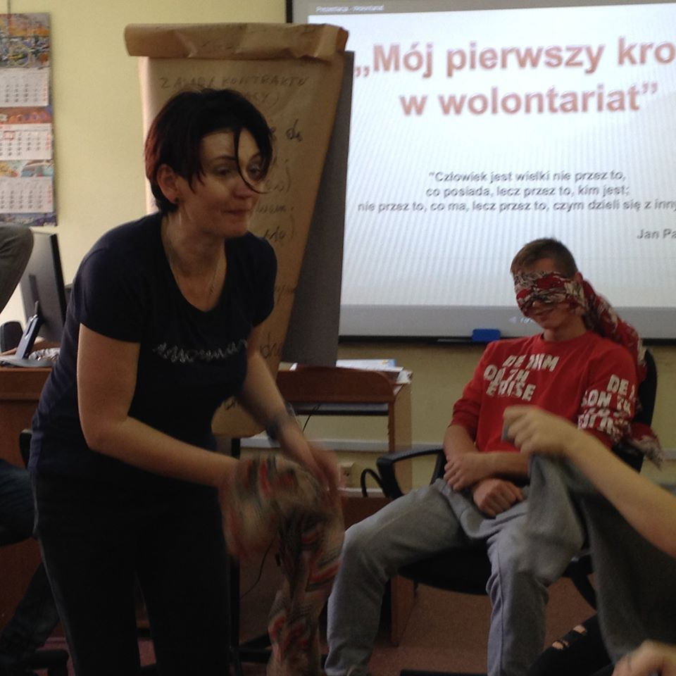
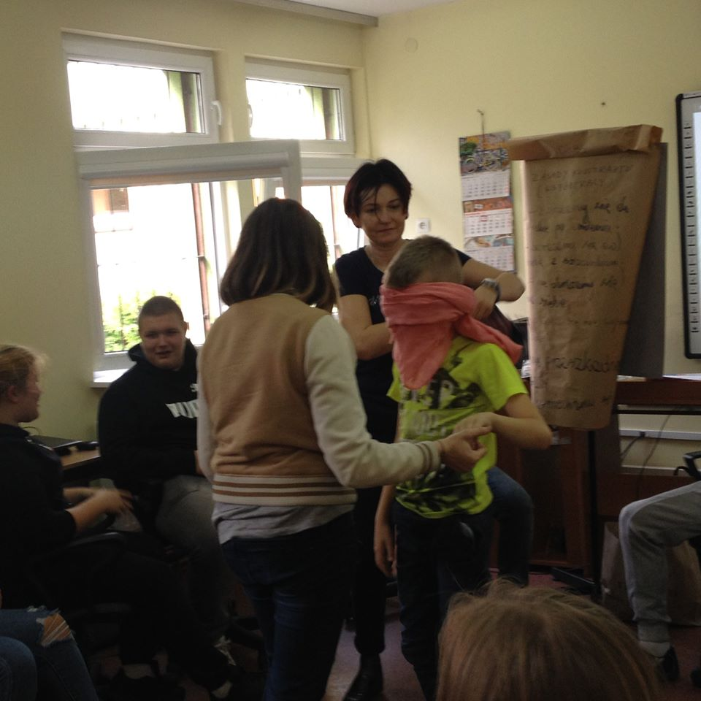

Slide 4
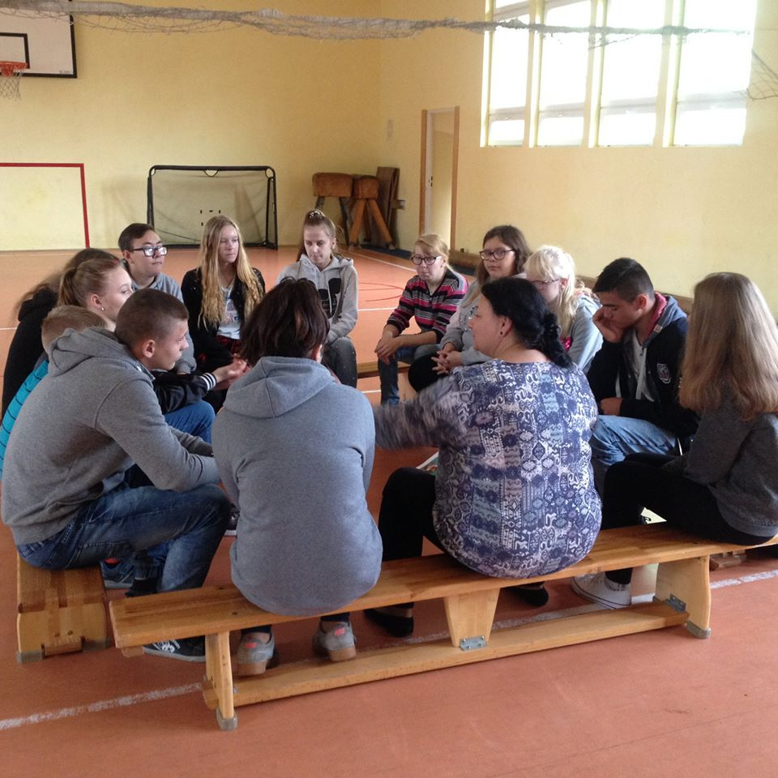
The 2nd workshop We were learning to recognize feelings, emotions and intentions

Slide 5
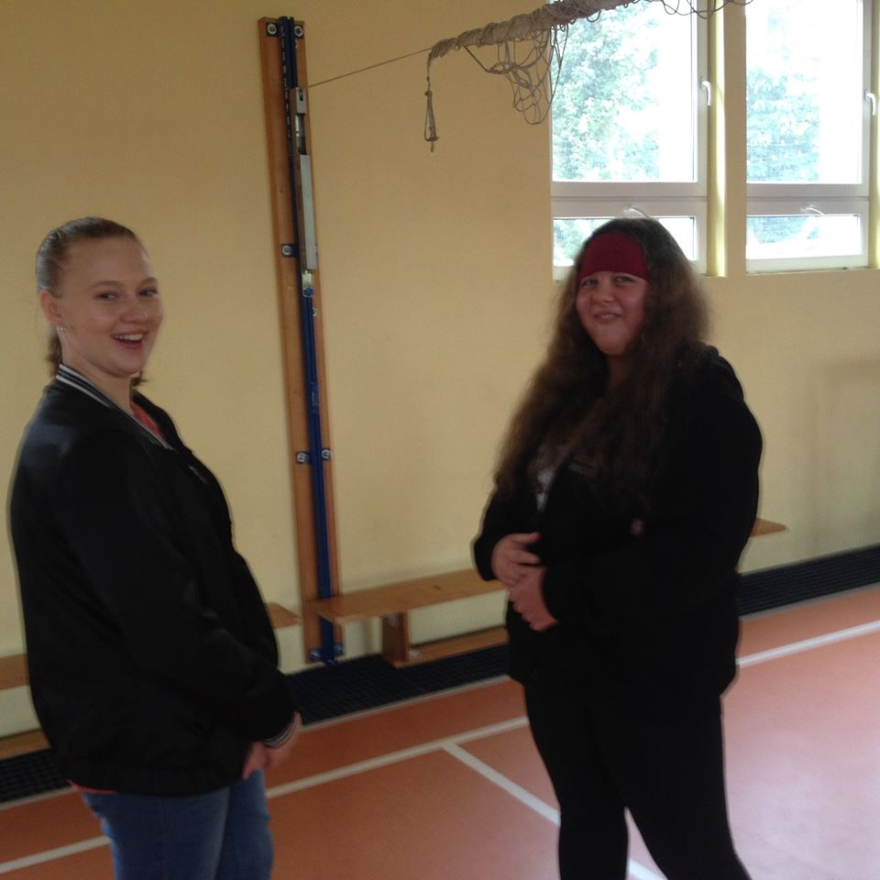
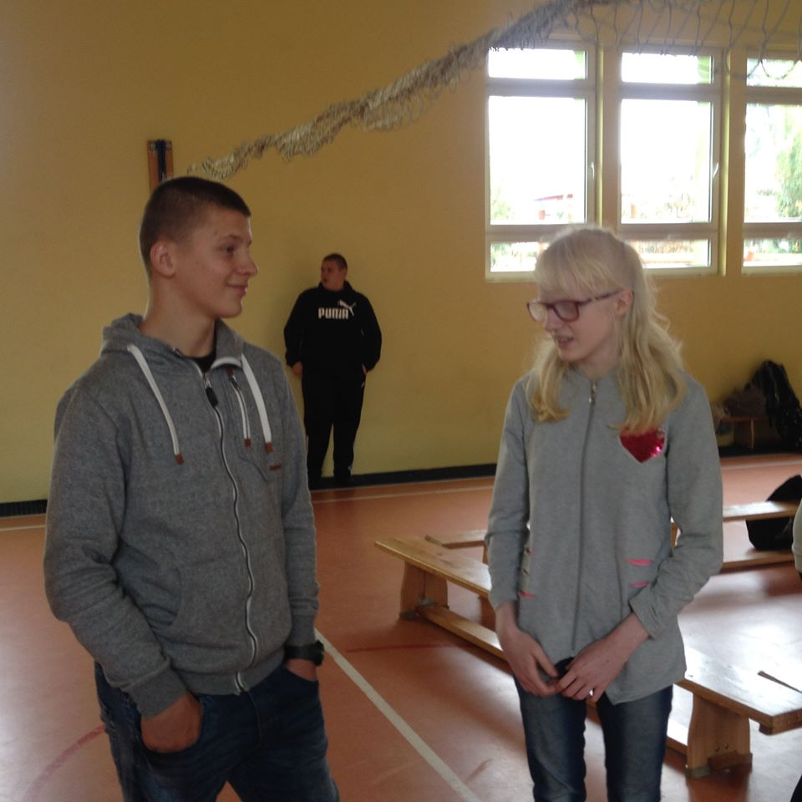
Based on facial expressions we recognized the mood of the other person.

Slide 6
The 3rd workshop In the boarding school we started with a game in pairs named „Make me laugh”. The most difficult one to make laugh was Amelka. Then, two teams competed in a game „ Chinese whispers”, and at the end, we were expressing different emotions with gestures.

Slide 7
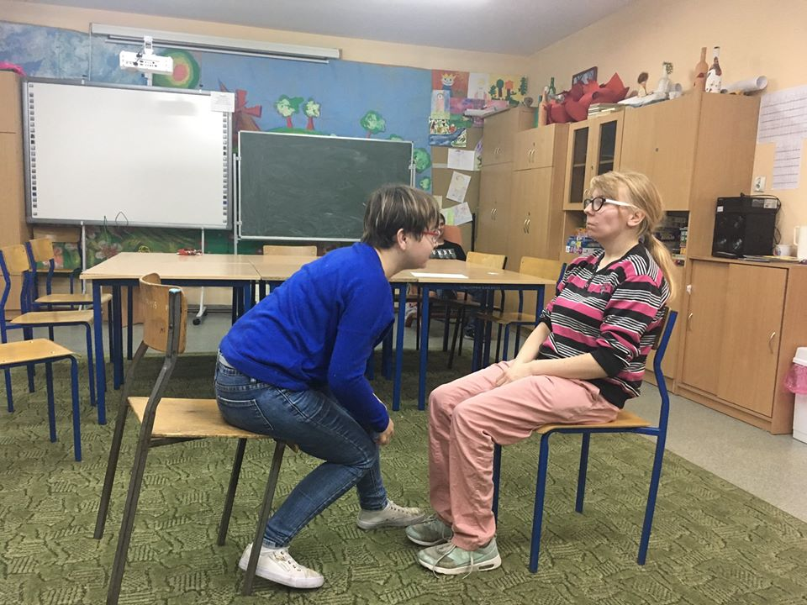
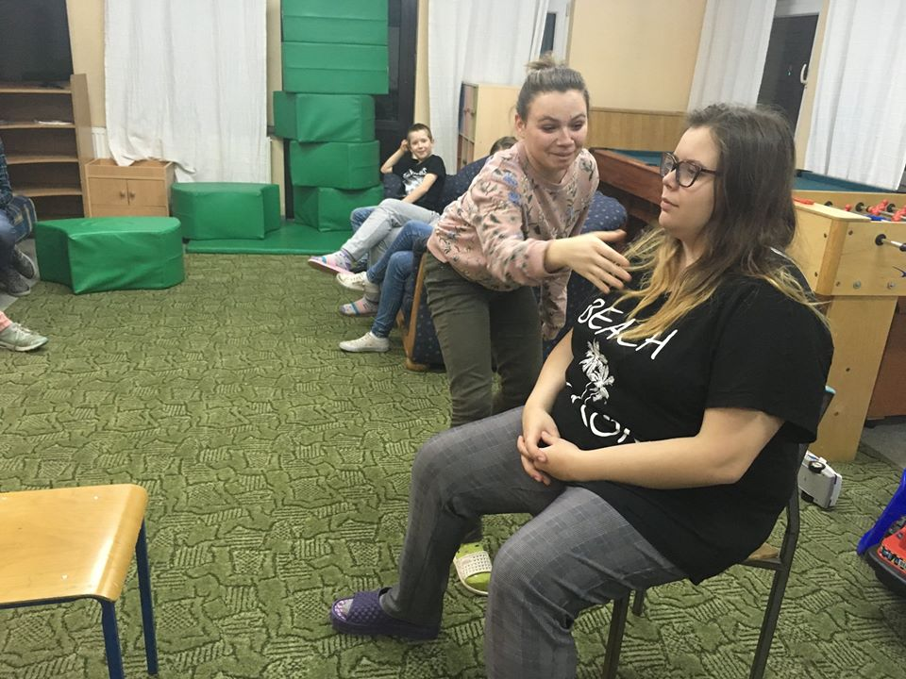

Slide 8
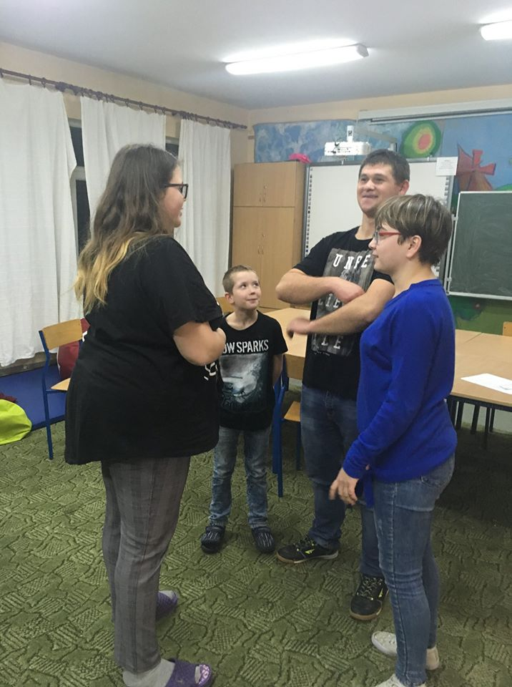
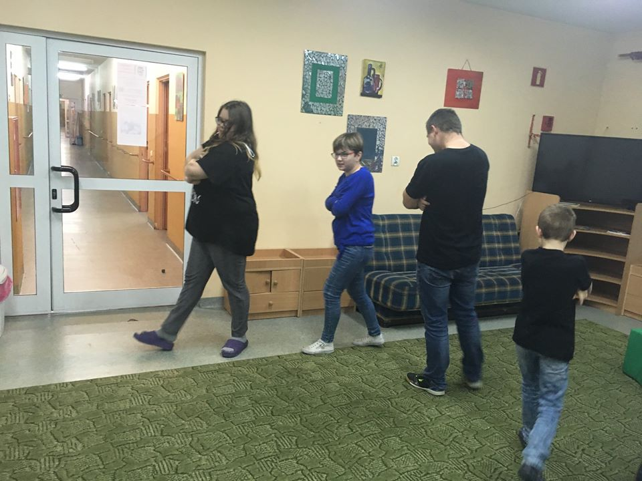

Slide 9
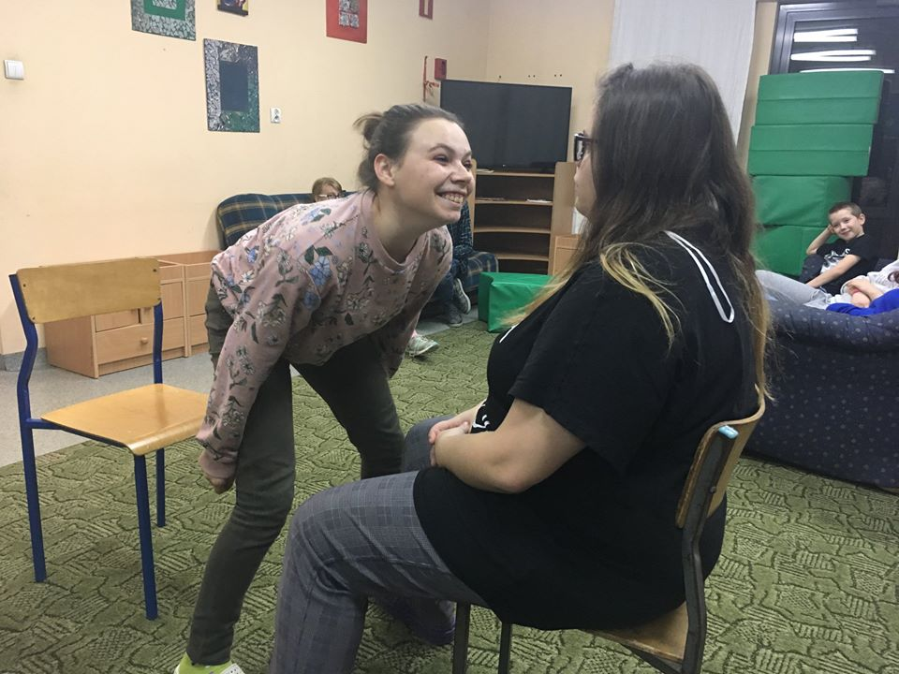
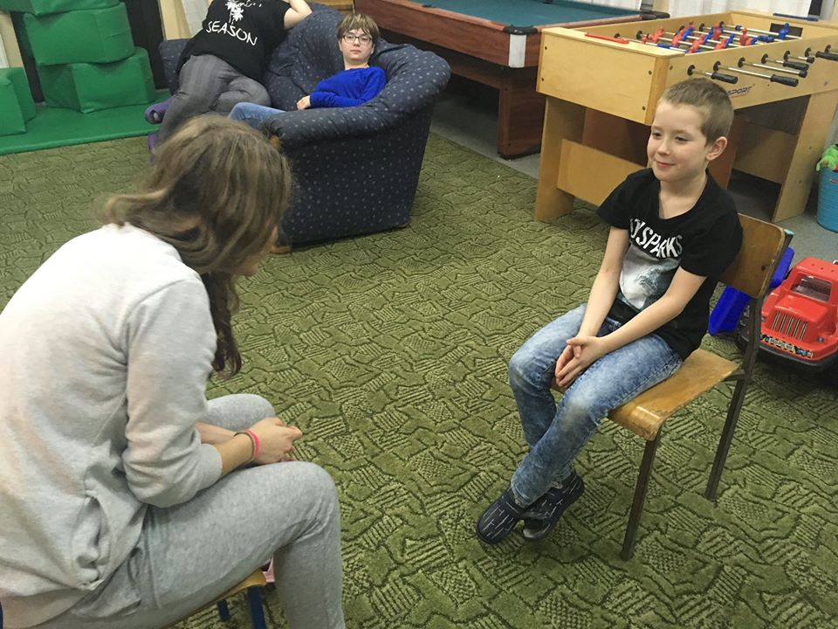

Slide 10
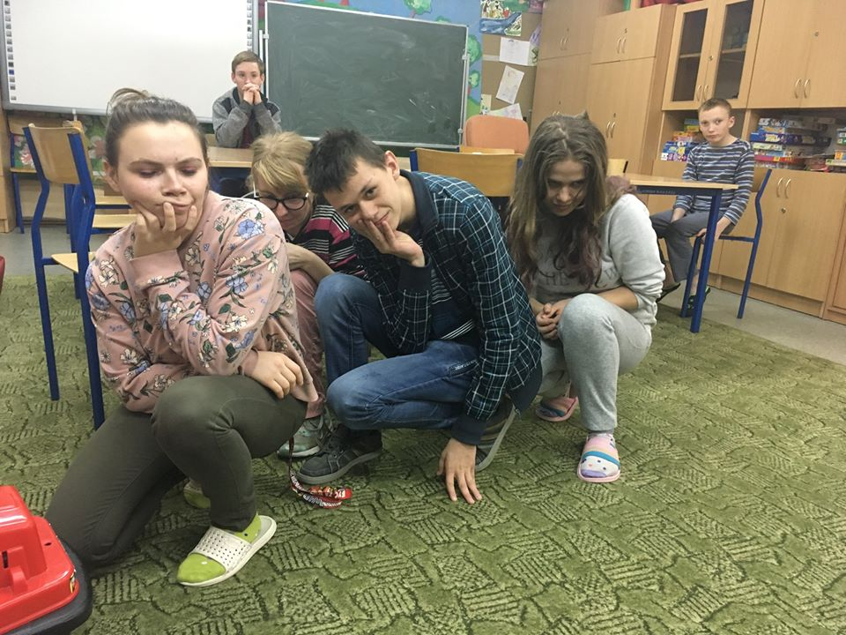
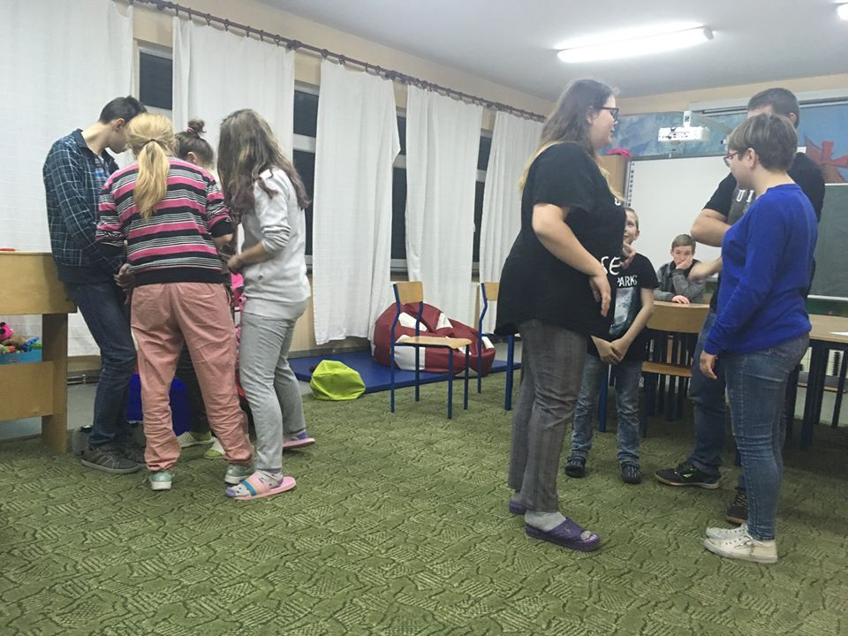

Slide 11
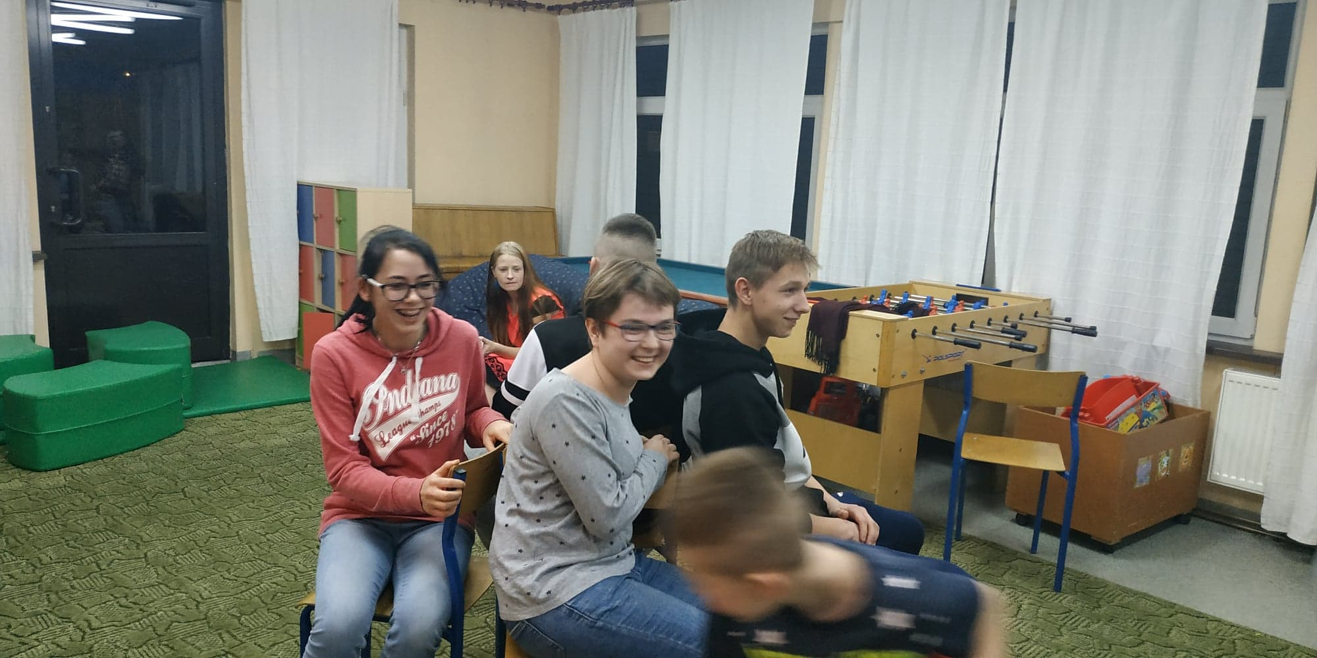
The 4th workshop We used playing with chairs from the visit to Croatia :) and practiced cooperation in a team, focusing on gestures and non-verbal speech.

Slide 12
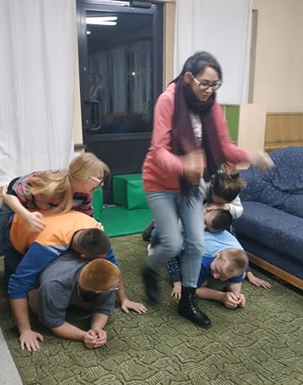
Each team has got a piece of paper with a name of a machine ( helicopter, lawn mower, a trucck, traktor...) which the members are supposed to imitate. Each team member is a different part od the machine. The goal is to guess the names of the other teams' machines.

Slide 13
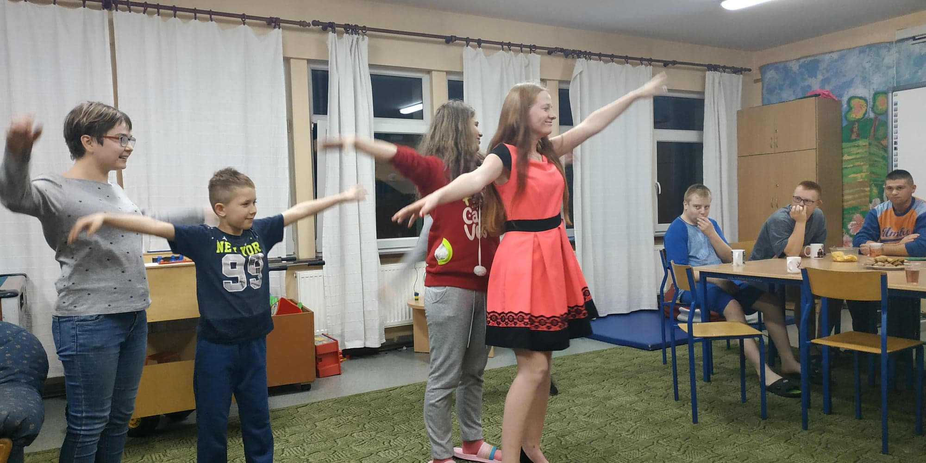

Slide 14
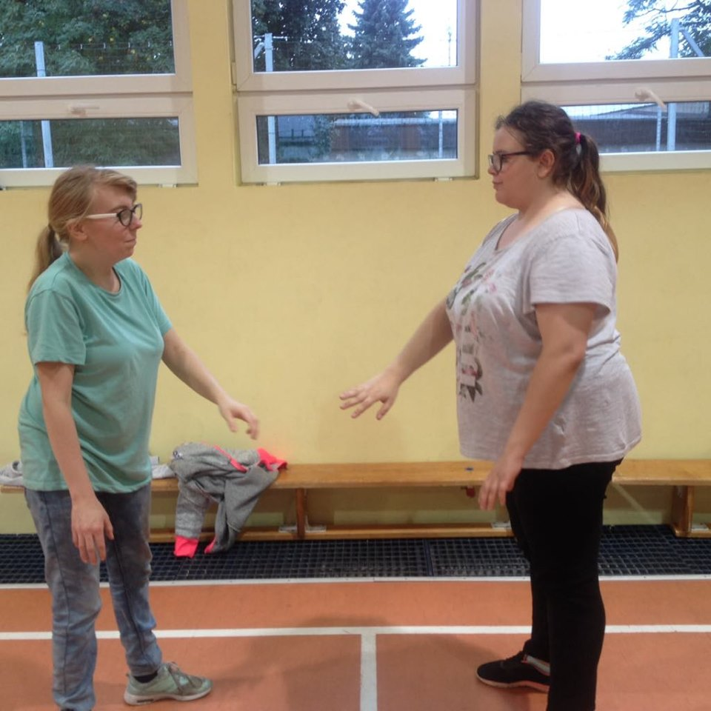
The 5th workshop We were learning empathy, we focused on the other person.

Slide 15
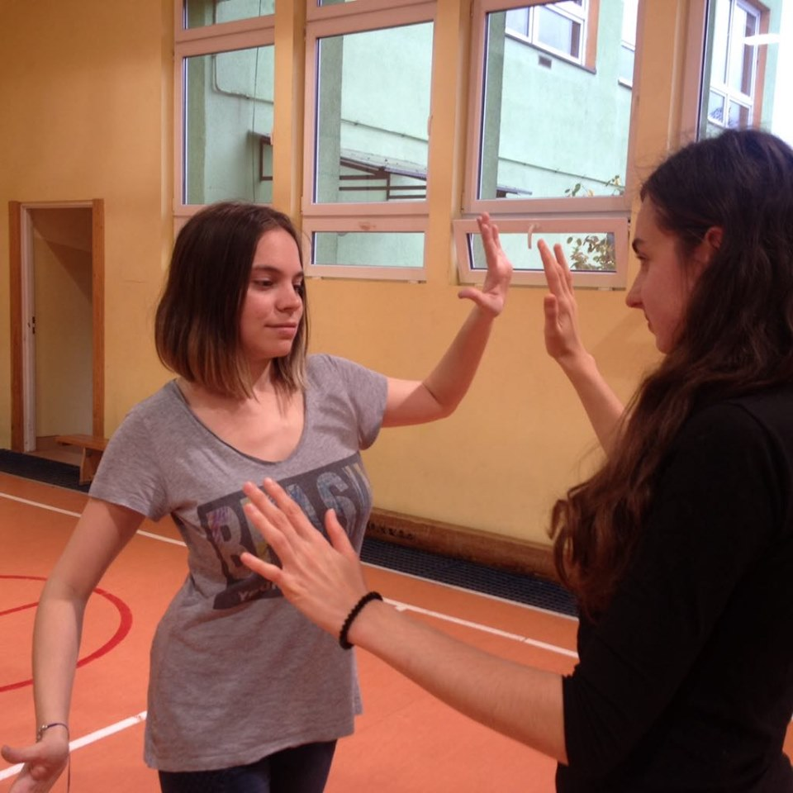
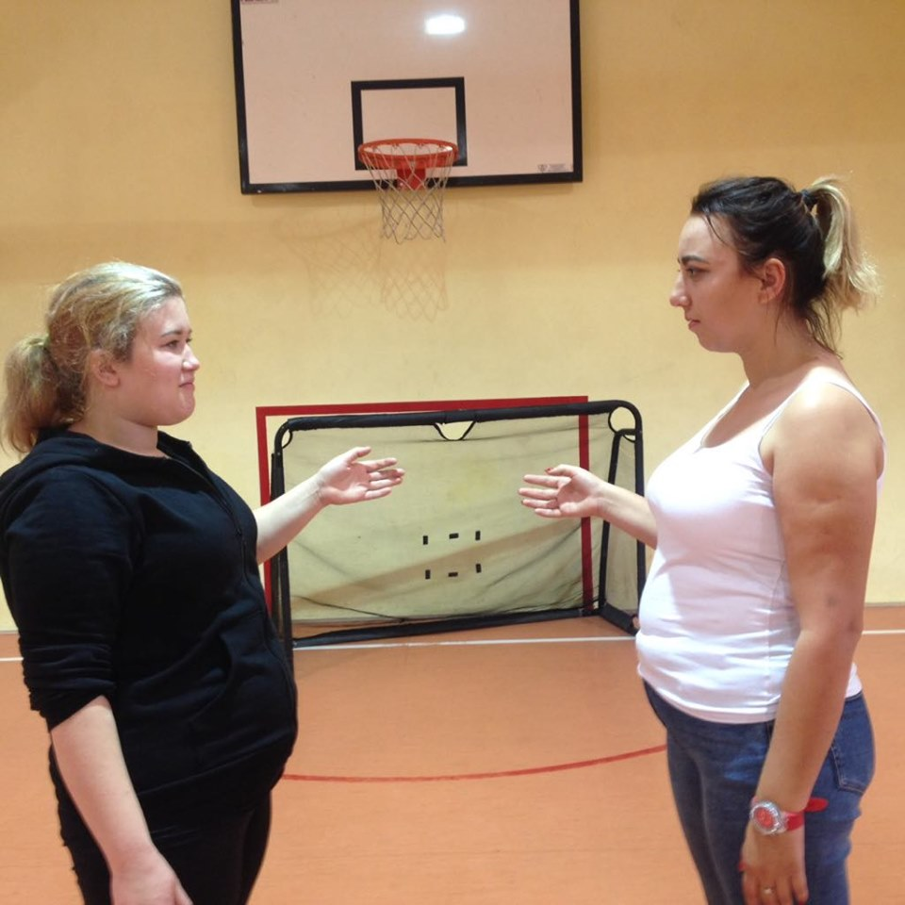

Slide 16
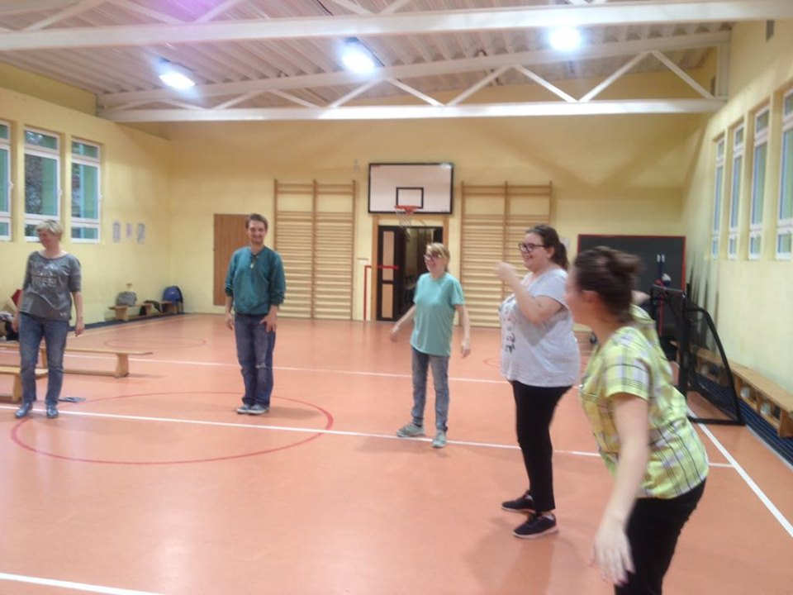

Slide 17
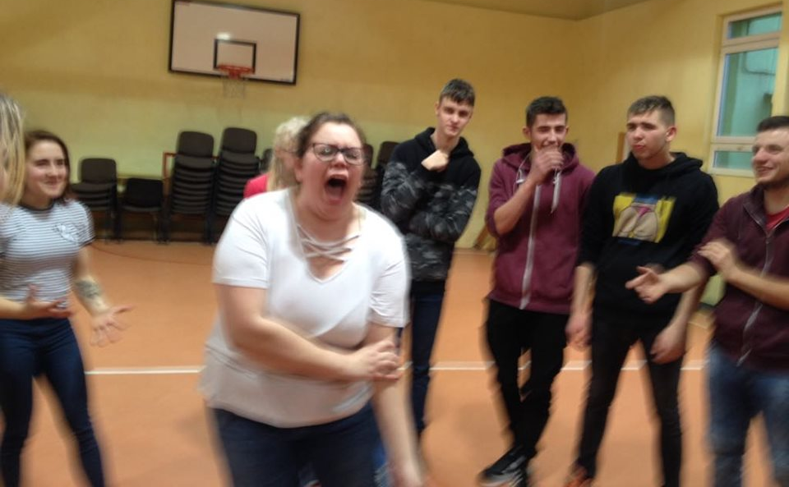
The 6th workshop We were learning to say "no". Let's be assertive when we don't like the behavior of others, when someone tries to force us to do something we do not want to do or wants to hurt us.

Slide 18
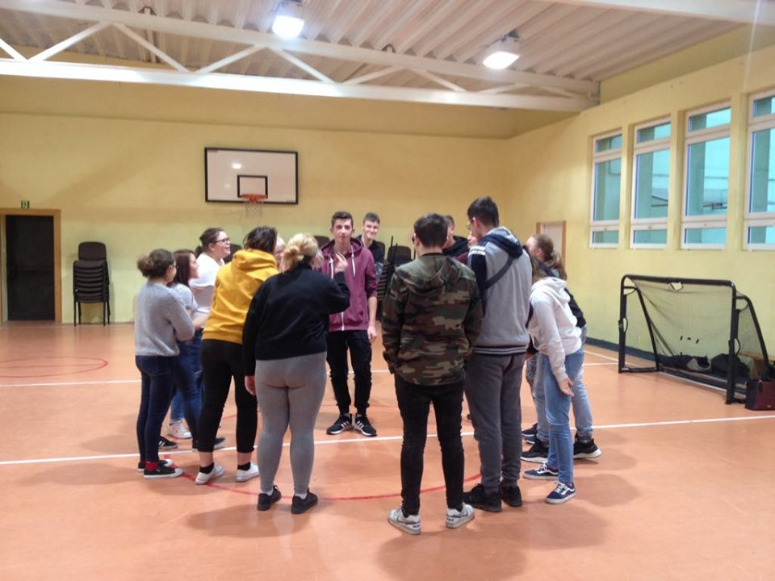

Slide 19
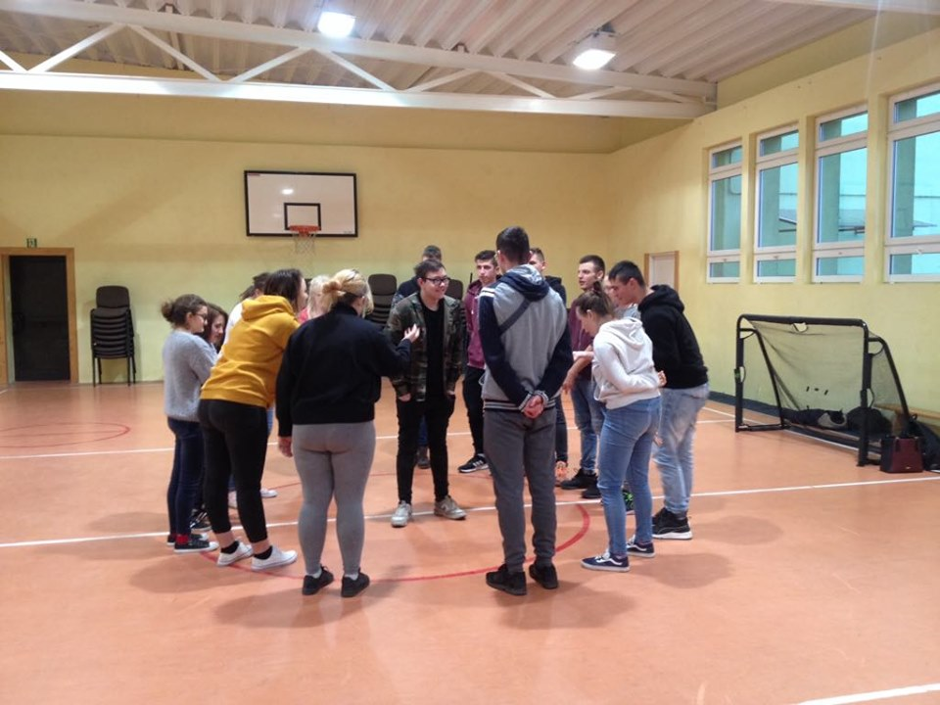

Slide 20
Conclusions:
Thanks to the participation in the workshop, we have become: - more confident, assertive, on the other hand open to others, more sensitive, we have learned to notice and name emotions in others, express our own emotions.

