Slide 1
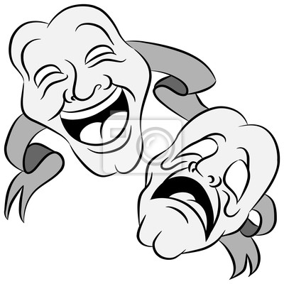
“The Future Begins Today” Project KA229 2018-1-PL01-KA229-050749
THEATER CLUB

Slide 2
THEATER IN POLAND
has a long tradition.
We have a few types of it.
“The Future Begins Today” Project KA229 2018-1-PL01-KA229-050749

Slide 3
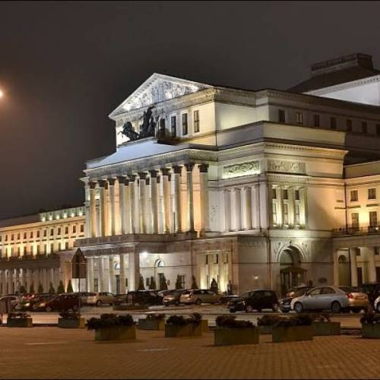
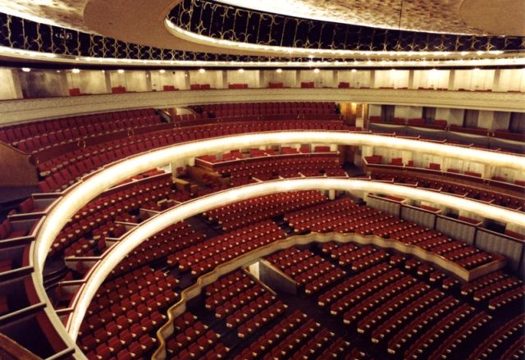
“The Future Begins Today” Project KA229 2018-1-PL01-KA229-050749

Slide 4
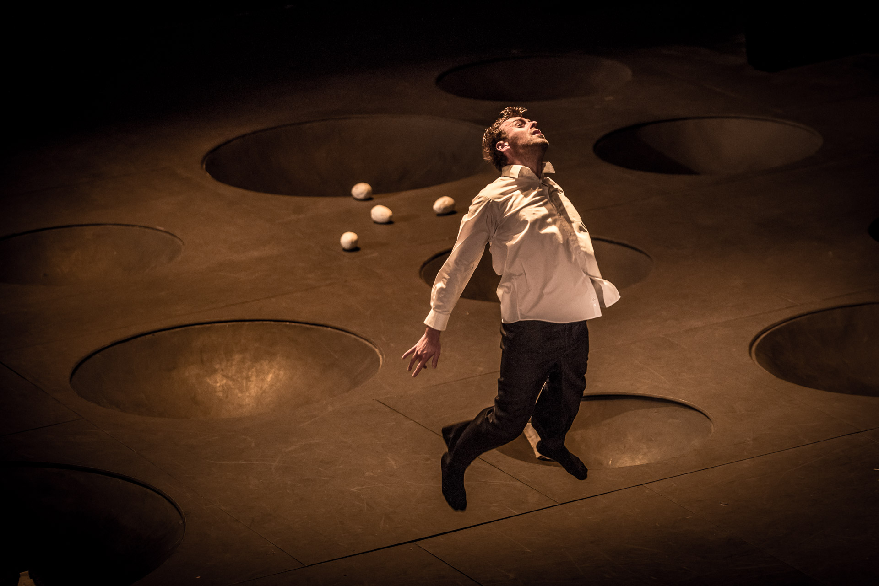
Dramatic plays
“The Future Begins Today” Project KA229 2018-1-PL01-KA229-050749

Slide 5
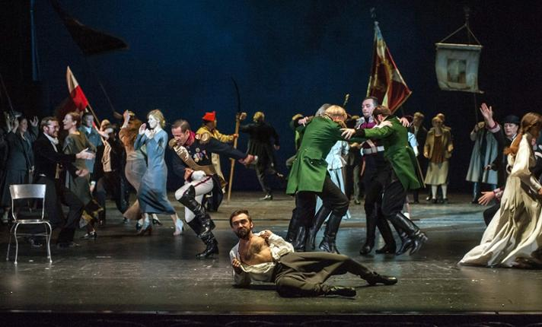
“The Future Begins Today” Project KA229 2018-1-PL01-KA229-050749

Slide 6
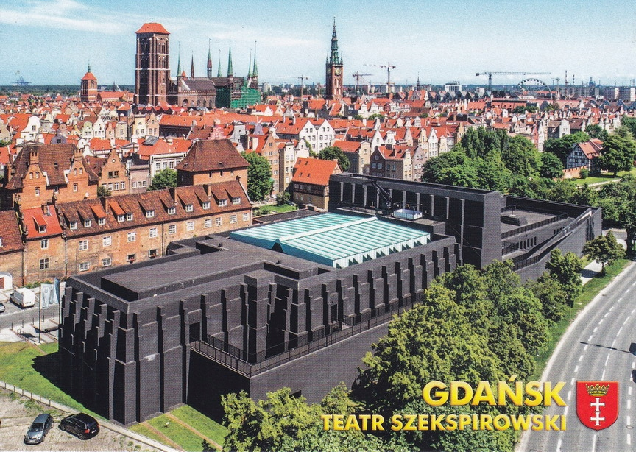
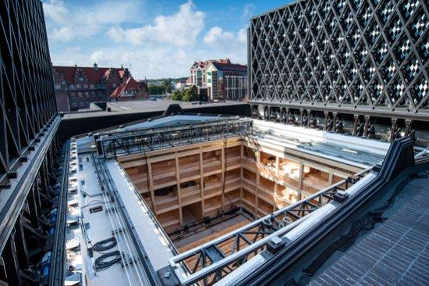
“The Future Begins Today” Project KA229 2018-1-PL01-KA229-050749

Slide 7
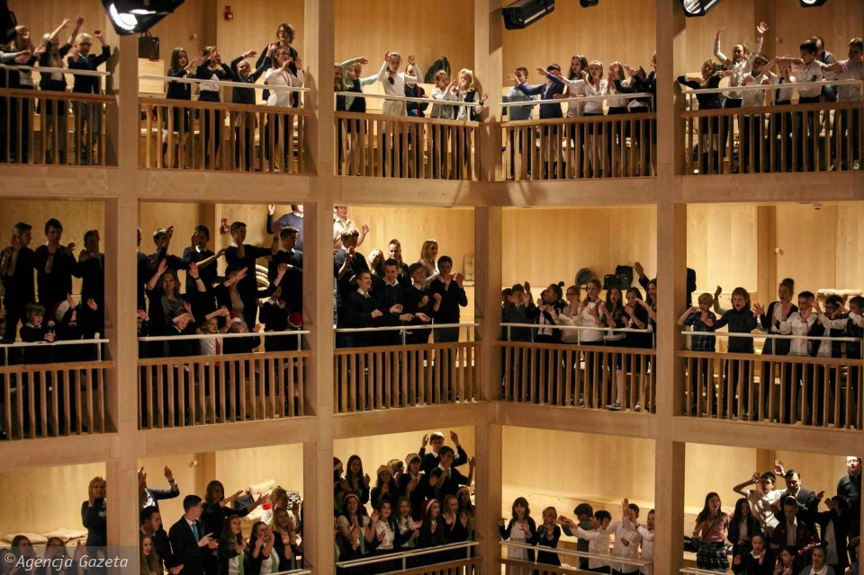
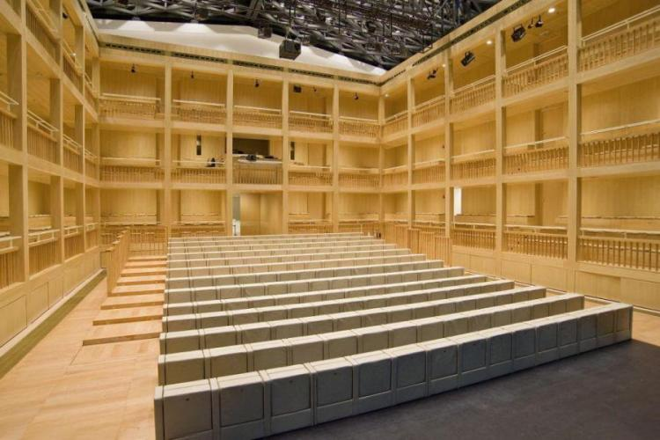
“The Future Begins Today” Project KA229 2018-1-PL01-KA229-050749

Slide 8
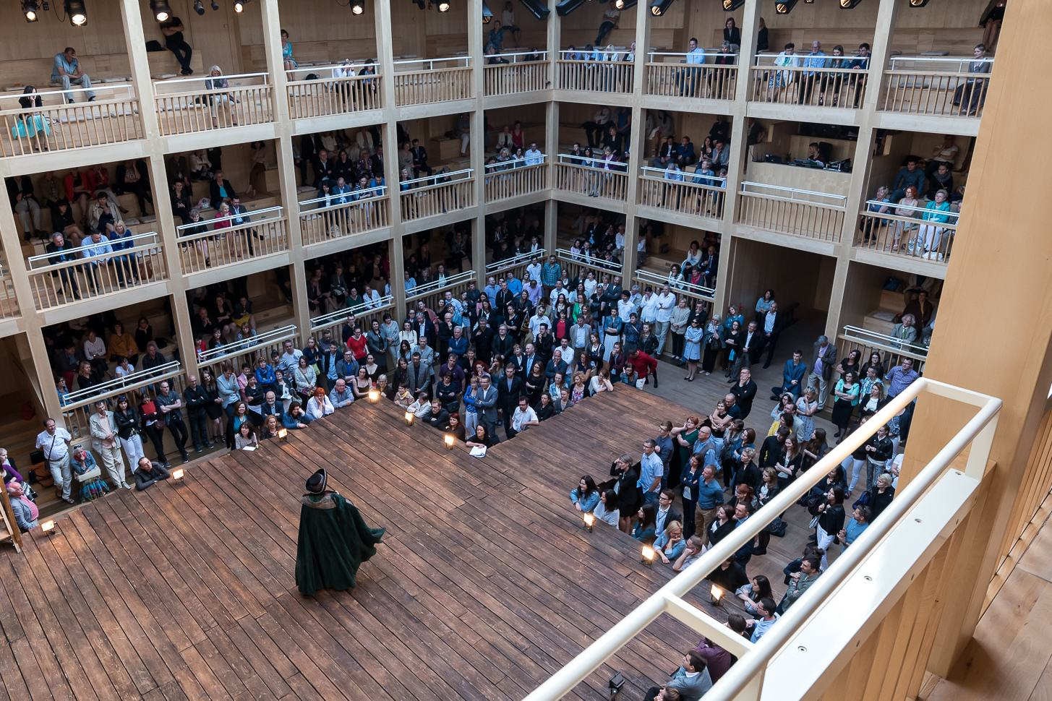
SHOW ROMEO AND JULIA
“The Future Begins Today” Project KA229 2018-1-PL01-KA229-050749

Slide 9
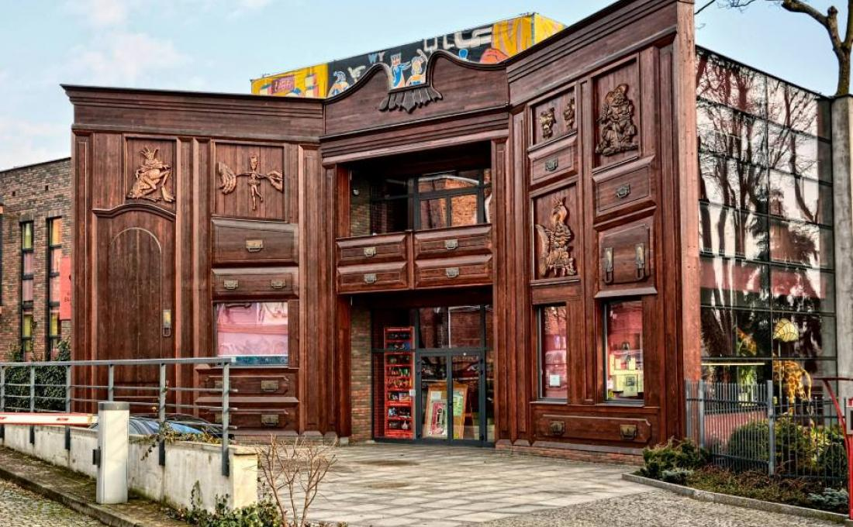
Theater Baj Pomorski in Toruń
“The Future Begins Today” Project KA229 2018-1-PL01-KA229-050749

Slide 10
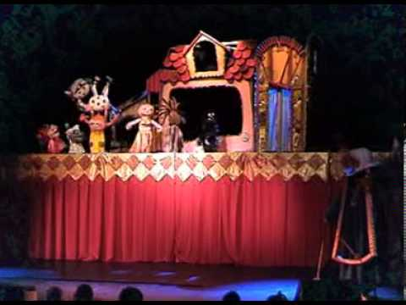
Theater Baj prepares plays for the youngest viewers.
Cinderella
“The Future Begins Today” Project KA229 2018-1-PL01-KA229-050749

Slide 11
Moomin
“The Future Begins Today” Project KA229 2018-1-PL01-KA229-050749

Slide 12
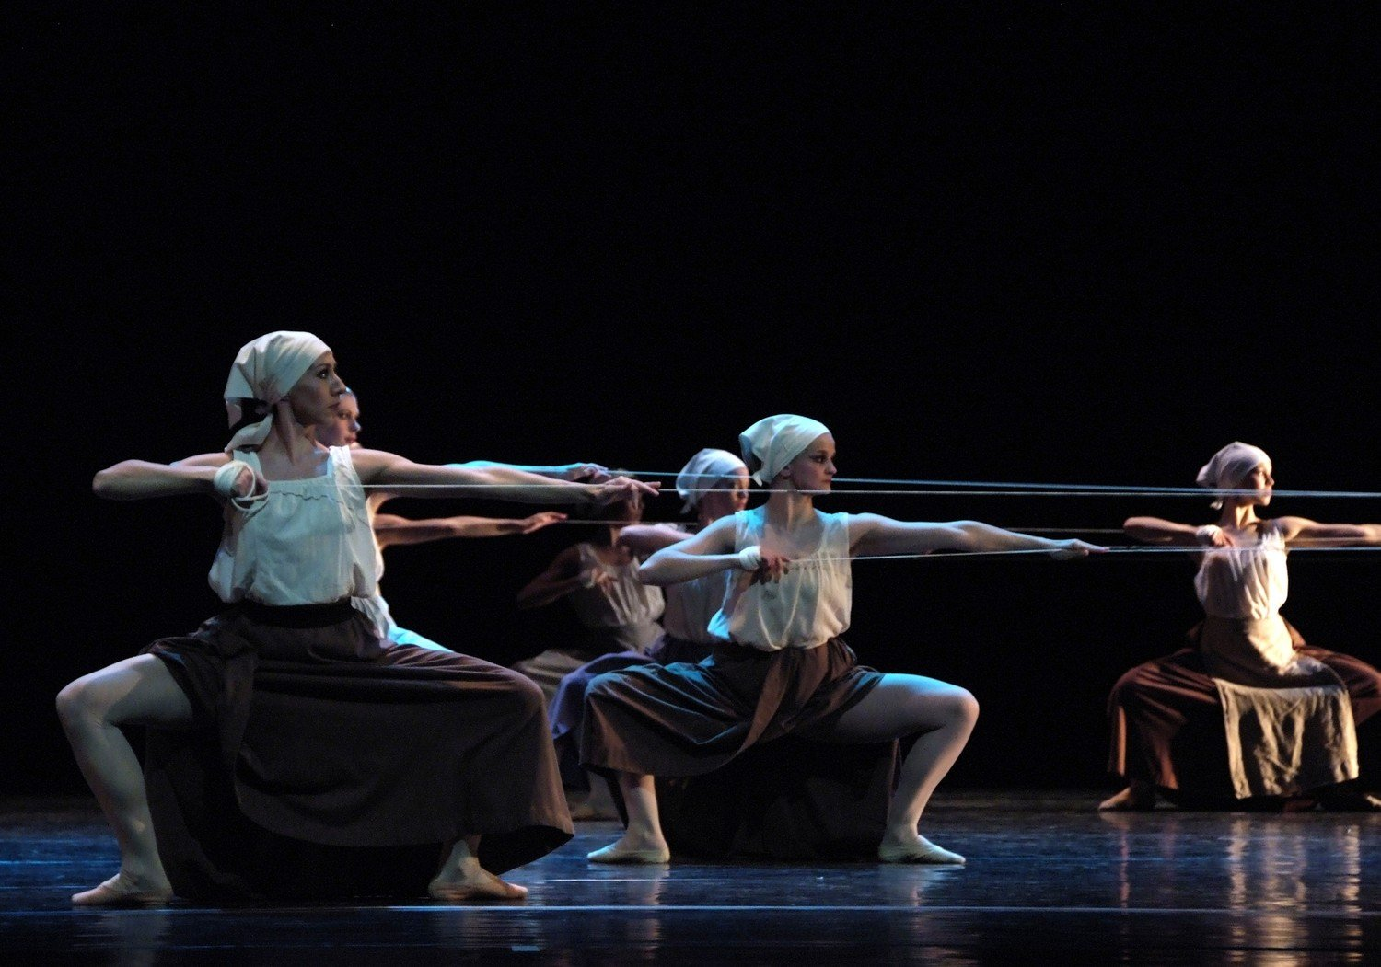
Ballet version of the novel Promised Land
by W. S. Reymont
- weaving workshop -
“The Future Begins Today” Project KA229 2018-1-PL01-KA229-050749

Slide 13
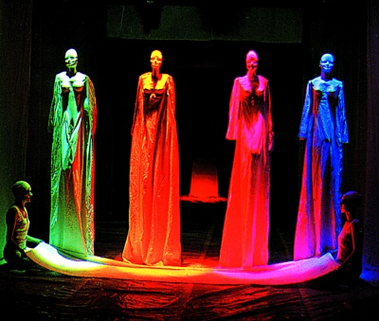
Art theater by Leszek Mądzik
“The Future Begins Today” Project KA229 2018-1-PL01-KA229-050749

Slide 14
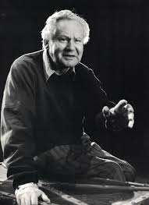
“The Future Begins Today” Project KA229 2018-1-PL01-KA229-050749

Slide 15
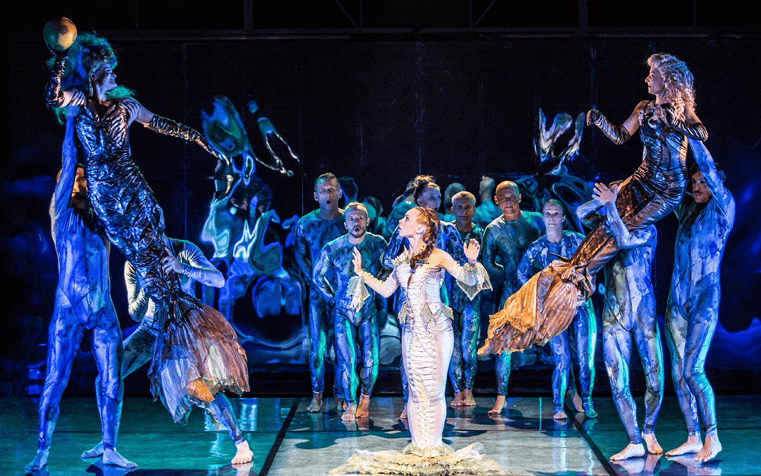
HYDROKOSMOS
“The Future Begins Today” Project KA229 2018-1-PL01-KA229-050749

Slide 16
Opera in Wrocław prepares mega shows
in a large space
“The Future Begins Today” Project KA229 2018-1-PL01-KA229-050749

Slide 17
THEATER IN THE SPECIAL EDUCATIONAL AND CARE CENTER IN SIERADZ
“The Future Begins Today” Project KA229 2018-1-PL01-KA229-050749

Slide 18
We have diffrent kinds of theater groups
“The Future Begins Today” Project KA229 2018-1-PL01-KA229-050749

Slide 19
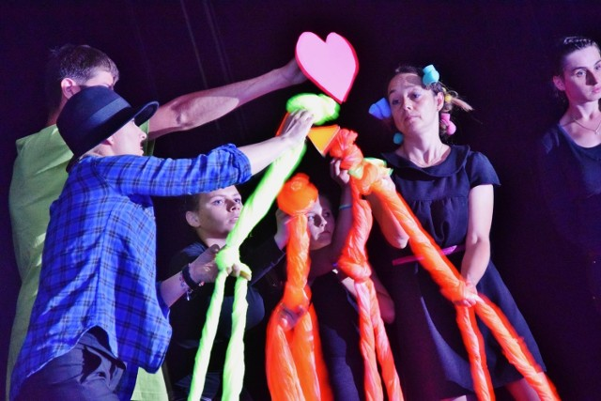
... using animation
“The Future Begins Today” Project KA229 2018-1-PL01-KA229-050749

Slide 20
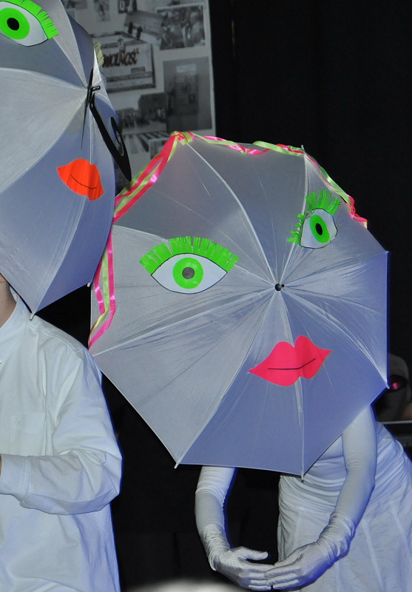
... Black theater - using ultraviolet lights and various props
“The Future Begins Today” Project KA229 2018-1-PL01-KA229-050749

Slide 21
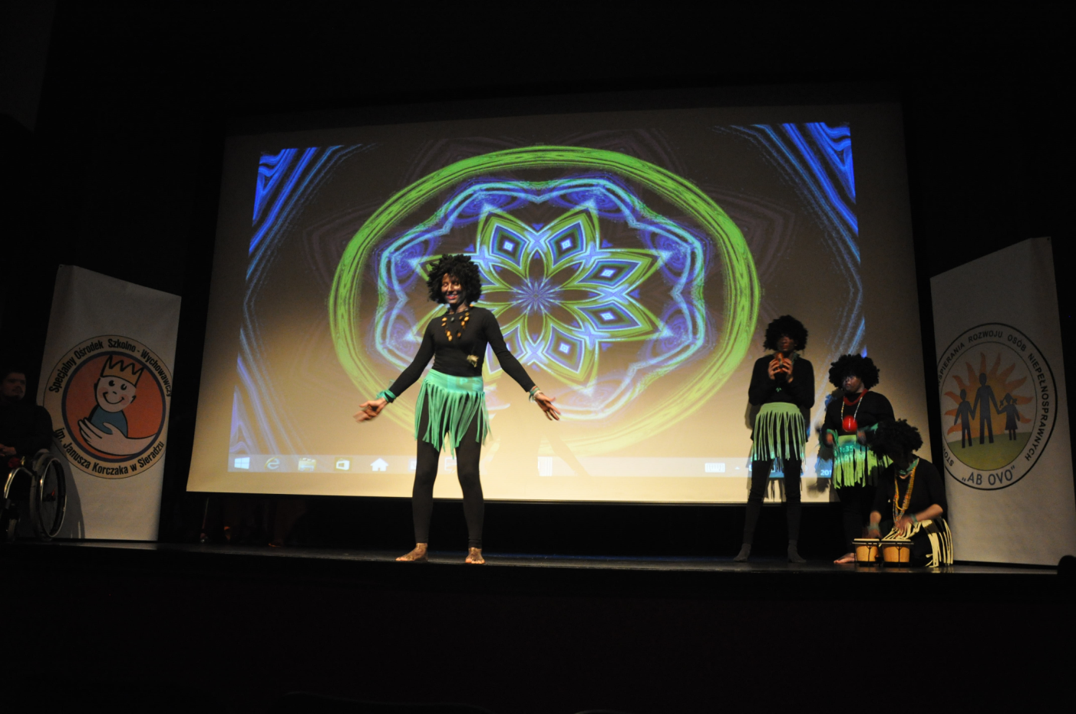
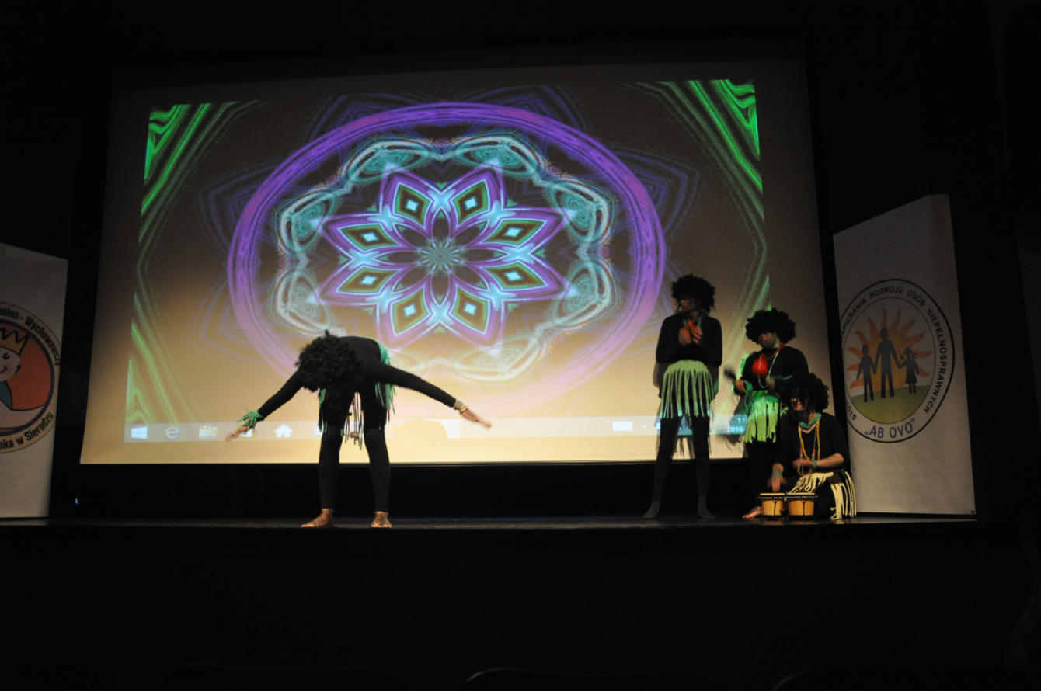
... using multimedia scenery
“The Future Begins Today” Project KA229 2018-1-PL01-KA229-050749

Slide 22
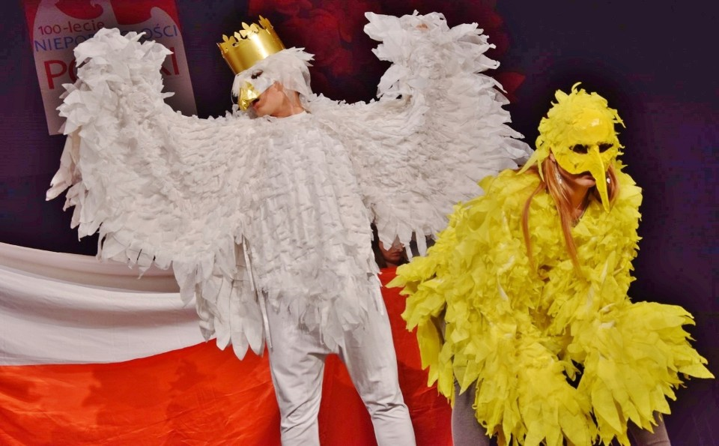
... using costumes
and masks
“The Future Begins Today” Project KA229 2018-1-PL01-KA229-050749

Slide 23
The theater groups
are present
at our school ceremonies
“The Future Begins Today” Project KA229 2018-1-PL01-KA229-050749

Slide 24
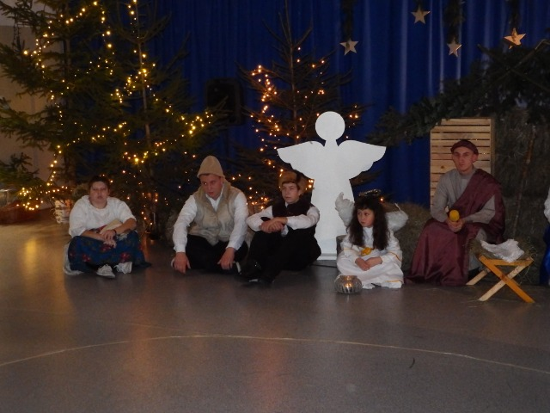
CHRISTMAS
“The Future Begins Today” Project KA229 2018-1-PL01-KA229-050749

Slide 25
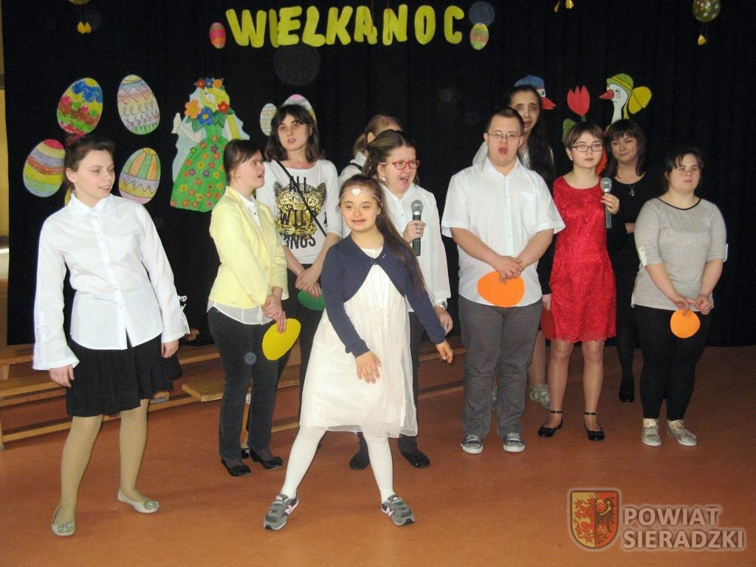
EASTER
“The Future Begins Today” Project KA229 2018-1-PL01-KA229-050749

Slide 26
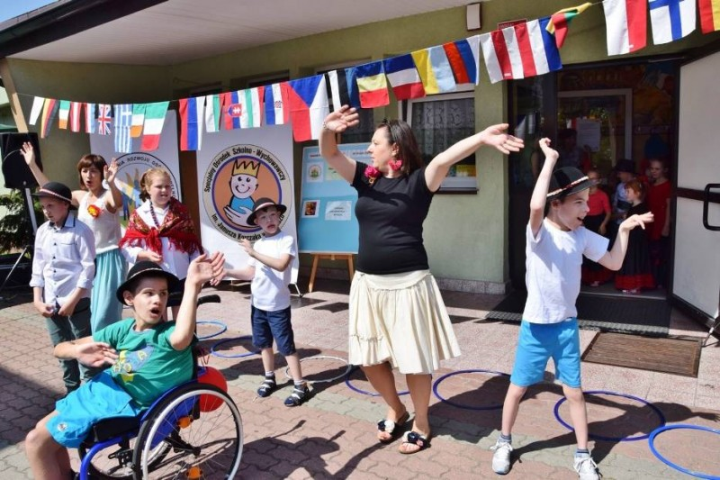
CHILDREN'S DAY
“The Future Begins Today” Project KA229 2018-1-PL01-KA229-050749

Slide 27
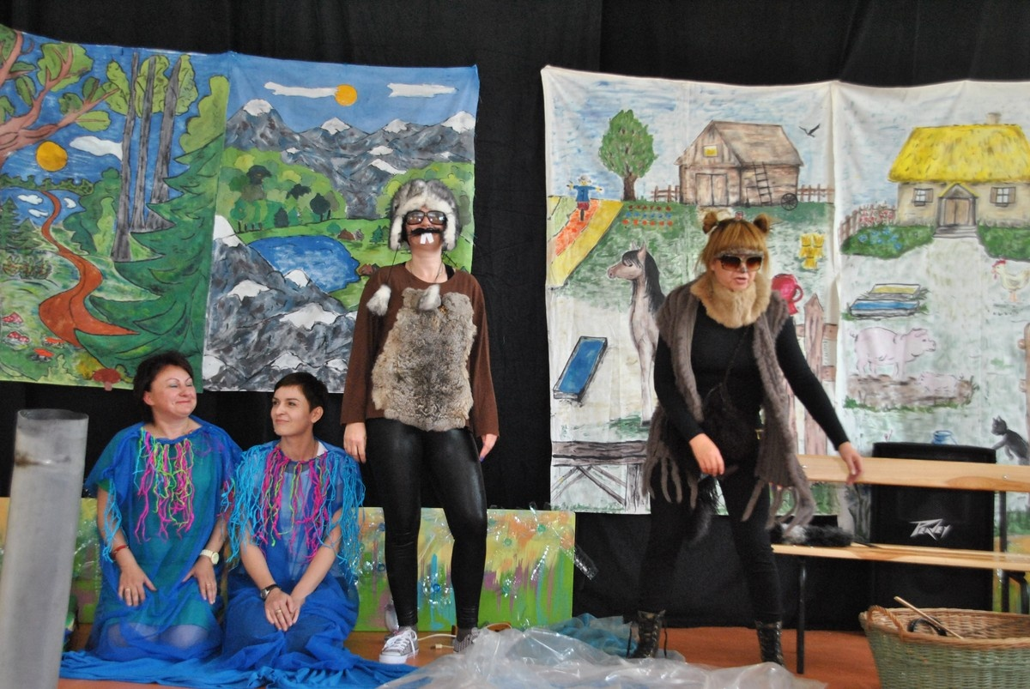
ECOLOGICAL CHILDREN'S DAY - TEACHERS FOR CHILDREN -
“The Future Begins Today” Project KA229 2018-1-PL01-KA229-050749

Slide 28
Our school organizes
the Culture Review
"In the land of fairy tales,
song and dance"
an artistic review of
disabled children and youth from around the region.
“The Future Begins Today” Project KA229 2018-1-PL01-KA229-050749

Slide 29
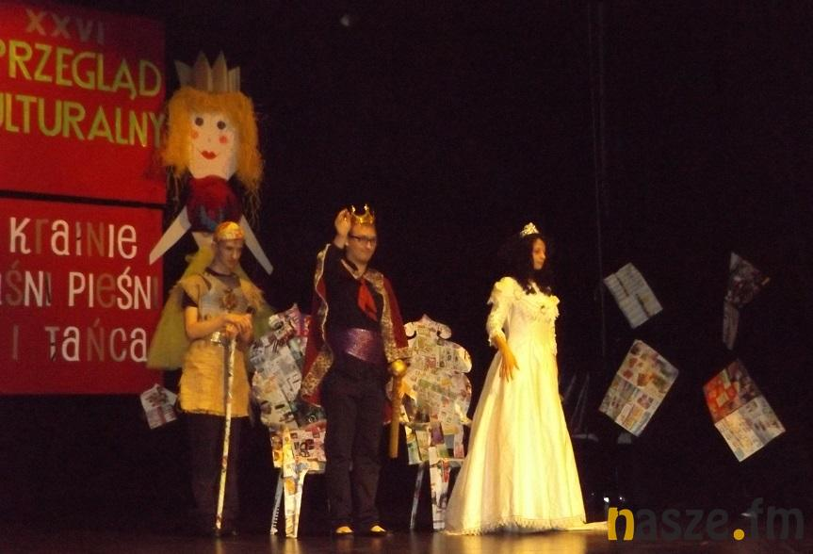
Review topic: WITH A PRINCESS IN THE MAIN ROLE
“The Future Begins Today” Project KA229 2018-1-PL01-KA229-050749

Slide 30
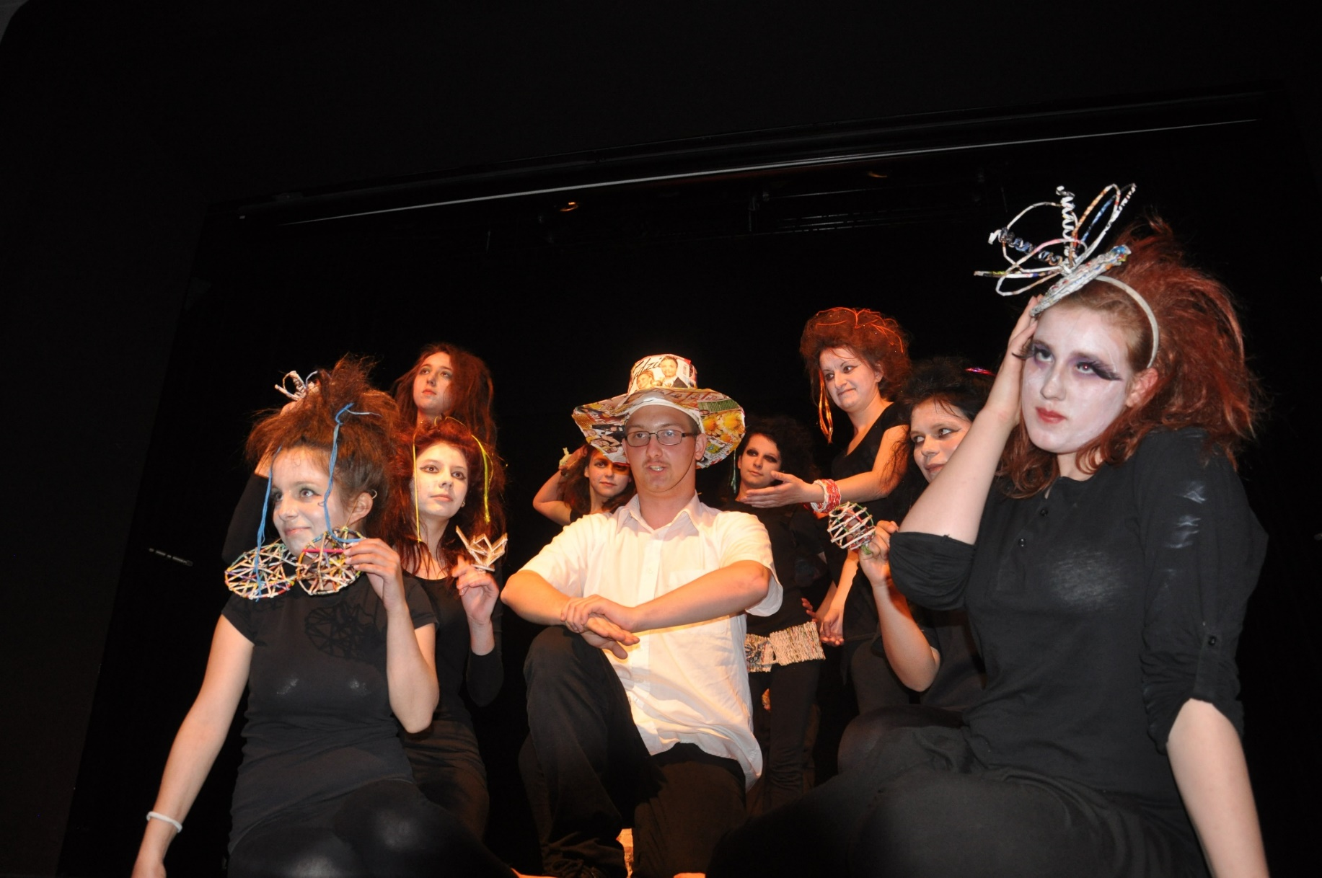
E
“The Future Begins Today” Project KA229 2018-1-PL01-KA229-050749

Slide 31
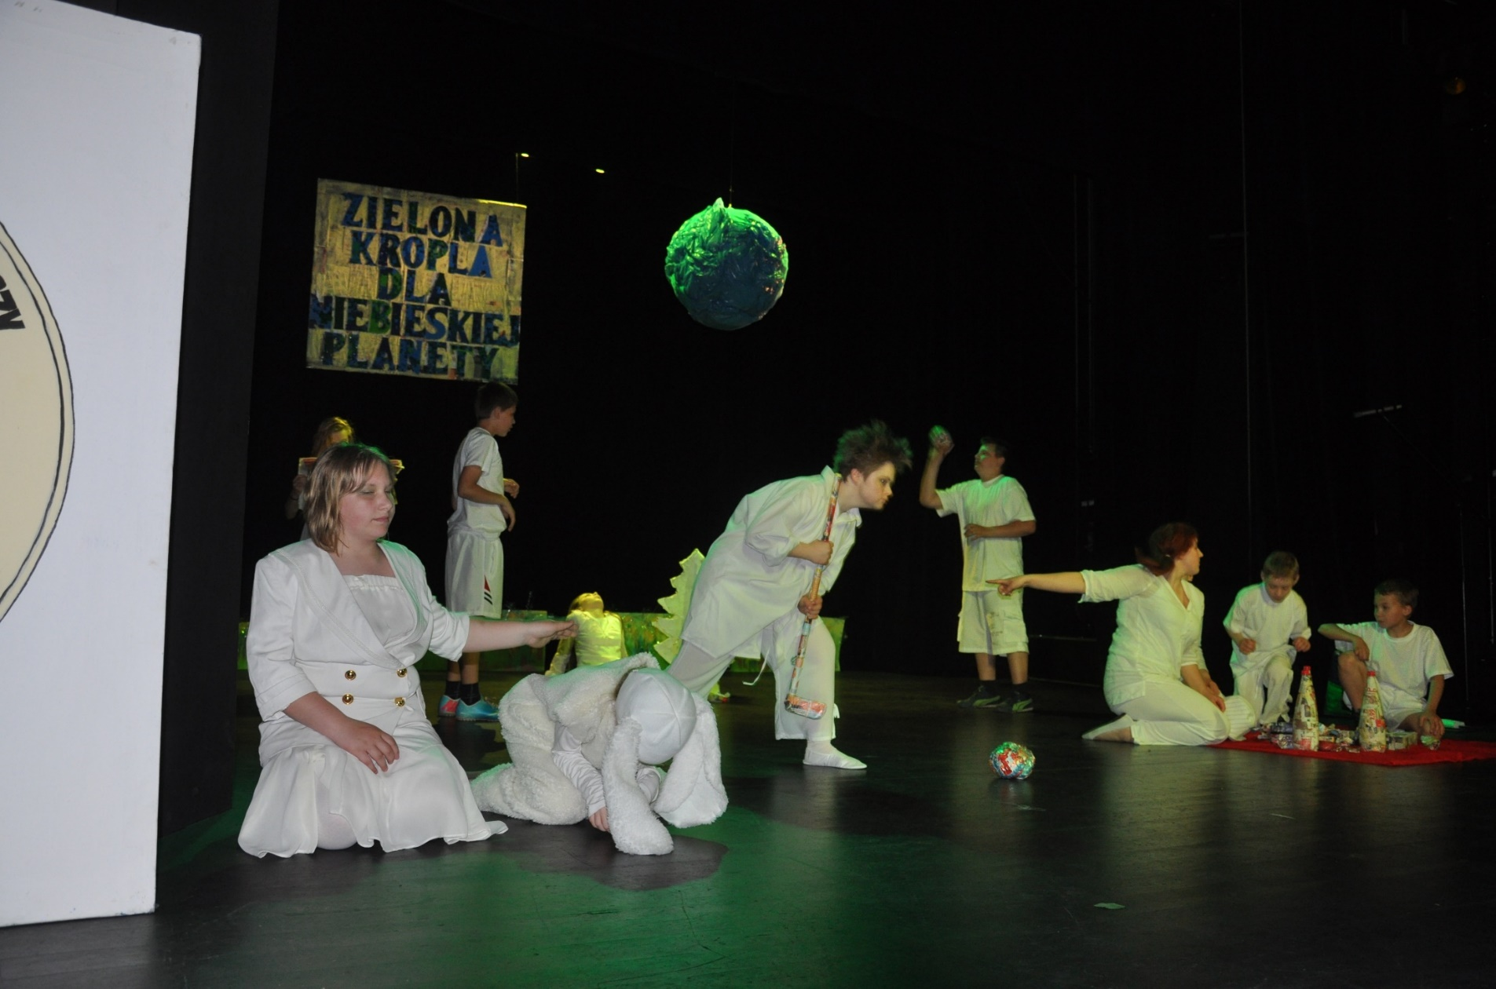
E
“The Future Begins Today” Project KA229 2018-1-PL01-KA229-050749

Slide 32
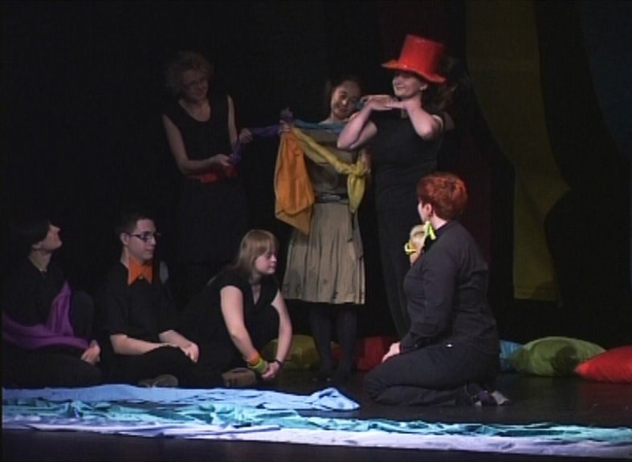
E
“The Future Begins Today” Project KA229 2018-1-PL01-KA229-050749

Slide 33
Our students took part in the plays of the PAT prevention group, which went to Germany with the "Requiem for Maia" and workshops for young people
“The Future Begins Today” Project KA229 2018-1-PL01-KA229-050749

Slide 34
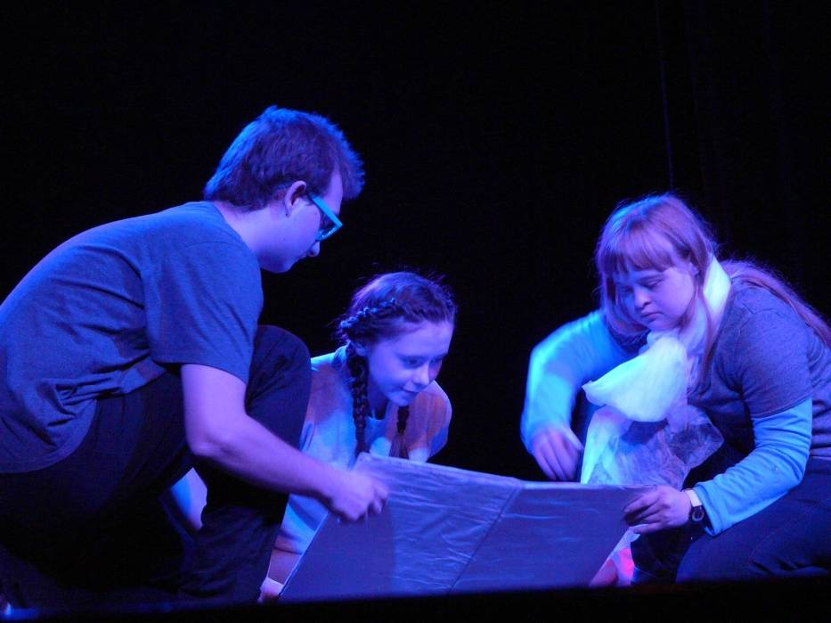
E
“The Future Begins Today” Project KA229 2018-1-PL01-KA229-050749

Slide 35
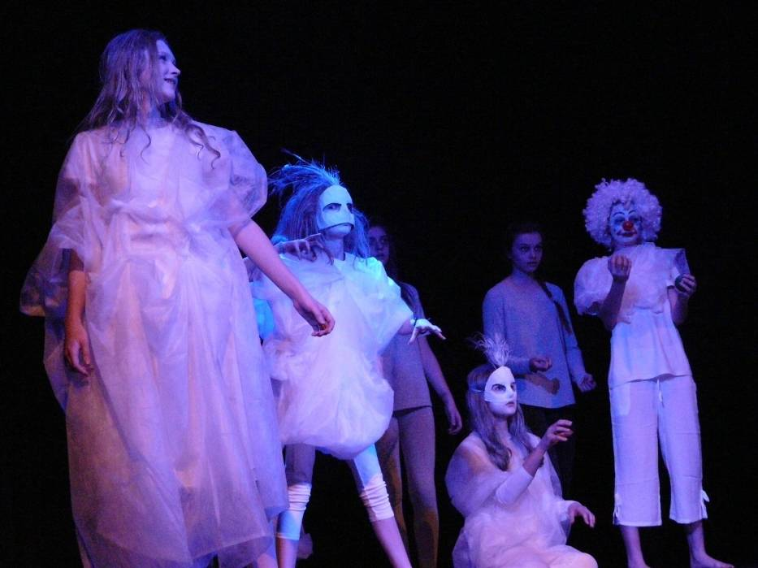
“The Future Begins Today” Project KA229 2018-1-PL01-KA229-050749

Slide 36
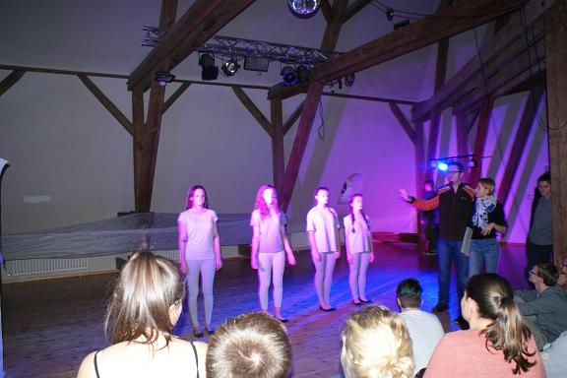
“The Future Begins Today” Project KA229 2018-1-PL01-KA229-050749

Slide 37
We also take part
in competitions, reviews and plays
in various Polish cities.
“The Future Begins Today” Project KA229 2018-1-PL01-KA229-050749

Slide 38
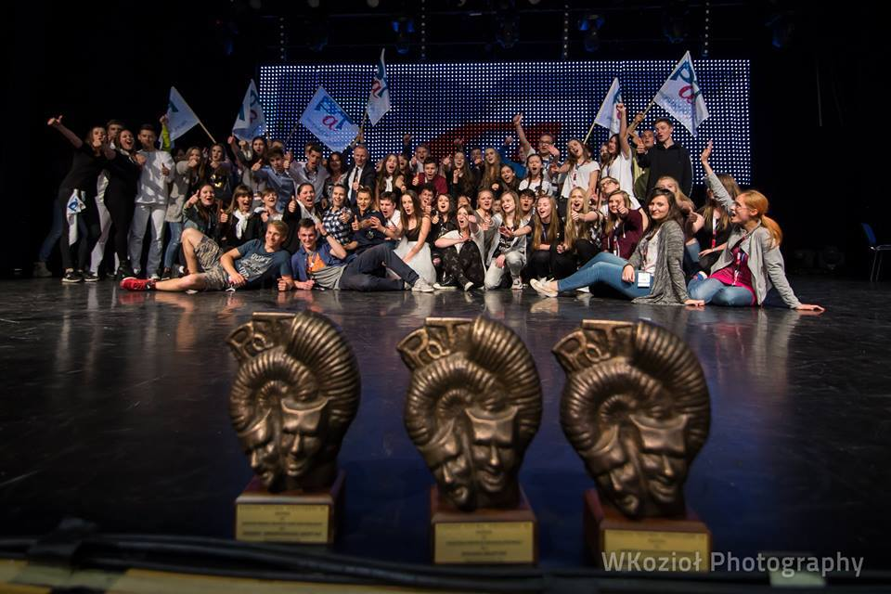
Częstochowa
“The Future Begins Today” Project KA229 2018-1-PL01-KA229-050749

Slide 39
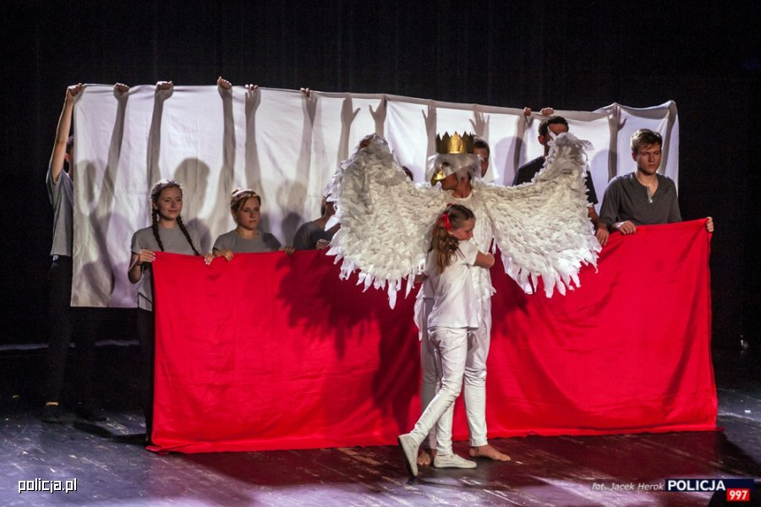
Warsaw – The final gala of the artistic competition to celebrate the 100th anniversary of the police in Poland
“The Future Begins Today” Project KA229 2018-1-PL01-KA229-050749

Slide 40
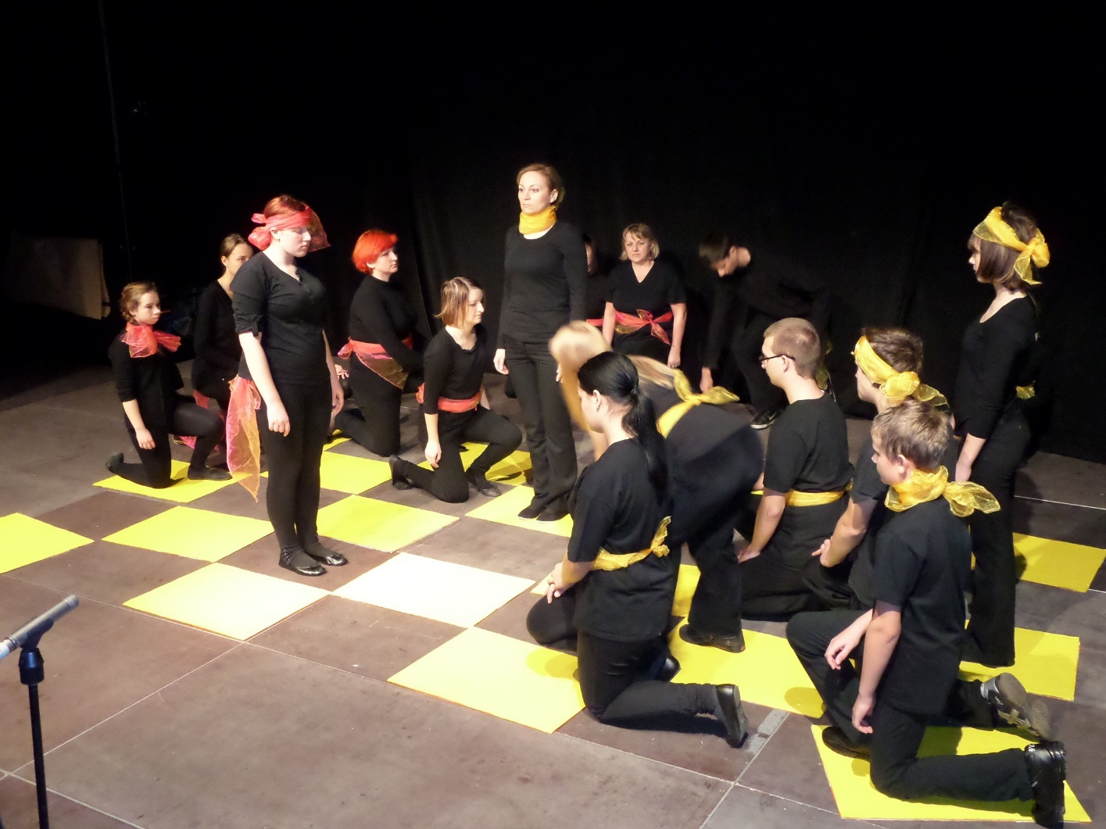
Łódż - Second place in the voivideoship competition for preventive theater
“The Future Begins Today” Project KA229 2018-1-PL01-KA229-050749

Slide 41
We also have the Amateur Adult Theater Massacre
which consists of teachers, students, parents and graduates
“The Future Begins Today” Project KA229 2018-1-PL01-KA229-050749

Slide 42
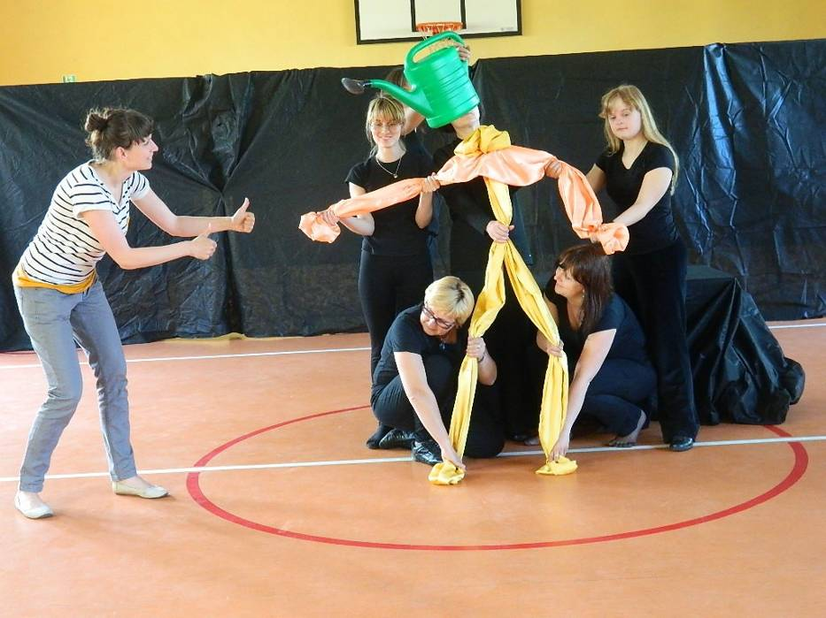

Slide 43
The Massacre organizes theater lessons, debates and meetings with the youth of various schools in Sieradz.
“The Future Begins Today” Project KA229 2018-1-PL01-KA229-050749

Slide 44
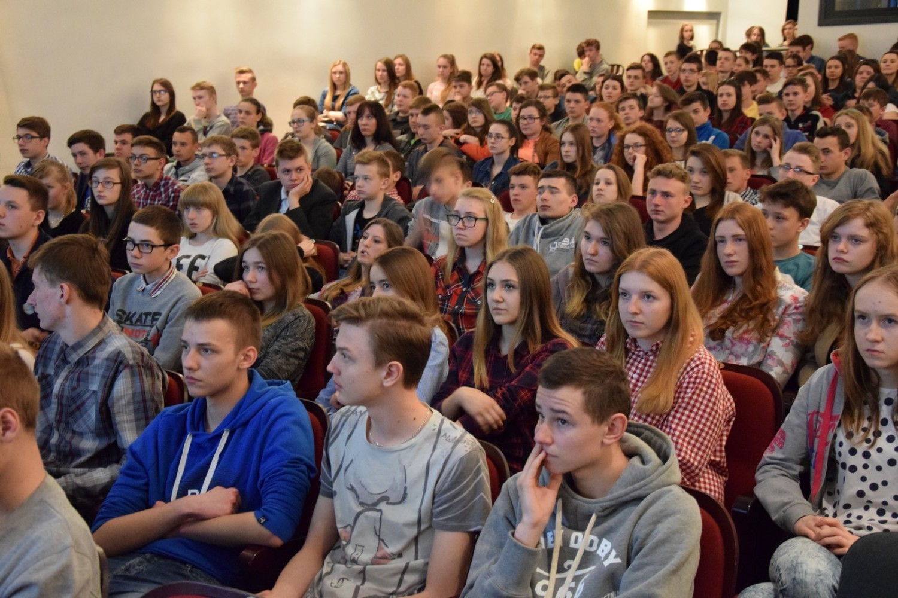

Slide 46
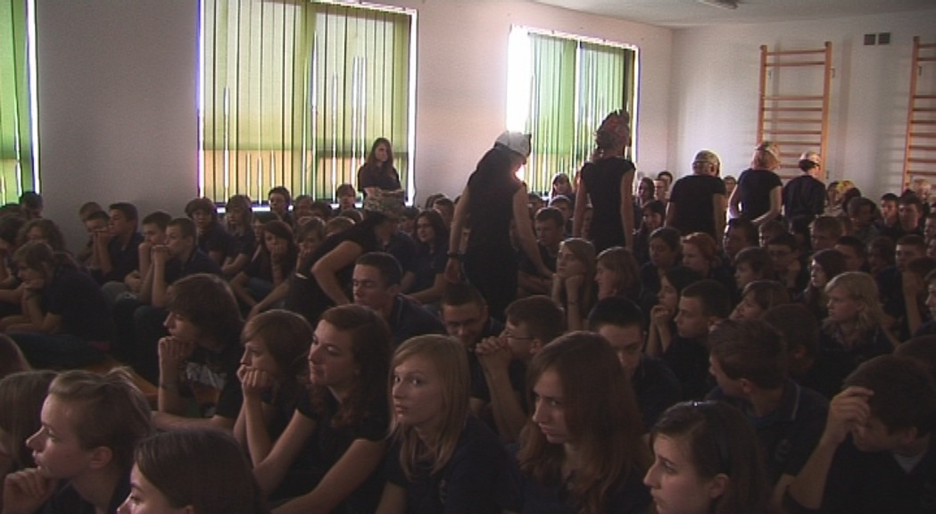

Slide 47
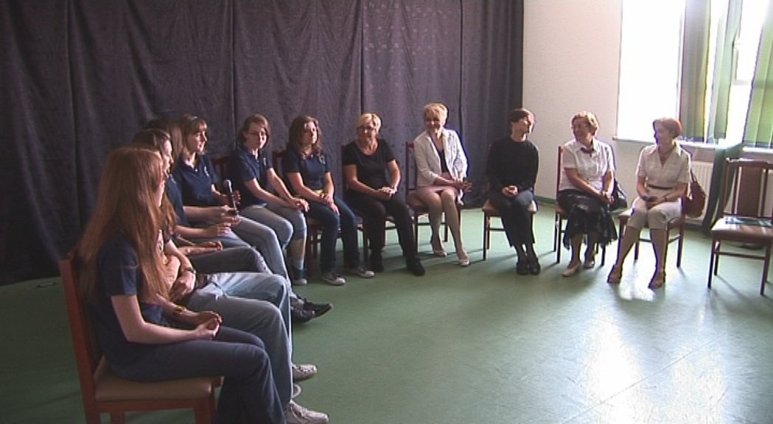

Slide 48
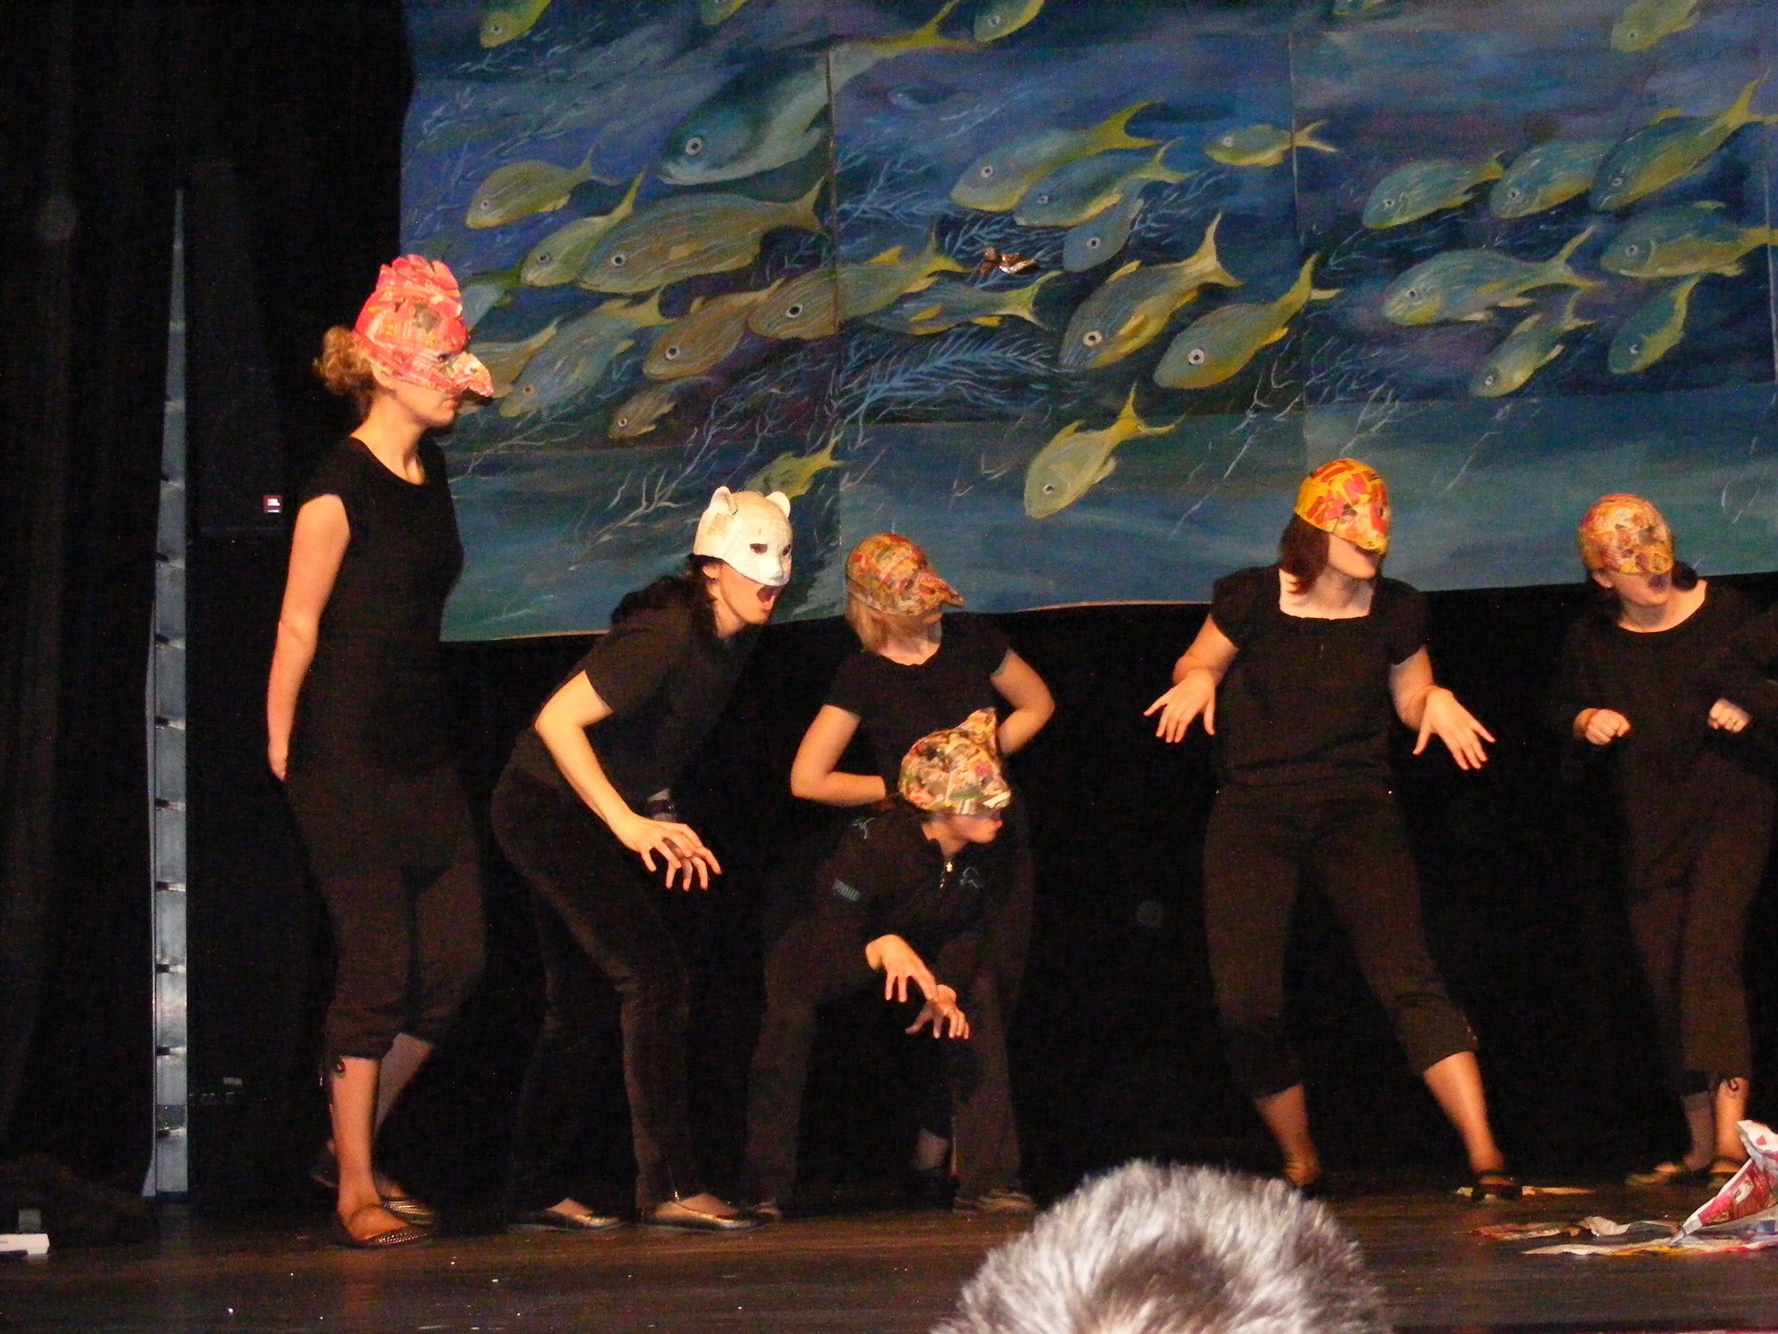

Slide 49
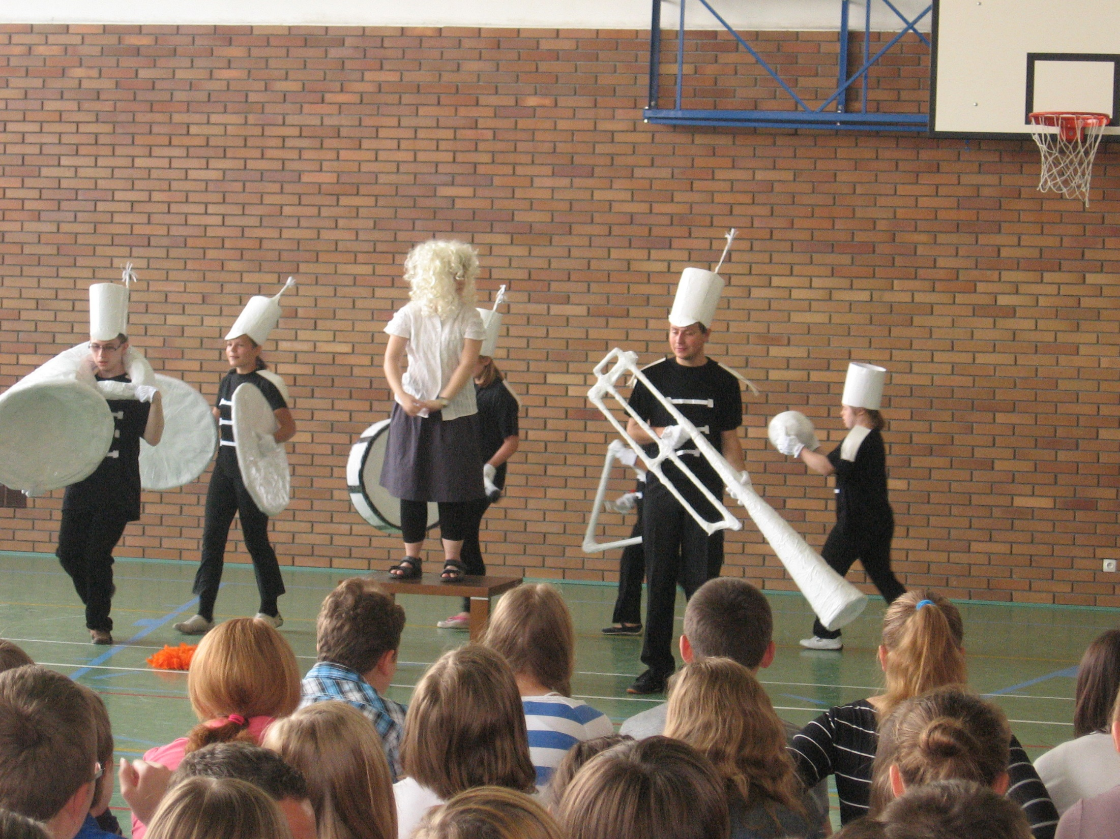

Slide 50
We meet new people, theater techniques and solutions.
We talk about various topics of interest to us. We collect experiences, emotions and impressions. We are richer than before :)
“The Future Begins Today” Project KA229 2018-1-PL01-KA229-050749

