Slide 1
How did Covid 19 impact my life?
Karla Leskovar

Slide 2
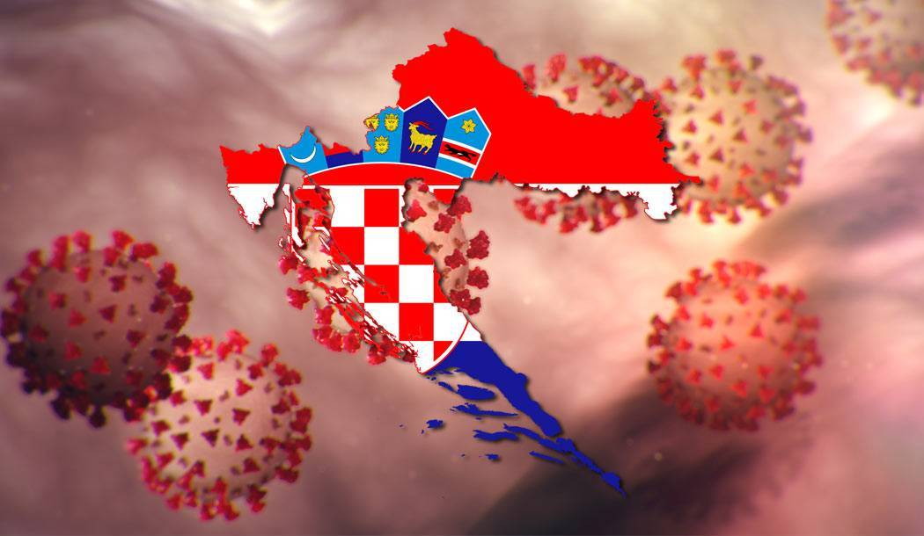
coronavirus did not appear in our country at first, but in China, and only later in Croatia, I was worried, but I was not afraid

Slide 3
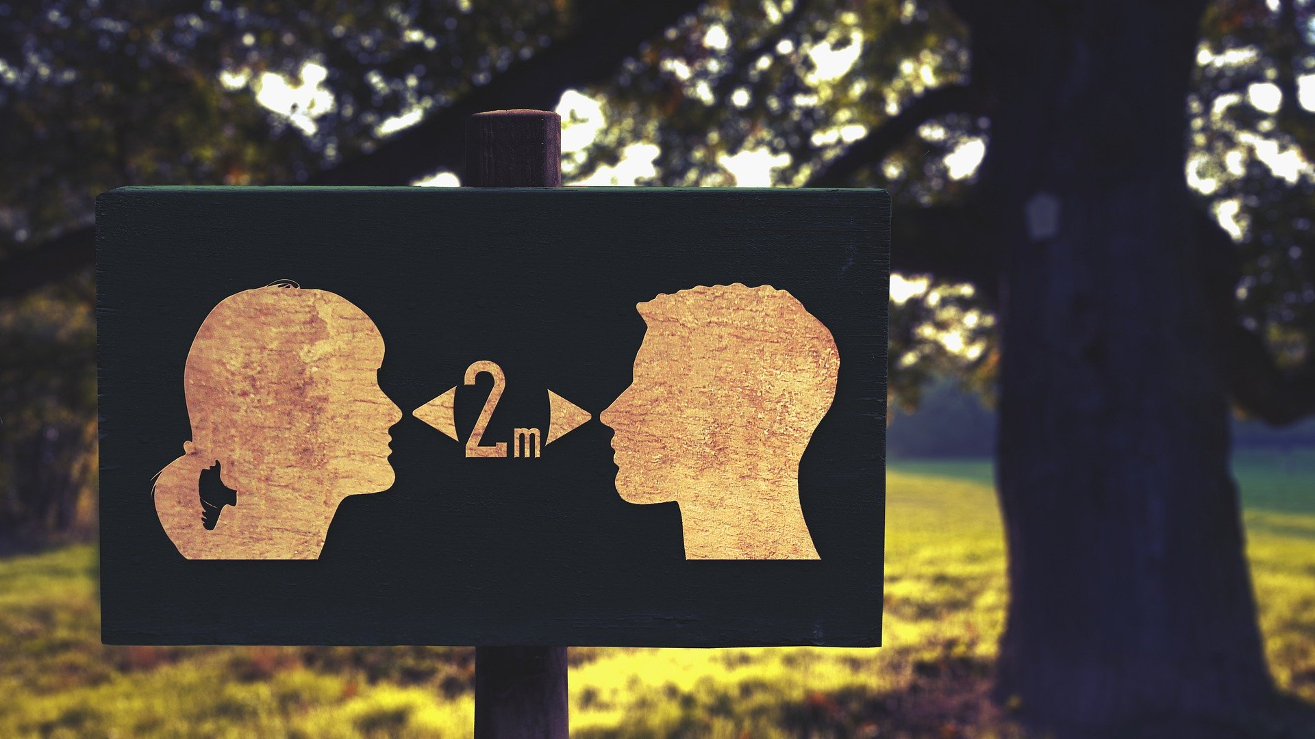
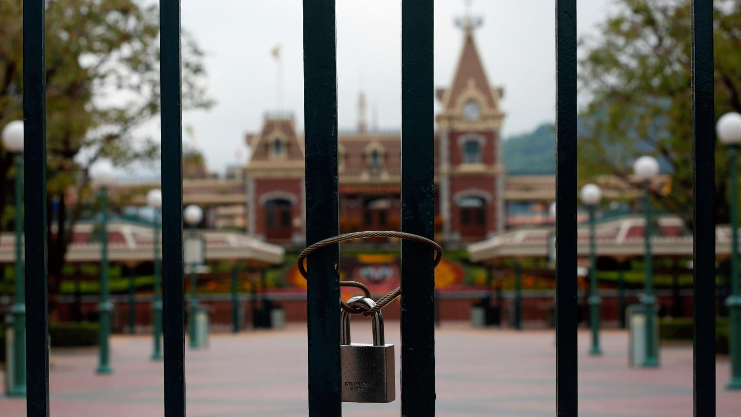
as the rise of the infected started in croatia, many people were in isolation and quarantine, wherever they went outside our place, we would need a pass

Slide 4
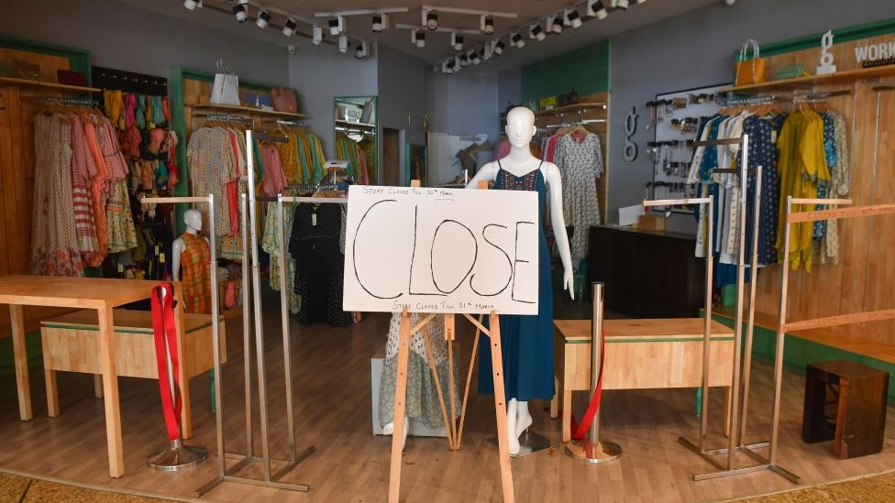
online school for students started, everything was closed for cafes, shopping malls, a lot of people lost their jobs due to coronavirus

Slide 5
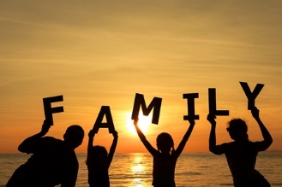
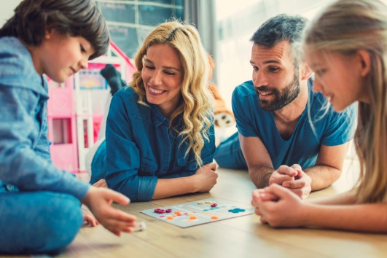
I was very sad because at first I was not allowed to hang out with a friend, but I spent a lot of time with family

Slide 6
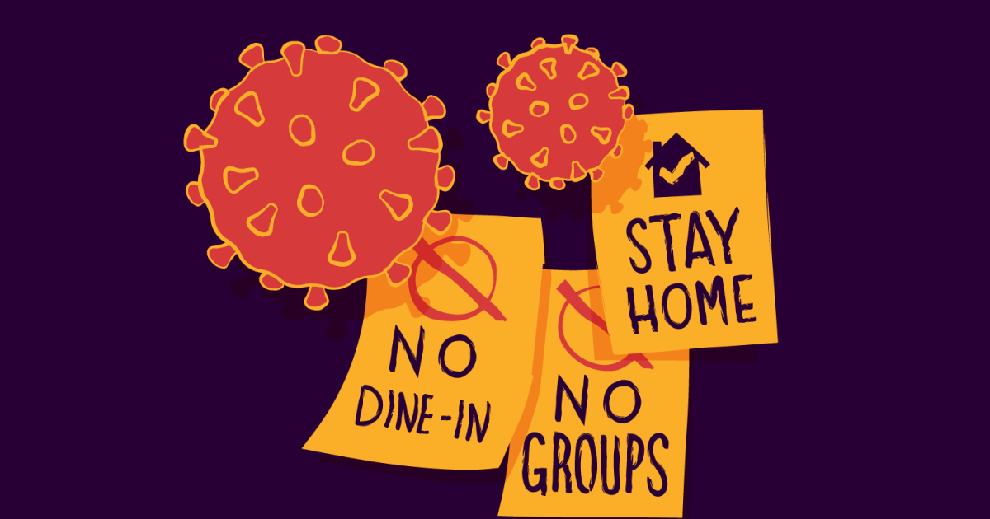
we have to adhere to measures (stay at home) to make the coronavirus go away faster and we get back to normal life!!!

