Slide 1
KA229 2018-1-PL01-KA229-050749
3rd Exchange of Students
Institut Guillem Catà
Manresa- Spain
10-14 February 2020
Logbook

Slide 2
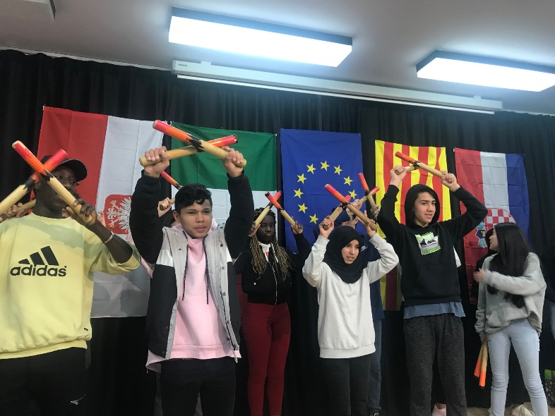
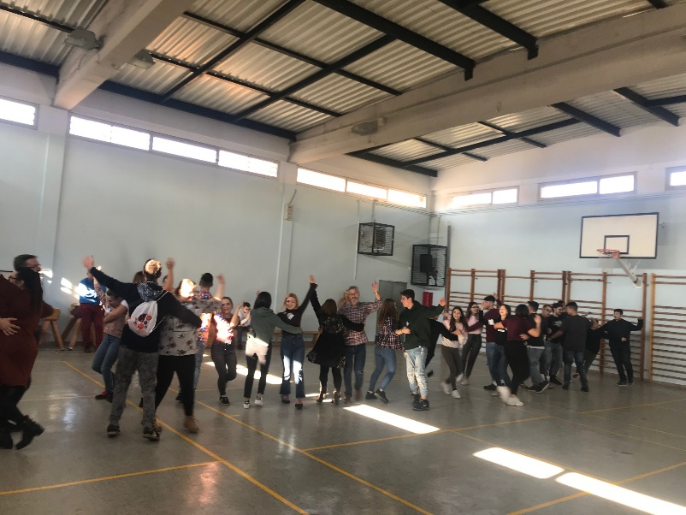
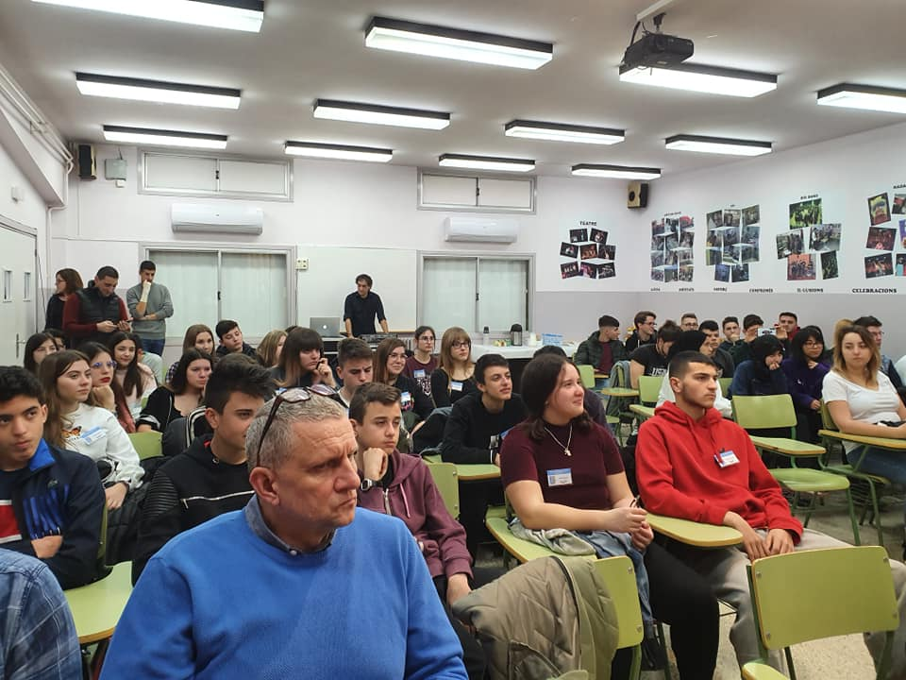
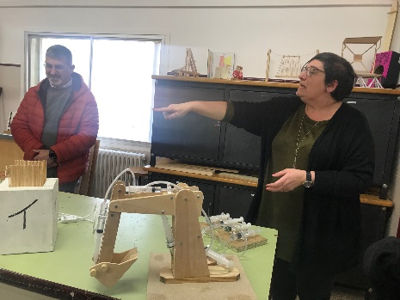
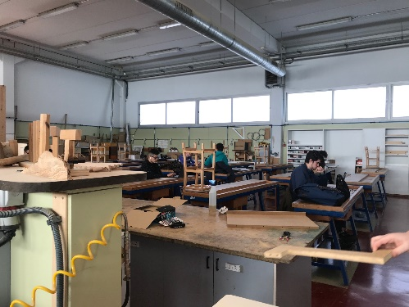
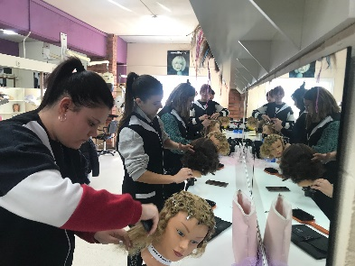
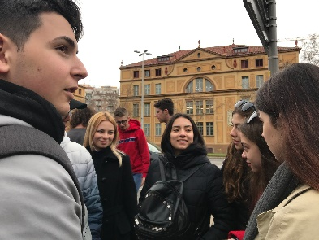
1° Day
Welcome cerimony and ice-breaking activites, CULTURAL FOLKLORE
Catalan Team welcomed delegations from Italy, Polland and Croatia by organizing a show and by teaching us traditional dances
We presented interpersonal relationship classes and visited the school to learn about the school vocational studies
In the afternoon we had a tour around Manresa and activity on orientation with mobile phones

Slide 3
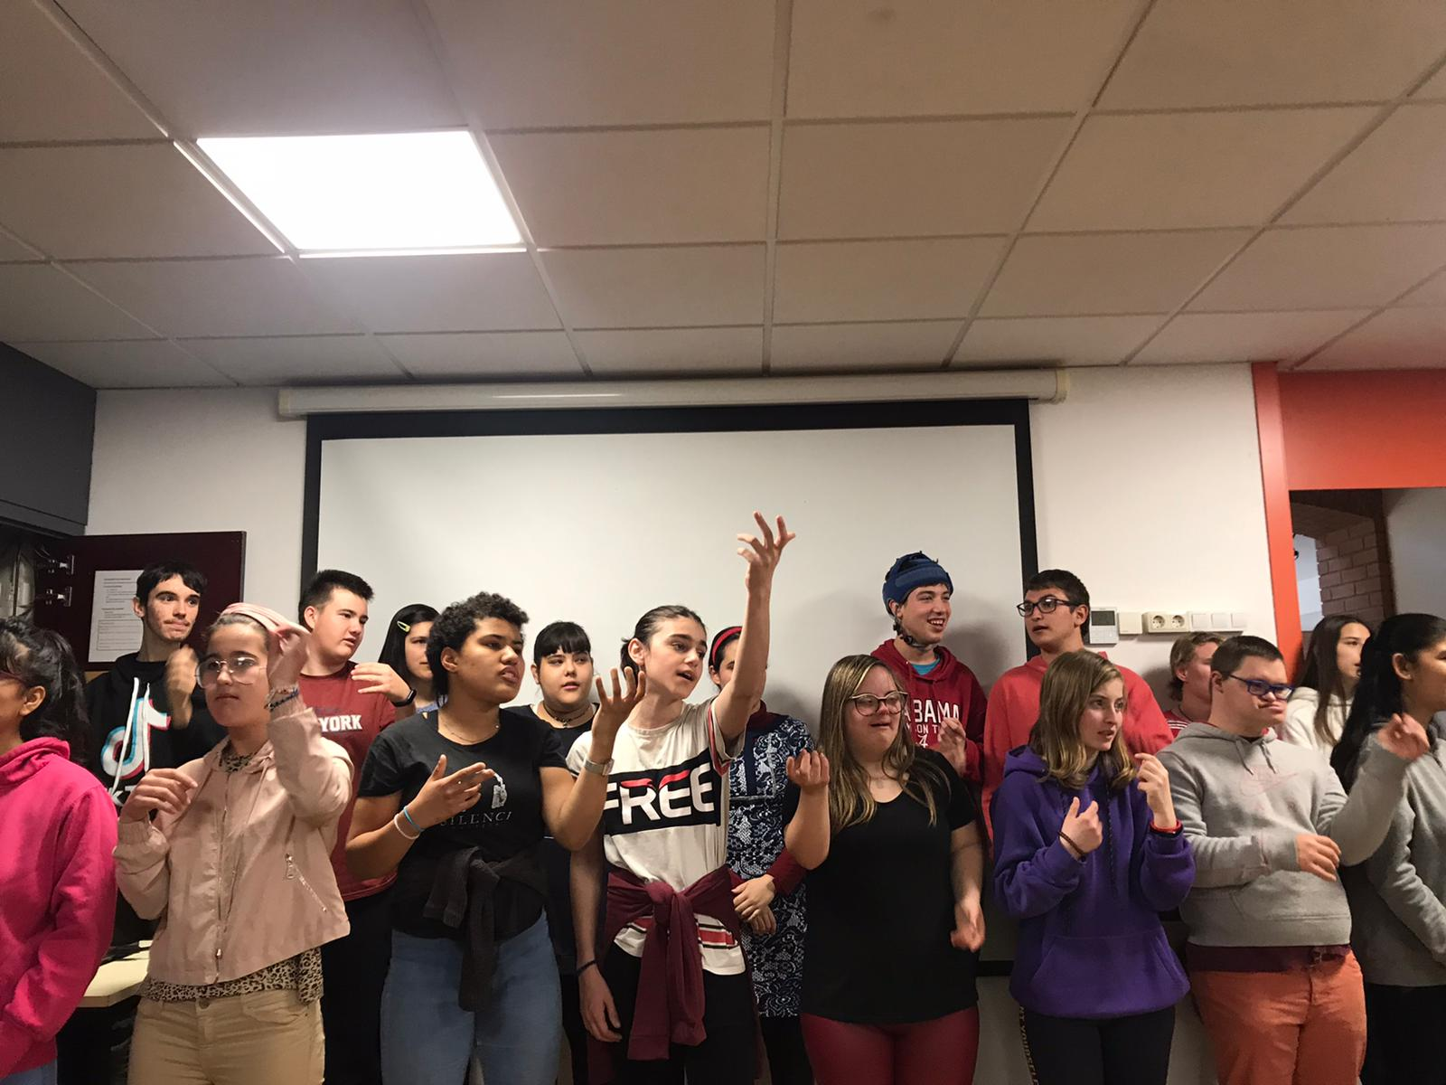
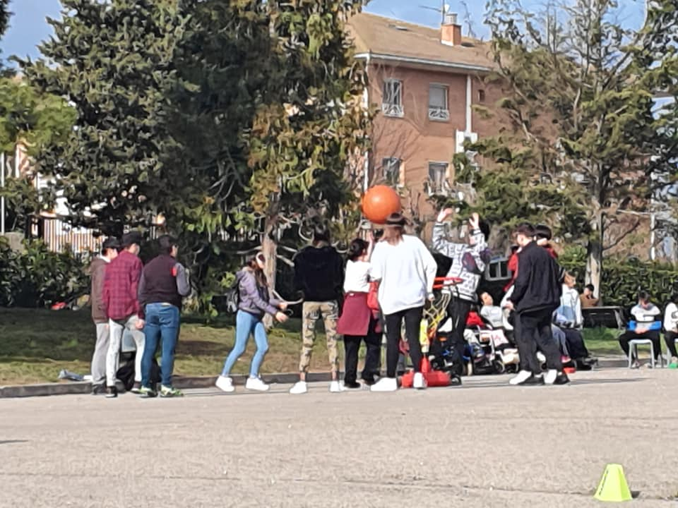
2nd Day
We visited a Sen school called AMPANS and we helped students create games
It was really striking, the visit made us ponder about the issue on inclusion at school

Slide 4
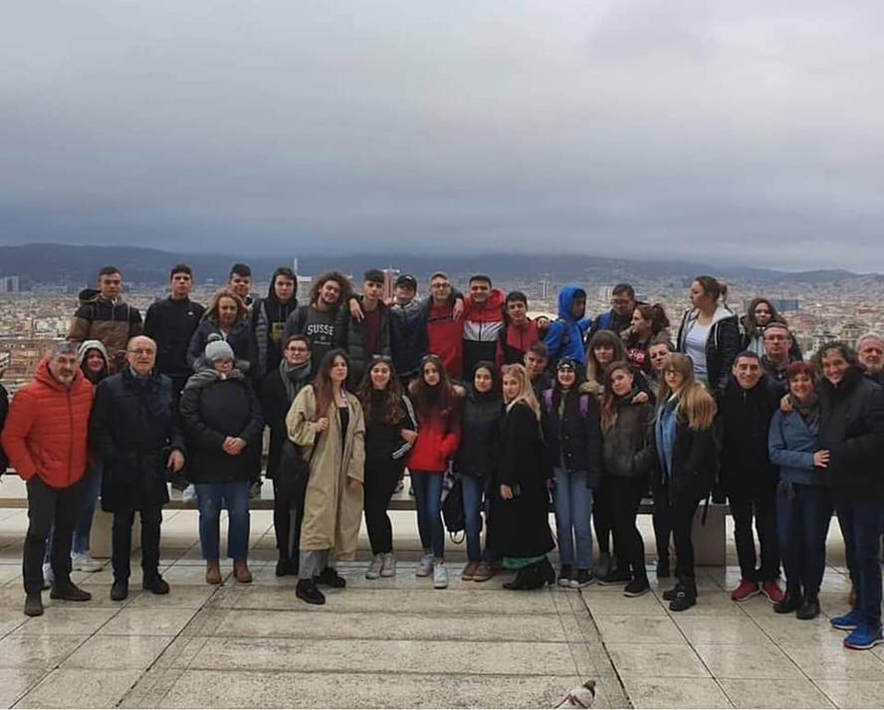
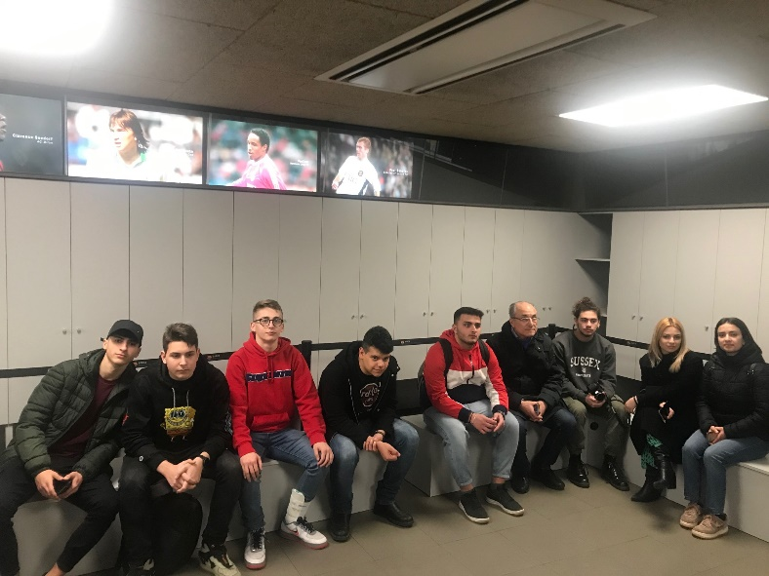
3rd Day
Our Spanish hosts succeded in letting us visit the most important sites of interest in Barcelona such as la Sagrada Familia and Camp Nou

Slide 5
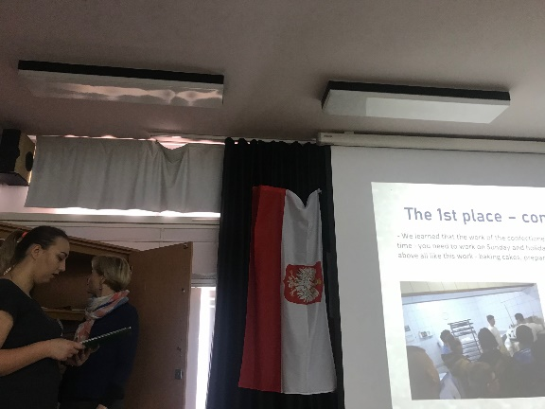
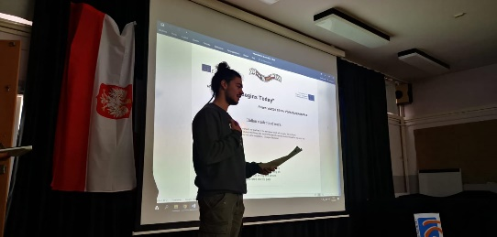
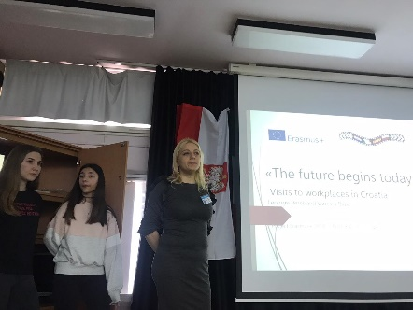
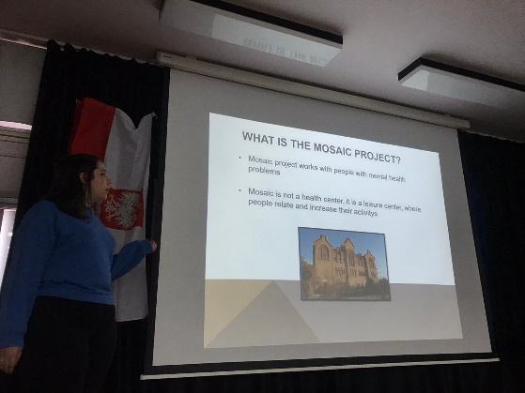
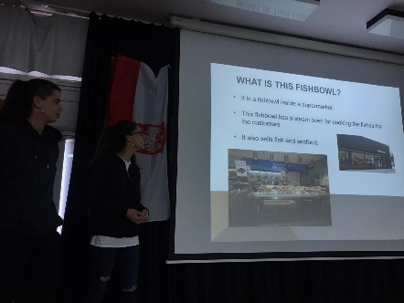
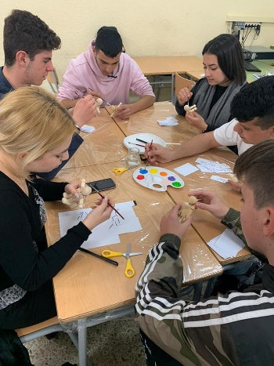
4° Day
Students from partner countries reported on visits to workspaces: it was interesting to share our experience in real workplaces
We joined the workshop “Get to know yourself“ and we identified ourselves with a puppet: in this way we succeeded in externalize our future job position

Slide 6
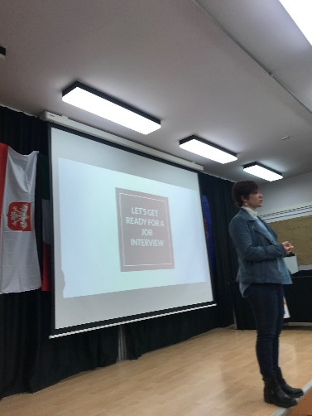
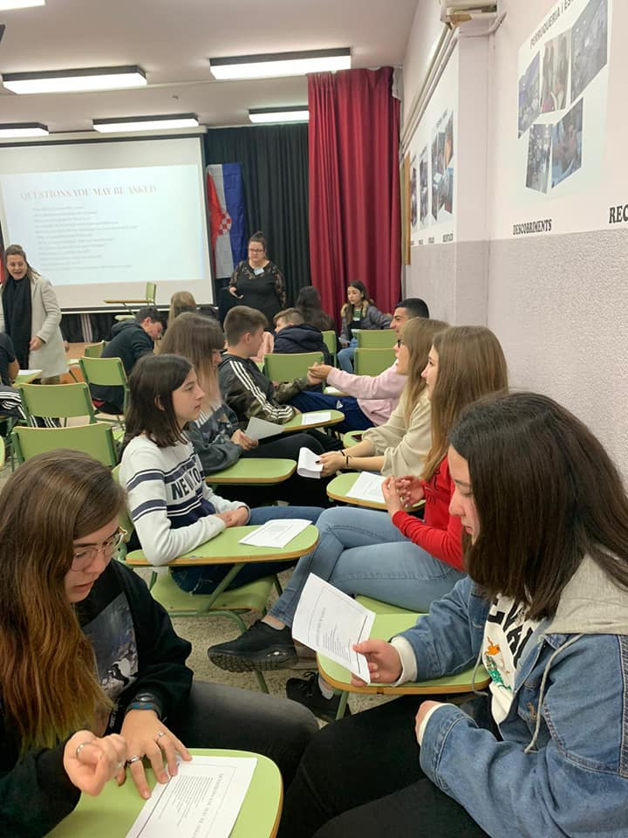
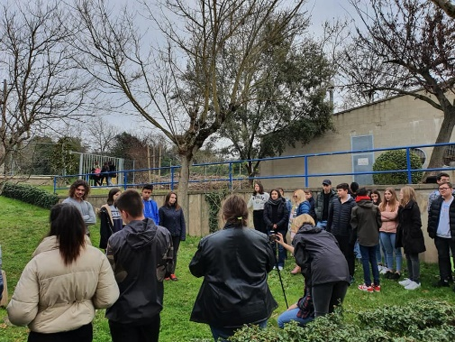
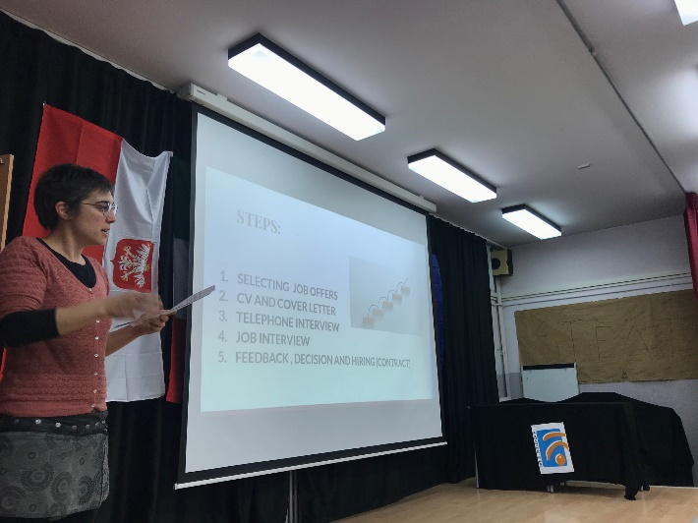
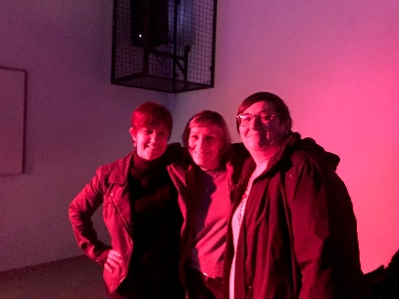
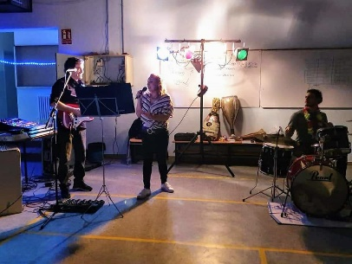
5th Day
We were introduced to Europass and Role played on job interviews simulating real job application
We recorded the last part of the movie: Dreams come true..
..and joined a fantastic farewell party organized by our Spanish teacher

Slide 7
Thanks for the attention
Valerio Raschillà
ITT Malafarina- Soverato- Italy
"This project has been funded with support from the European Commission. This publication reflects the views only of the author, and the Commission cannot be held responsible for any use which may be made of the information contained therein."

