Slide 1
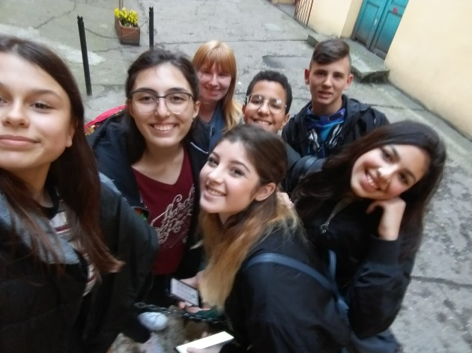
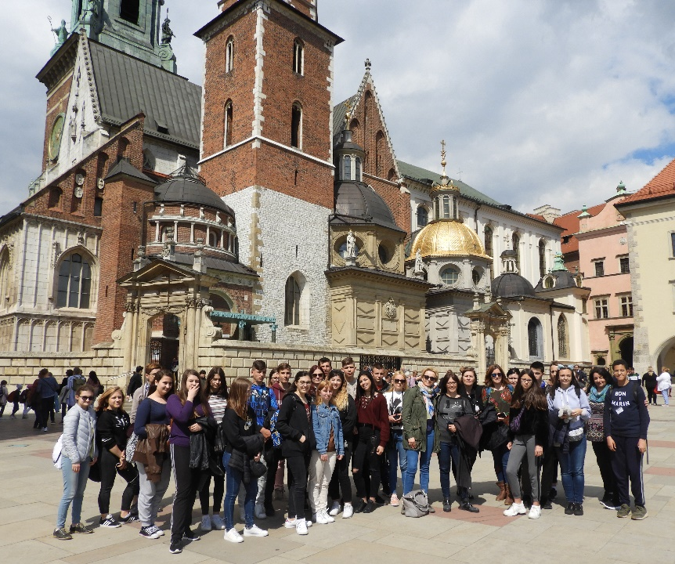
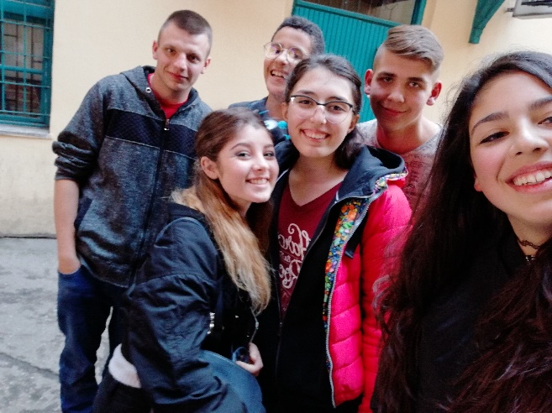
Chiara Rosanò, 1B CAT
The Erasmus experience in Poland has improved my competences a lot.
The workshop "Who am I?" certainly amused me but it also helped me to be less shy and more outgoing. It also favored integration with the other guys with whom we built a great friendship.
The theater workshops instead made me appreciate more this art which is very beautiful and, at the same time, very difficult for me.
The Festival of Cultures was one of the most beautiful and exciting moments of this mobility because it gave me the opportunity to know other cultures and taught me to appreciate more my roots and the traditions of my land.
Finally, the visit to Krakow was very interesting: we saw fantastic monuments and we spent convivial moments with all the other guys.

