Slide 1
How did Covid 19 impact my life?
Noa Leskovar

Slide 2
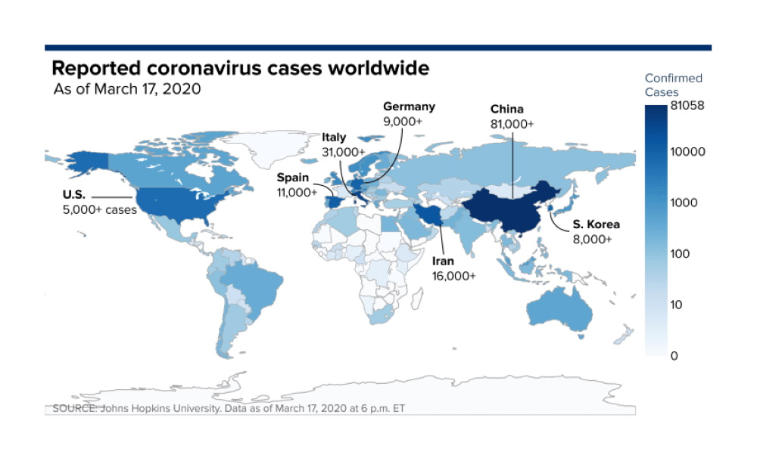
coronavirus first appeared in China but i wouldn't worry about that

Slide 3
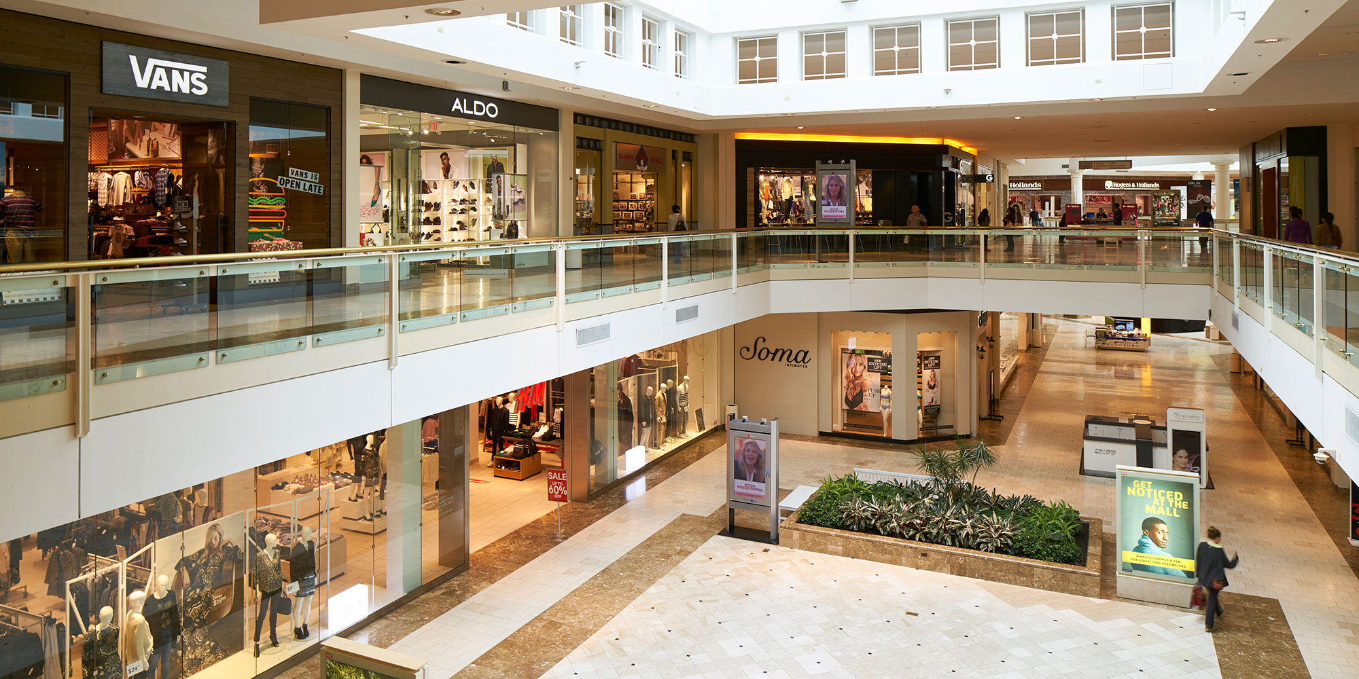
after some time it appeared in Croatia then all malls closed and nobody can go hang out

Slide 4
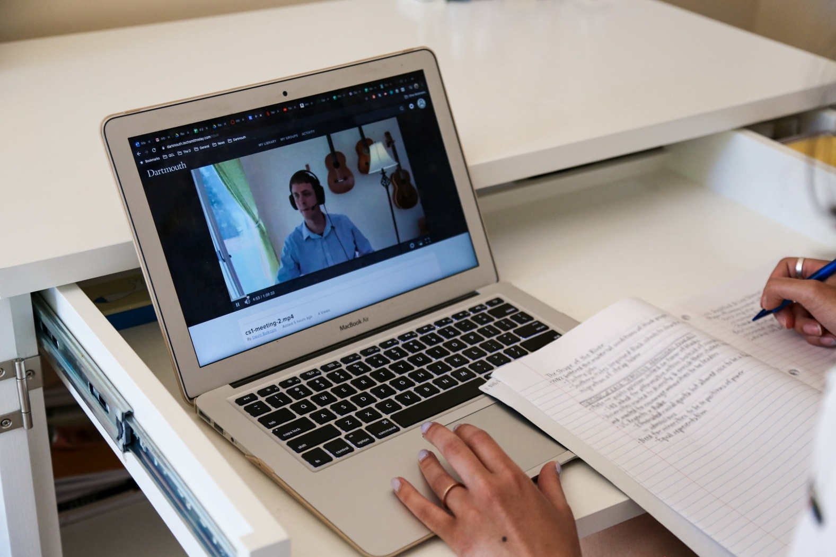
schools started online and we were all sad about it, we could not hold on or see

Slide 5
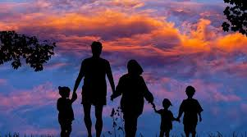
I spent my days at home with my parents, sometimes I was on the computer

Slide 6
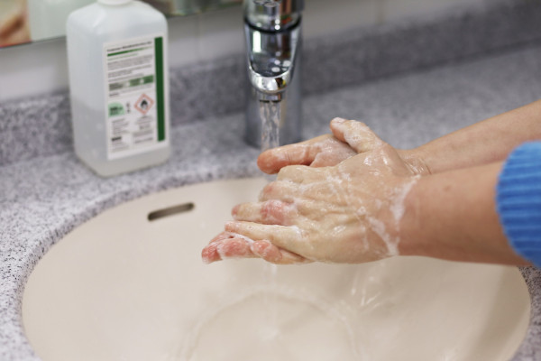
I'll take more care of washing my hands, and I will be careful not to touch the things that people have put their hands on before me

Slide 7
Stay home and your normal life will return soon!

