Slide 1
“The Future Begins Today” KA229 2018-1-PL01-KA229-050749
Characteristic elements of tradition and culture in Calabria

Slide 2
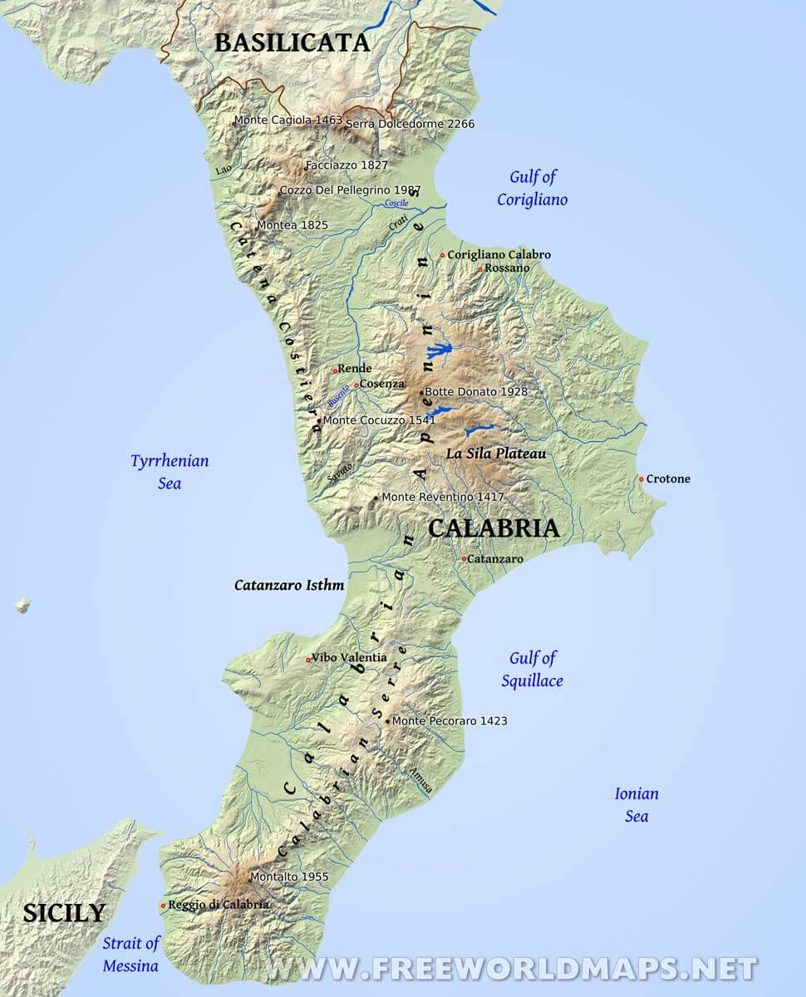
Calabria is at the toe of the boot, in the extreme South of Italy - lapped by the splendid crystal blue Ionian and Tyrrhenian Seas and separated from Sicily by the Strait of Messina. The warm climate, the beautiful colors of the sea, the rocky coasts that alternate with sandy beaches, a nature that is wild and mysterious, the strong and genuine flavors of local food and the vestiges of its ancient origins make Calabria a unique place where vacationers can enjoy themselves both in Winter and Summer.

Slide 3
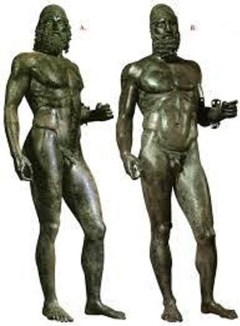
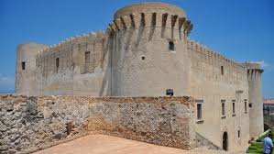
The territory was called Brutium by an ancient Italic tribe that occupied the land. The name Calabria comes from the Hebrew 'kaleb' meaning land of resin or woods. Greek influence occurred between the 8th and 7th centuries. Later the region was ruled by the Roman Empire. After the fall of the Roman Empire, Calabria remained under the rule of the Byzantines. In the following years it was ruled by the Longobards, the Byzantines again, the Normans, The Aragonese and Angioini, the Spanish, the French up to the time Garibaldi put an end to Bourbon influence and annexed it to the Regno d’Italia

Slide 4
Traditional recipes from Calabria

Slide 5
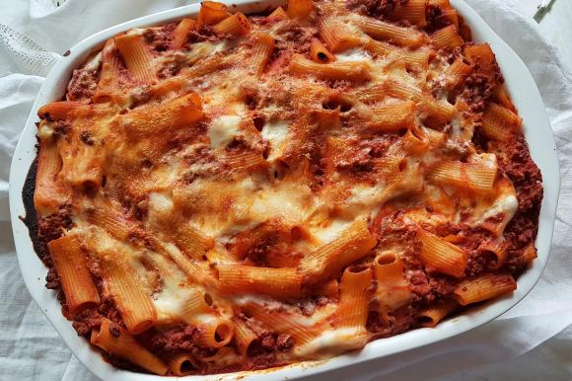
Pasta China
Recipe for four people:
500 g of penne pasta
250 g of mixed minced meat
1,5 l of tomato sauce
5/6 boiled eggs
1 egg
Suppressata (homemade salami from Calabria)
Provola chese
100 g grated Parmesan cheese
200 g of grated white breadcrumbs
For small meatballs:
Take the minced meat, 50 g of Parmesan cheese, the grated crumb, the egg, mix everything in a bowl, shape the small meatballs and finally fry them.
For the two layers of dough:
Boil the pasta, dress it with the sauce, put it in an ovenproof dish for the first layer, cut all the boiled eggs into segments, dice the provola and the suppressata and add a little Parmesan cheese, finally assemble everything and repeat for the second and last layer and on this make a sprinkling of Parmesan cheese and breadcrumbs.
Bake in a static oven at 180° for about 30 minutes.

Slide 6
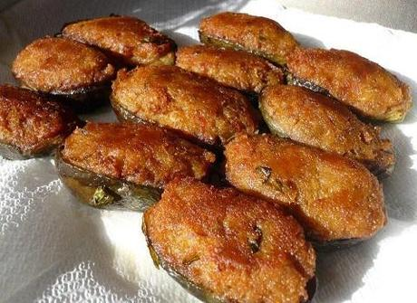
Malangiani Chini
For 4 medium-small aubergines:
250 g of grated white breadcrumbs
100 g grated parmesan cheese
2 eggs
2/3 small cut boiled eggs
120 g provola cheese
Garlic, basil and salt
Olive oil
Procedure for filling eggplant:
cut the aubergines in halves, remove the inside of the aubergine and put the outside aside, boil them together, then chop the inside in a pan where it will be fried together with chopped garlic, a little oil and basil, let cool and add ithe breadcrumbs and the 2 eggs and mix everything.
For the outer part of the aubergines:
after boiling them, let them cool and fill each cup with a slice of boiled egg, provola and previously prepared filling. Once finished filling them, fry them in a frying pan.

Slide 7
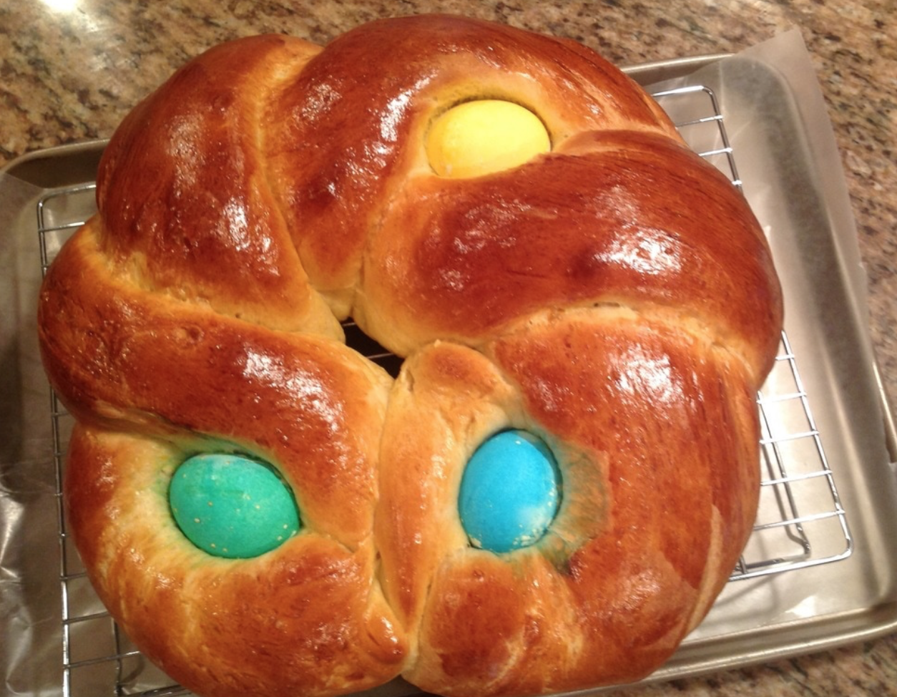
Italian Easter Bread (Cuzzupa Calabrese)
Ingredients
2 ¼ teaspoons rapid rise yeast
1 ¼ cups scalded milk, cooled
Pinch of salt
5 1/2 tablespoons butter, softened
2 eggs, beaten
1/2 cup sugar
3 ½ cups flour (the flour is approximate, you may need to go up to 4 to 4 1/2 cups)
1 egg, slightly beaten
3 uncooked dyed or undyed egg
Directions
In a large mixing bowl, combine yeast, milk, salt, softened butter, eggs and sugar. Mix until just combined.
Add half the flour and beat until smooth using a dough hook.
Knead until smooth with either dough hook or turn out on board and knead by hand.
Place in a bowl that has been greased with 1 tablespoon of oil. Cover and let rise in a warm place until doubled, about an hour, depending on the temperature in your kitchen. Punch dough down and divide into 3 pieces. Roll each piece to form a thick rope about 12 inches long. Form a braid, pinching the ends, and loop into a circle.
Place on a greased baking sheet or sheet that has been lined with parchment paper.
Cover and let rise a second time, until double, about 45 minutes to one hour again.
Brush the bread with beaten egg wash. In the middle of the bread ring, gently place an egg, making an indentation with the egg. Continue with the other two eggs.
Bake at 350 degrees until golden – about 40 minutes. Cool on rack.

Slide 8
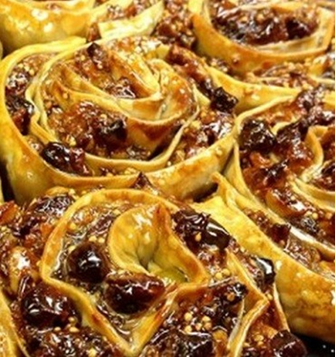
Pitta 'Mpigliata
Ingredients
Crust: 2 lbs flour - 1 cup water - 1 cup red wine
1 cup of extra virgin olive oil (or 1/2 cup of butter) 1 cup sugar - 2 eggs - 1/2 oz baking powder.
Stuffing: - honey - cinnamon - 3 lemon peels - 2 lbs walnuts - 10 oz raisins.
Directions
Mix flour, sugar and baking powder and knead slowing adding the water, then the wine a little at a time.
Continue to knead adding the eggs, the olive oil (or butter), and keep kneading until the dough is elastic. Allow it to rest a little under a cloth.
Prepare the stuffing with crushed walnuts, grated lemon peel, sugar, honey, the raisins that were reconstituted in water, and the cinnamon.
Use a rolling pin to obtain strips of 1/8 in thick dough that's about 4 inches wide.
Finish the edges with a rolling pizza cutter to obtain a zig zag edge. Drizzle the honey down the middle of each strip of dough and add the stuffing.
Fold over the edges to trap the stuffing inside, and roll the stuffed strips into rose shapes. Place the roses in an oven pan and cook in a preheated oven at 350 degrees F for about 40 minutes .

Slide 9
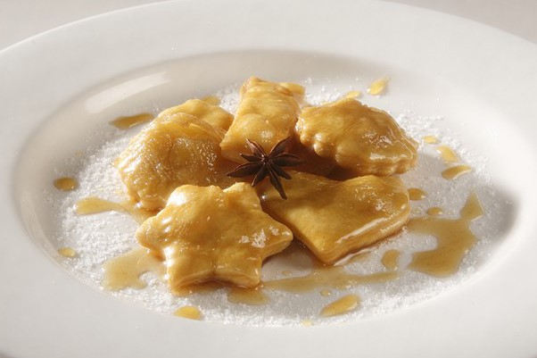
Ciccitielli (calabrian christmas fritters with honey)
Ingredients
2 lb all-purpose flour
10 eggs
5 oz sugar
5 oz butter
2 half cups anise liqueur
10 oz honey
½ cup water
1 package baking powder
frying oil to taste
1 pinch salt
In a large bowl, mix together seven whole eggs, three egg yolks, sugar, butter, anise liqueur and a pinch of salt. Once well mixed, add the baking powder and slowly pour in the flour, stirring continuously until you have a smooth, yet firm dough. Cover and let the dough rest for an hour.
Then, roll out the rough until ½ inch thick. Cut out little stars, circles, sticks or any form you prefer. Fry the ciccitielli a few at a time in a pan of boiling oil. Make sure the dough is completely covered by the oil. Once golden brown, remove the fritters using a slotted spoon and place them on a plate lined with papery towels.
Once all of the dough has been fried, melt the honey in a pot with ½ cup water. Let boil for 10 minutes, then remove the pot from the heat.
Add the fritters and stir carefully. Place the honey-covered fritters on a plate and serve immediately or at room temperature.

Slide 10
TRADITIONAL CALABRIAN DANCE
Calabrian habits have been preserved not only in the customs and traditions, but also in the dances, music, festivals and events. Dances are by far the most significant expression of an important event. The folk dance is the tarantella, which changes from area to area and even from country to country. In Soverato area the most famous artists are Mimmo Cavallaro and Cosimo Papandrea, who perform during the festivities creating a cheerful atmosphere, bringing together all the people belonging to the neighboring towns.

Slide 11
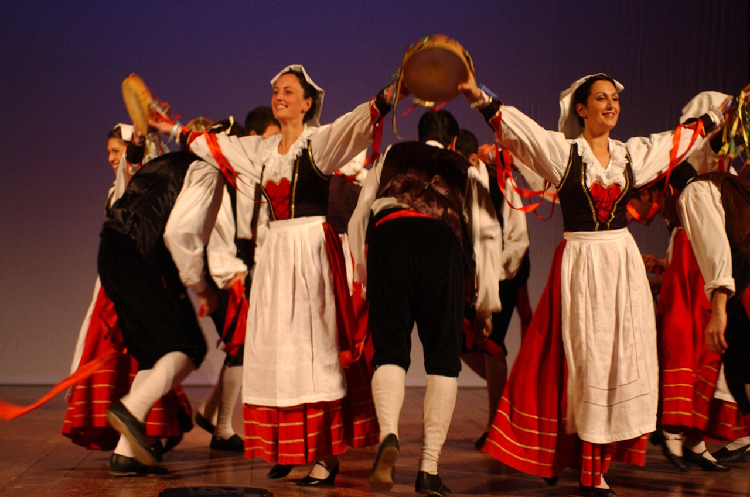
TARANTELLA
This dance takes the form of a duel, around a couple of dancers there is a circle called "rota" underlined with cries and claps of hands to the rhythm of the music. With multiple couples, the tarantella is a circle dance alternating from clockwise to counter-clockwise and back as the music progresses, picking up speed as it goes. In some countries tarantella is danced twice at a time, in alternating pairs, often regulated by a master of dance, sometimes with spontaneous changes. It is a very popular dance, it is danced on the spaces of the villages, during the festivities or on the streets on the occasion of the harvest or crops but also indoors, at home or in the halls for private parties, during the holidays or during various ceremonies.

Slide 12
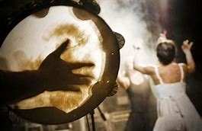
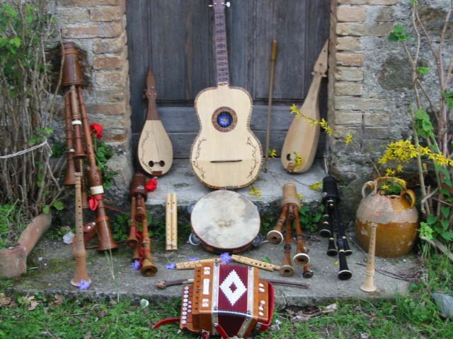
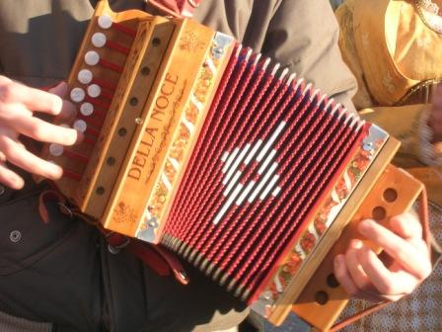
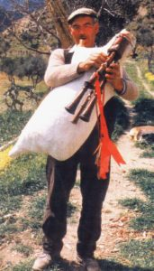
The melodic thread is entrusted to the accordion, which almost always replaces the bagpipe, or by the beat of the hands of the dancer. In this type of tarantella from upper and middle Calabria, a bass drum struck with a large curved mallet is still used.

Slide 13
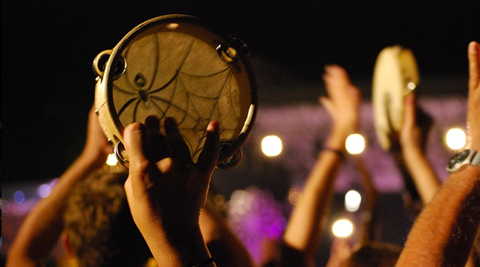
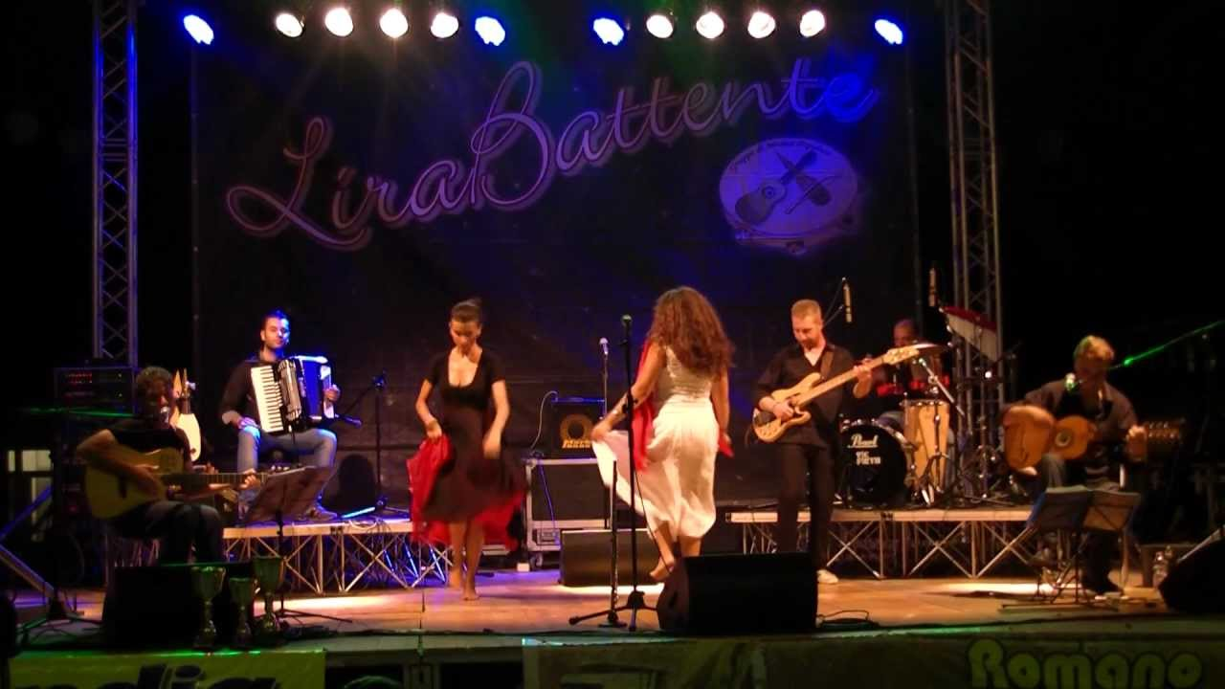
Most Famous tarantella songs
Tarantella VI
Tarantella d’amuri
Su calabrisi
La zitella
Bella figghiola
U jimbusedu

Slide 14
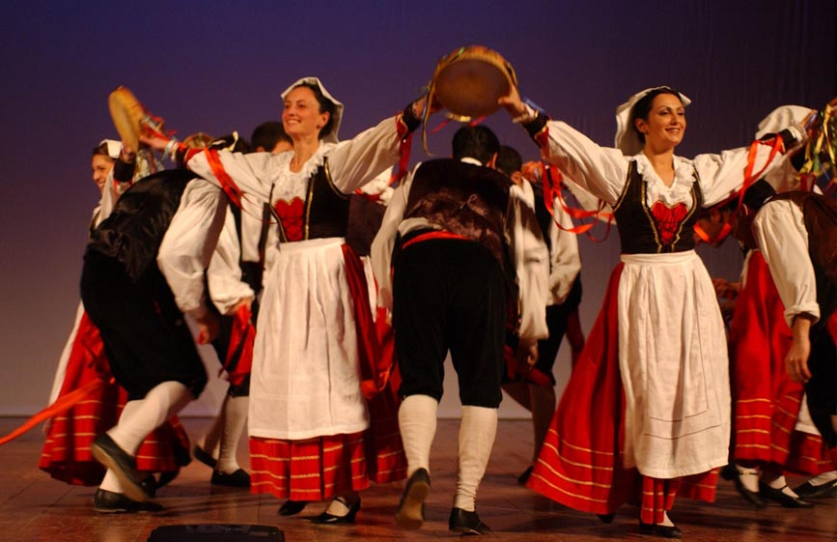
Popular music in Calabria
Its traditional instruments are the accordion, the “Lira” and the bagpipe, which accompanied all the phases of life:
Weddings
Baptisms
Births
all private parties

Slide 15
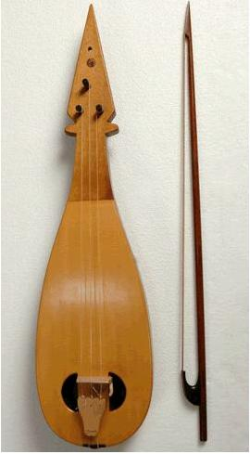
Popular music in Calabria
The “Lira” is made from a single piece of hollowed wood onto which the soundboard is glued, equipped with two resonance holes, usually circular, between which it is generally placed the bridge and it has three strings.

Slide 16
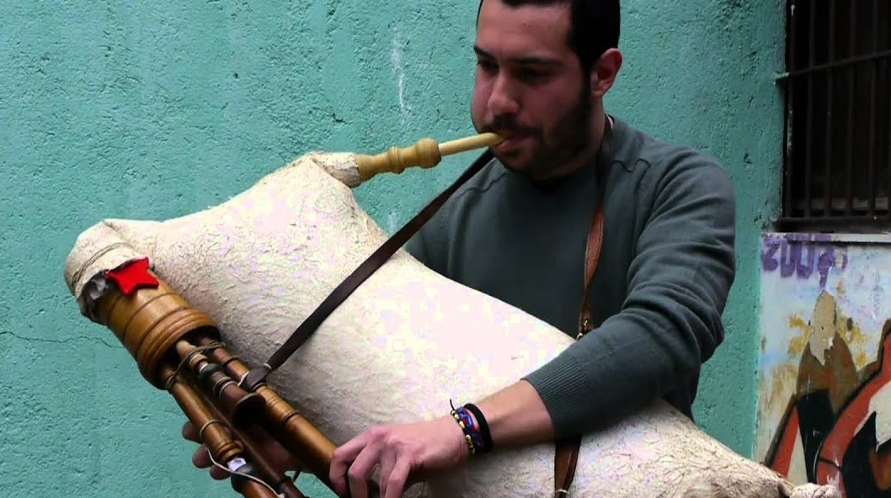
Popular music in Calabria
Bagpipes
Its sweet sound is given by the canes and by a bag of sheepskin or goat which serves as an air deposit.

Slide 17
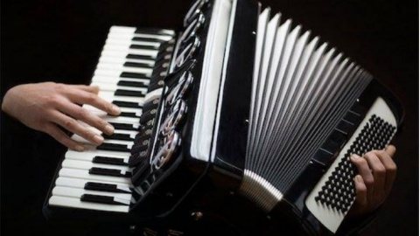
Popular music in Calabria
The Accordion is composed of two wooden boxes connected by a cardboard. Inside there are movable tabs that vibrate to produce sound when in contact with the air.
On the right side of the instrument the keys produce a single note, while on the left side they activate the contemporary sound of several reeds, giving life to the harmonic-rhythmic part.

Slide 18
Thanks for you attention
ITT MALAFARINA students:
Arcuri Francesca
Moretti Letizia
Rosanò Chiara
With the supervision of Giuseppe Schiavi, Mariella Battaglia and Savina Moniaci
"This project has been funded with support from the European Commission. This publication reflects the views only of the author, and the Commission cannot be held responsible for any use which may be made of the information contained therein."

