Slide 1
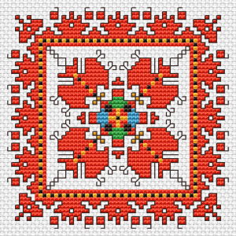
Basic school “Hristo Botev” an innovative school
Bulgaria/Pomorie

Slide 2
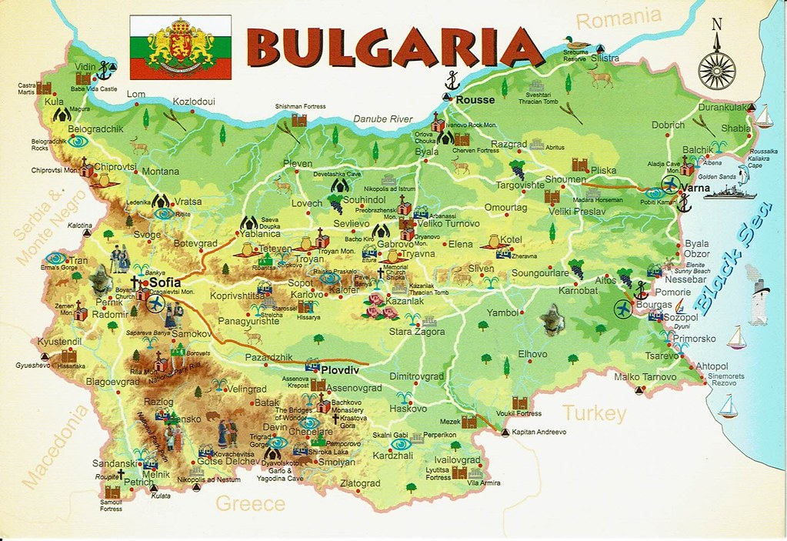
Our country

Slide 3
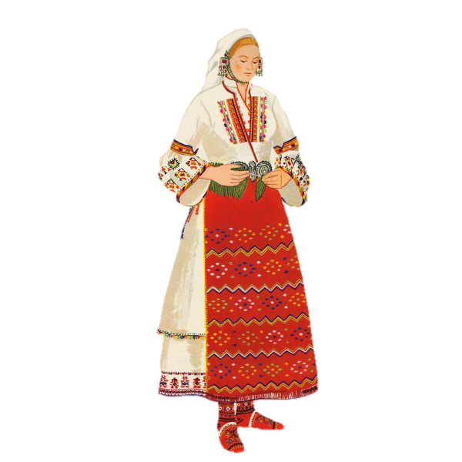
Our country
Bulgaria is a Balkan nation with diverse terrain encompassing Black Sea coastline, a mountainous interior and rivers, including the Danube. A cultural melting pot with Greek, Slavic, Ottoman, and Persian influences, it has a rich heritage of traditional dance, music, costumes, and crafts. At the foot of domed Vitosha mountain is its capital city, Sofia, dating to the 5th century B.C.

Slide 4
Pomorie
Pomorie is a town and seaside resort in southeastern Bulgaria, located on a narrow rocky peninsula in Burgas Bay on the southern Bulgarian Black Sea Coast.
It is situated in Burgas Province, 20 km away from the city of Burgas and 18 km from the Sunny Beach resort.

Slide 5
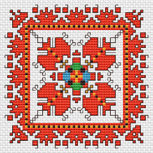
Pomorie at night

Slide 6
Pomorie
The Virgin Mary Church

Slide 7
Pomorie
Peyo Yavorov monument.
He was a Bulgarian Symbolist poet.
He was considered to be one of the finest poetic talents in the fin de siècle Kingdom of Bulgaria.

Slide 8
Pomorie
The alcove of stone in Pomorie

Slide 9
About us
The school was founded almost 87 years ago is the second largest school in e municipality of Pomorie. There are educated about 300 students from grades 1 to 7 from 35 pedagogical specialists.
80% of students are children from minority groups. In order to integrate them, the school has put in place a program to prevent early school leaving and improve the quality of education.
Many extracurricular activities are organized in our school to stimulate the development of students’ intellectual emotional, social and physical development.

Slide 10
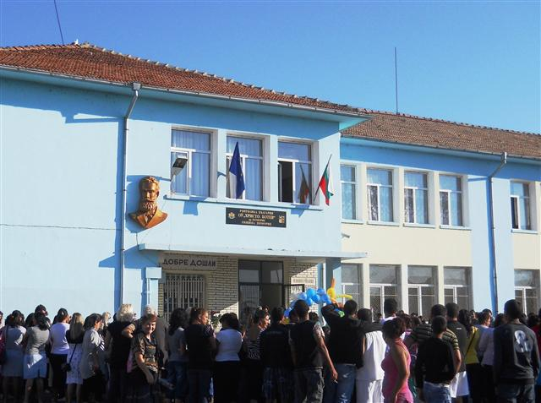
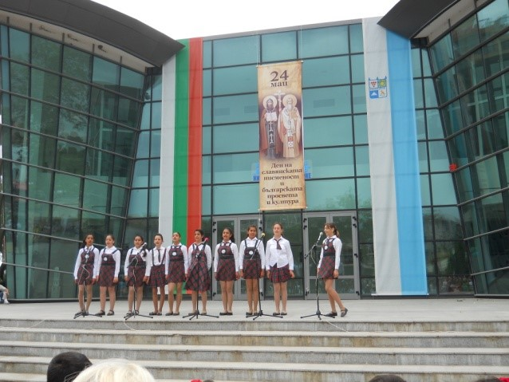
About us

Slide 11
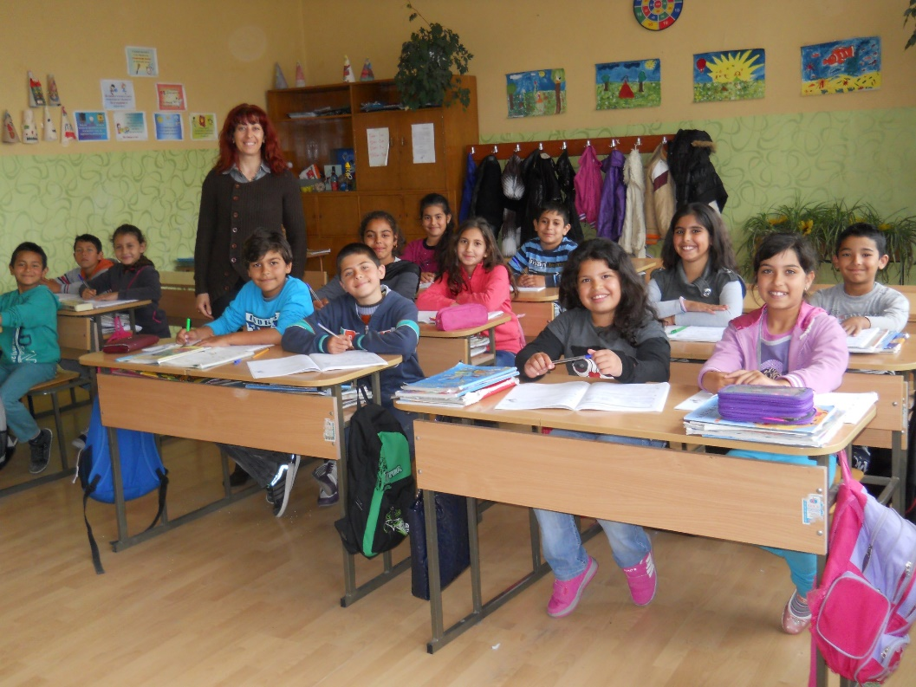
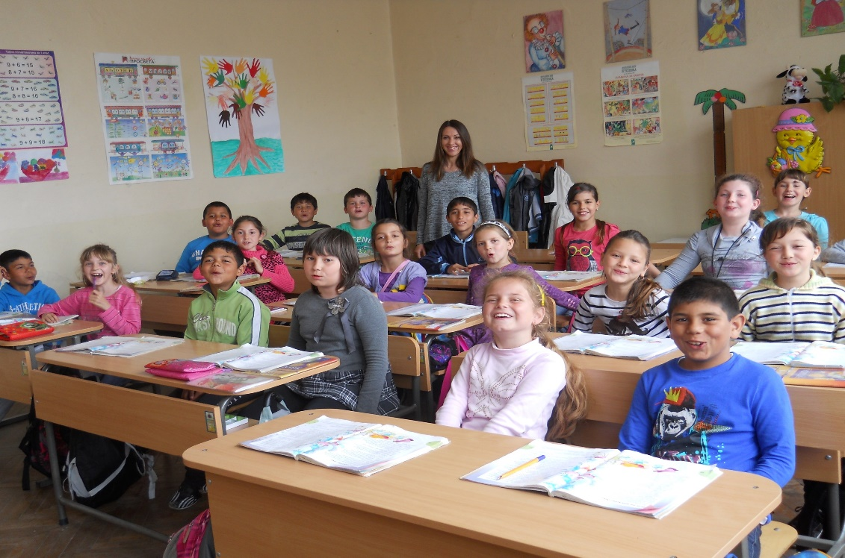
About us

Slide 12
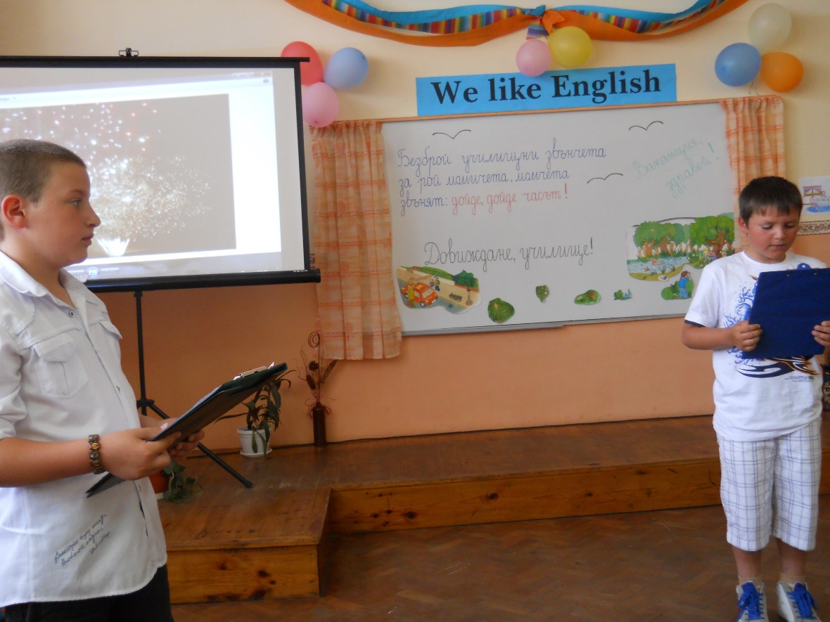
About us - extracurricular

Slide 13
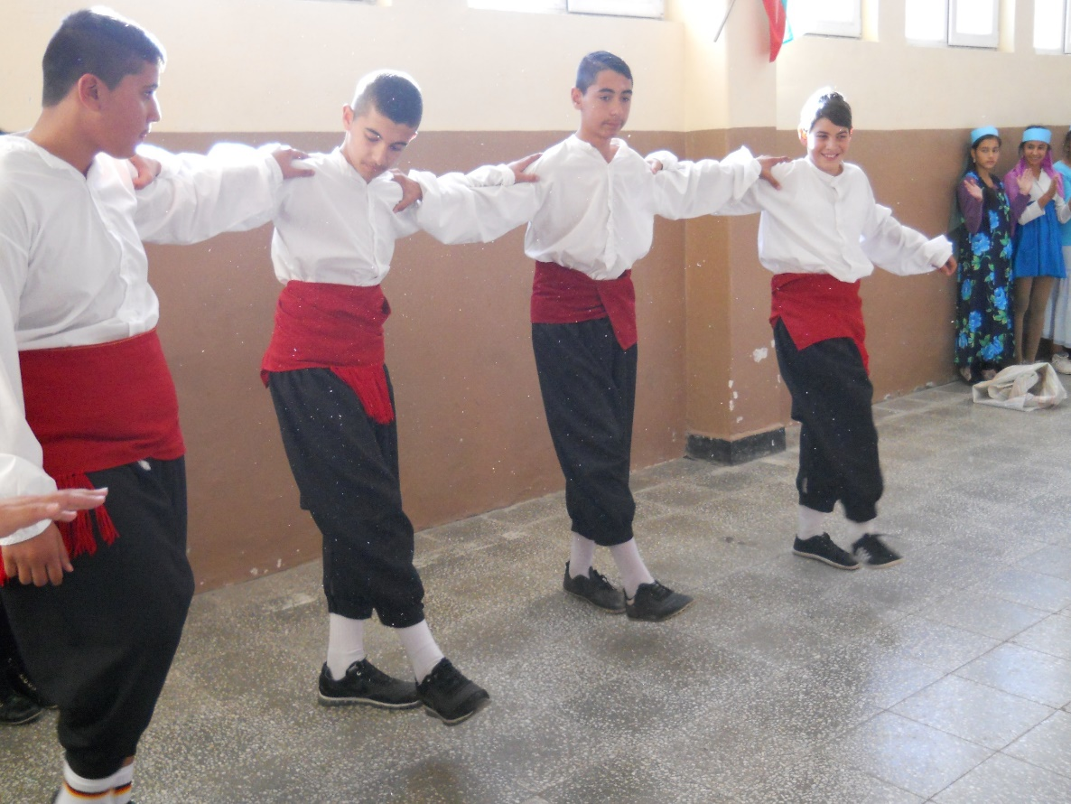
About us - extracurricular

Slide 14
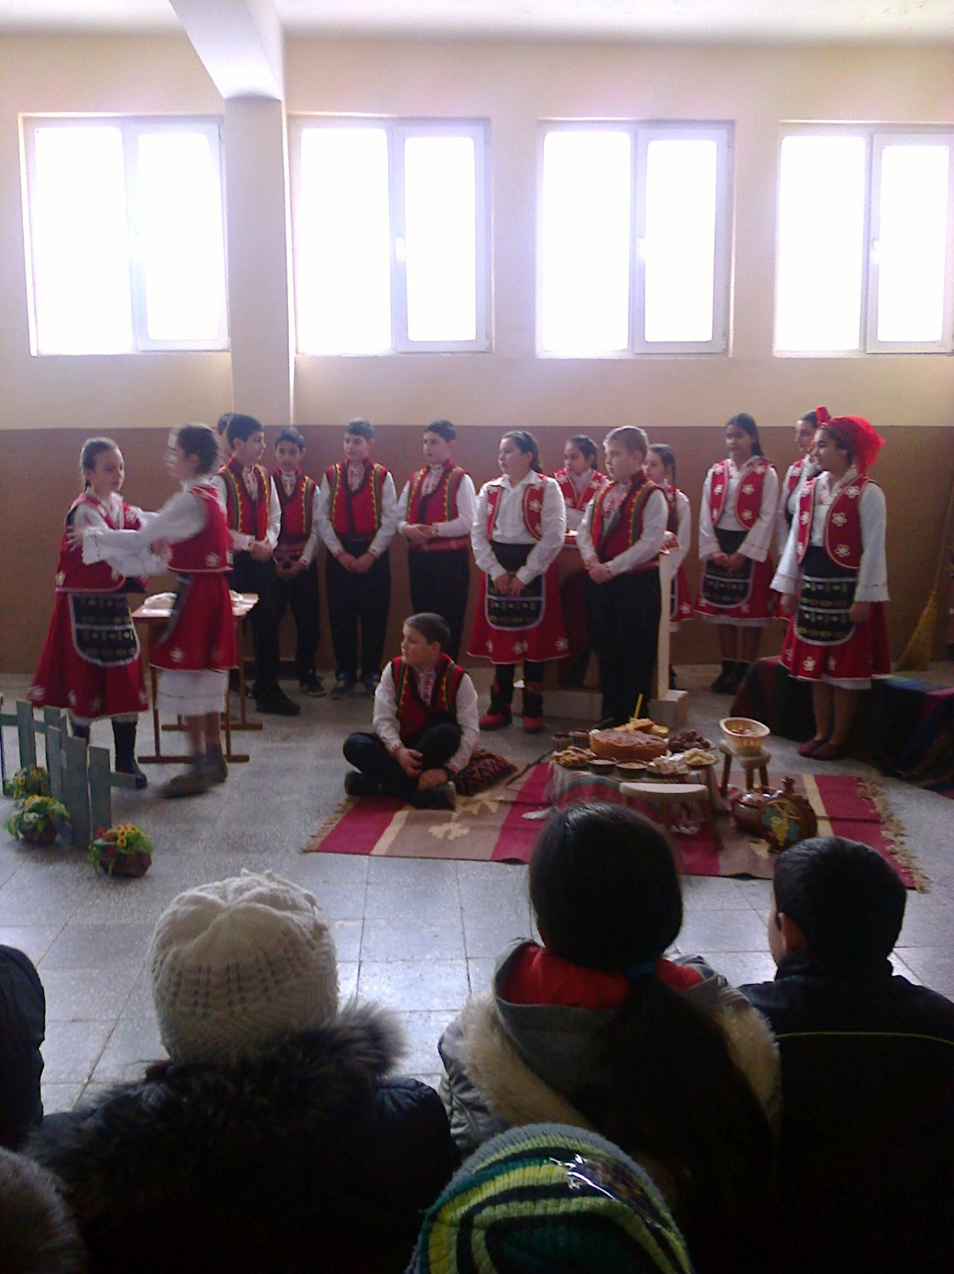
About us - extracurricular

Slide 15
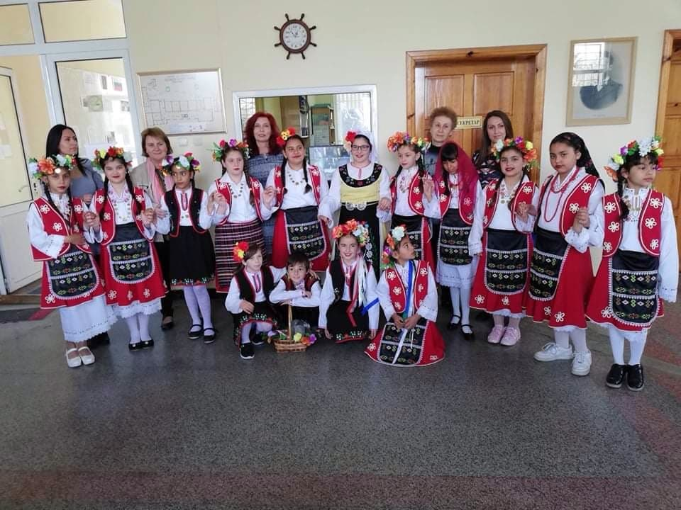
About us - extracurricular

Slide 16
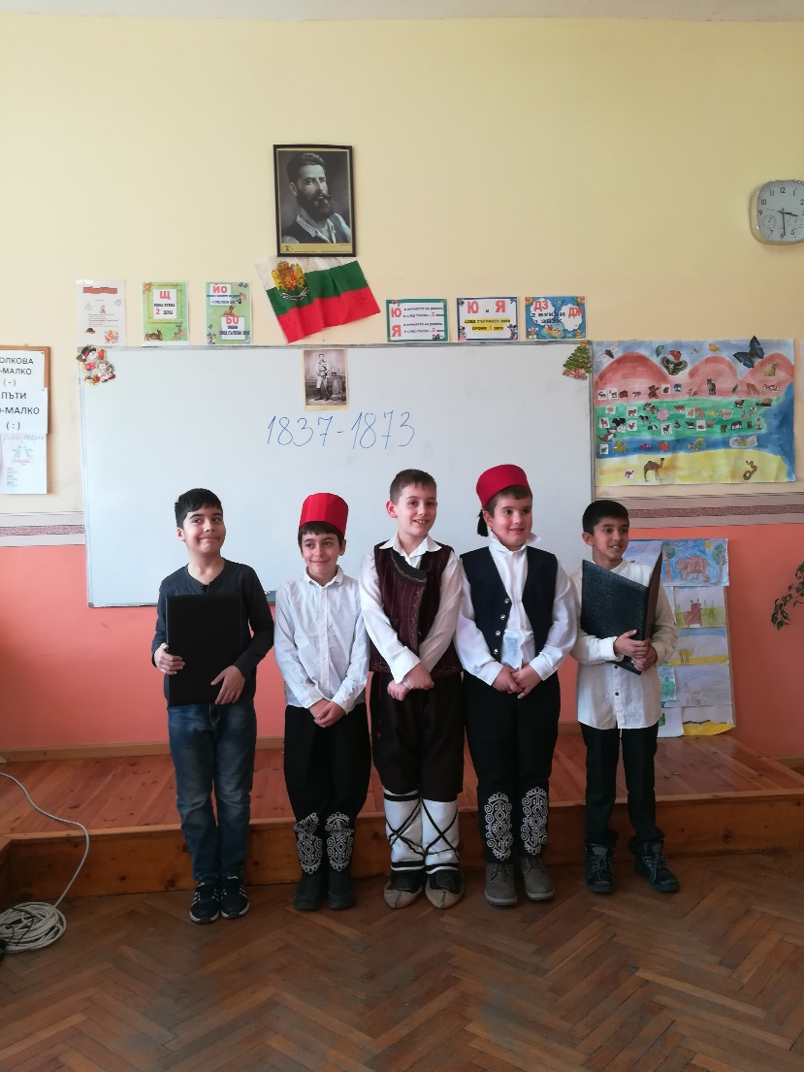
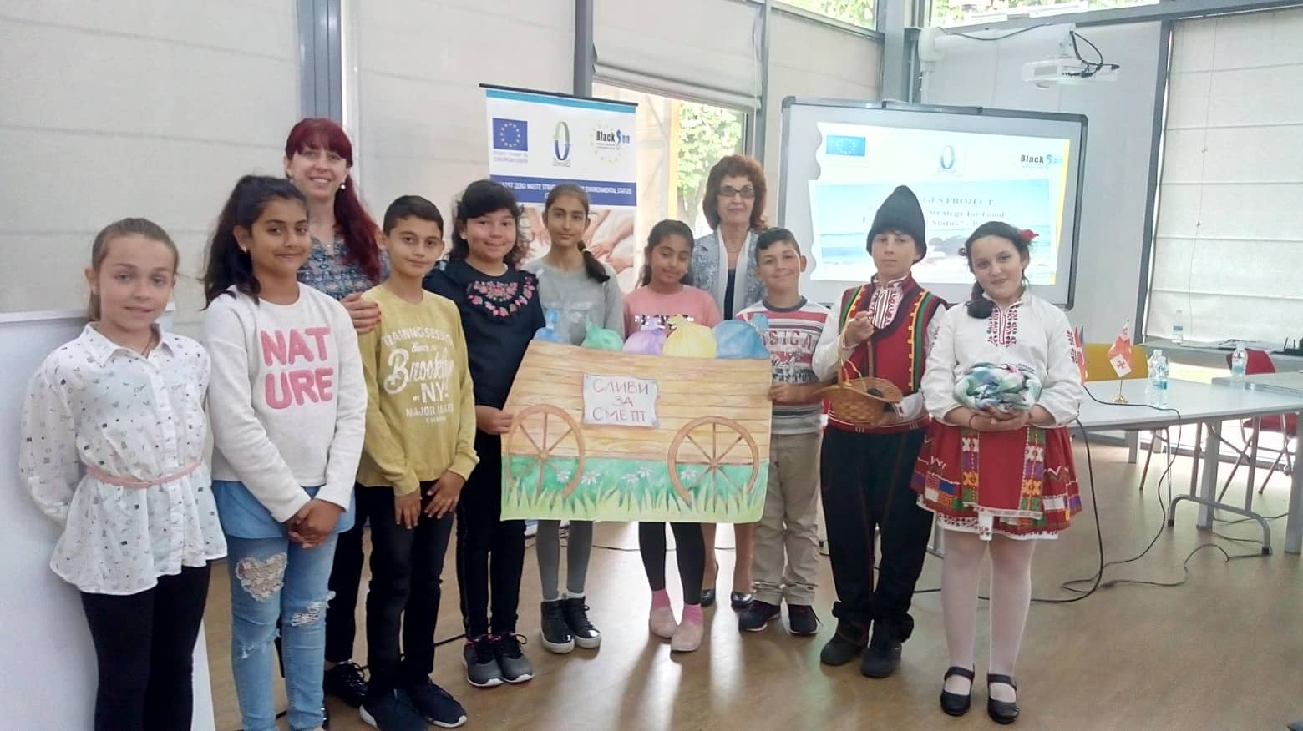
About us - extracurricular

