Slide 1









„United in Europe“
Symbols of EU
Kindergarten „Ziedelis“
of Kursenai
2022
Erasmus+ KA2 M. A. G. I. C 2019-1-EL01-KA229-062457
Myths, Art, Tales and Games for Intercultural Cooperation
2019–2022

Slide 2
Coordinator of the project
21st primary school of Athens “Lela Karagianni”, Greece
Partners
Kindergarten Detski Svyat, Bulgaria
Lohkva Lasteaed, EstoniaLohkva Lasteaed, Estonia
48° Circolo Didattico "Madre Claudia Russo", Italy
Kursenai kindergarten „Žiedelis“, Lithuania

Slide 3
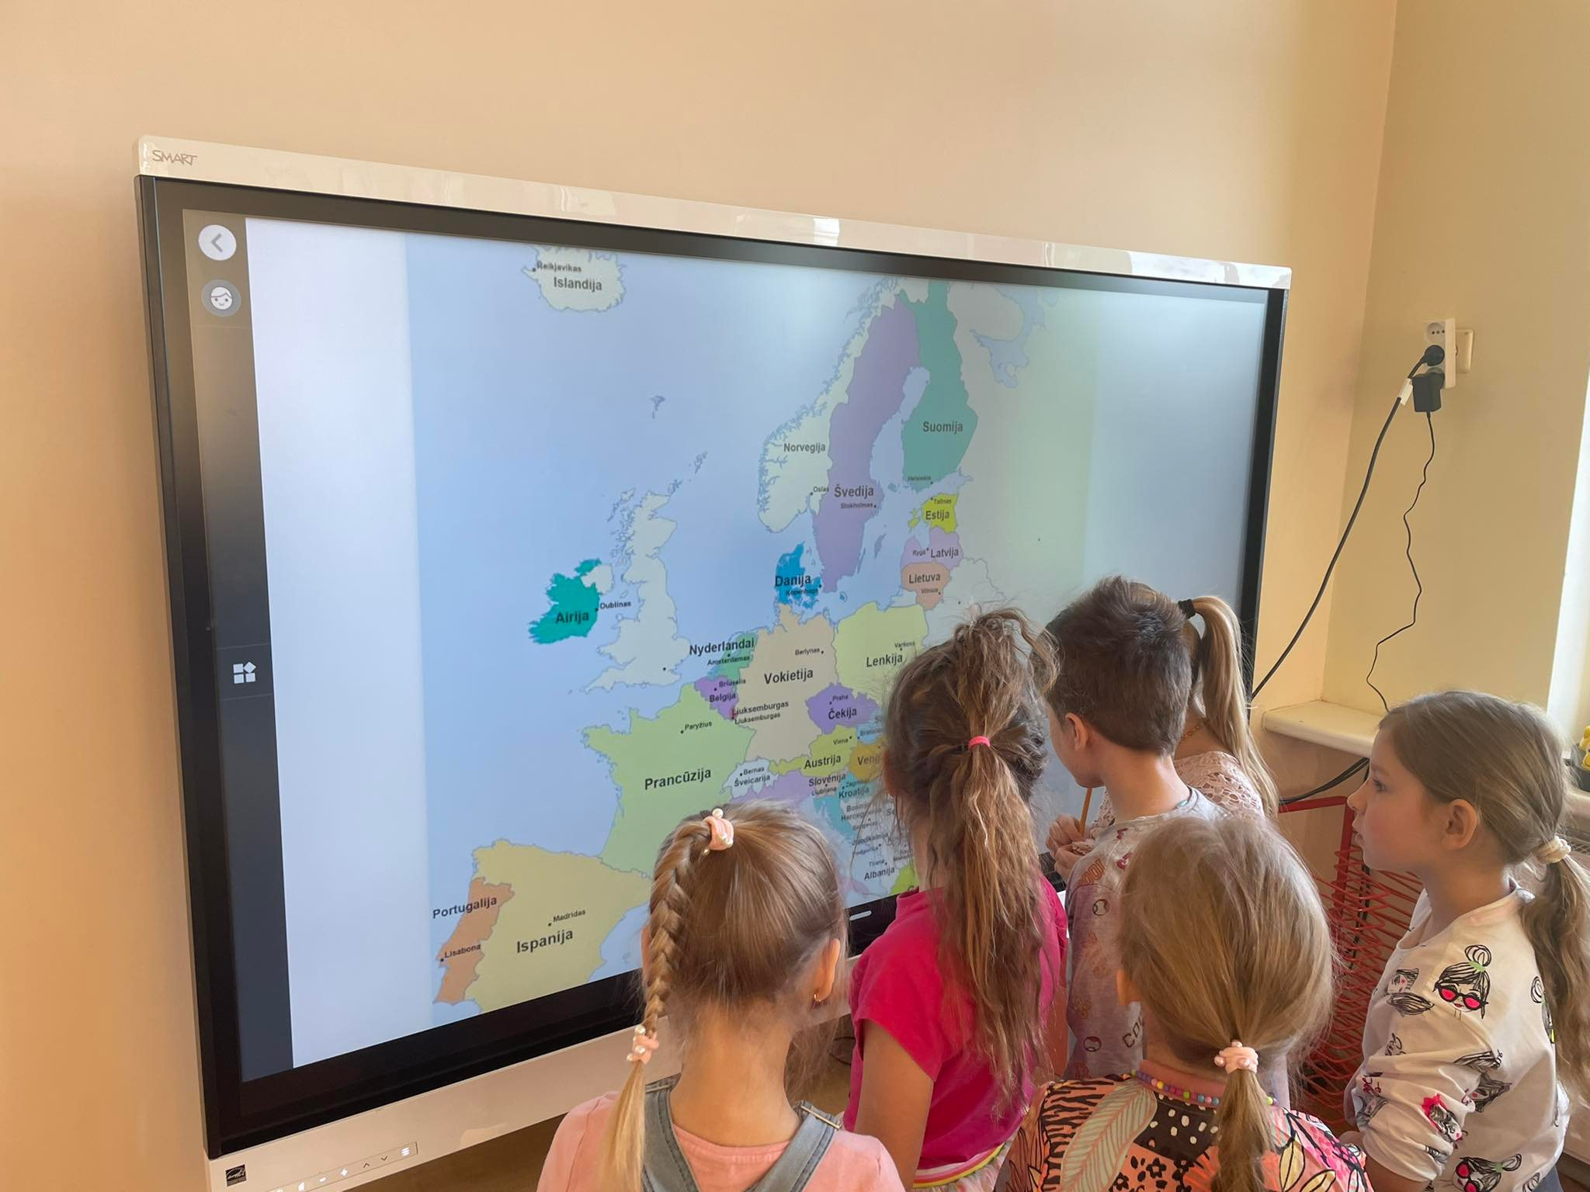
European Union
The children got acquainted with the map of the European Union.

Slide 4
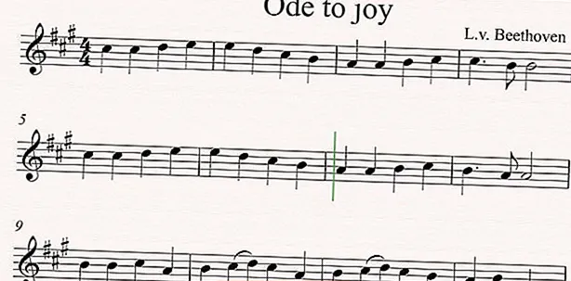
Anthem of the European Union
The official anthem of the EU in 1985 became L. van Beethoven's Ode to Joy.

Slide 5
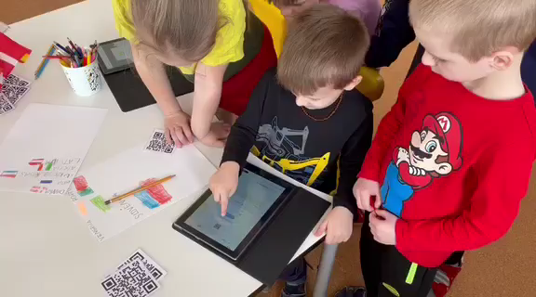
Using QR codes, the children deciphered symbol of the European Union - the anthem.

Slide 6
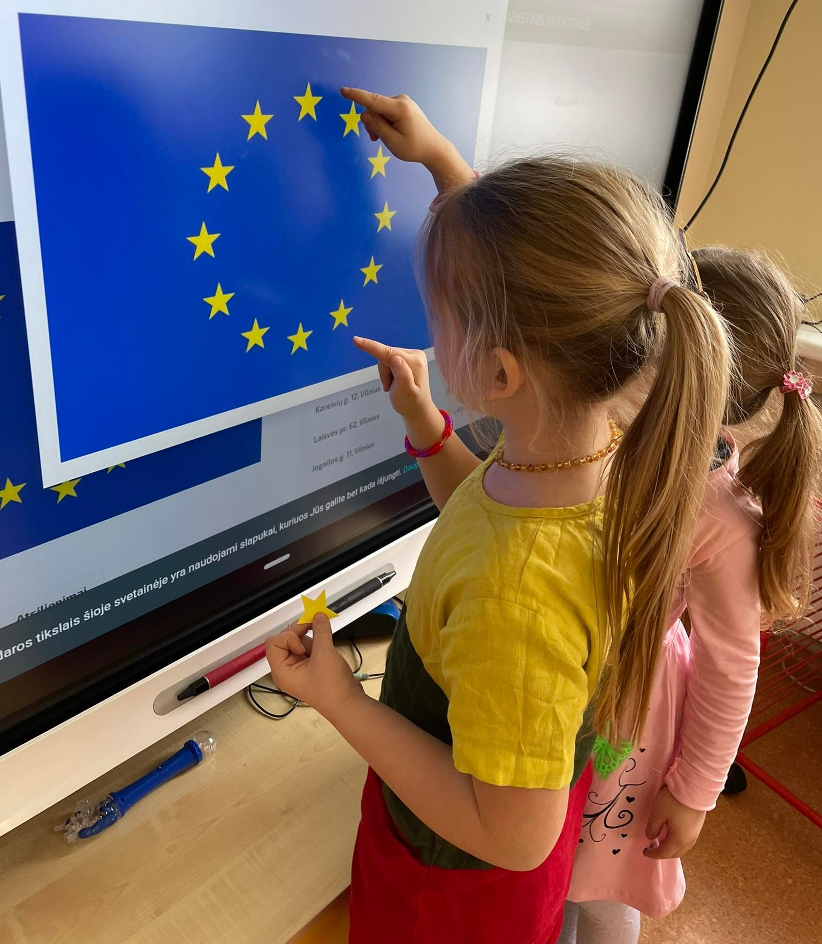
European Union flag
We discussed the symbols of the European Union and got to know the flag.
We calculated how many stars are in the flag.

Slide 7
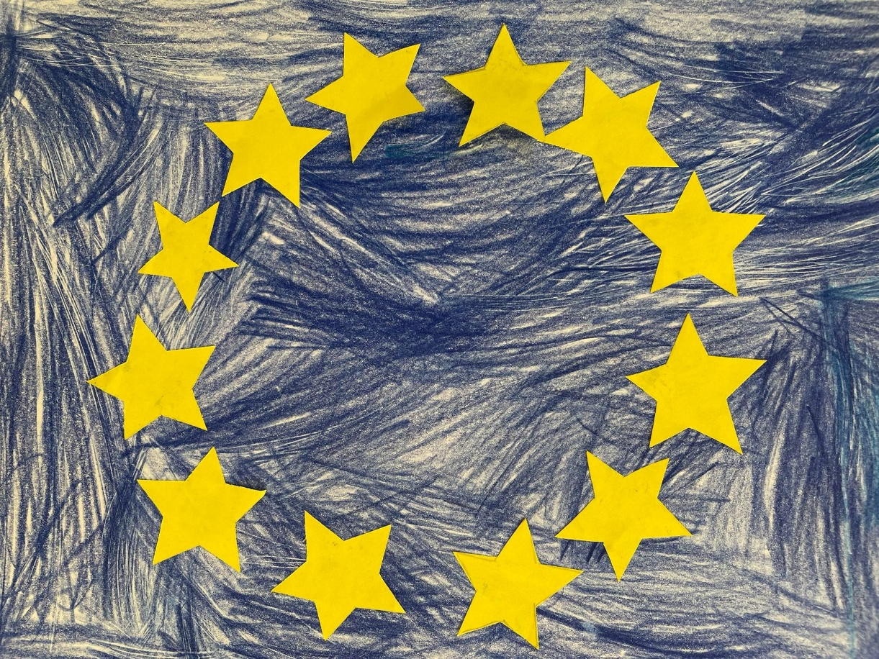
The flag of the European Union symbolizes both the European Union and the identity and unity of the whole of Europe.

Slide 8
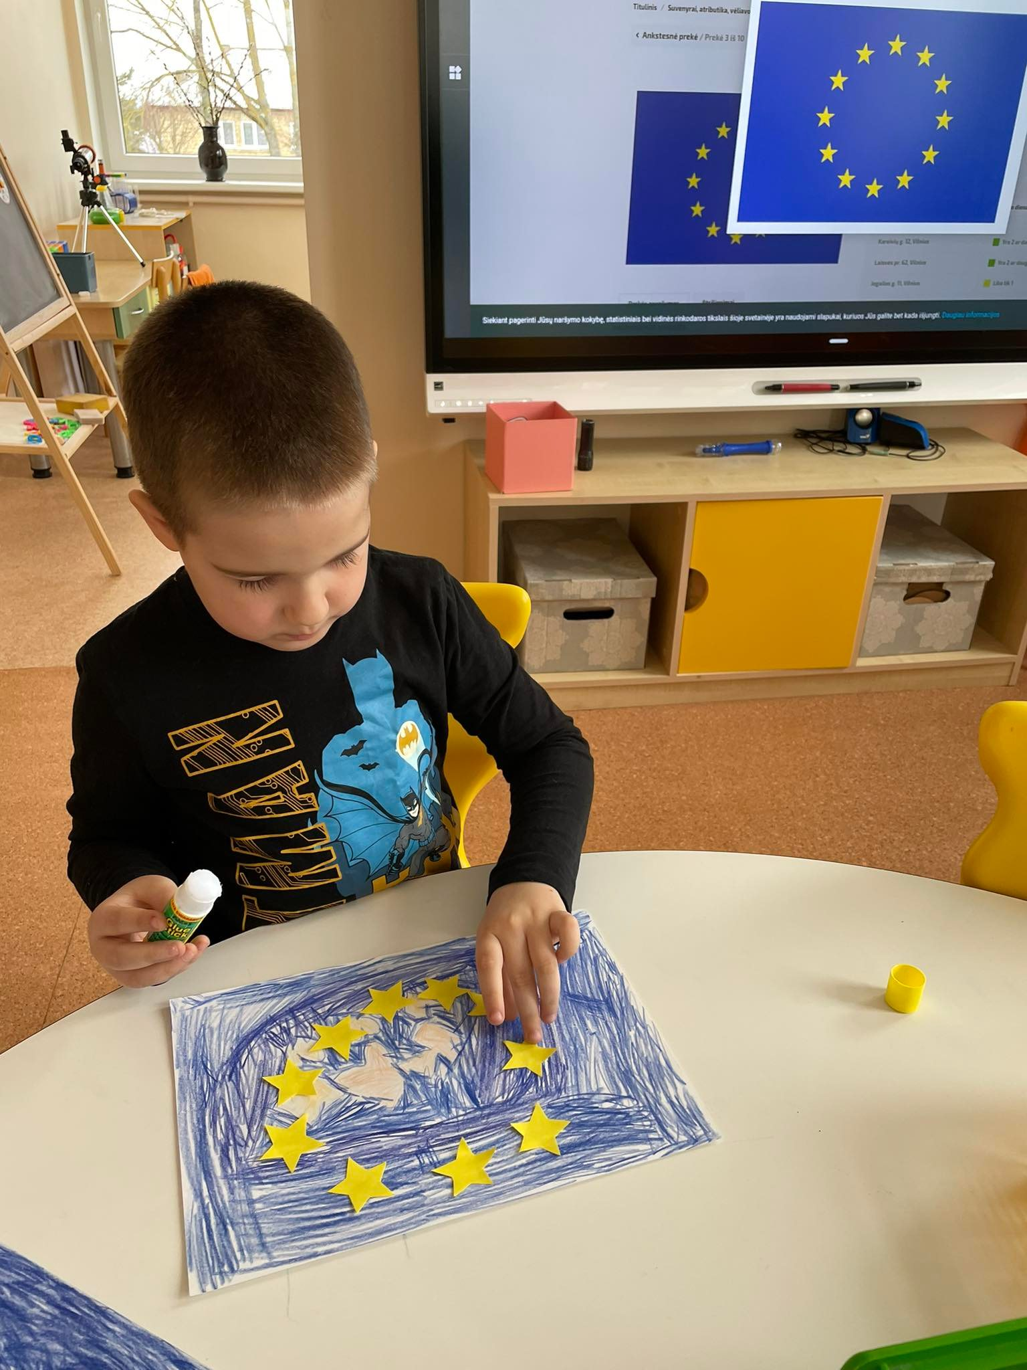
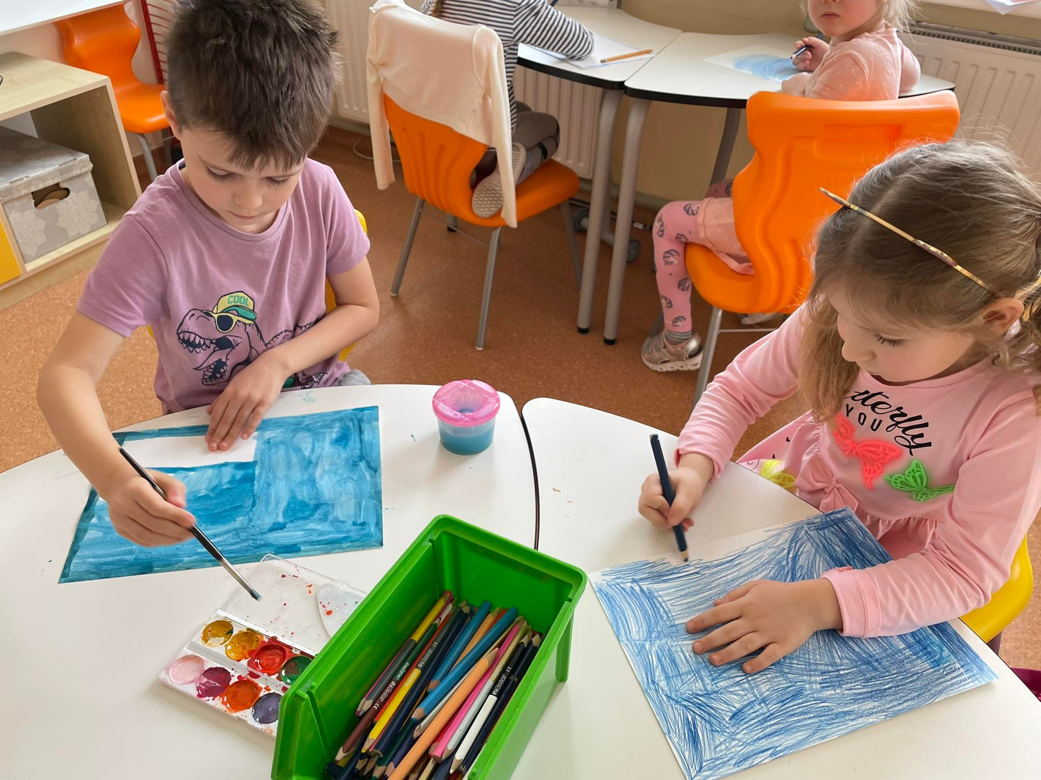
The children produced the flags of the European Union.

Slide 9
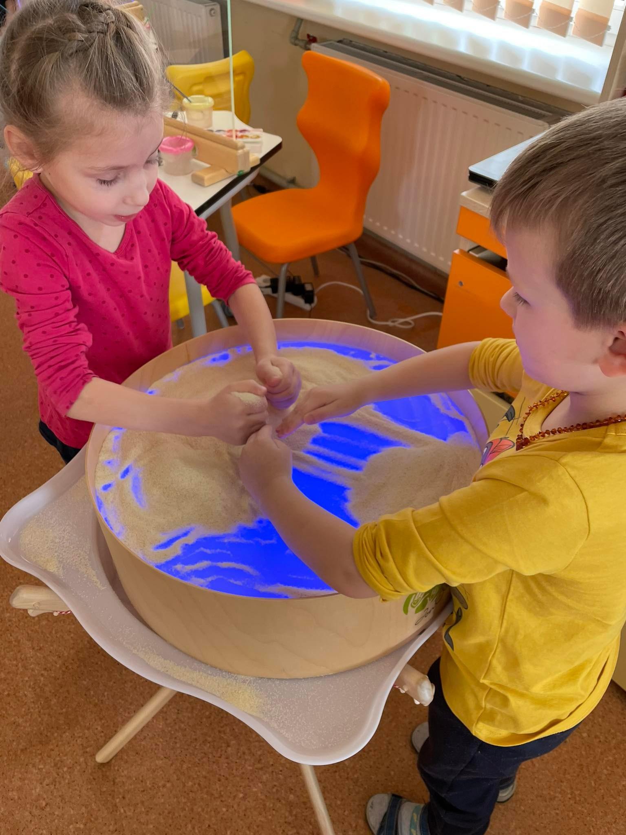
We used light tables in our activities to draw the flag of the European Union.

Slide 10
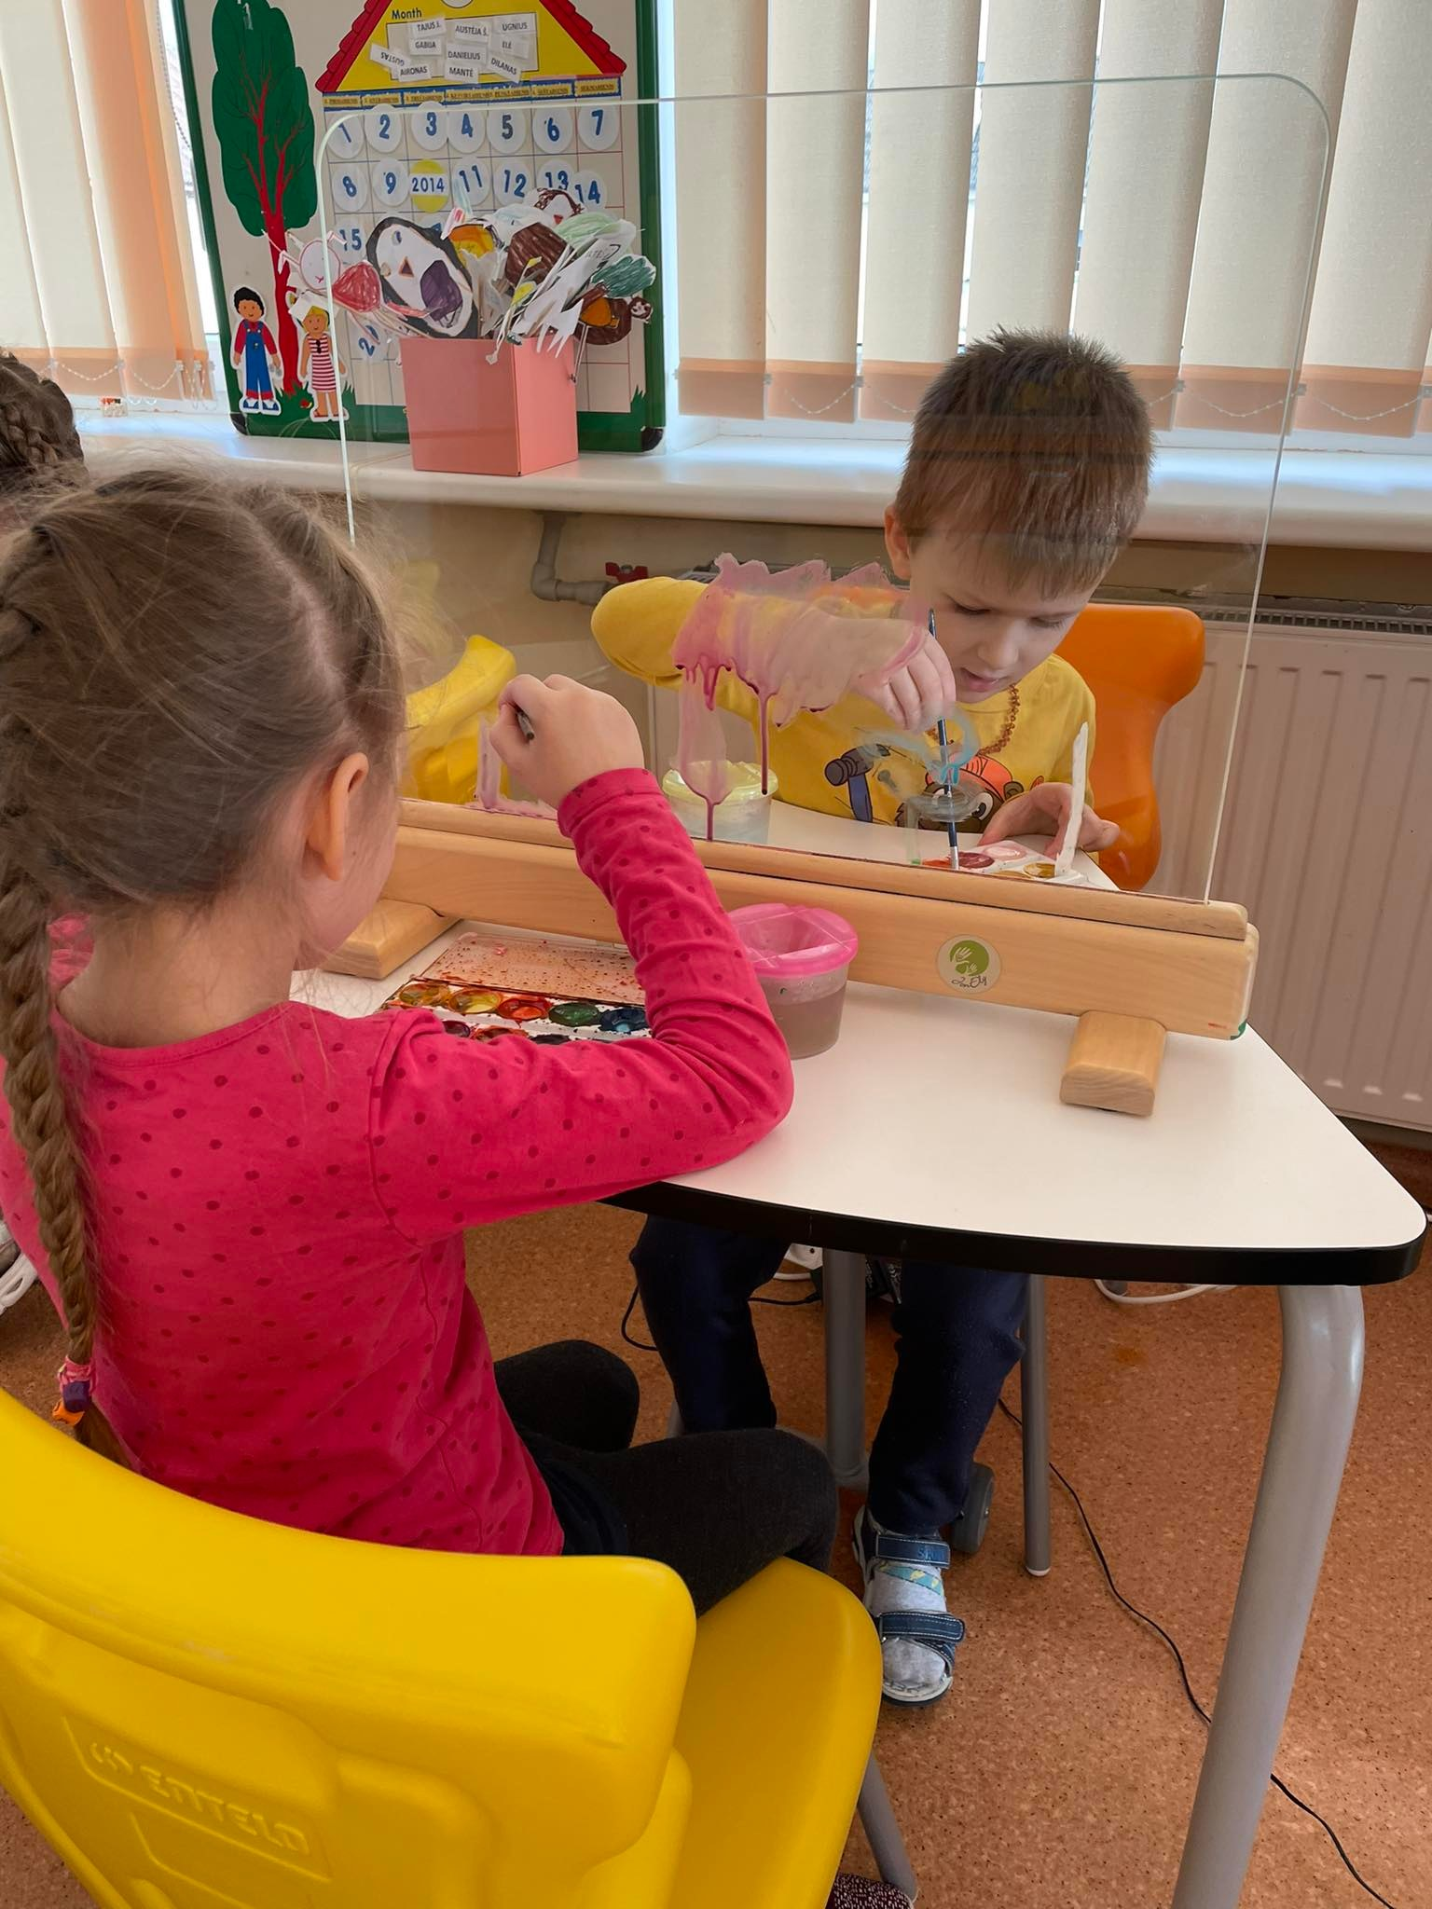
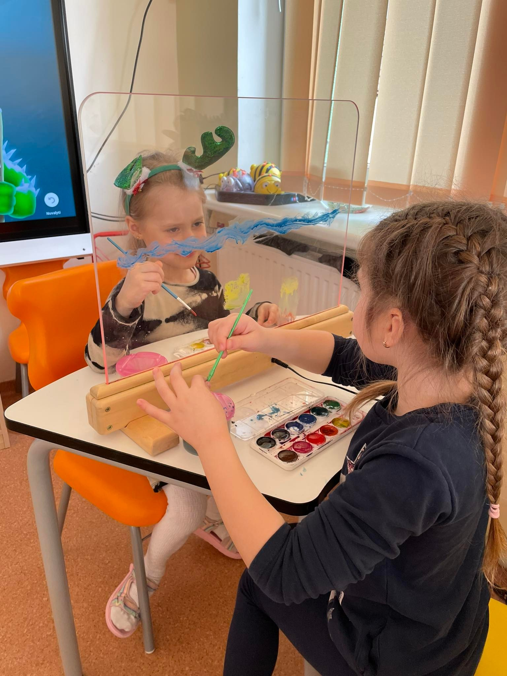

Slide 11
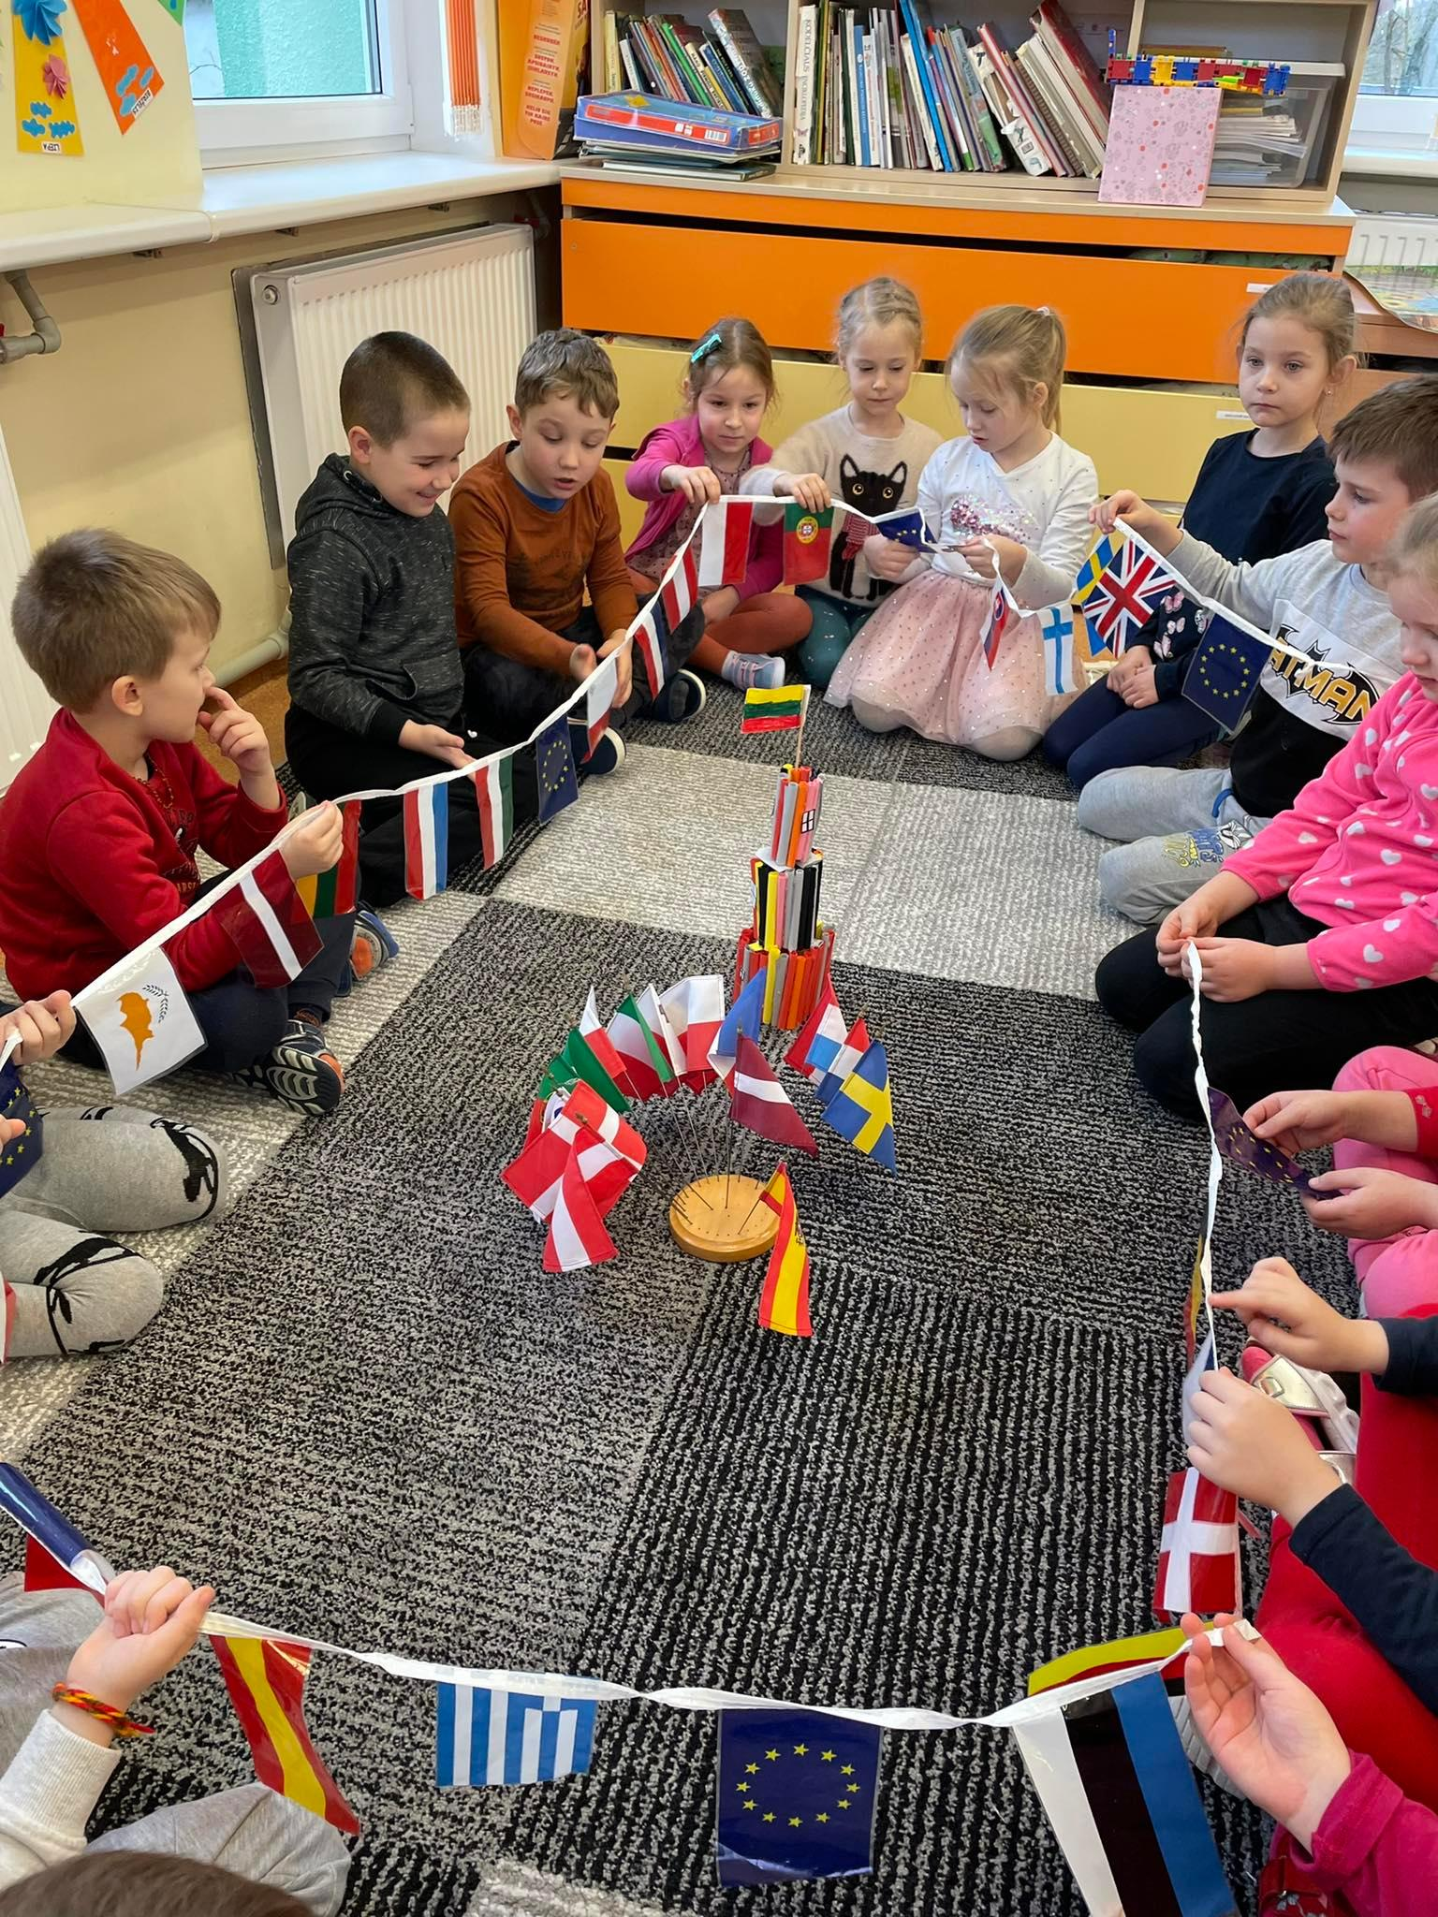
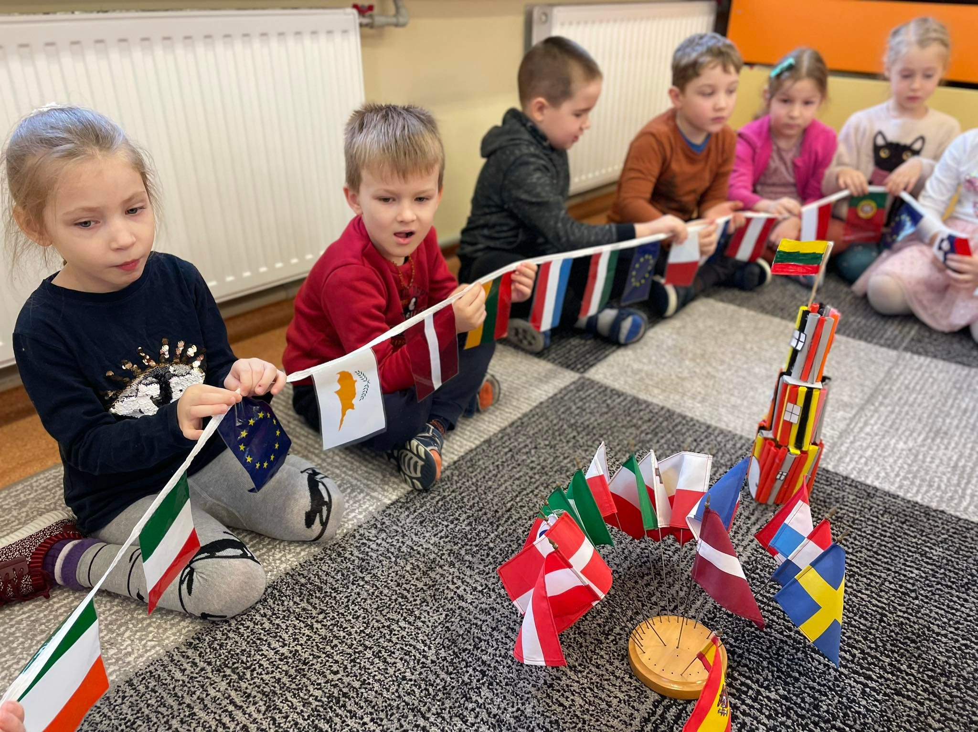
The children counted the flags of the states and got acquainted with them.

Slide 12
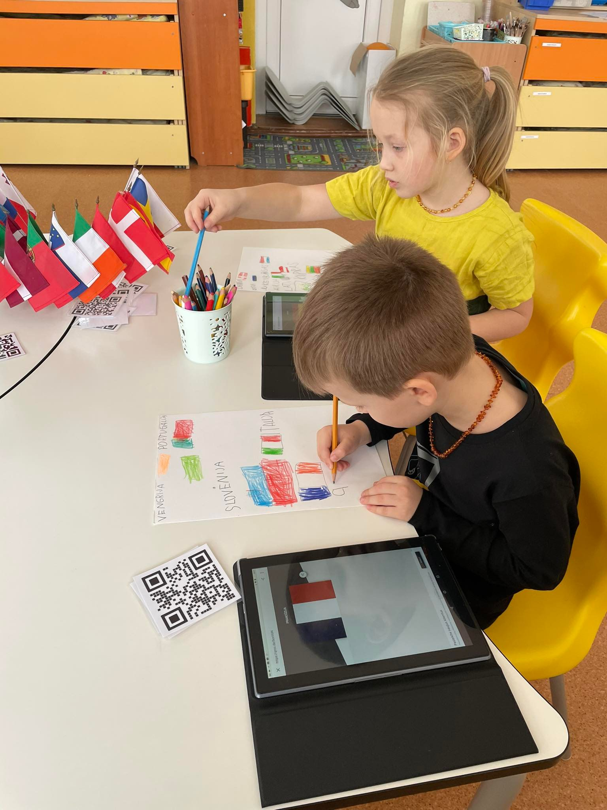
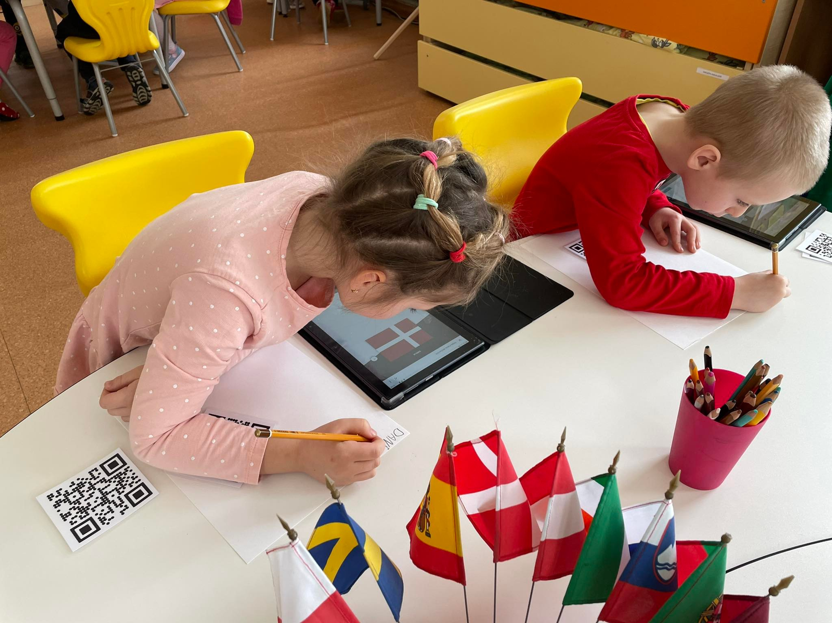
Children drew flags and wrote their names using QR.

Slide 13
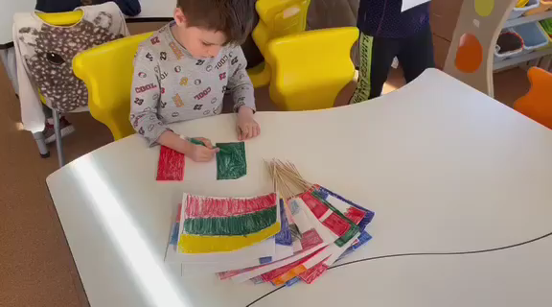

Slide 14
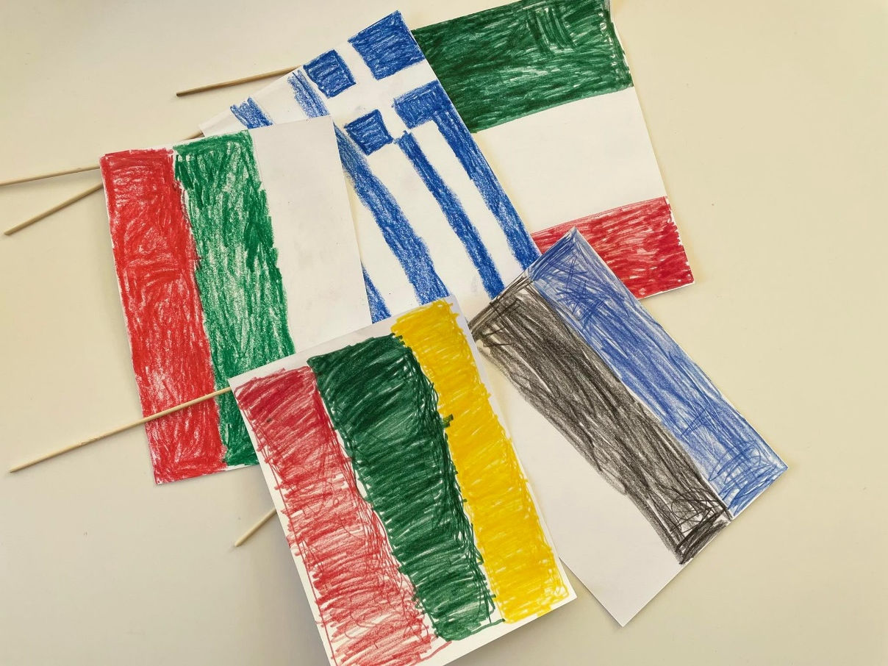
European Union motto
Another symbol of the European Union is the motto. The European Union's motto "United in diversity" was introduced in 2000.

Slide 15
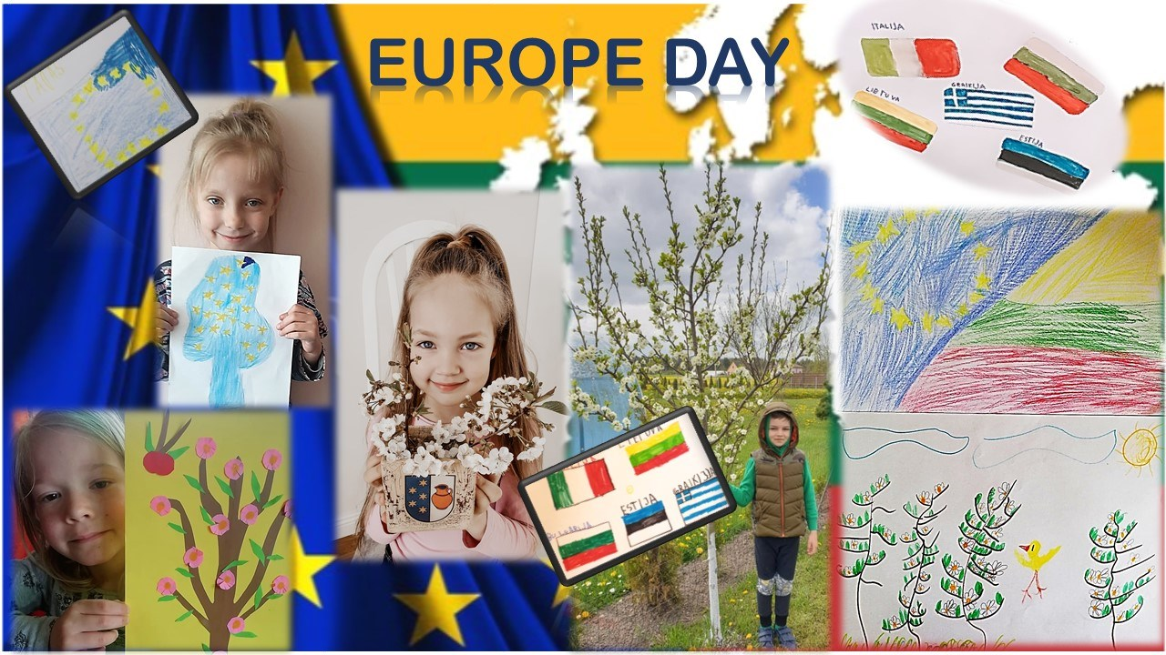
The European Day
Europe Day is celebrated every year on 9 May. This year marks the anniversary of the historic Schuman
Declaration
and welcomes
peace and unity
in Europe.

Slide 16
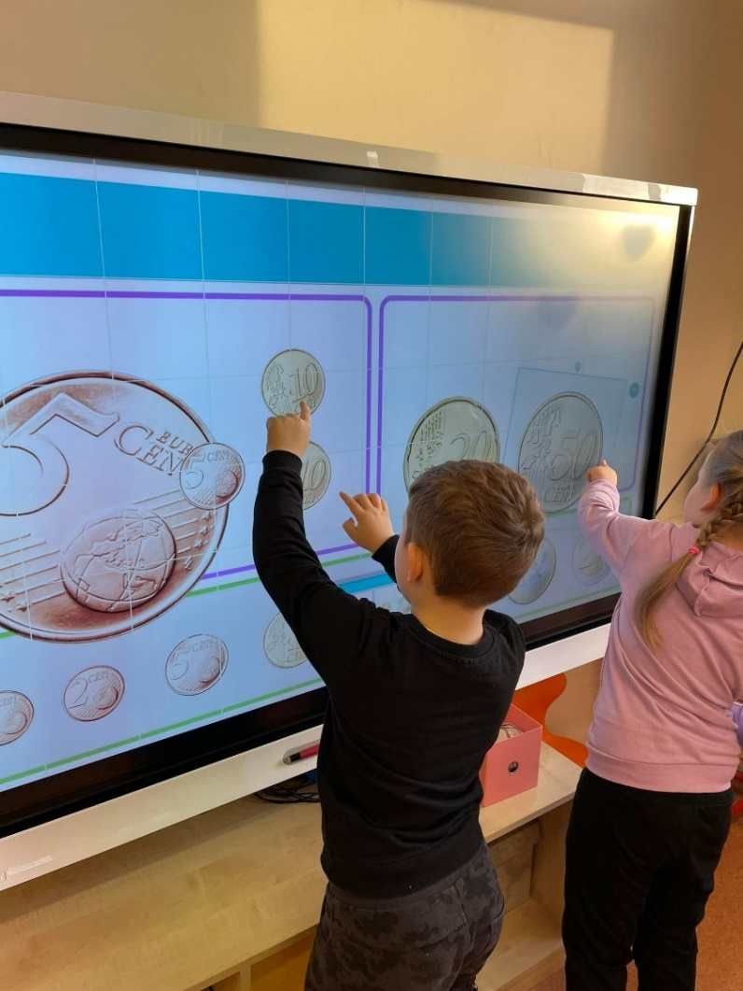
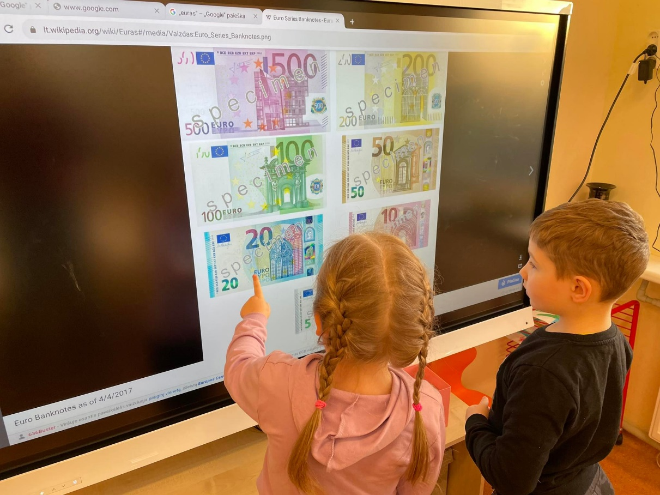
Currency of the European Union
The euro is the official currency of the 19 countries of the European Union, which together make up the euro area.

Slide 17
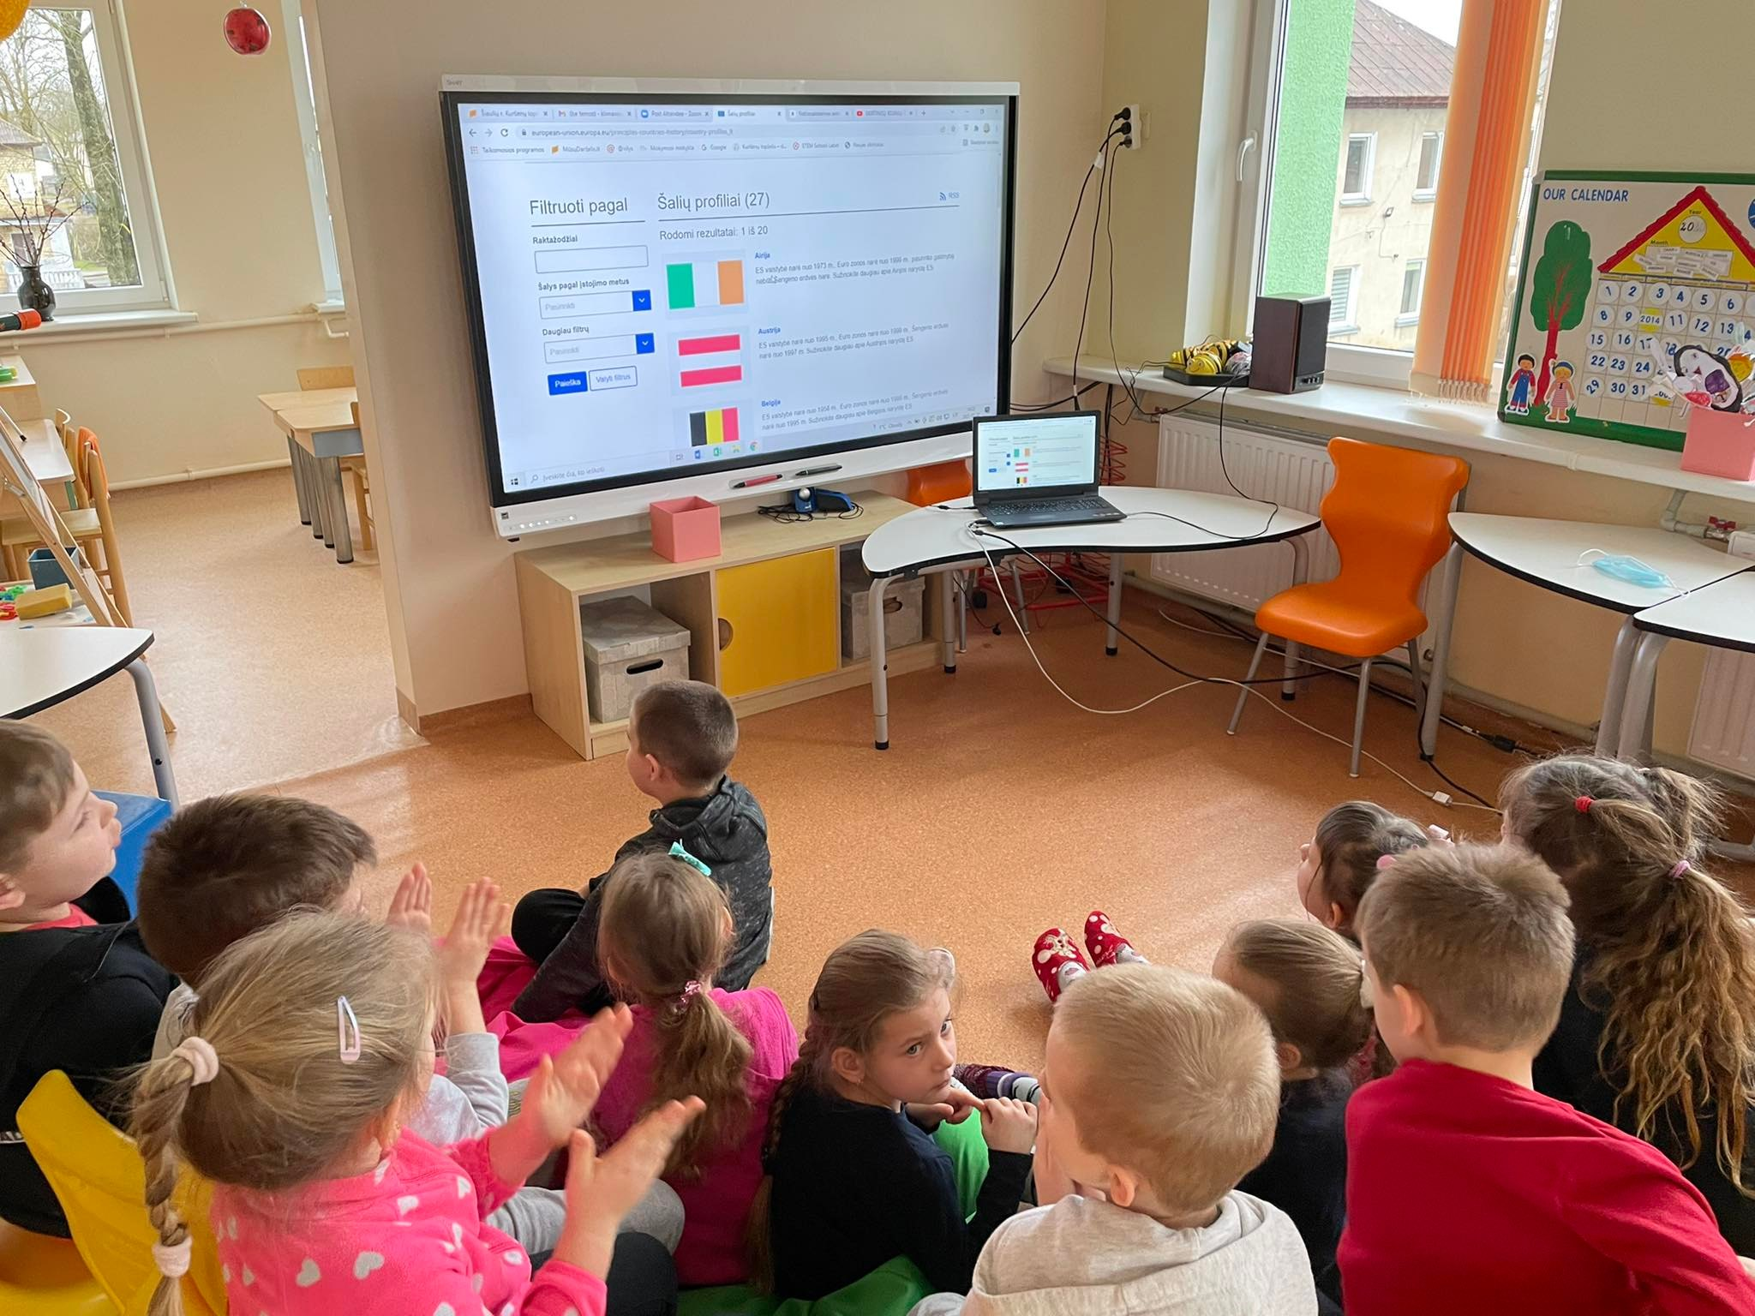
At the end of the topic about the European Union and its symbols, the children took part in a quiz.

Slide 18

This material has been created with the financial support of the European Commission. The content of this material is the sole responsibility of the authors, and the National Agency and the European Commission are not responsible for the way this content will be used.

Slide 19
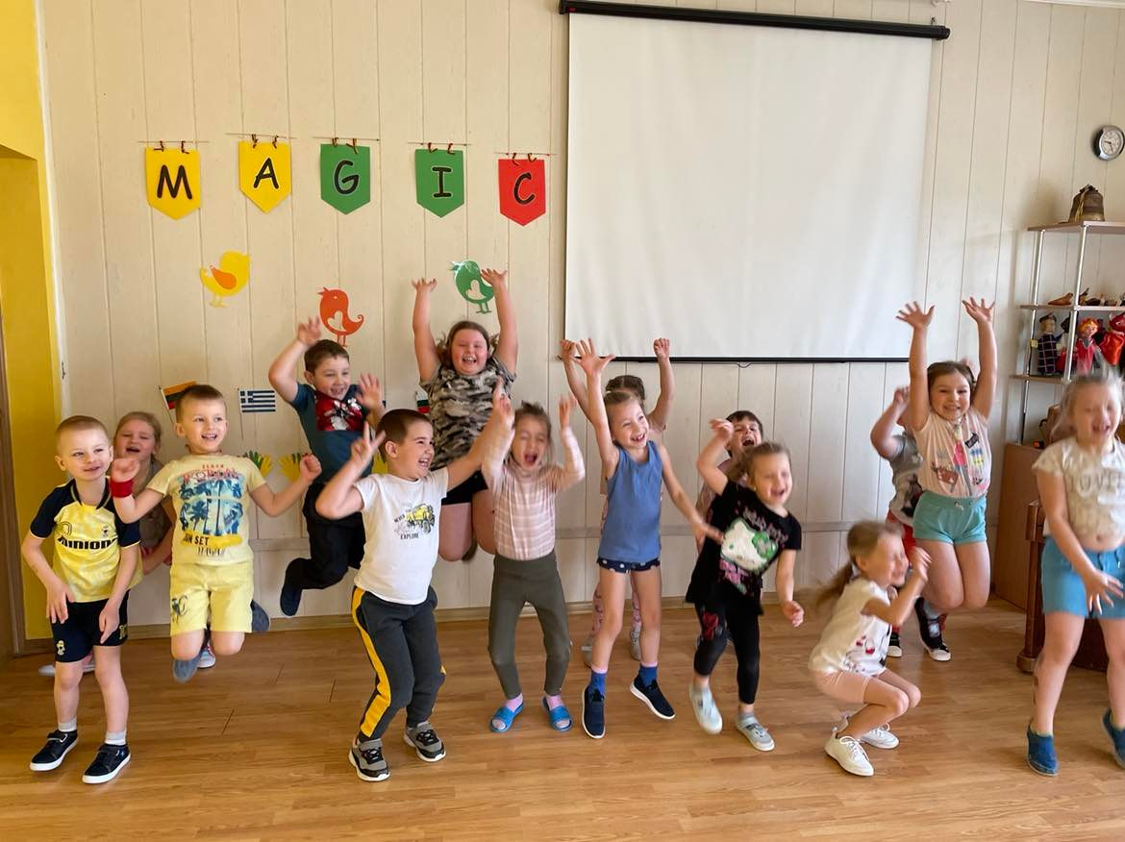
Thank you for attention!

