Slide 1
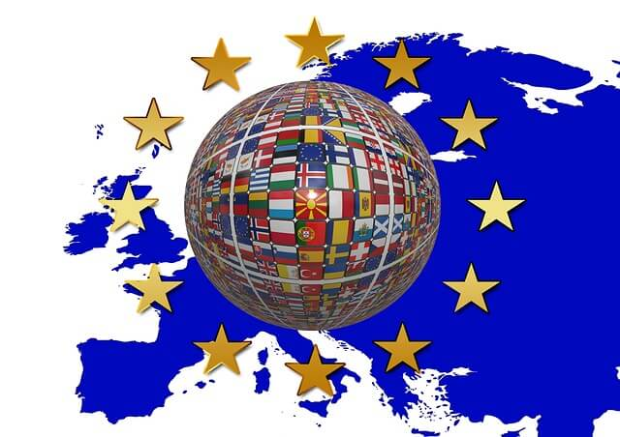
European
Union
Map

Slide 2
Erasmus+ KA2 M. A. G. I. C
Myths, Art, Tales and Games for Intercultural Cooperation
Bulgaria
District: Veliko Tarnovo
Town: Polski Trambesh
Kindergarten “Detski Svyat”

Slide 3
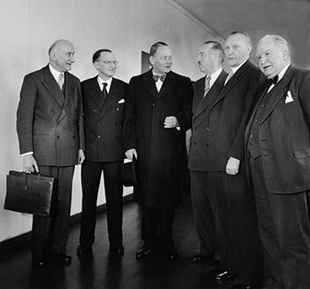
The pioneers of the EU
05.05.1949 Establishment of the Council of Europe

Slide 4
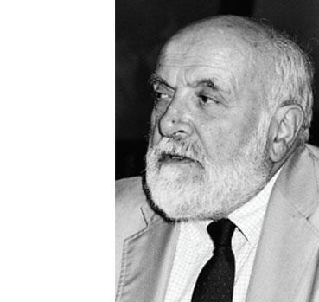
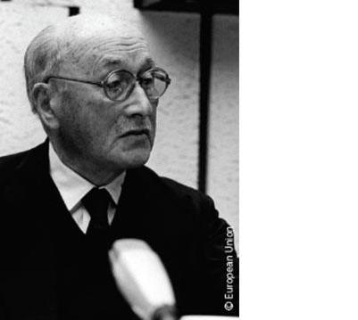
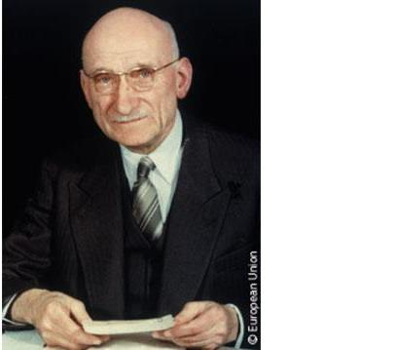
Jean Monnet
has been
called
"The Father
of Europe“,
1950s –
European
Coal and
Steel
Community,
the predecessor
of today's
European
Union
Altiero
Spinelli –
one of the
founding
fathers
of the European
Union and author
of Ventotene
Manifesto
Robert
Schuman –
one of the founders
of the European Union,
the Council of Europe
and NATO;
May 9, 1950 pronounces Schumann's
famous declaration, since then May 9
has been celebrated as Europe Day

Slide 5
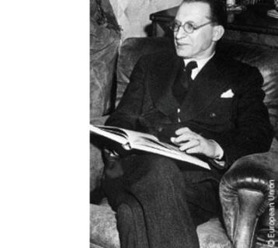
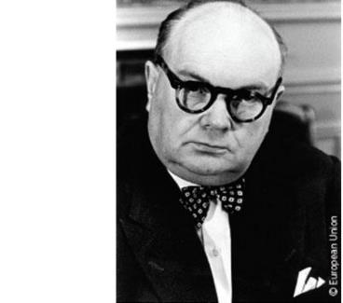
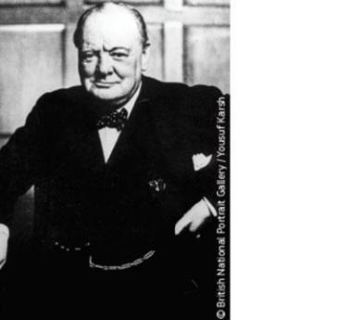
Alcide
Amedeo Francesco
De
Gasperi –
prime
minister of
Italy
Paul-Henri
Charles
Spaak –
Prime
Minister of
Belgium
Winston
Leonard
Spencer
Churchill –
Prime Minister of
the United Kingdom

Slide 6
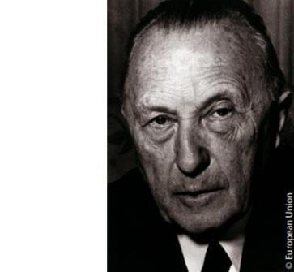
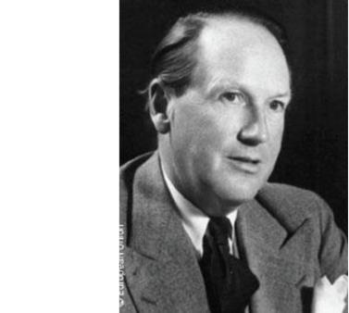
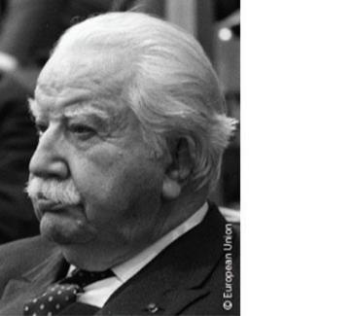
Konrad
Hermann
Joseph
Adenauer –
first
chancellor
of West
Germany
Johan
Willem
Beyen –
Dutch
politician
Joseph
Bech –
Luxembourg
foreign
minister

Slide 7
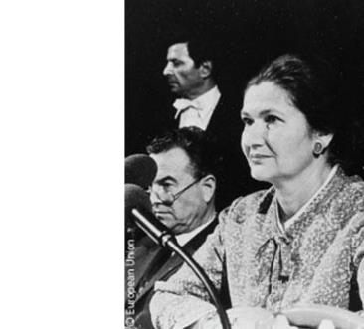
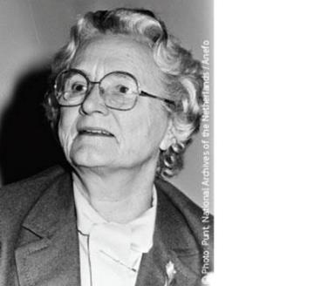
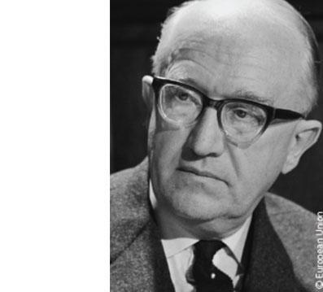
Marga
Klompé –
the first female
member of the European Coal and Steel Community’s Common Assembly, the forerunner of today’s European Parliament, which held its first session in 1952.
Simone
Veil –
Holocaust
survivor
and first
female
President
of the
European
Parliament
Walter
Hallstein –
the first
President of
the
European
Commission

Slide 8
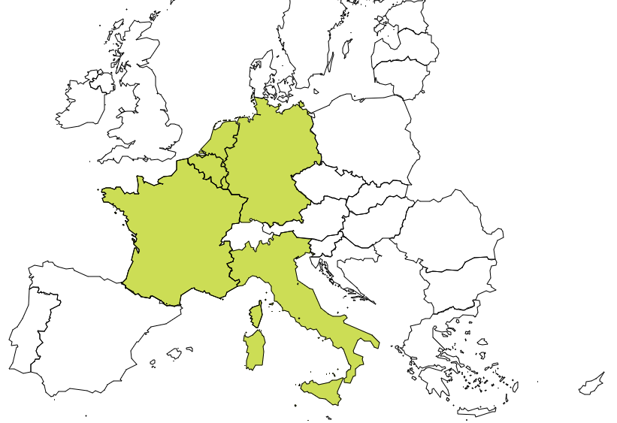
01.01.1958
Netherlands
Belgium
Germany
Luxembourg
France
Italy

Slide 9
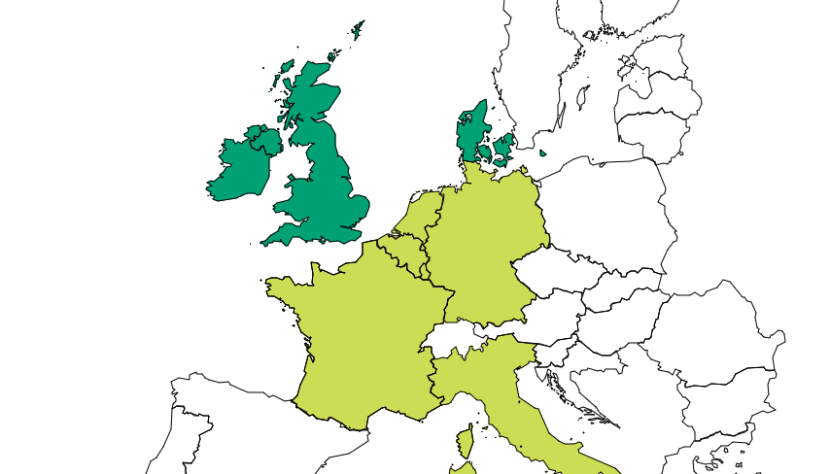
01.01.1973
Denmark
Ireland
United Kingdom

Slide 10
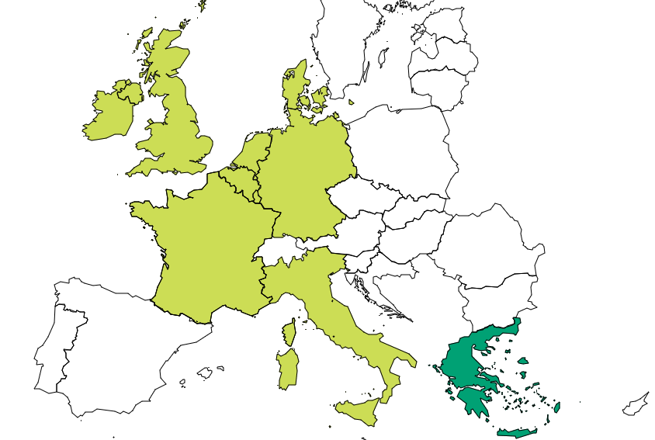
01.01.1981
Greece

Slide 11
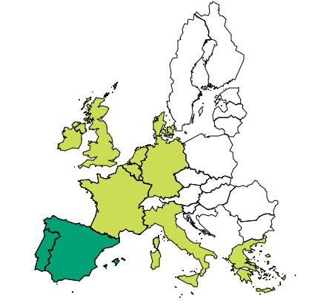
01.01.1986
Spain
Portugal

Slide 12
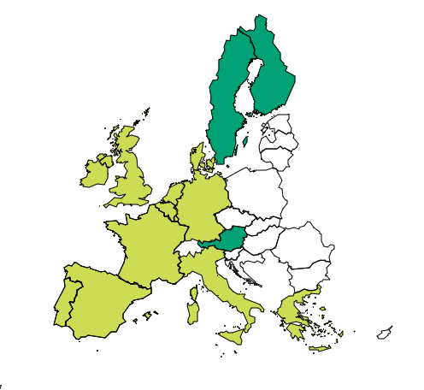
01.01.1995
Sweden
Finland
Austria

Slide 13
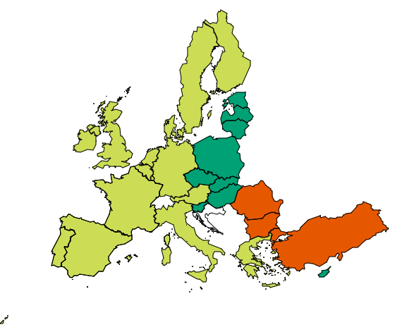
10.05.2004
Final division
of Europe after
WWII
Estonia
Latvia
Lithuania
Poland
Czechia
Slovakia
Hungary
Slovenia
Malta
Cyprus

Slide 14
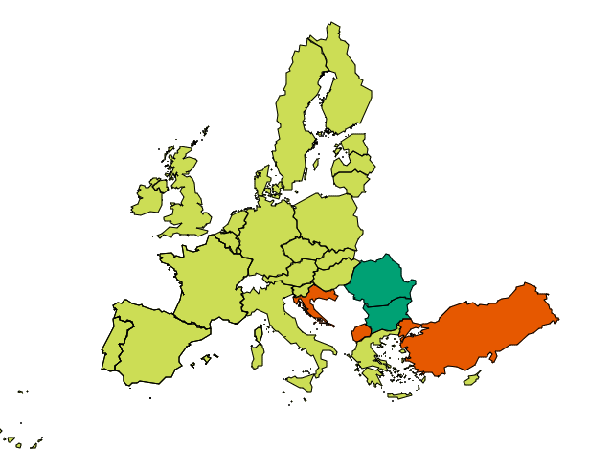
01.01.2007
Romania
Bulgaria

Slide 15
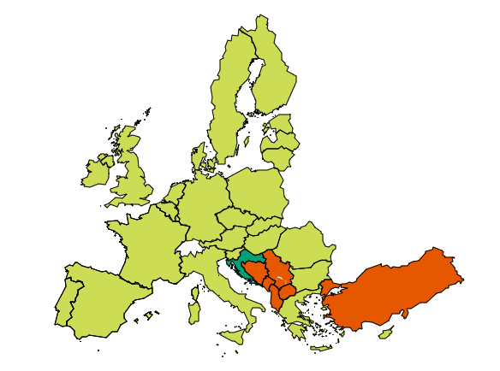
01.07.2013
Croatia

Slide 16
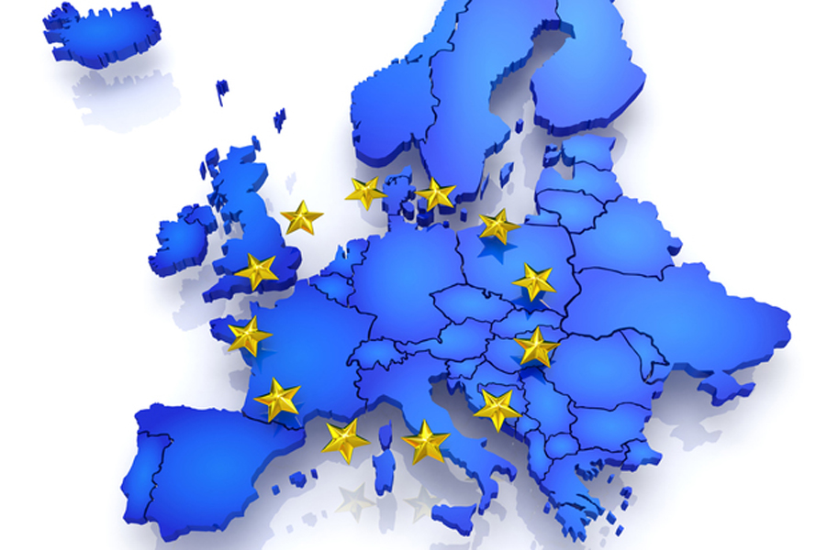
European
Union

Slide 17
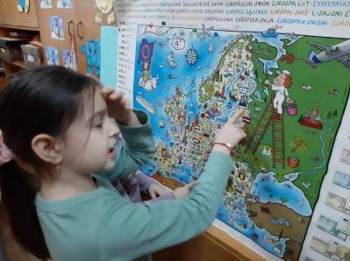
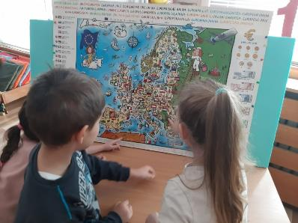
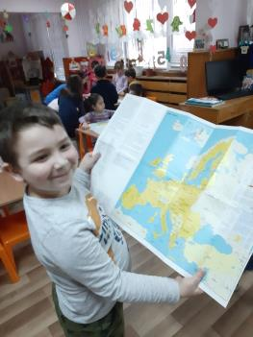
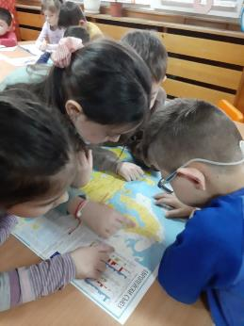
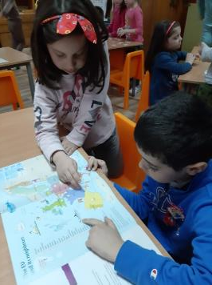
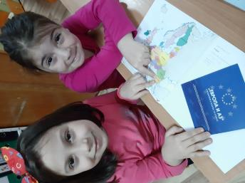
Europe and me
The children from
the preparatory group
"Pinocchio" plunged into
its European journey
through the maps they looked at.
Imaginarily, they were traveling
by land, air and water.

Slide 18
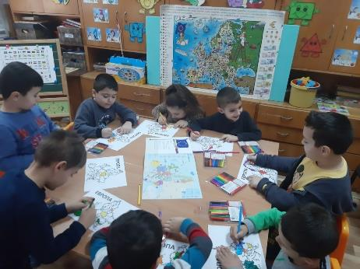
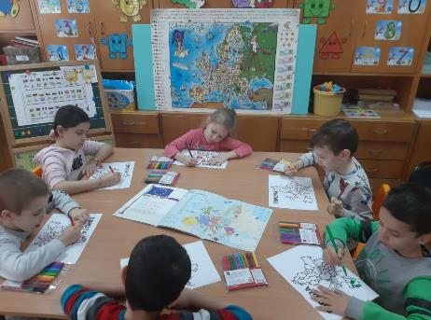
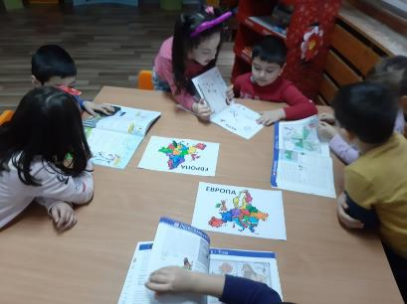
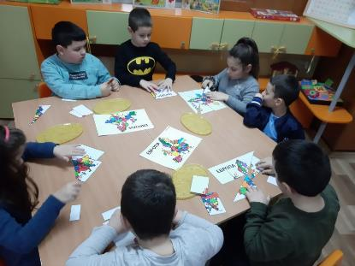
The journey continued…
The children drew a map of Europe and colored the member states of the European Union.

Slide 19
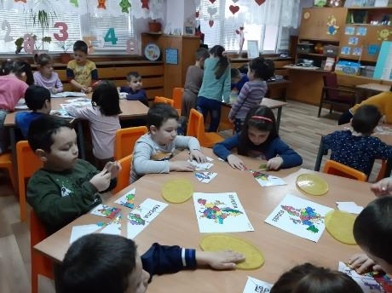
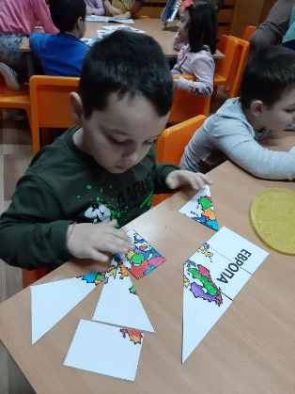
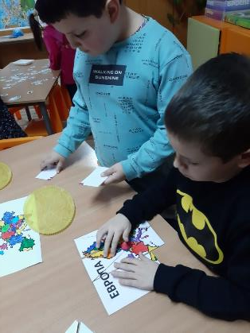
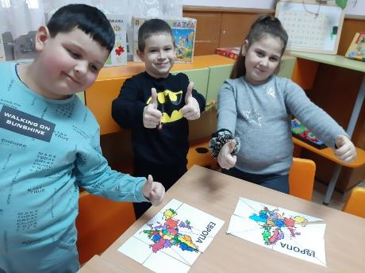
We worked together
puzzles on the map
of Europe,
which children with large
enthusiasm lined up.

Slide 20
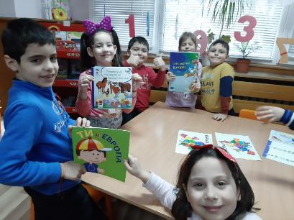
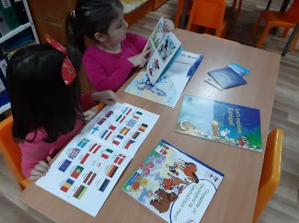
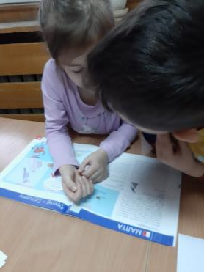
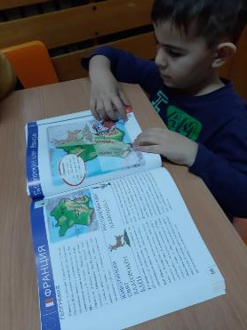
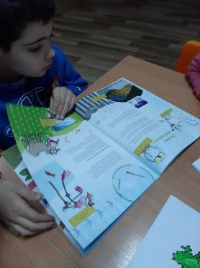
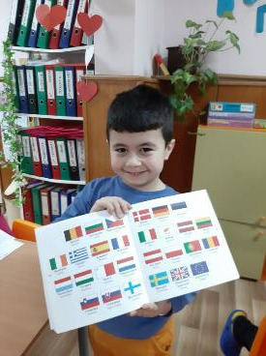
The children's attention
was attracted by the books,
who examined.
They learned from them
a lot for the plant,
the animal world and
the sights
in different European countries…

Slide 21
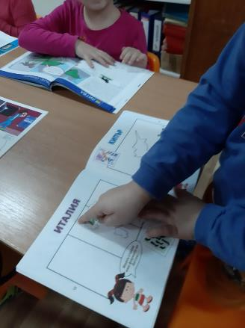
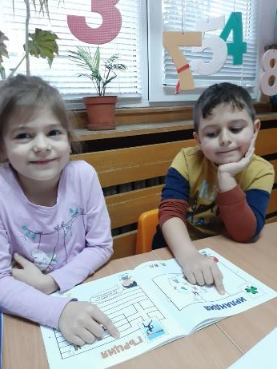
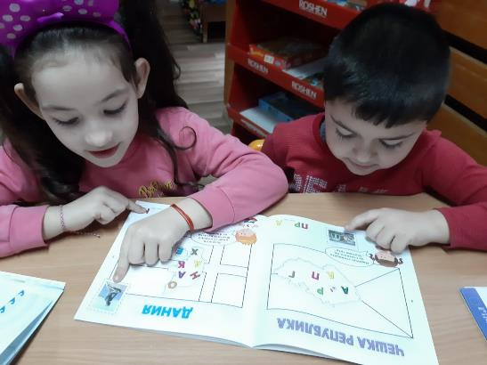
With his knowledge
future students,
read the names
of European countries and
discovered interesting facts about them.

Slide 22
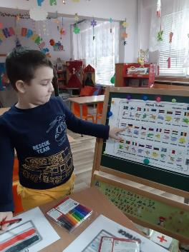
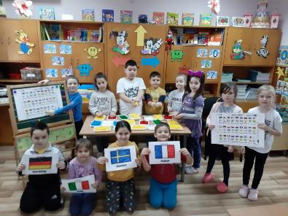
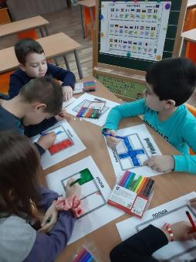
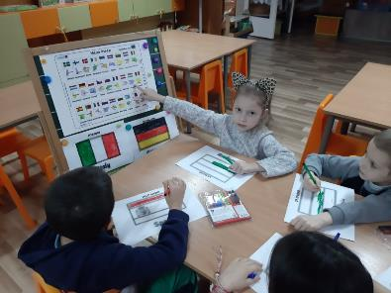
Driven by their desire to learn more and more
for European countries, children drew their flags…

Slide 23
… Made them from tissue paper…

Slide 24
… With their skillful hands they made the geographical
maps of the countries of modeling and clay…

Slide 25
We made an exhibition of maps
and the flags of the states
participants in the M.A.G.I.C. project.

Slide 26
With the accumulated
knowledge and skills,
the children lined up with desire and enthusiasm
flash cards
who made
in a team.

Slide 27
We are a part
from
EUROPE

Slide 28
That’s us!
Made by Pedagogical Team of
Kindergarten “Detski svyat”
Polski Trambesh

