Slide 1
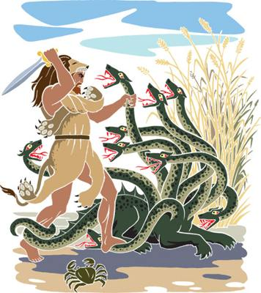
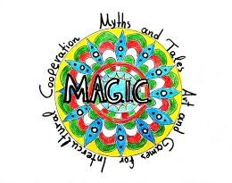
Hercules 21st primary school of Athens “Lela Karagianni”

Slide 2
Hercules’ Passport
Son of Zeus, father of men and gods, and of Alcmene, queen of Thebes.
Since his birth, Hera, wife of Zeus, was jealous of him and was constantly trying to destroy him.
Real person, lived during prehistorical era I Greece.

Slide 3
The creation of Milky Way
According to the myth, Zeus put newborn Hercules to nurse from Hera’s breast milk in order to become immortal. When she realized it ,quickly pushed away the baby. As a result her milk was spilt all around forming the Milky Way.

Slide 4
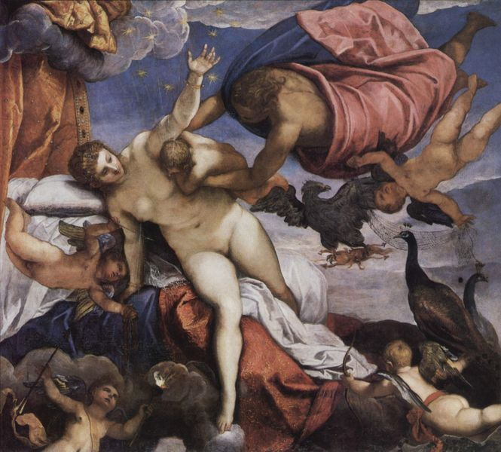
The Milky Way creation in art

Slide 5
Hercules killing the two snakes
Hera sent two big snakes to kill baby Hercules while he was asleep in his bed. But the baby caught and asphyxiated the snakes. Since that age it was obvious how strong and brave he was.

Slide 6
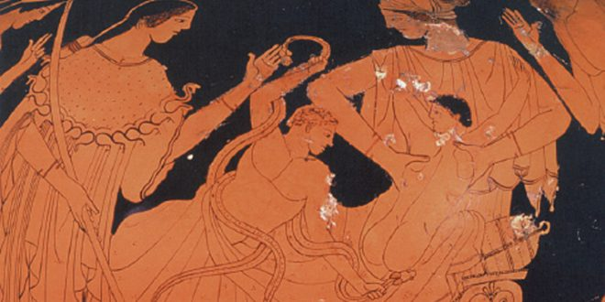
Hercules killing the two snakes – detail from an Attic red-figured stamnos

Slide 7
The route of Arete and Kakia
Young Hercules was thinking which life route to choose. It was then that he met two totally different women. One was humble and simple and the other had a very pretentious look. It was the second who approached him first and offered him a way of appreciation without caring for anything or anyone. When Hercules asked her name, she answered: “my friends call me Bliss and my enemies Malice (Kakia)”.

Slide 8
The route of Arete and Kakia
The other woman promised him a life full of struggle and battle, helping out people and his country for a better life.
Hercules realized that she was Virtue (Arete) and decided to follow her route in life.

Slide 9
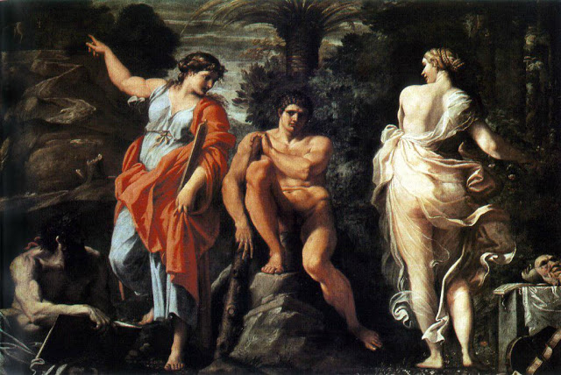
The choice of Hercules in art

Slide 10
Hercules’s End
Hercules’s life comes to an end when he wears a poisoned shirt. He suffers and aches. Climbs on the top of a mountain. Prepares the wood for the fire, lays the lion’s skin on the wood, lies on it holding his bat close to him and asks from a friend to light the fire.
It is Filoktetes passing by, who lights the fire. Hercules gives him as a gift his poisoned arrows. Before he gets burnt, heavy rain starts to fall and the hero is being transferred to mountain Olympus. There, he makes friends with Hera and marries her daughter.

Slide 11
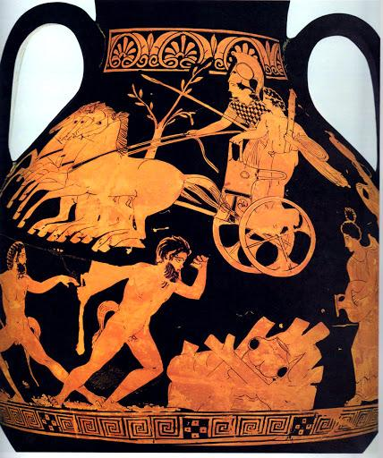
Hercules’s End - Detail from Attic red-figured stamnos

Slide 12
The hero and the man
Hercules became the symbol of a man who seeks virtue, fights his demons, makes mistakes but asks God for forgiveness, improves himself, doesn’t stop to fight, to smile and to hope.
Is the type of Greek hero that later will be called Jason, Theseus, Odysseus and other.
Is the hero we grow up with and always inspires all ages.

Slide 13
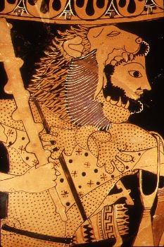
Hercules: The ancient Greek Hero

