Slide 1
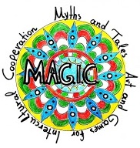
M. A. G. I. C
Myths, Art, Tales and Games for Intercultural Cooperation
2019–2021
Erasmus+ KA2
Easter traditions in
Lithuania
Kindergarten „Buratinas“
of Kursenai
April 2020

Slide 2
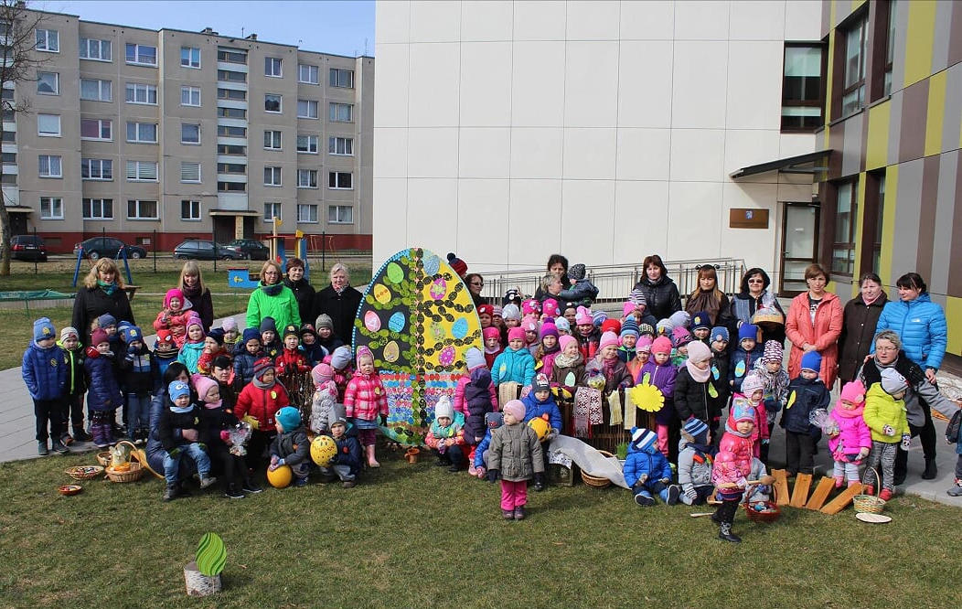
The word Easter means “important day”.
This day is one of the most important Lithuanian traditional festival.
Easter is not only the feast of Christ’s Resurrection but also nature is awakening nature from winter’s sleep.

Slide 3
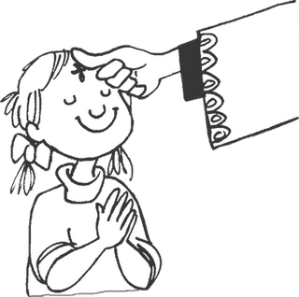
The Lent
It is such an important celebration that we spend over six weeks preparing for it.
It is a time of struggle, suffering and repentance.
And the name of the season is Lent.

Slide 4
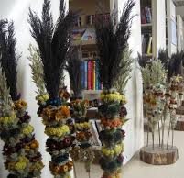
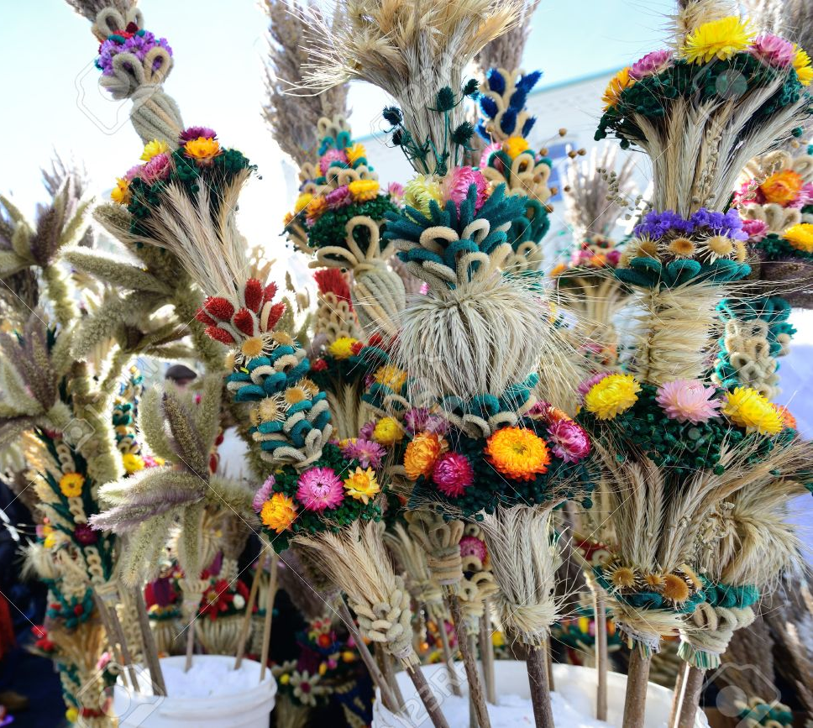
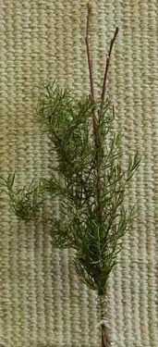
Preparation. Palm Sunday
Easter rituals start one week before Easter, on Palm Sunday.
That week is called the Great Week.
It is full of prohibitions, beliefs and archaic traditions.
Palms (“verbos”) are made of colorful dried wild flowers and herbs. Usually people take them to church on palm Sunday to be blessed.

Slide 5
Holly Thursday
Holly Thursday is a time for ritual cleaning.
On Holy Thursday you must wash not only yourself but clean the whole house.

Slide 6
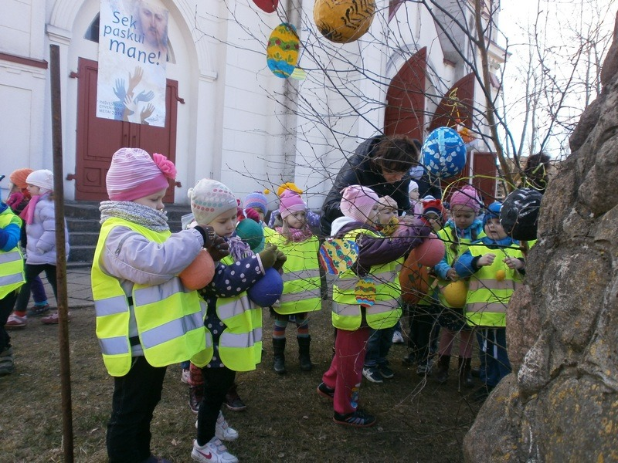
Good Friday
On Good Friday people are very sad in people in respect for the crucified Christ.
Children are forbidden to make noise.

Slide 7
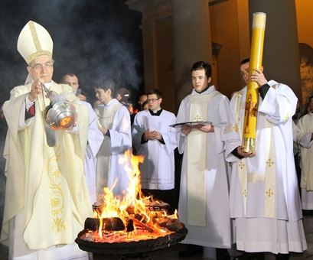
Holy Saturday
On Holy Saturday, people go to church to obtain blessed fire and water.
The belief is that they have miraculous powers.

Slide 8
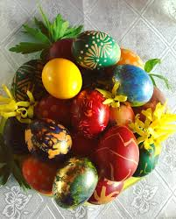
Preparing for Easter on Holy Sunday
The food that will be eaten on Easter is prepared on Easter is
prepared on Holy Saturday.
Also on Saturday people color Easter eggs. The eggs are decorated
by different methods.
In simplest form, they dyed naturally with onion skins.
The more elegant eggs are made with the wax-resist method.

Slide 9
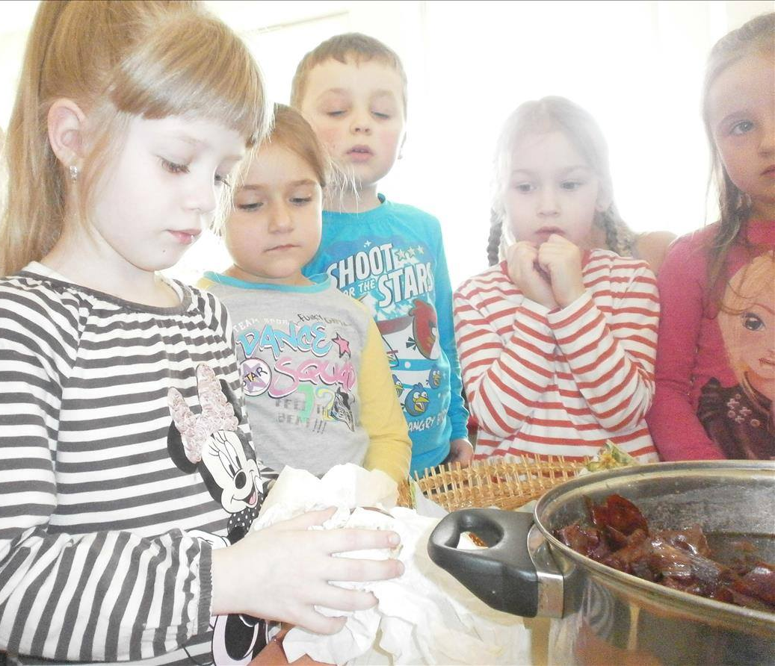
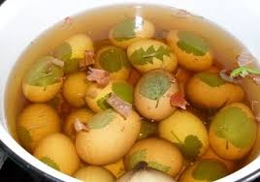
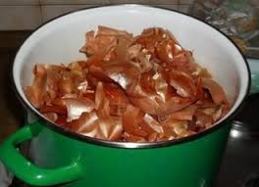
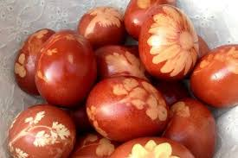
Easter eggs dyed with onion skins and leafy herbs

Slide 10
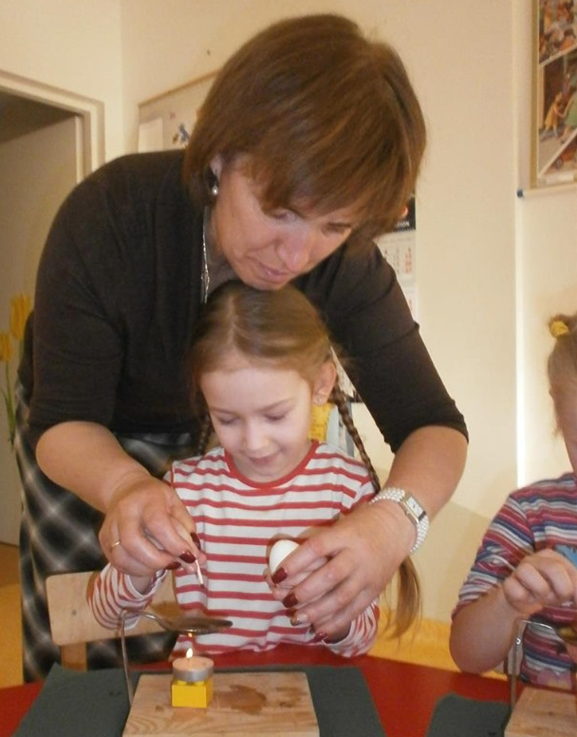
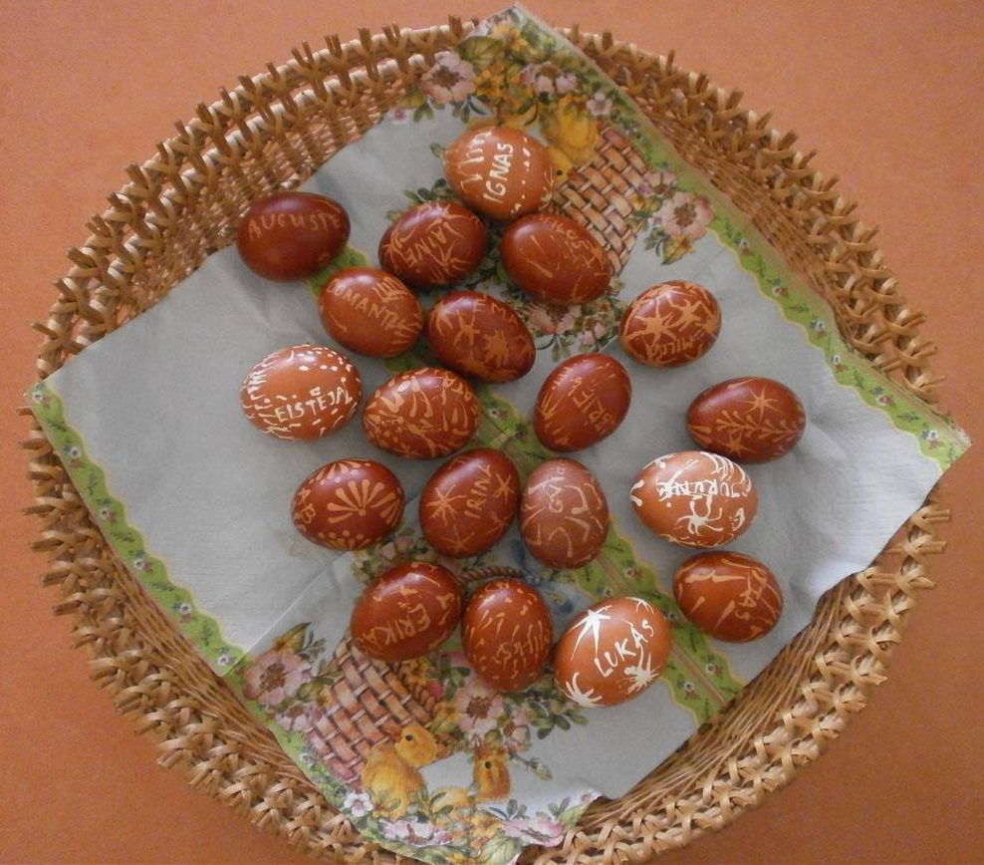
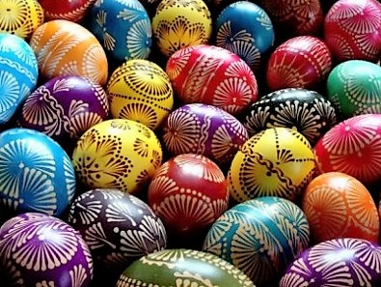
Wax – painted eggs

Slide 11
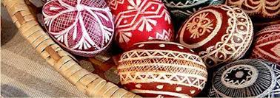
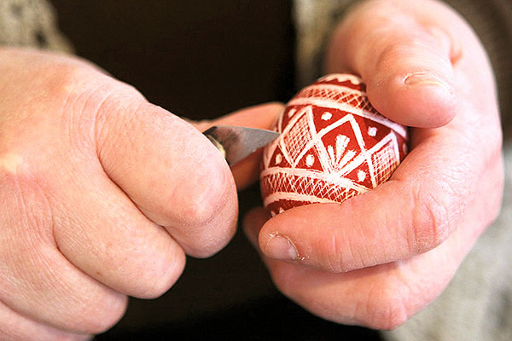
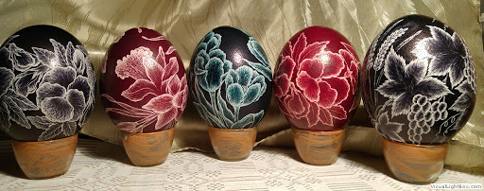
Easter eggs is scraping with a knife

Slide 12
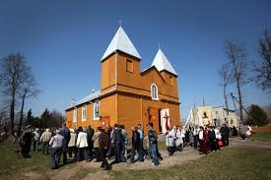
Easter morning in church
The Easter morning procession is usually conducted around the church.
We have: Church flags is hold high, girls strew flowers, the choir and all the people sing and the church bells ring loudly.

Slide 13
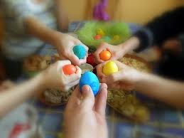
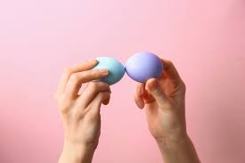
Easter Dinner
After Easter morning church services, people return to their homes to dine.
The meal starts with an egg. Each personan egg has his own egg and clicking it against another’s.
If your egg shell remains unbroken after the "clinking," you are destined to have a long life.

Slide 14
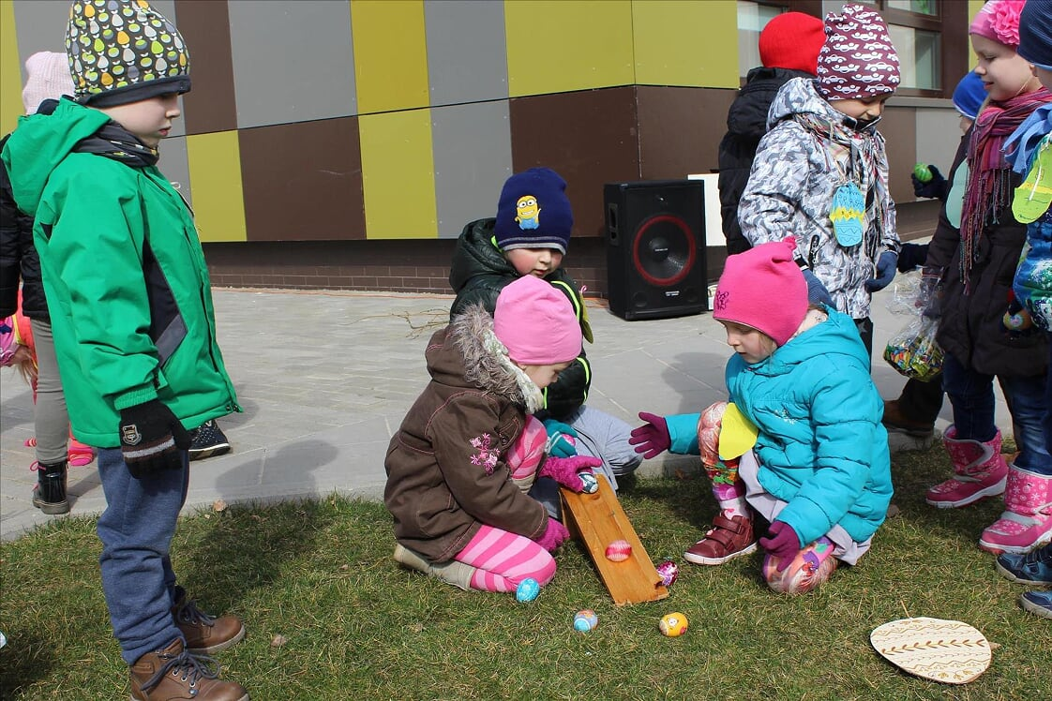
Egg rolling
Another tradition is egg rolling. Players prop one end of a rounded chute fashioned from bark or wood (or cardboard in modern times) at an angle from the ground.
They take turns rolling an egg down the chute attempting to tap another’s egg. If they succeed in tapping another egg, they claim both eggs. The player with the most eggs at the end of the game wins.

Slide 15
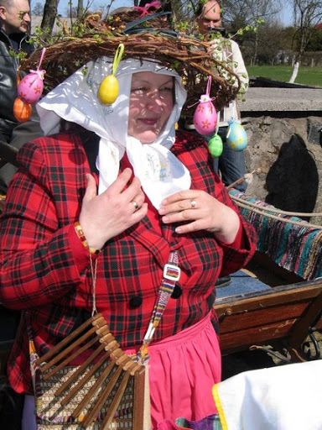
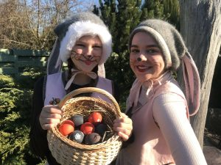
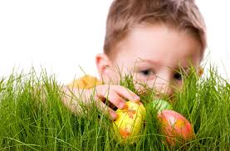
The Easter Granny In Lithuania
The Easter Granny (Velykų Bobutė) delivers Easter eggs and treats to children.
Children often prepare for the Easter Granny by leaving empty homemade egg nests outside their homes in gardens and shrubs.
On Easter morning, they wake to search for their hidden colored, decorated eggs (margučiai) treasures.

Slide 16
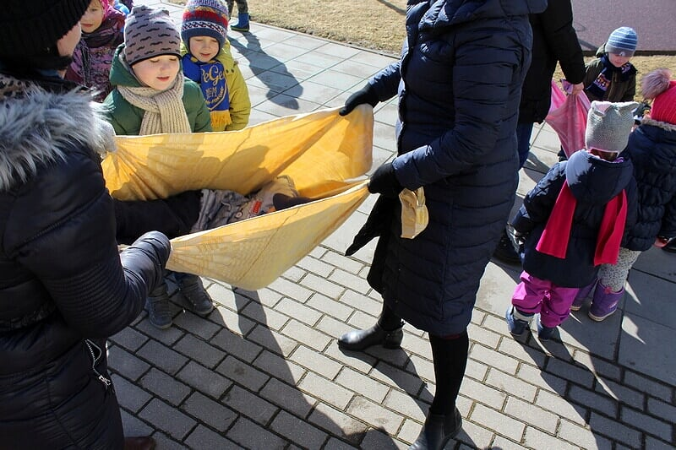
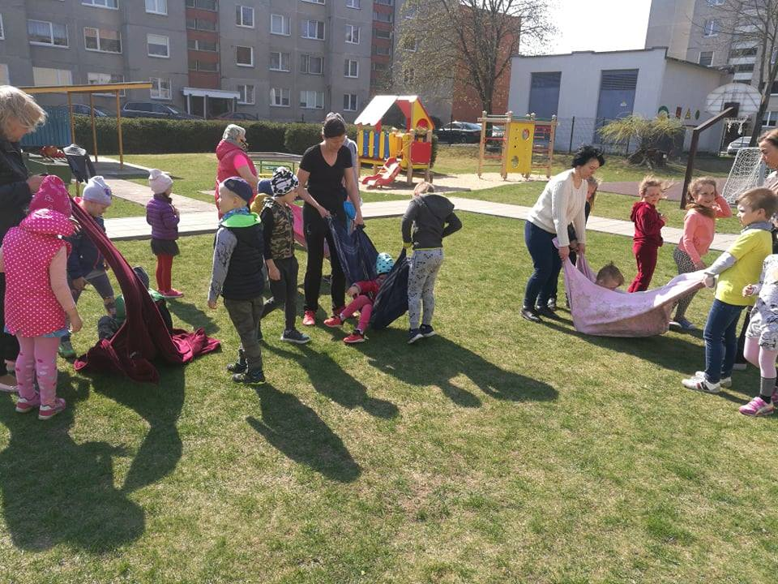
Rocked on the swing
In the past, the girls rocked on the swing not only in order to wait for grooms and matchmaker, but also that the flax would be longer.
One more, Easter advised irrigated with water because then enough rain for crops in the summer.

Slide 17
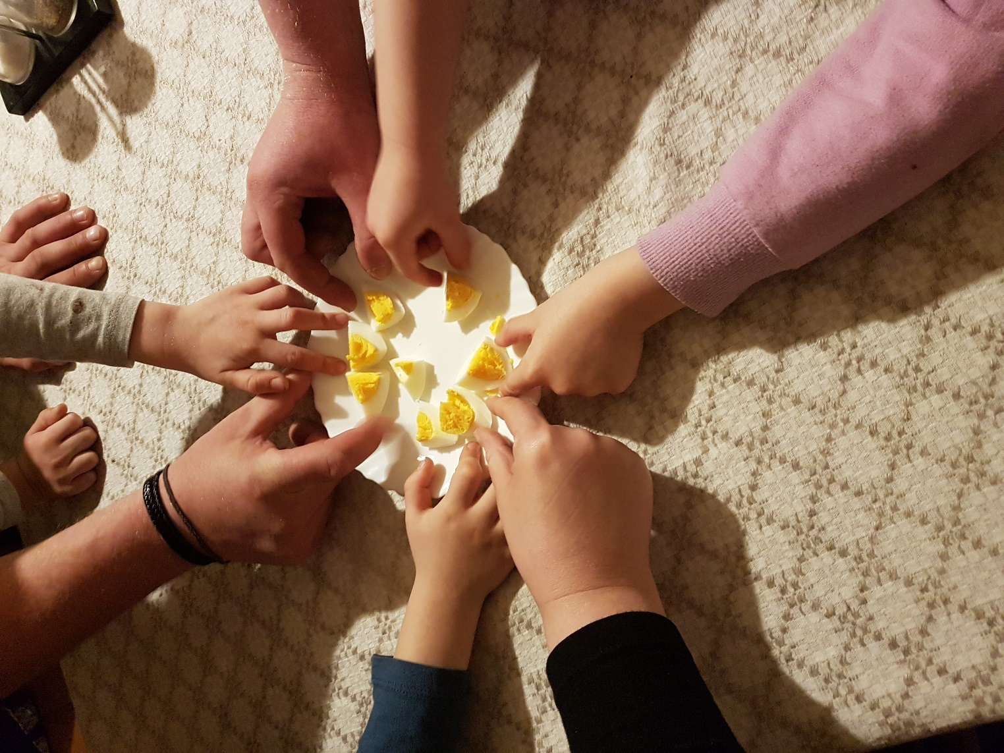
We should mention two final uniquely Lithuanian Easter traditions.
Before everyone indulges in the Easter feast, the dinner host slices a hard-boiled egg into as many pieces as there are guests and passes the plate around the table to share this one egg with everyone.
This sharing of the egg is believed to bring harmony and unity to the household.

Slide 18
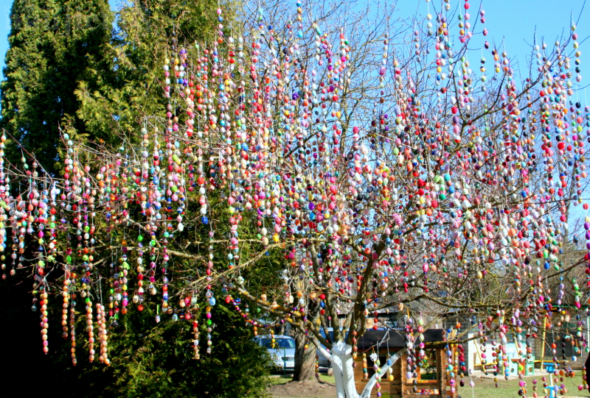
Easter Superstitions
•If it rains on Easter morning, little children let it pour on their heads to ensure quick growth.
•If, on the way to Easter Mass you pass a woman, you'll have an accident. To take the "curse" off, you'll have to retrace your steps and take another road to church.
•After Mass, the person who arrives home first will be
successful all year. Watch out for pushing and shoving.
•If an accident occurs on Easter, the rest of the year is
destined to be frought with bad luck.
•If Easter morning is sunny and beautiful, the summer
will be fair. It it rains or snows, bad weather is to be
expected for the rest of the year.

Slide 19
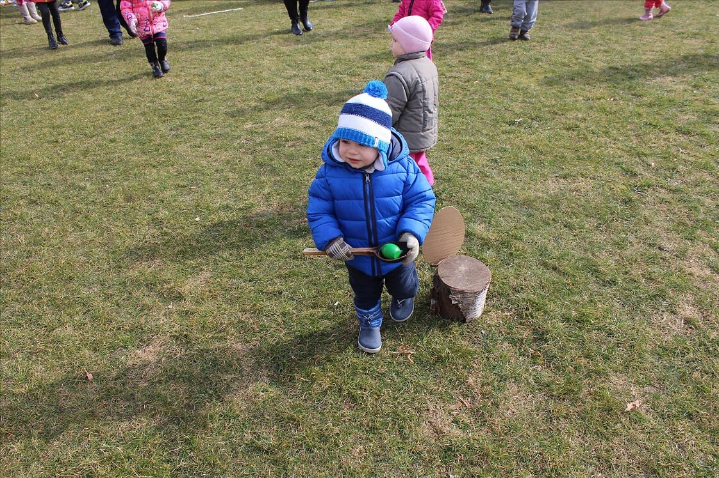
Have a nice Easter time
Be healthy everyone ☺
"The European Commission's support for the production of this publication does not constitute an endorsement of the contents, which reflect the views only of the authors, and the Commission cannot be held responsible for any use which may be made of the information contained therein."

