Slide 1
Dig Learning
Experiences from a fully digitalized classroom

Slide 2
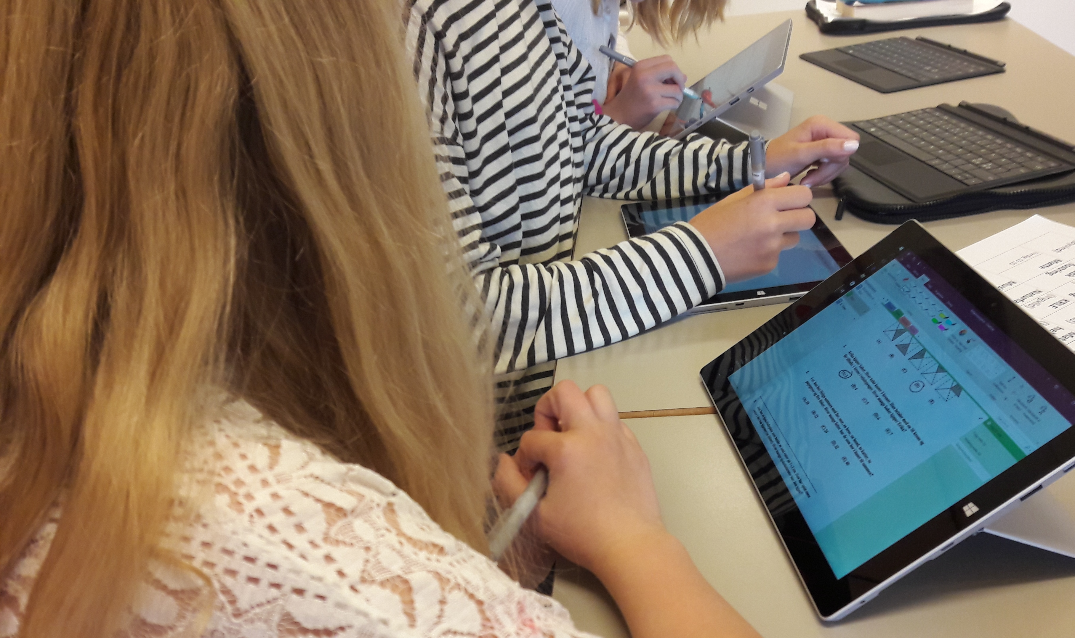
What is Dig Learning?
Knappskog primary school
1st – 4th grade: iPad
5th – 7th grade: Surface
O365
OneDrive as cloud storage
Kunnskapsbyen i vest – «the Knowledge City West»

Slide 3
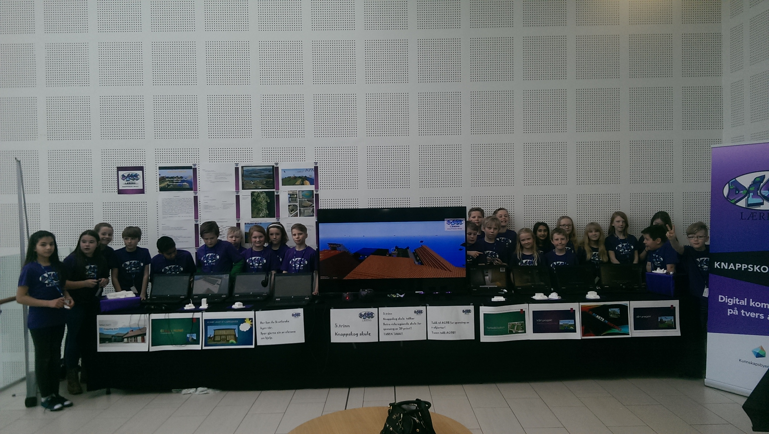
Our work focus
7th grade
Our work focus:
Learning, motivation and achievement for the pupils
21st century skills
Teaching our pupils how to learn
Goal: Pupils can find, evaluate and use information, and convert it into knowledge

Slide 4
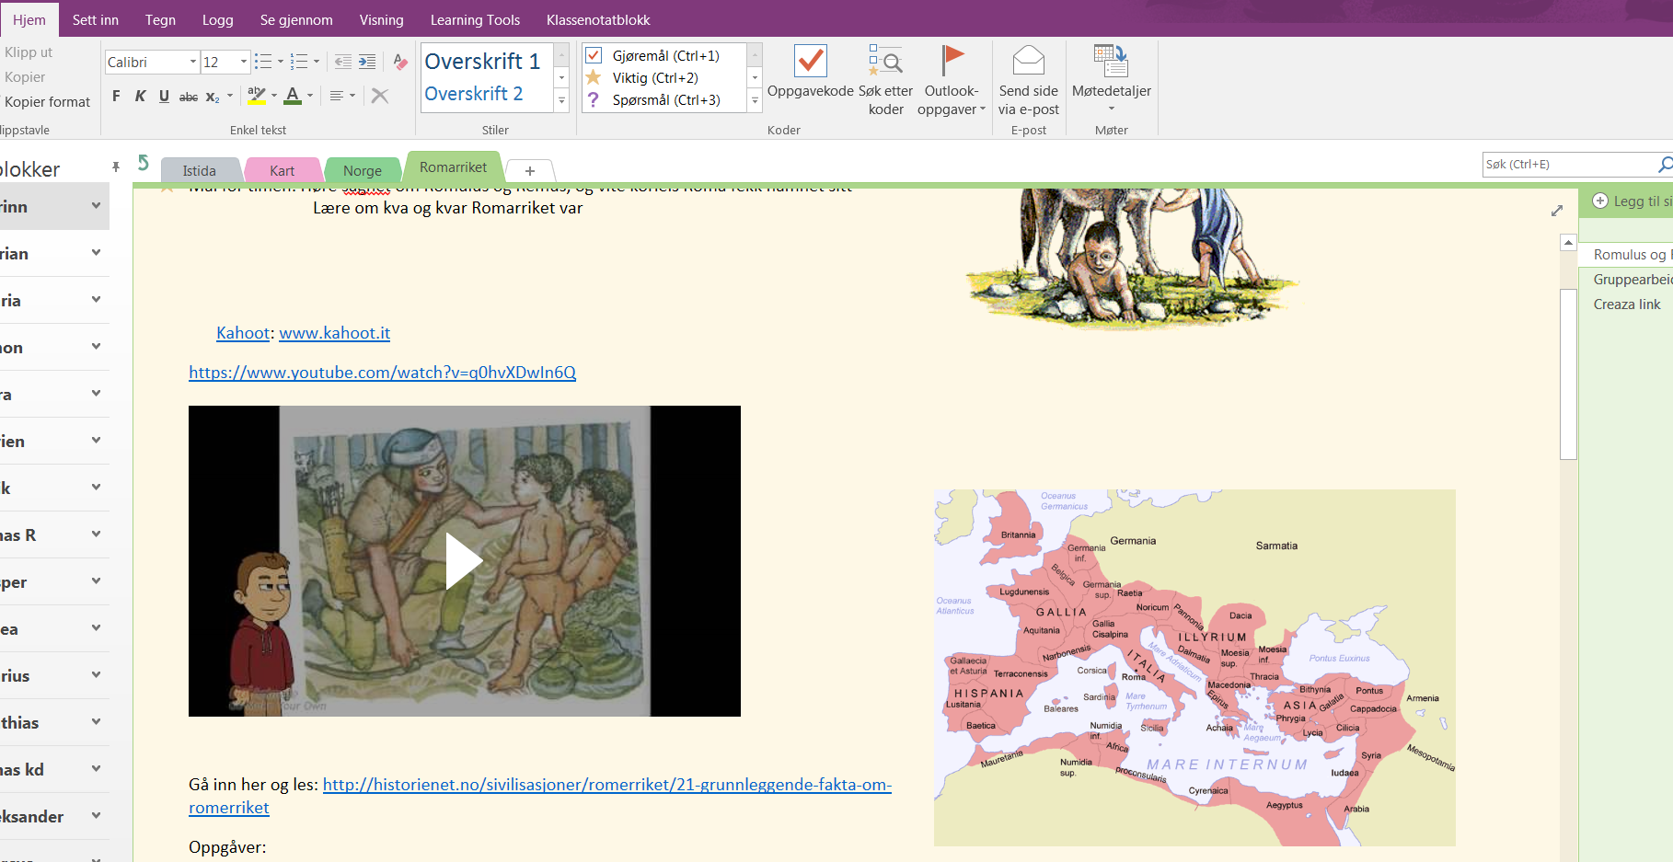
Books
No written textbooks
One Note as both textbook and workbook
Easier to differentiate

Slide 5
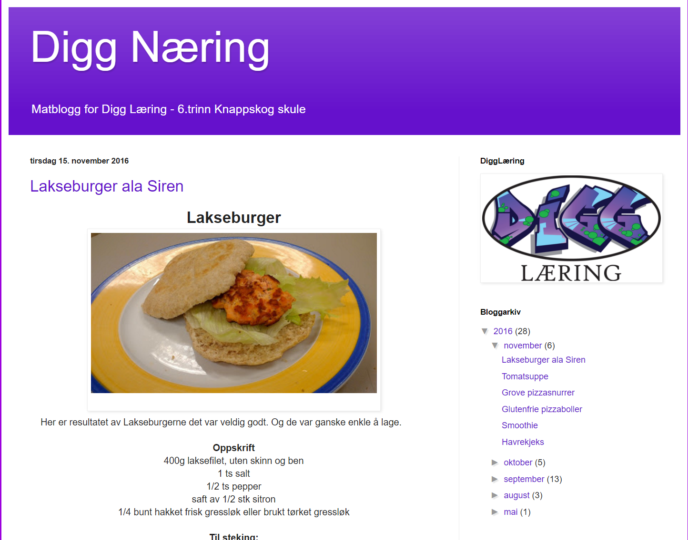
Educational class work
The educational class work must be in the driving seat
Do everything as in any other 6th grade, plus more
Easier to have projects taking in different subjects

Slide 6
Maths
Flipped classroom
Adaptive learning tool
Multi Smart Øving – smart practice
Work in the flow → achievement and motivation
Quantity training

Slide 7
Creative tools
Creaza
Mind maps, presentations, cartoons and movies
Information into knowledge
Good methods to gather information

Slide 8
Quizlet
Words and terms both in Norwegian and English
Don’t have to correct the pupils work
Easy to differentiate
Achievement and motivation

Slide 9
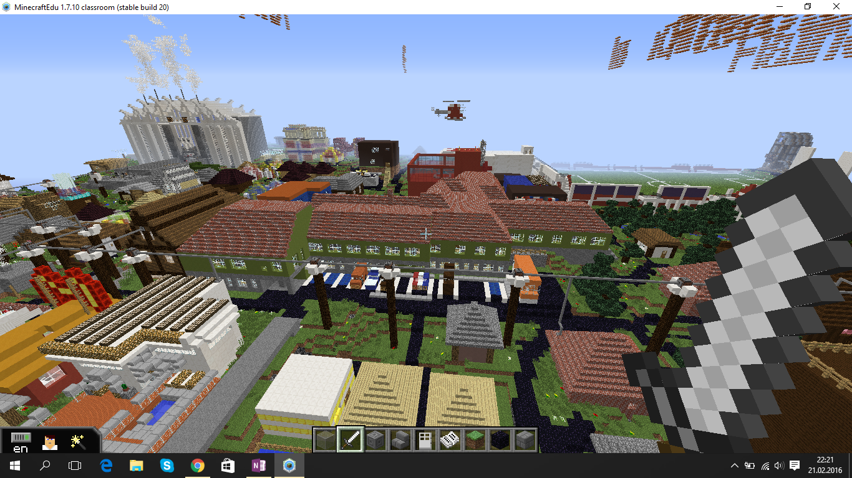
Minecraft
Pupils’ home ground
Educational purposes
Projects taking in different subjects

Slide 10
Other educational tools
Office
Word
Excel
Power Point
Sway
Kahoot

Slide 11
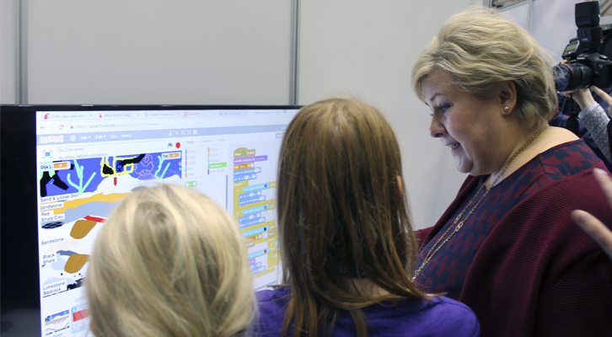
Coding
Scratch
Collaboration with a local IT-company, Acos
Equip our pupils with the skills our local businesses need in the future
International oil and offshore exhibition (OTD)
Makey Makey
Micro:bit

Slide 12
Conclusion
Will never go back to textbooks again
More motivated and are learning more
Turned around our teaching strategies and educational classwork

