Slide 1
THINK ABOUT THE CONTENT YOU POST!
ARE YOU THE SUBJECT OR NOT?

Slide 2
Could it be misinterpretated or misunderstood?
YES
NO

Slide 3
Think carefully about whether you really want to post this content. Should you make use of privacy settings so that you are in control of who can see it?
YES
NO

Slide 4
Go ahead and publish the content. Always remember that others can capture content- e.g. Take screen shots or repurpose it somehow.
BACK

Slide 5
Okay-go ahead and publish the content.
BACK

Slide 6
You should find out more about privacy setting.
BACK

Slide 7
Have you checked
with the subject of
the photo or content
to see if they are happy
for it to be published?
YES!
NO!

Slide 8
Check with the subject BEFORE
you post any content.
Think about how you would feel
if someone posted content about
you without asking first.
BACK

Slide 9
Are they happy for you to go ahead and publish the content?
NO!
YES!

Slide 10
You should respect their wishes and not publish the content unless they are happy for you to do so.
Consider the consequences of going against what they want.
How would you feel if you were in the same situation?

Slide 11
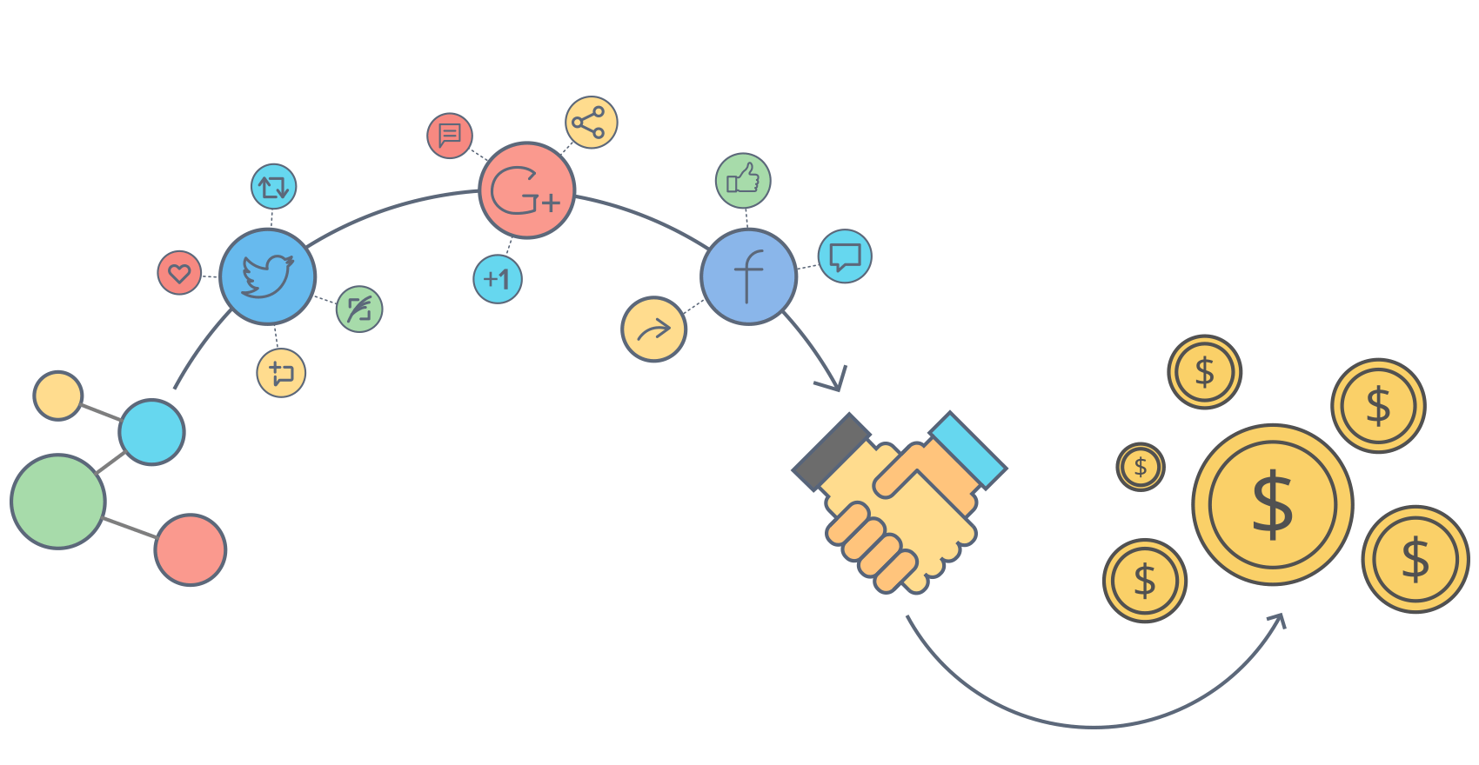
Go ahead and publish the content. Remember that it is good practice to always check with others before you post content about them.
BACK

