Slide 1
Introduction to eTwinning and our project ‘Let’s interACT’

Slide 2
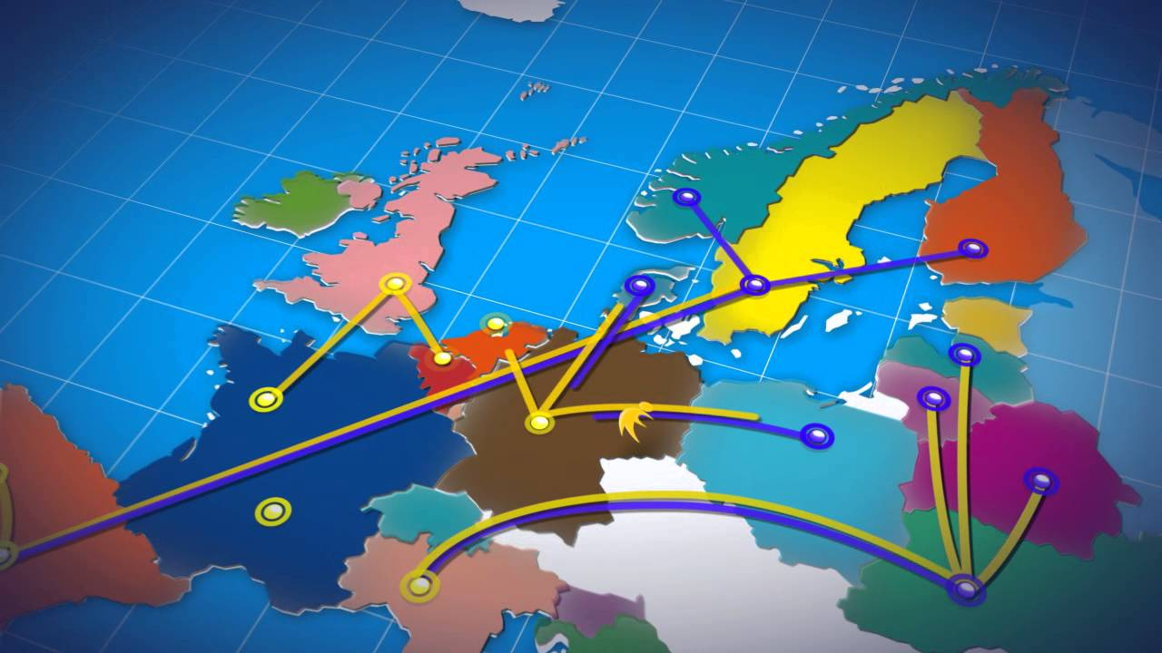
Introduction on eTwinning

Slide 3
Introduction on eTwinning
More than 800.000 teachers

Slide 4
Introduction on eTwinning
More than 800.000 teachers
More than 200.000 schools

Slide 5
Introduction on eTwinning
More than 800.000 teachers
More than 200.000 schools
More than 100.000 projects

Slide 6
Introduction on eTwinning
Students can …
???

Slide 7
Introduction on eTwinning
Students can …
communicate with each other.

Slide 8
Introduction on eTwinning
Students can …
communicate with each other.
get to know each other’s environment.

Slide 9
Introduction on eTwinning
Students can …
communicate with each other.
get to know each other’s environment.
show presentations and project material to each other.

Slide 10
Introduction on eTwinning
Students can …
communicate with each other.
get to know each other’s environment.
show presentations and project material to each other.
develop their English.

Slide 11
Introduction on eTwinning
Students can …
communicate with each other.
get to know each other’s environment.
show presentations and project material to each other.
develop their English.
collaborate with their peers.
create a short film together

Slide 12
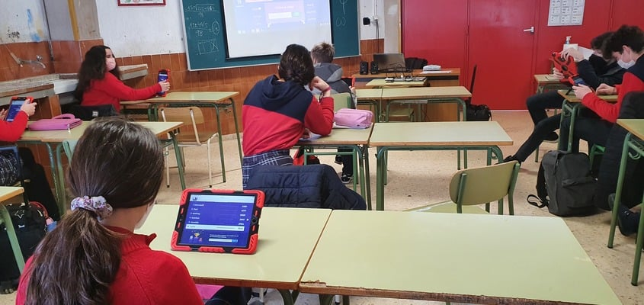
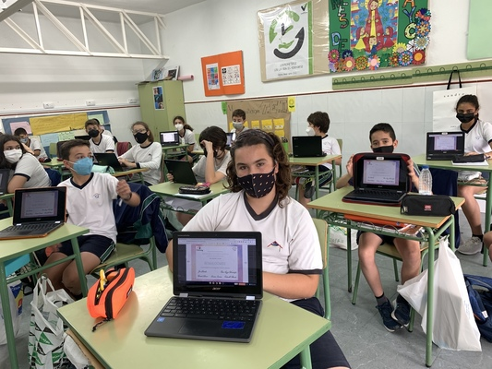
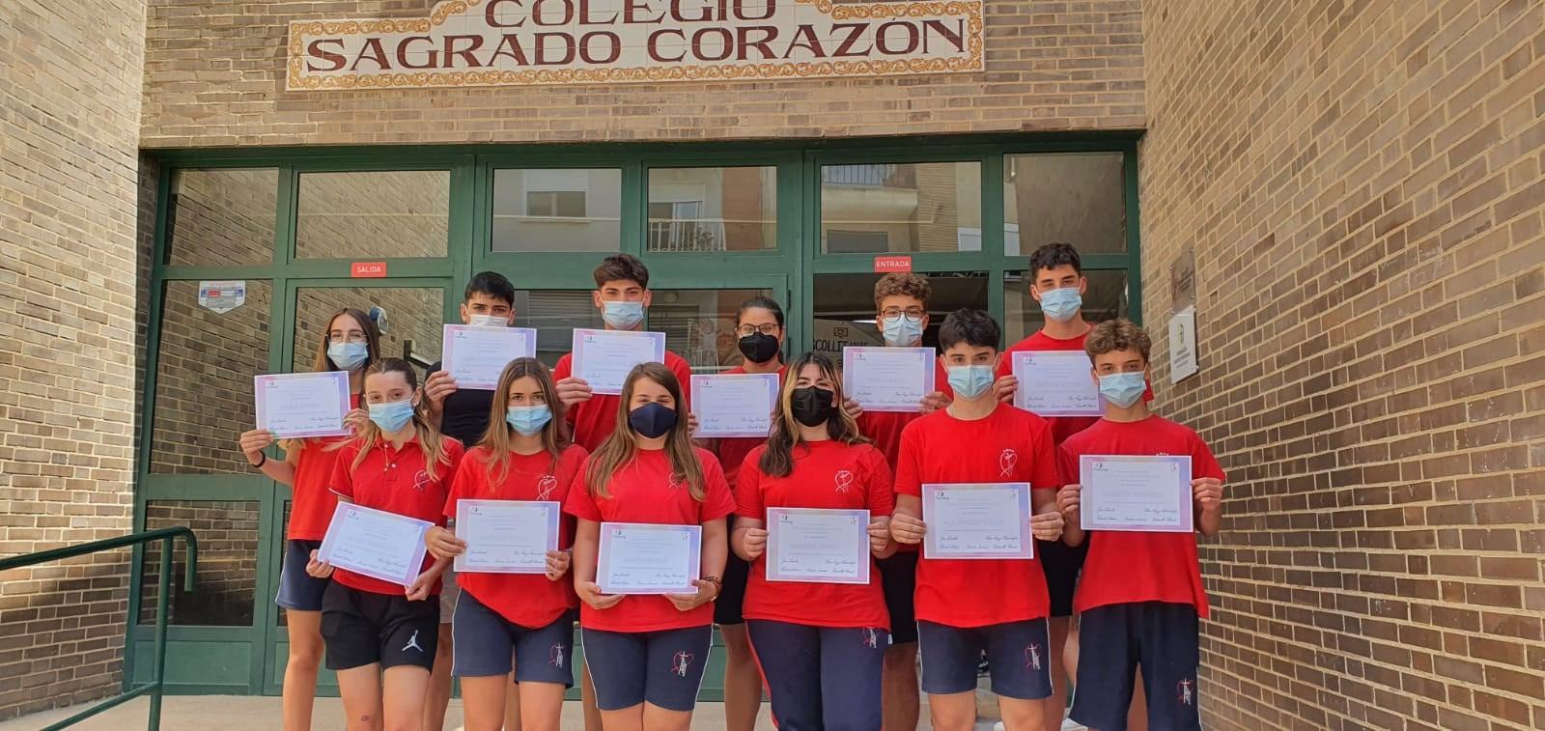
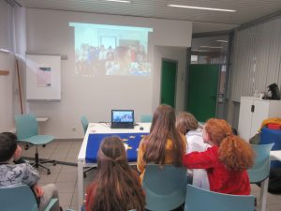
Introduction on eTwinning

Slide 13
Let’s interACT

Slide 14
Let’s interACT
During the project, you will …
meet foreign peers;
develop a logo for the project;
introduce yourself through emails, video messages and presentations;
get to know each other's culture: place of residence, school, country, famous people, typical holidays, national dishes, etc.;
use ICT tools;
improve your English;
make your dreams known: job, travel, relationship, home, ... ;
create a short film/ play or advert together
send each other a (digital) thank you card.

Slide 15
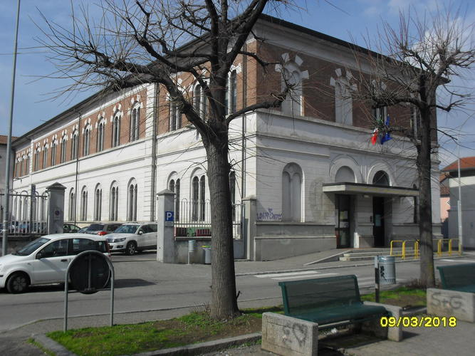
Let’s interACT
Istituto Comprensivo di Fagnano Olona

Slide 16
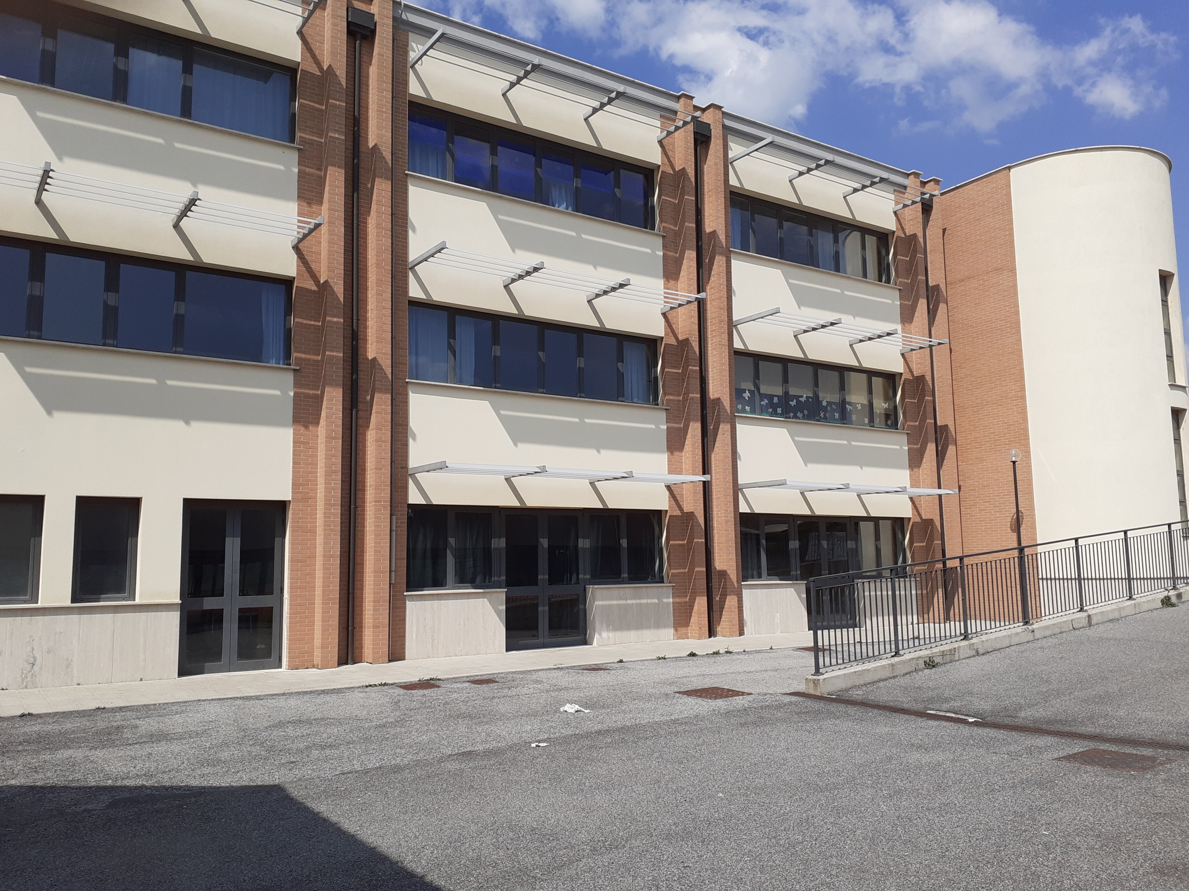
Let’s interACT
Istituto Comprensivo di Fagnano Olona
Istituto Comprensivo Luigi Pirandello di Fonte Nuova

Slide 17
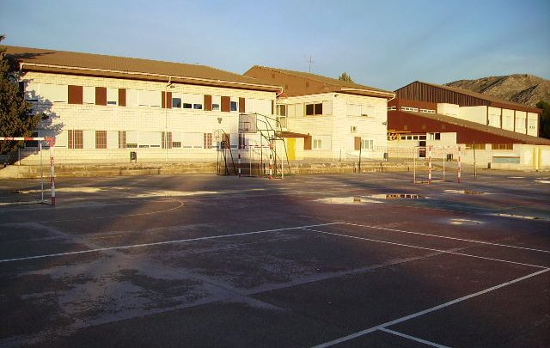
Let’s interACT
Colegio La Encarnacion Villena

Slide 18
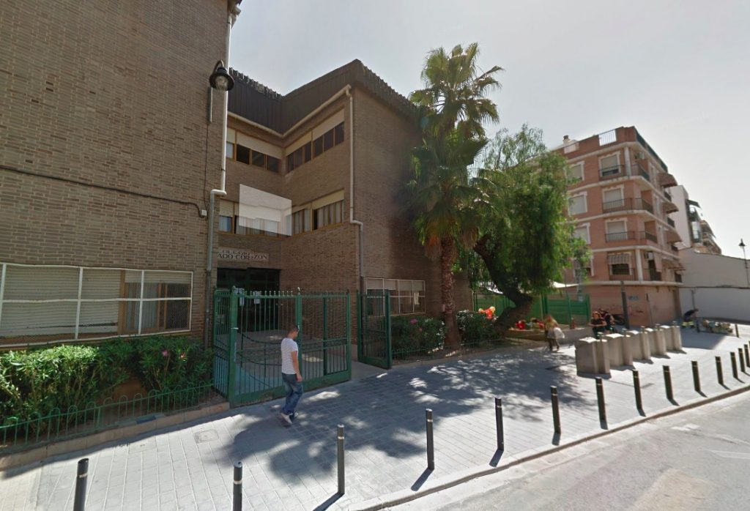
Let’s interACT
Colegio La Encarnacion Villena
Colegio Sagrado Corazon Quart de Poblet

Slide 19
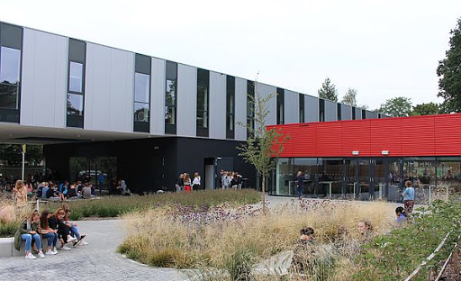
Let’s interACT
Sancta Maria Kasterlee

Slide 20
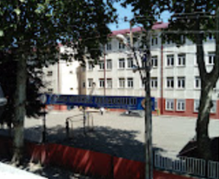
Let’s interACT
Yomra Merkez Ortaokulu
Sancta Maria Kasterlee

Slide 21
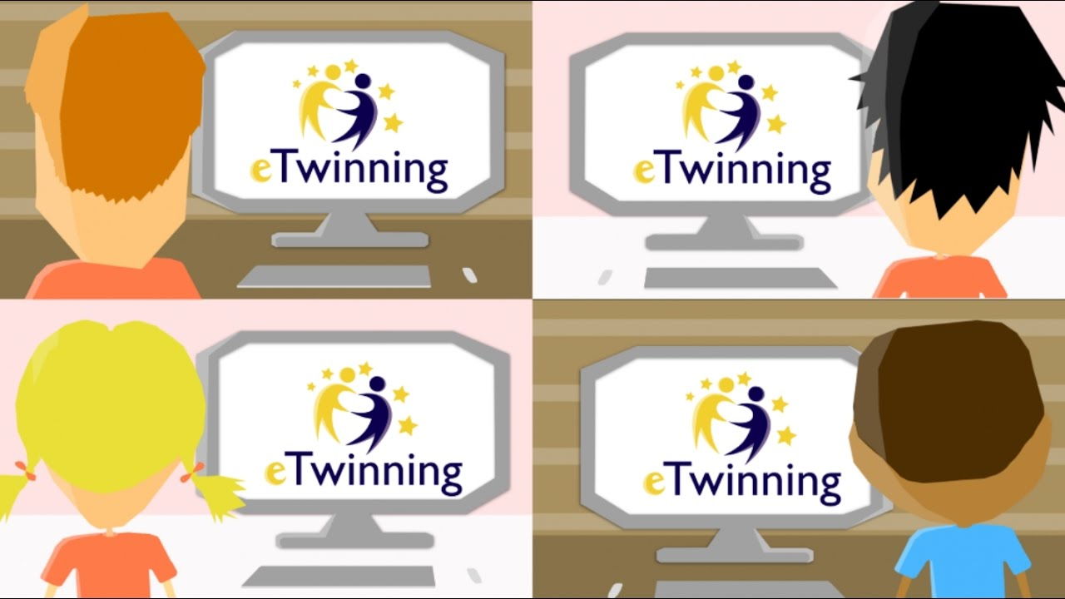
Have a nice eTwinning!

