Slide 1
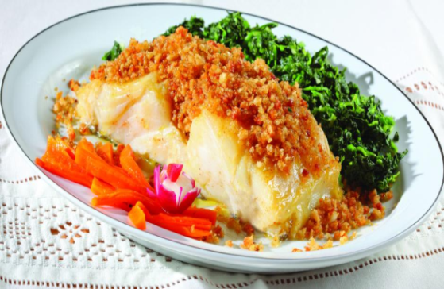
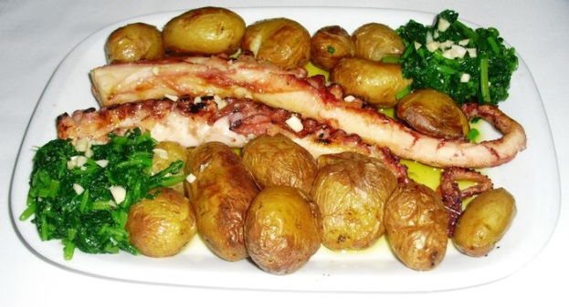
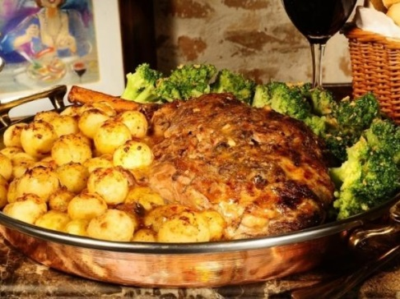
Traditional christmas food in portugal
In Portugal we celebrate Christmas on 25 December and we open the presents at midnigth but before that we have supper which may contain the following foods:
Consoada cod Octopus roasted lamb

Slide 2
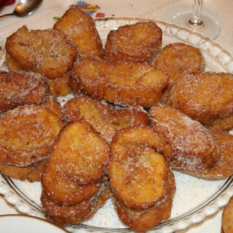
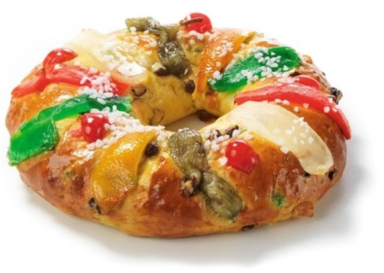
Desserts
Rabanadas king cake
Golden slice sweet rice

Slide 3
consoada cod
1 coded cod
0,3 snapshot pneaker
0,5 onion
0,8 garlic clove
0,5 dl olive oil
0,3 dl wine of Porto
0,4 dl white wine
0,5 vinegar soop spoon
10 g sultanas
Sheda pinada
salt
chili
Flour (to pass)

Slide 4
This is how we do it:
preparation time: 50 min.
1 - Put the cod to be soaked cold water for 48 hours. Subsequently remove it and drain it. Peel the onions and garlic. Chop the garlic and cut the onion into thin half moons and set aside.
2 - Bring a frying pan to the heat and let it warm. Pass the cod slices in flour and fry them on both sides, leaving them not too flushed. Remove them and put them in an oven dish.
3 - Add the garlic and onion to the olive oil where you fried the cod and cook until the onion is transparent. Add the white wine, season with salt and pepper and simmer for 5 minutes. Add vinegar and sultanas and bring to a boil. Add the port wine and turn off the heat.
4 - Prepare the puree according to the directions on the packaging and arrange mounds of puree around the cod. Spread the onion mixture over cod and bake in preheated oven at 200ºC for 15 minutes. Serve warm and sprinkled with chopped parsley.
Tip: You can replace sultanas with raisins

Slide 5
Rabanadas
800 ml semi-skimmed milk
100 g sugar
1 lemon peel
1 cinnamon stick
8 thick slices bread stick
3 eggs
500 ml frying oil
2 c. sugar soup (to sprinkle)
qb cinnamon (to sprinkle)

Slide 6
This is how we do it:
1. Heat the milk with 100 g of sugar, the lemon rind and the cinnamon stick without boiling. Remove from heat and set aside.
2. Soak bread slices in warm milk. Reserve.
3. Wrap each slice of bread in the previously beaten egg as it fries.
4. Fry in abundant hot oil on both sides until golden brown.
5. Drain on absorbent paper. Reserve.
6. Mix sugar with cinnamon to sprinkle to taste.
7. Pass the slices one by one into the mixture and serve.

Slide 7
sweet rice
1 l semi-skimmed milk
200 g sugar powder
200 g carolino rice
1 c. salt coffee
1 lemon peel
3 egg yolks M
qb ground cinnamon
PREPARATION
1. Cook a pan of milk, sugar, rice and salt, and when it boils, add the lemon rind.
2. Cook over low heat, stirring occasionally, until rice is well cooked but still brothy.
3. Undo the egg yolks with a fork in a bowl, add a little of the cooked rice, stir and mix everything in the pan.
4. Bring to the heat again, now very low, and stir about one minute.
5. Remove from heat and distribute in individual bowls or deep dish.
6. Once cold, sprinkle with cinnamon.

