Slide 1
My Erasmus experience

Slide 2
Introduction
Erasmus is a fun and learning full experience, having the opportunity to learn new languages and cultures is great and within these slides i will share my own feelings and experiences that i lived during this week!

Slide 3
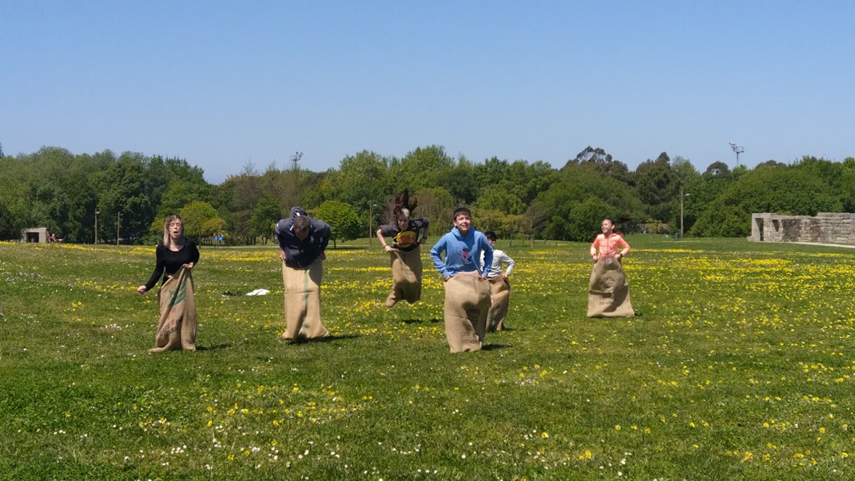
Day 1- Monday
On monday we had a picnic in the city park of póvoa de varzim with the newcomers and we all shared food with each other.
We played our traditional games with them and sang traditional songs from every country.
This made us know each other better and even make some new friends

Slide 4
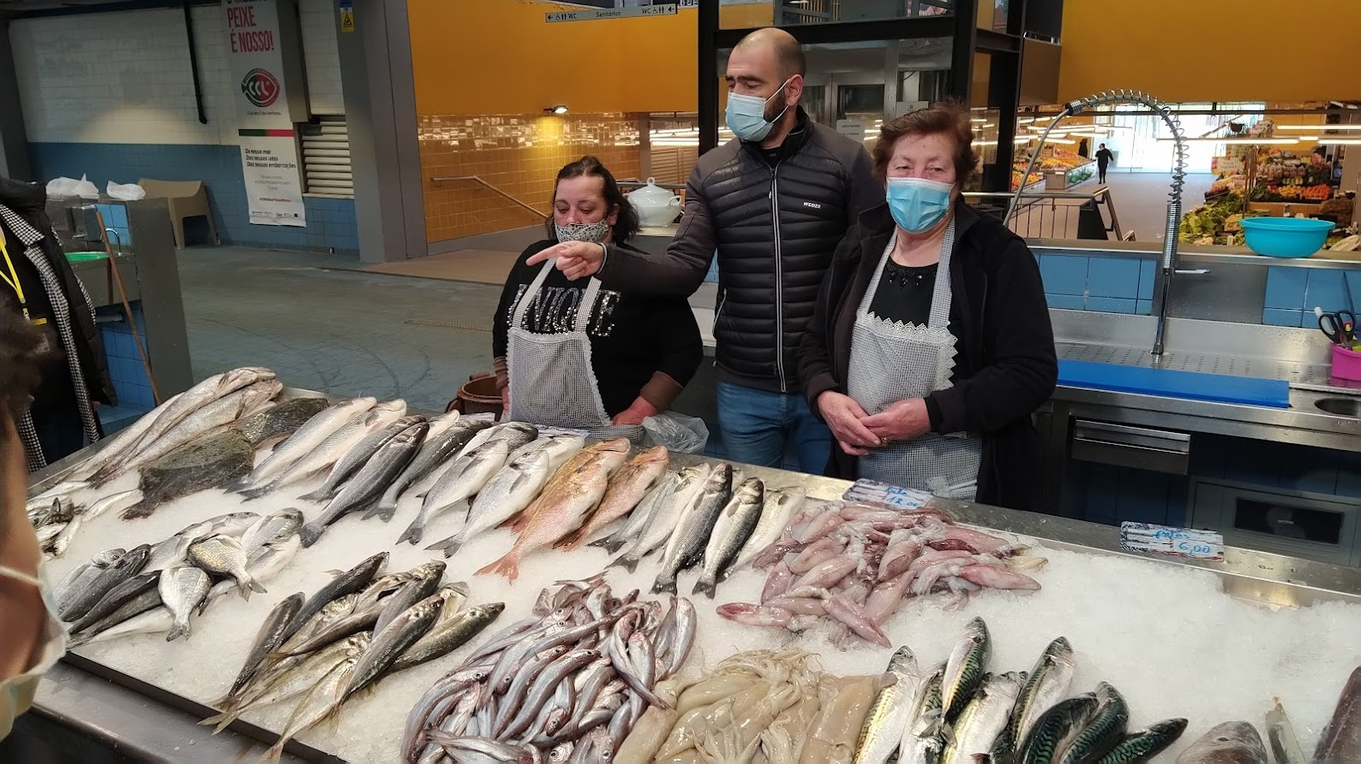
Day 2-Tuesday
We went to our municipal market and tasted traditional dishes from our city: Sardine rice and bread with codfish, i really enjoyed the food even though i'm not a big fan of fish. After that we went to the Town Hall and the vice-president told us about the story of our beautiful city. In the afternoon we had a very relaxing mindfulness session while eating m&m's!

Slide 5
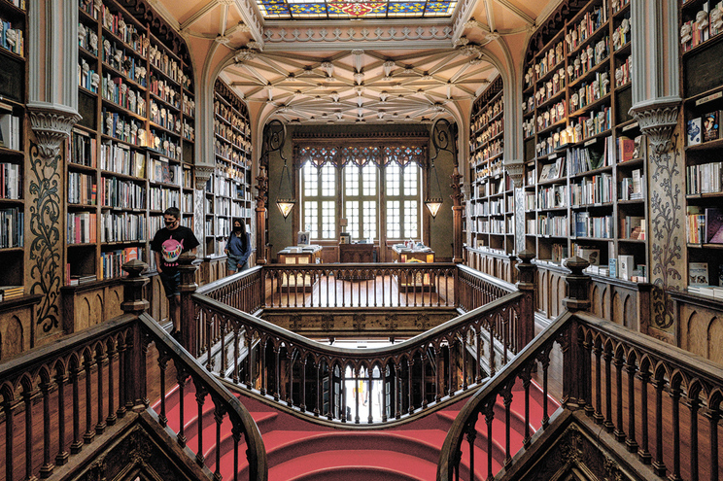
Day 3-wednesday
We started the day by entering the metro in Póvoa de Varzim and we went to Porto. When we reached our destination we went through the historic center to the Lello library. In the library some of us bought a book and others just walked around. Then we went to the restaurant called “N´o mercado” to eat some really good pizza!

Slide 6
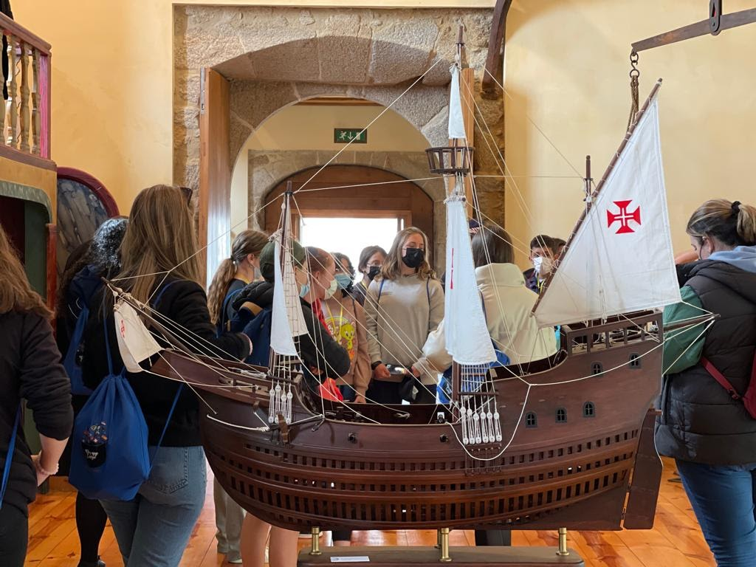
Day 4-Thursday
On Thursday we went to Vila do Conde where we divided into two groups: one went canoeing and the other one visited the “nau” and the Alfandega Régia.
We all had lunch at the restaurant of Anastácia´s parents a fellow portuguese student.
After that lunch, we went boating.

Slide 7
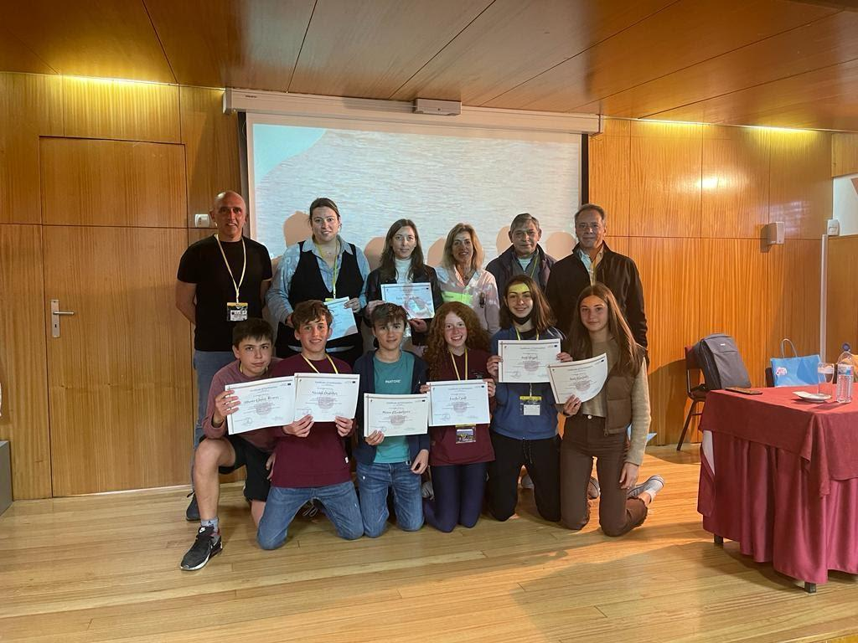
Day 5- Friday
I personally wasn't here because i went on another activity that i tough was important but basically everyone said their goodbyes and received their diplomas

Slide 8
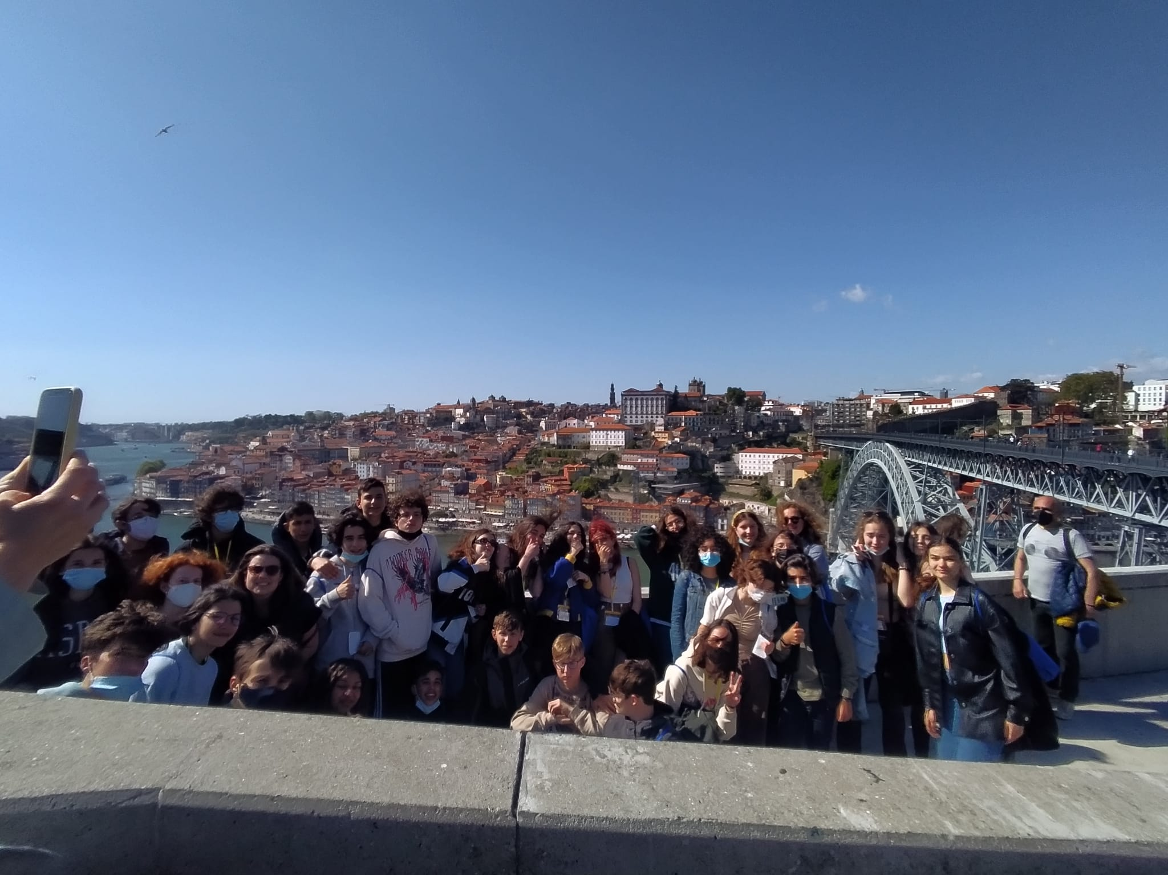
The end

