Slide 1
CROATIA

Slide 2
Croatia
country in Europe
member of the EU since 2013
surface is 56 500 km²
4 ranges:
hilly, lowland, coastal and mountain range
Adriatic Sea

Slide 3
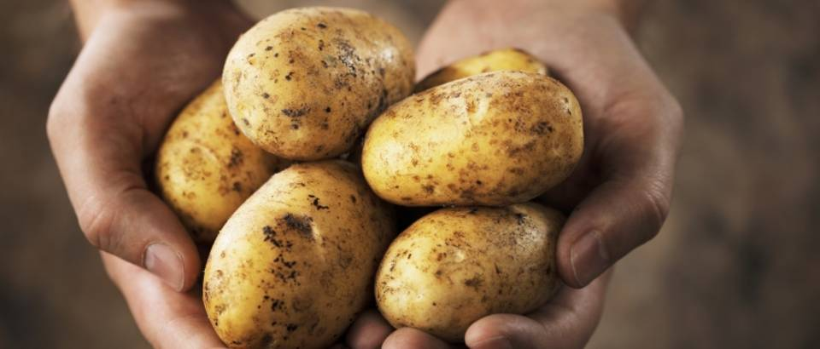
HILLY RANGE
northern and northwestern Croatia.
The main vegetable crop is potatoes.
horticulture, fruit growing and viticulture

Slide 4
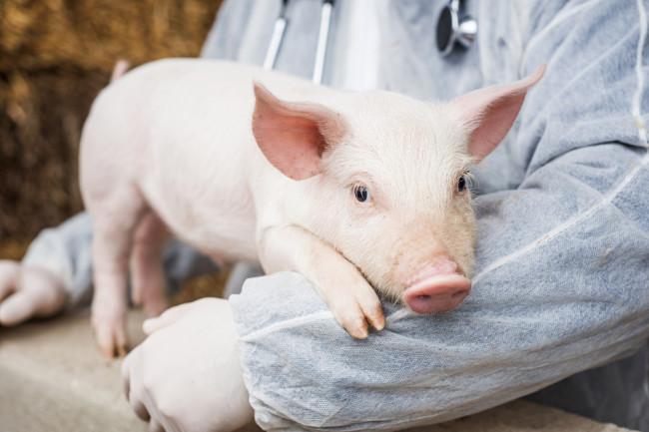
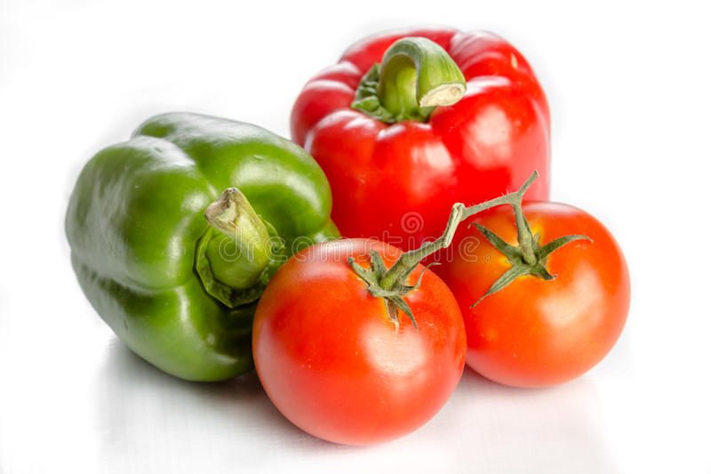
LOWLAND
East of Croatia
mostly made up of arable land
pigs are the most farmed, and cattle are the least
Potatoes, pepper, tomatoes

Slide 5
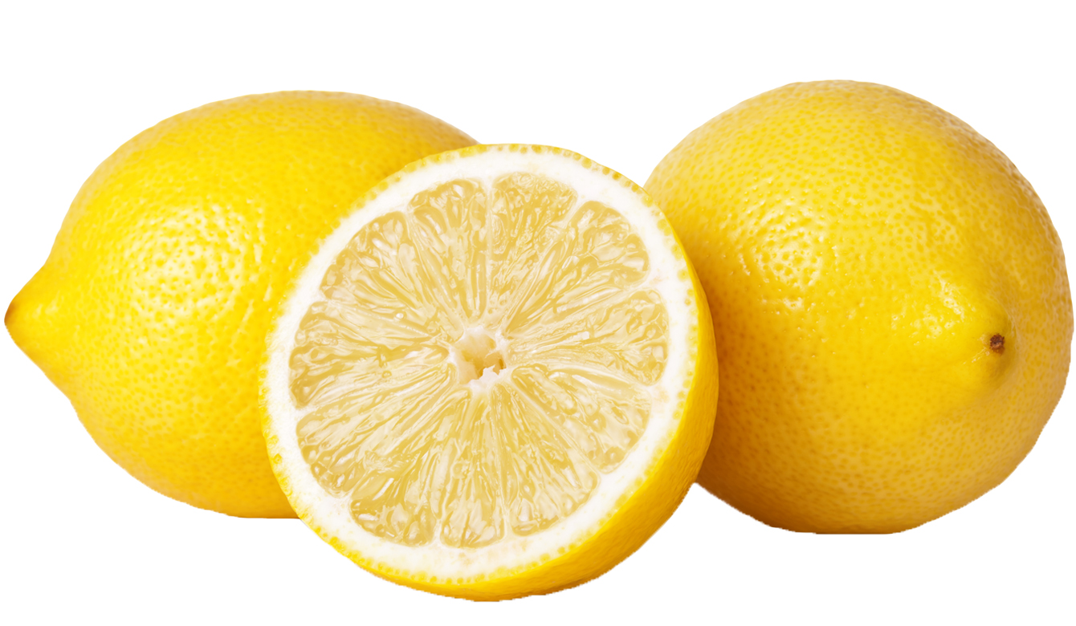
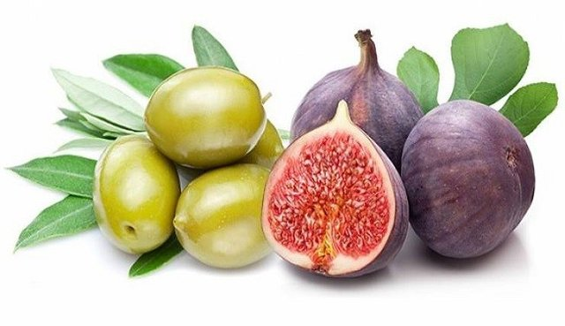
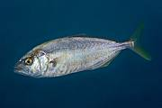
COASTAL
Along the Adriatic Sea
Three regions: Istra, Dalmatia, Kvarner
Tourism is the most developed
Fish, citrus, olives, kiwi and figs

Slide 6
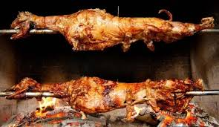
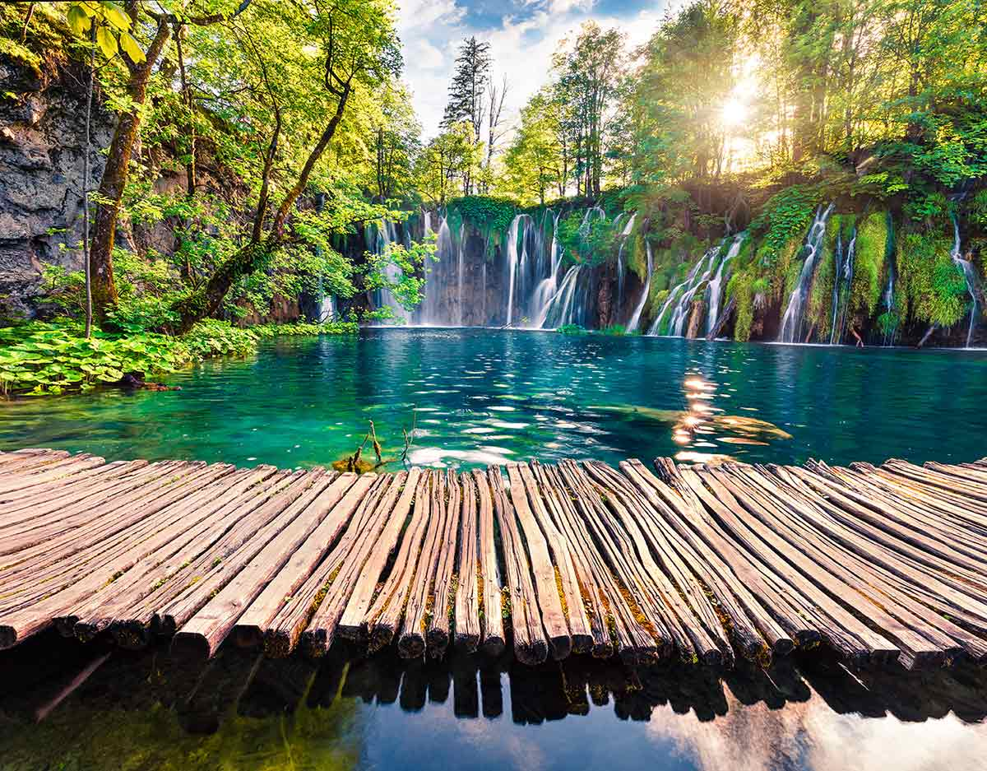
MOUNTAIN RANGE
Two regions: Lika, Gorski kotar
Wood industry
Agriculture: patatos, cabbage
lamb

Slide 7
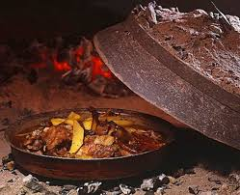
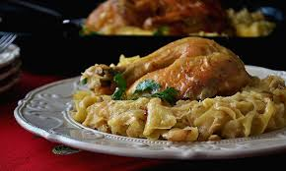
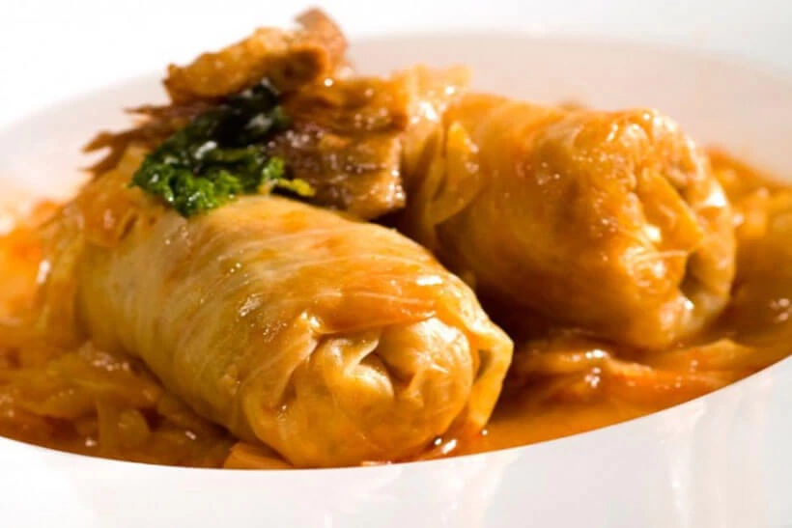
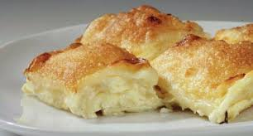
ZAGREB the capital city
Melting pot for a lot of cultures
Turkish, japanese, chinese, lebbanese, italian…
Croatian traditional food:
sarma
turkey and „mlinci”
roasted veal
„štrukli”

Slide 8
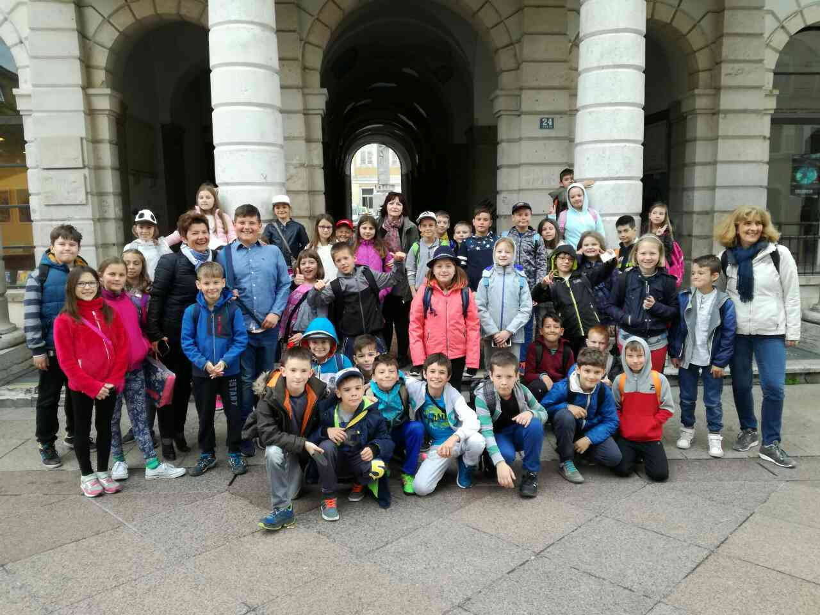
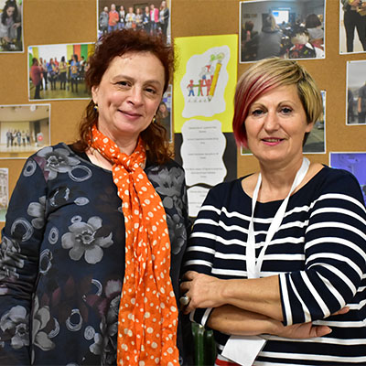
OUR SCHOOL
OTON IVEKOVIĆ Primary school
Named by a famous croatian painter
It is 50 years old
There are about 450 students
A lot of cross curricular activities

Slide 9
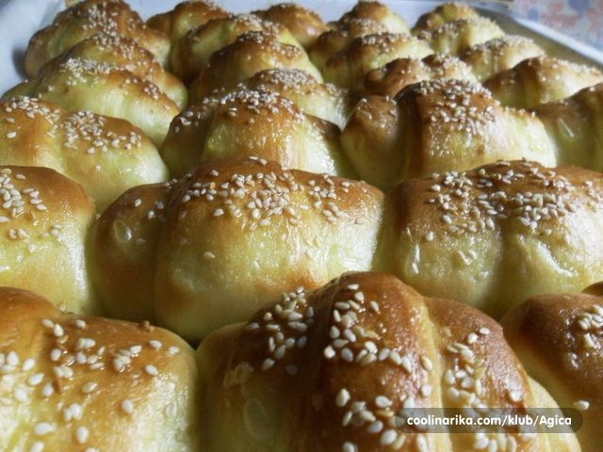
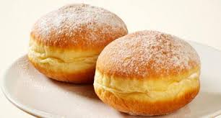
FOOD IN OUR SCHOOL
1st and 2nd grade have lunch
From 3rd to 8th grade have brunch
We have 2 cooks

Slide 10
The end
Made by: Magdalena, MAŠA, TONI, NINO, DOROTEA, DOMINIK

