Slide 1
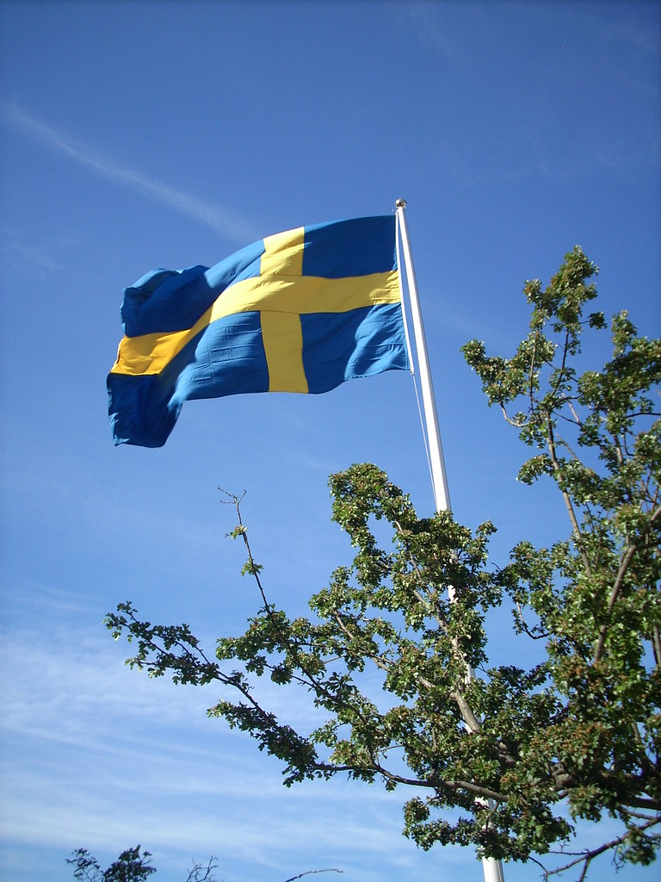
TWO TYPICAL SWEDISH TRADITIONS DURING SPRING AND SUMMER
Eve of Valborgsmäss, 30 of April
Midsummer, (around) 21 of June
Det här fotot av Okänd författare licensieras enligt CC BY-SA

Slide 2
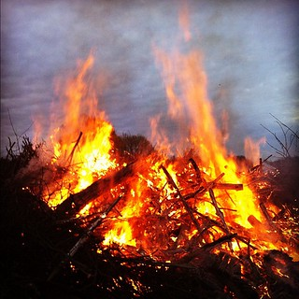
On the last of April every year, many Swedes participate in the celebration of ”Valborg”. They light large bonfires and sing spring songs. These bonfires are called Walpyrgis Mass bonfires or May-fires. In the past, fires were lit to burn out the old and make room for the new. In our days…throw out winter, welcome spring!

Slide 3
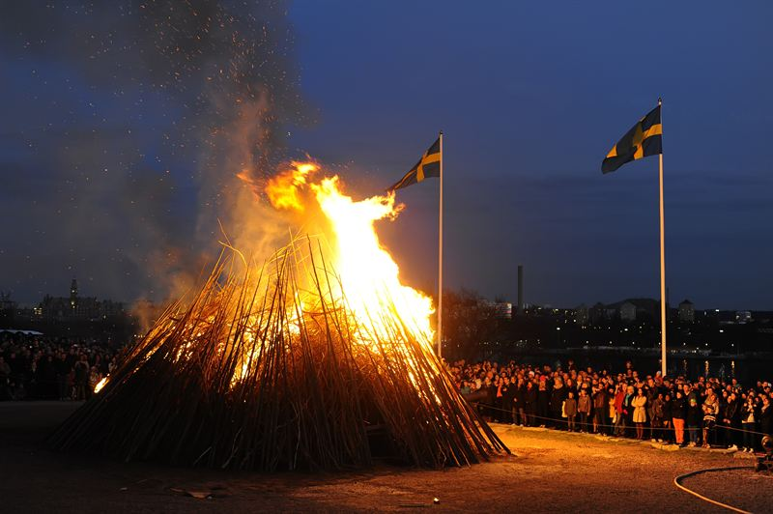
Valborg is a very old festival, which came to Sweden from Germany during Middle Ages. The origin is Catholic and it is celebrated in memory of the German saint Walpurgis
Det här fotot av Okänd författare licensieras enligt CC BY-NC-ND

Slide 4
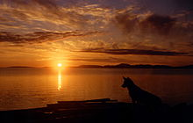
Midsummer is celebrated once a year, in connection with what we call summer solstice. This means….at that time the sun is highest in the sky and that day will be the longest of the year and the night will be the shortest. This happens around 21 of June.
Det här fov Okänd författare licensie
Det här fotot av Okänd författare licensieras enligt CC BY-SA

Slide 5
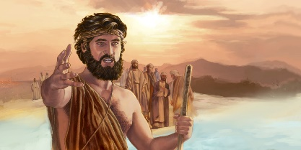
The reason why we celebrate Midsummer, is rooted in Christianity. The celebration is in memory of John the Baptist

Slide 6
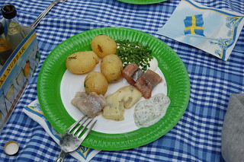
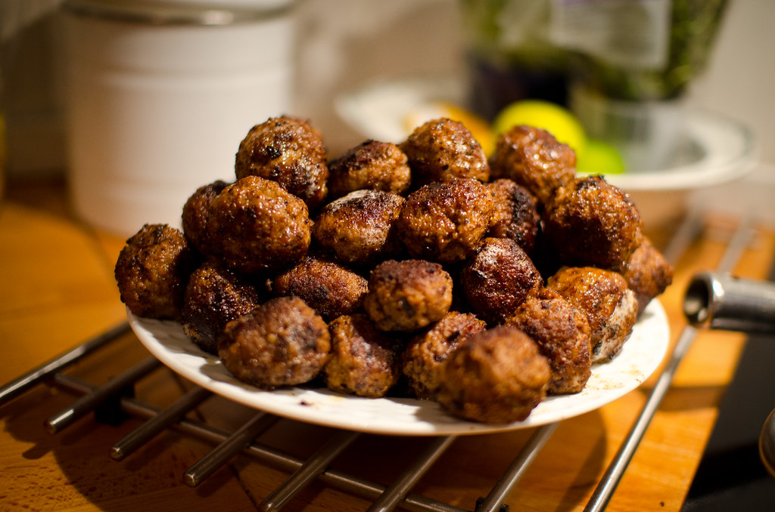
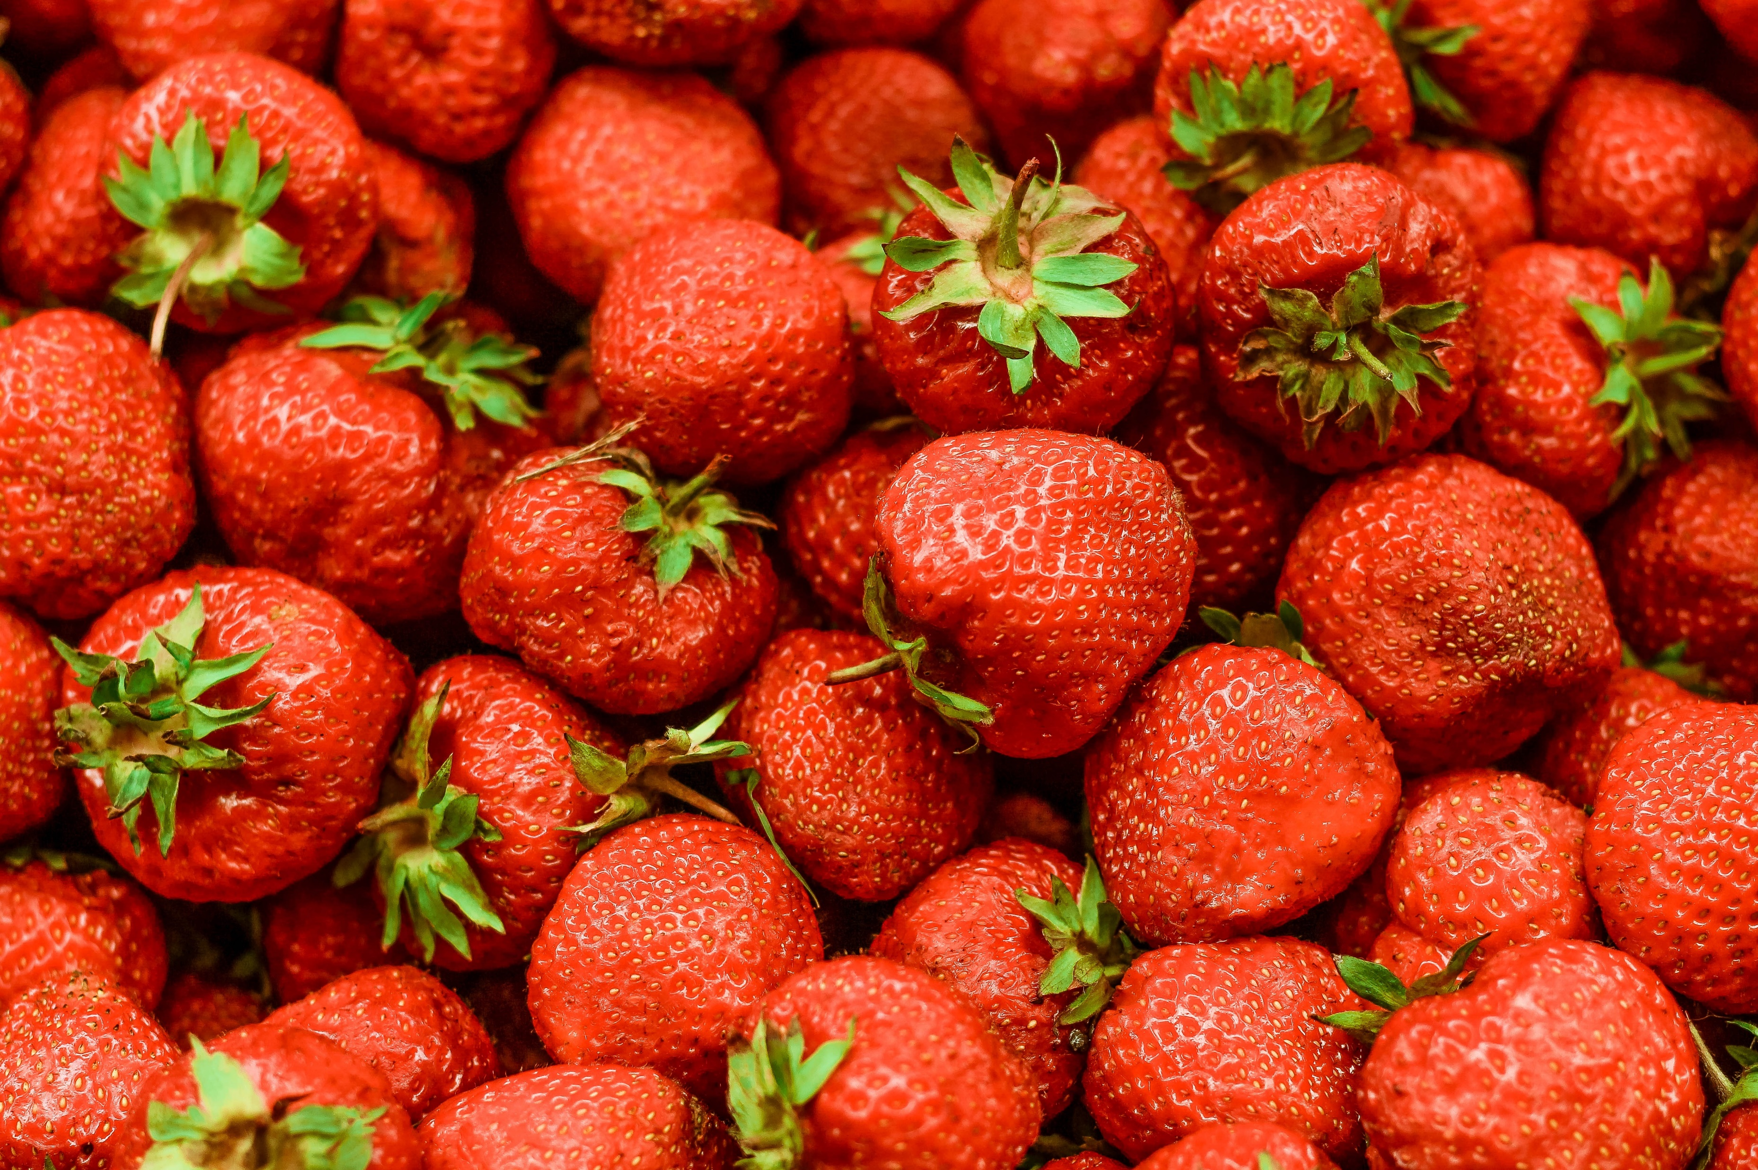
The Midsummer celebration circle around dance, games and a special type of food, such as herring, sour cream, chives and new potatoes (served with dill). But meatballs, eggs and salmon are also common. For dessert strawberries!

Slide 7
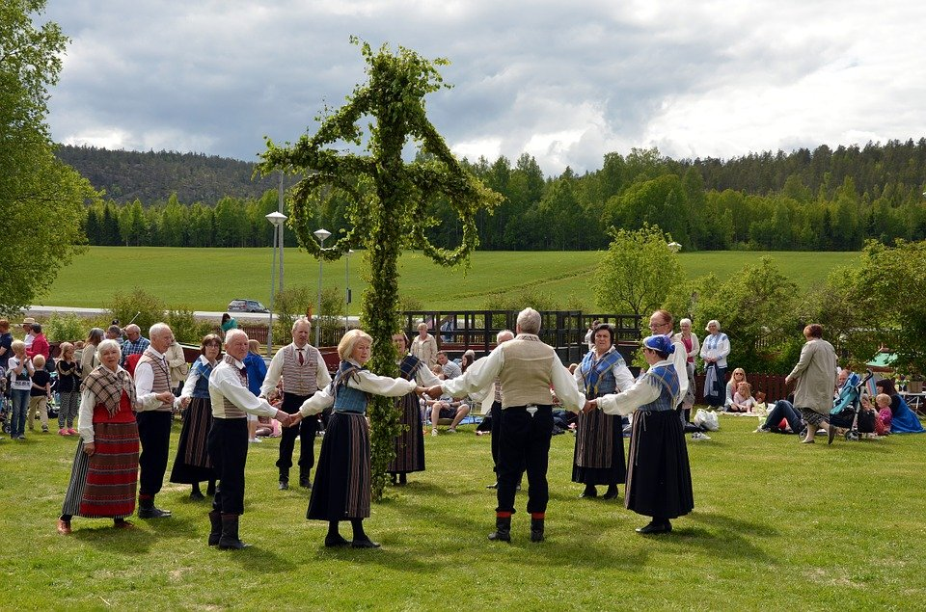
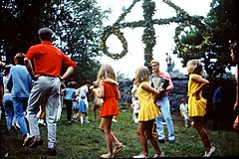
But what distinguishes the midsummer the most is the midsummer pole. It is usually shaped lika a cross and covered with flowers and leaves. People gather around the pole and form circles and dance and sing funny songs, such as ”The little frogs”
D

Slide 8
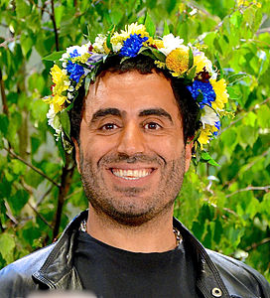
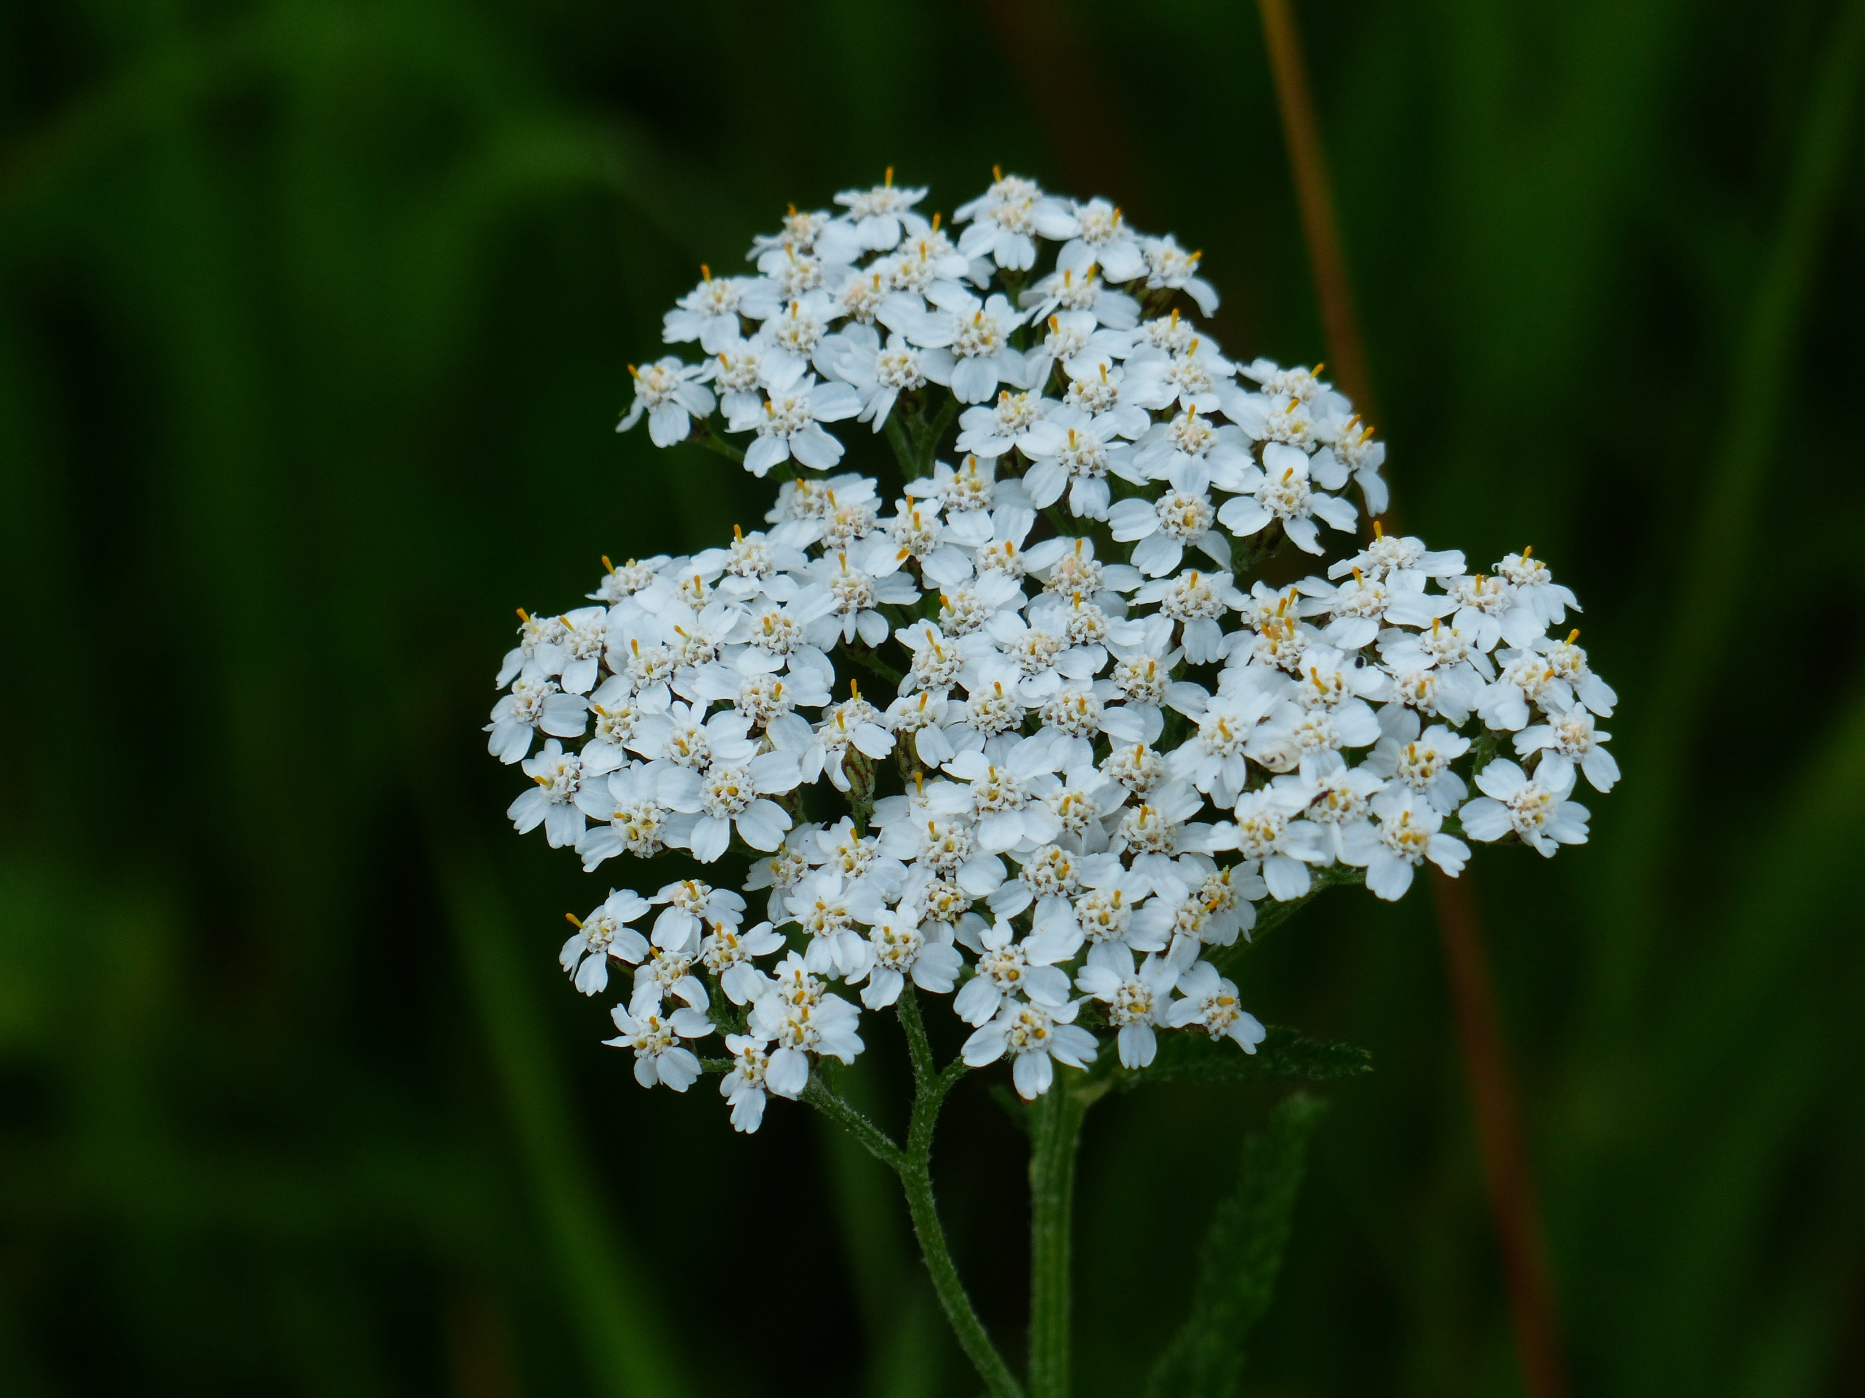
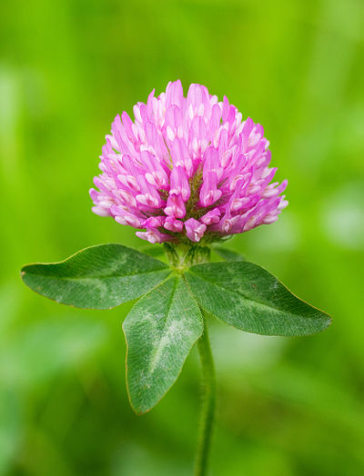
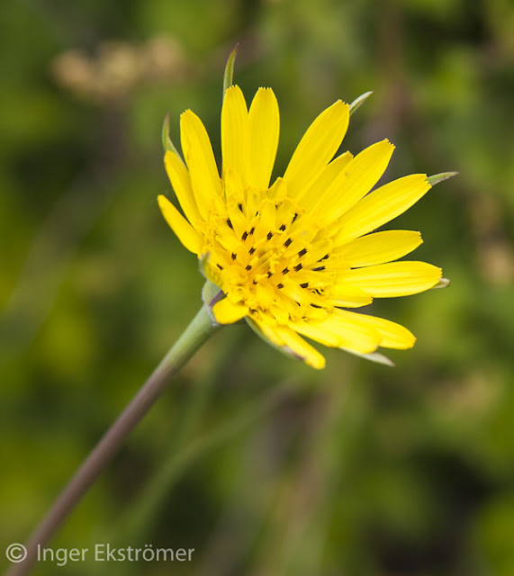
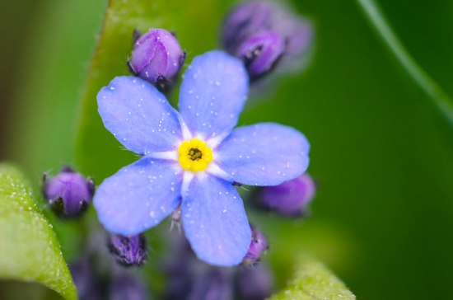
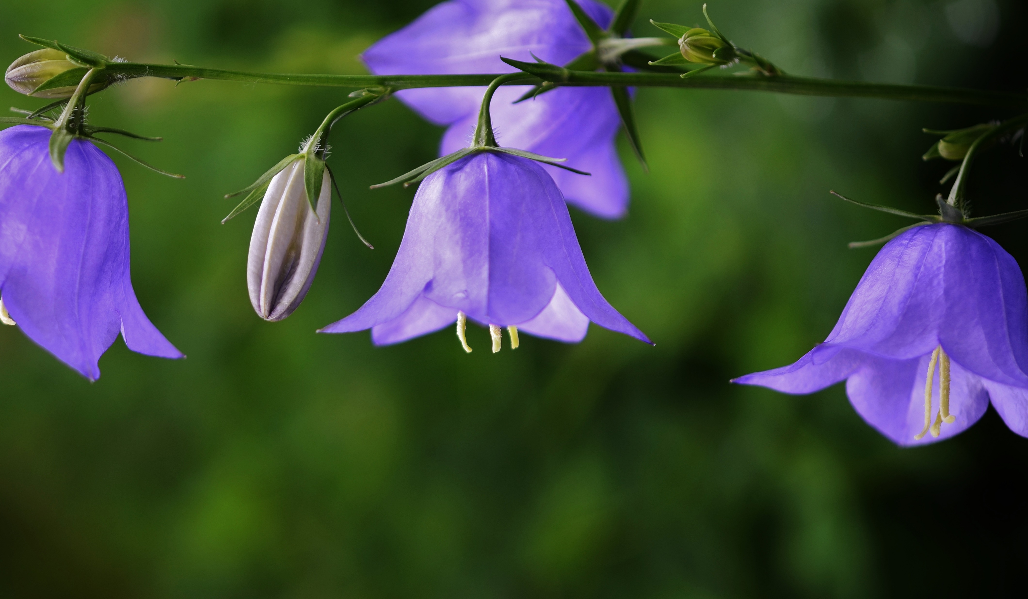
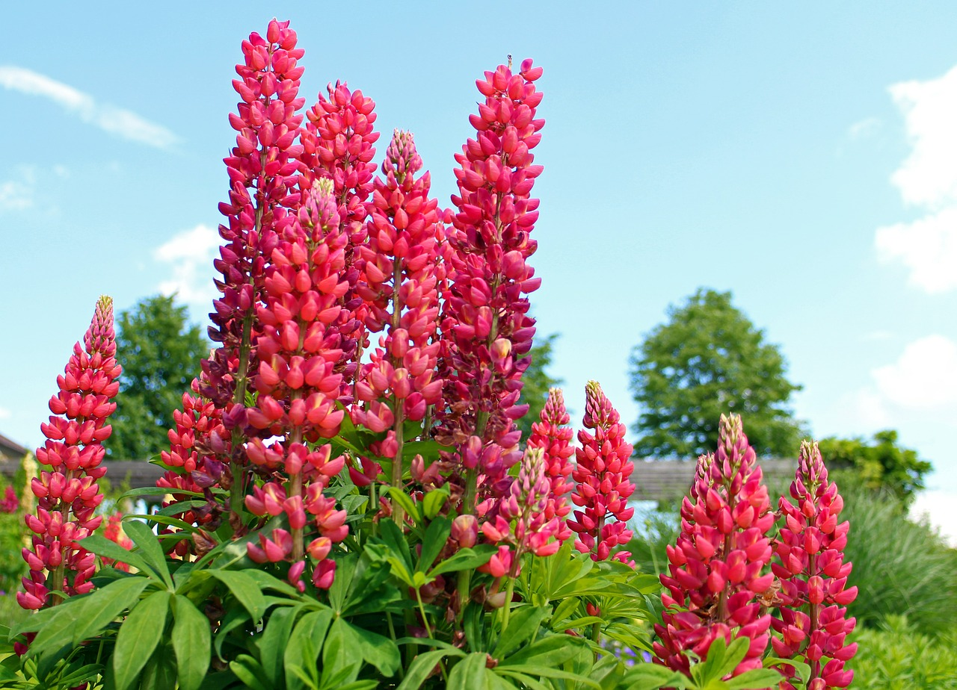
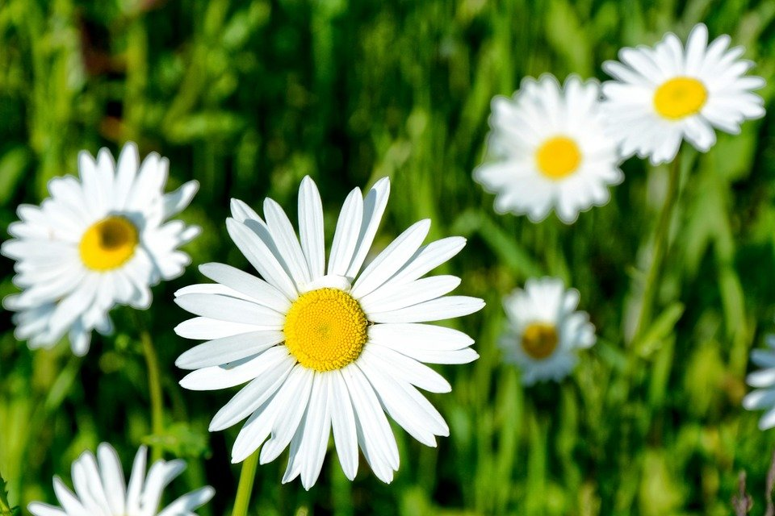
On Midsummer´s Eve it is also common to tie a midsummer wreath, which is also made of flowers and leaves. The wreath is then worn on the head. Later in the evening many people pick seven kinds of flowers and put them under the pillow. The one they dream of becomes their dearest..their love

