Slide 1
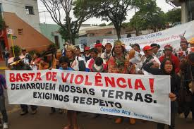
Are brazilian indian’s rights respected?

Slide 2
Human Rights
The 10th december 1948 United Nations presented the universal human rights declaration, after the second world war.

Slide 3
Native’s rights violation in Brazil
The natives suffered a lot of abuses, made by the first european conquerors, wich resulted in their decline and many tribe’s extinction. Some of them were kicked of their lands.

Slide 4
Native’s rights violation
Brazilian constitution ensure indians safety and the right of remaining in their lands and keeping their resources and traditions.
Despite these rules, many of the rights are being violated with threats , violence, corruption and murders because some people want to steal their lands.

Slide 5
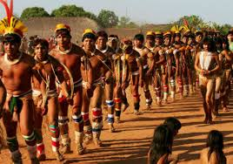
Consequences
Some natives have been kicked of their terrrotories, are loosing their natural environment and economic interests are risking they traditional way of life and survival.
Natives must be respected in their cultural diferences, otherwise they’ll risk etnical exctintion.
We should support their protests when some people invade their lands.

Slide 6
Fonts
https://pt.wikipedia.org/wiki/Declara%C3%A7%C3%A3o_Universal_dos_Direitos_Humanos
https://pt.wikipedia.org/wiki/Terras_ind%C3%ADgenas

Slide 7
This research was made by 6º D students:
Rodrigo Oliveira nº 21
Margarida Teixeira nº 17
Rita Marinho nº 20

