Slide 1
Braziliean Indians way of life
Escola Sophia de Mello Breyner
Made by:
Ana Catarina
Nº3 6º D
6ºD

Slide 2
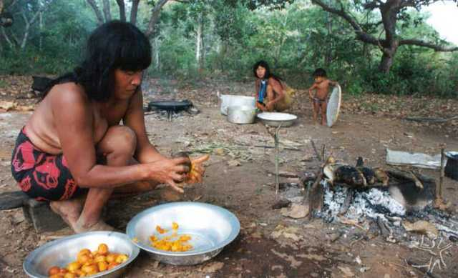
Food
They eat what nature provides:
Fish;
Animal meat;
Fruits;
Vegetables;
Tubers.

Slide 3
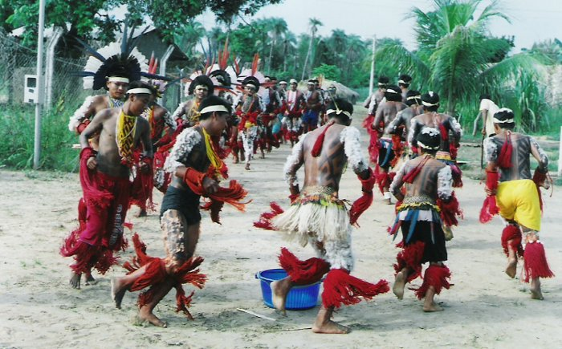
They use to bath several times a day in rivers.
Their rituals include a lot of music and dance.They paint their bodies for these ceremonies.
When they grow up they do passage rites.

Slide 4
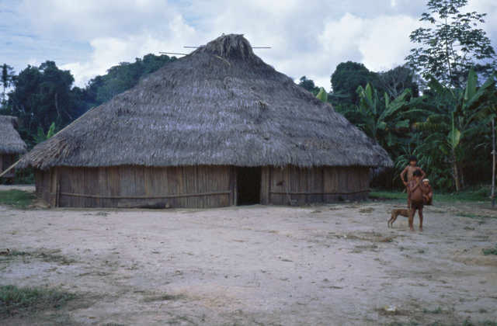
Housing
Their houses are made of nature’s elements:
Trunks and tree branches;
Straws;
Dry leaves;
Clay.

Slide 5
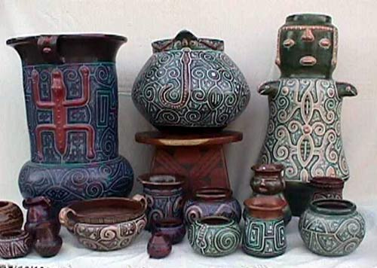
Arts and Crafts
They do:
Cerãmic pots;
Masks;
Necklaces.
They use natural elements.
Usually women do arts while men go out hunting.

Slide 6
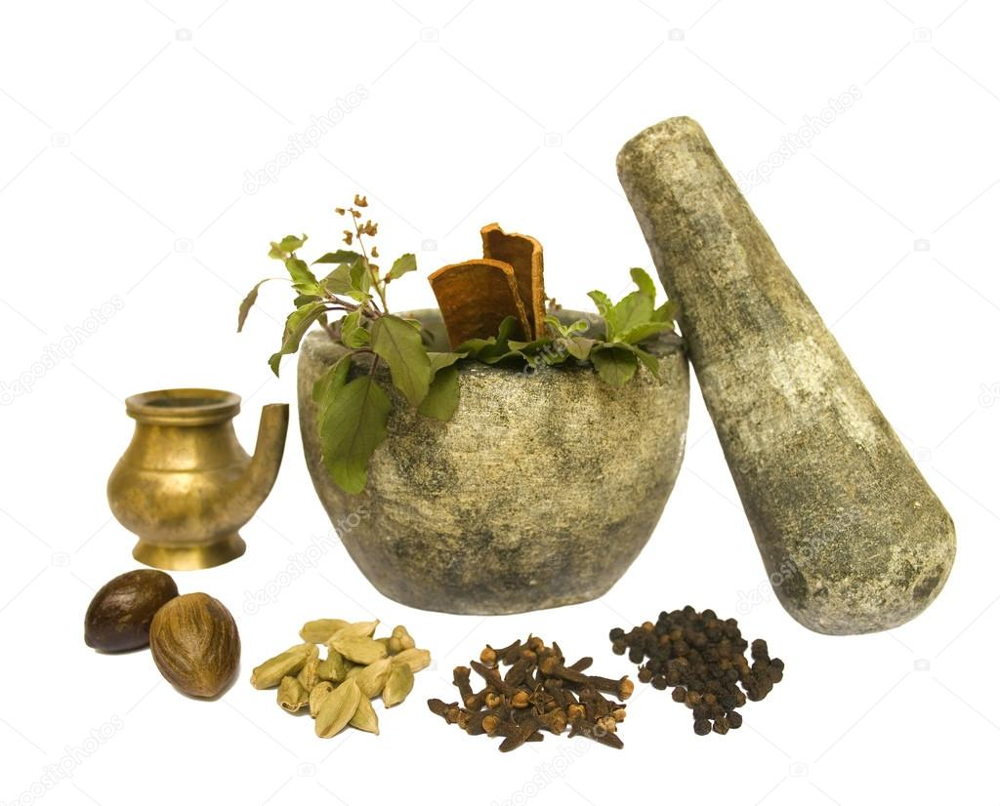
They cure diseases whith ritual cures, directed by a “pajé”;
Thewy follow nature’s religion based on spirits.

Slide 7
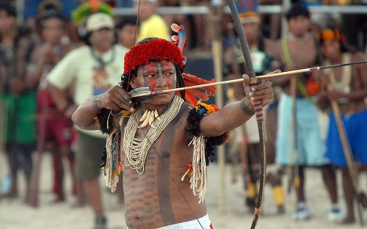
Hunting weapons
The most used is archery .
They also use the “chuço” (iron and wood made) and the “ zarabatana” (bamboop blowing pipe to shot arrows).

Slide 8
End

