Slide 1
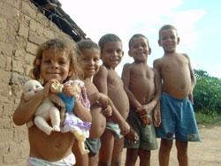
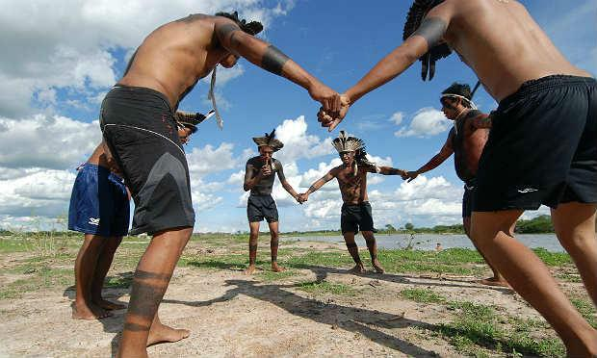
Native’s rights: present situation Cátia Madeira 6º D

Slide 2
Death, murders, racism, body injuries and sexual violation are some of the risks brazilian natives are suffering.

Slide 3
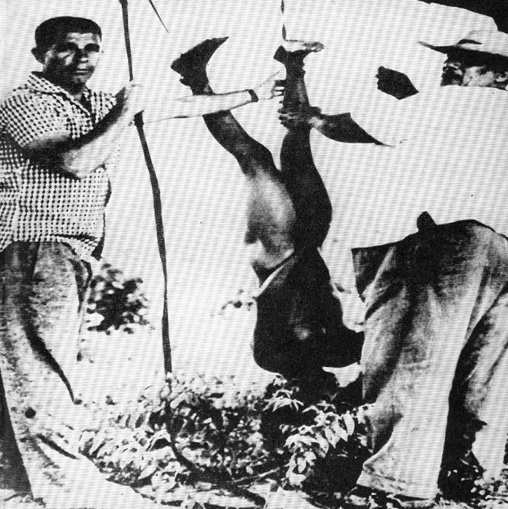
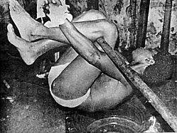
Mato Grosso do Sul, Maranhão and Bahia, are in top list of homicides against natives.

Slide 4
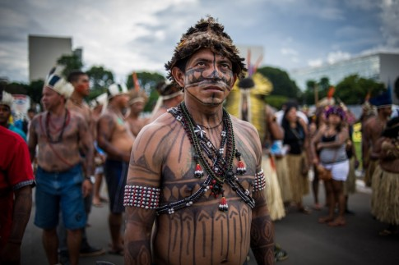
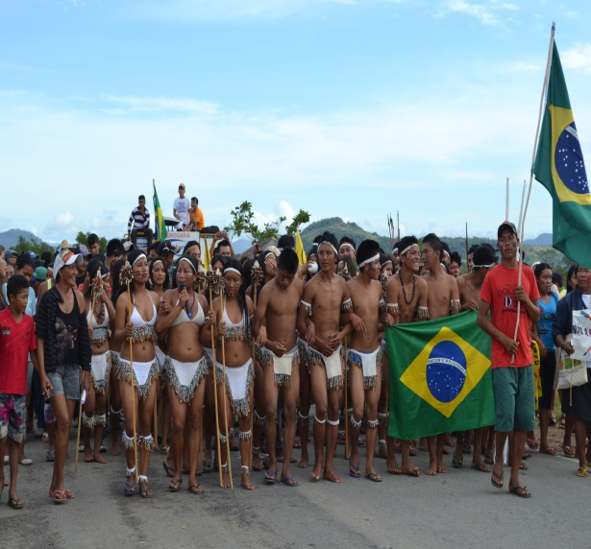
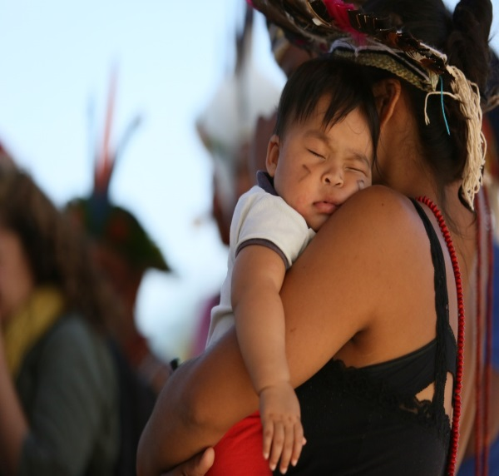
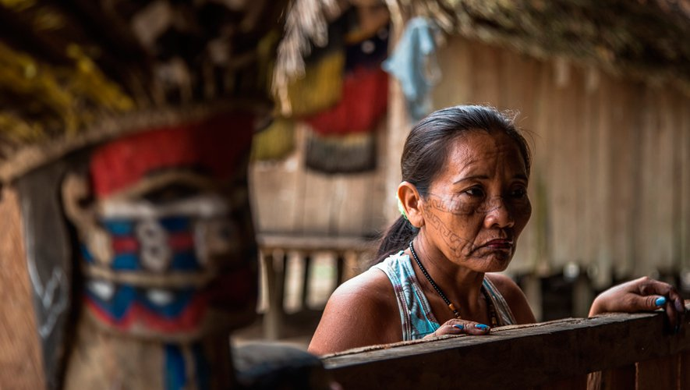
“These problems happen in territories where native’s lands are being disputed by economic reasons of the big national companies.

Slide 5
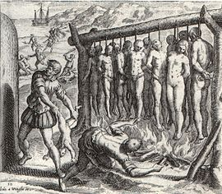
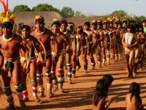
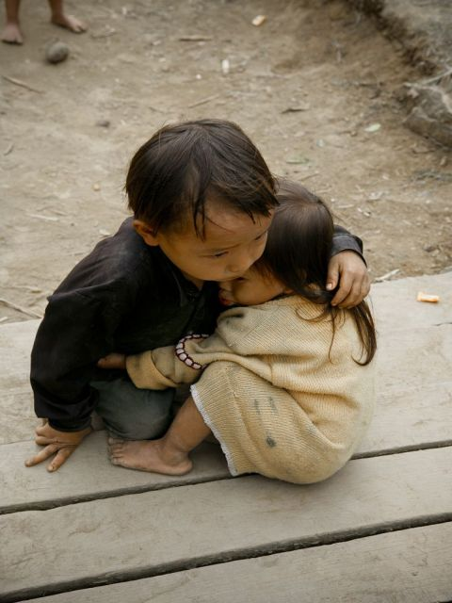
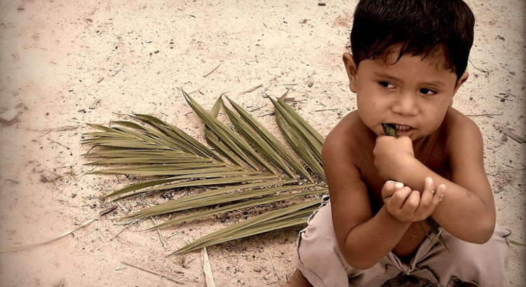
Since XV century, european settled in Brazil and began destroying native’s way of life and, in nowadays ,white pe0ple proceed until developement finishes with the tribes .

