Slide 1
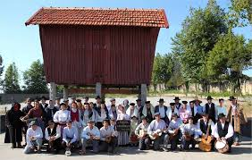
Rusga de Arcozelo Traditional Folk Group

Slide 2
INTRODUCTION:
What is a Traditional Folk Group?
It is a a group that preserves typical old dances, traditional musical instruments and traditional choreographies.
The Folk Group of Arcozelo was founded in December 1977 and it is located on Rua Dr. Milheiro in Arcozelo.

Slide 3
Their activities:

Slide 4
Costumes:

Slide 5
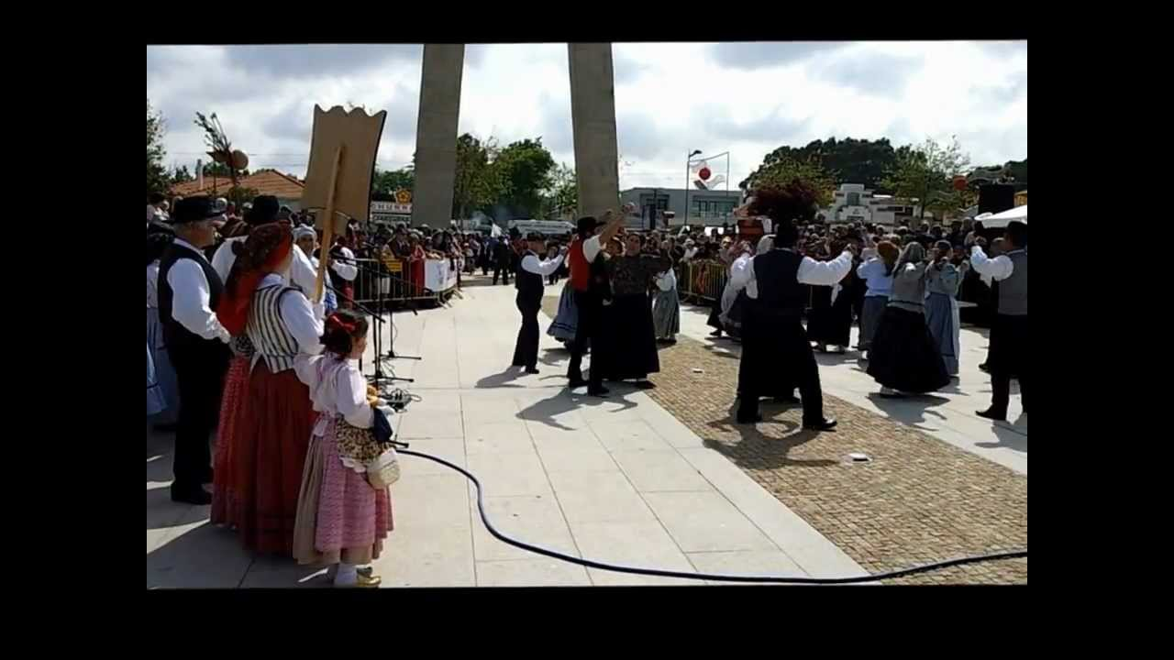
Some of their typical dances:
Ó cana, ó real das canas
Olha o velho
Verdegar…

Slide 6
Work performed by:
Rodrigo Oliveira nº 21
Lara Mendes nº15
Ruan Carlos nº 23
Rita Marinho nº 20

