Slide 1
What on Earth is Food Waste?
The presents
Notes:
This presentation below tries to give you an introduction in the topic of food waste.

Slide 2
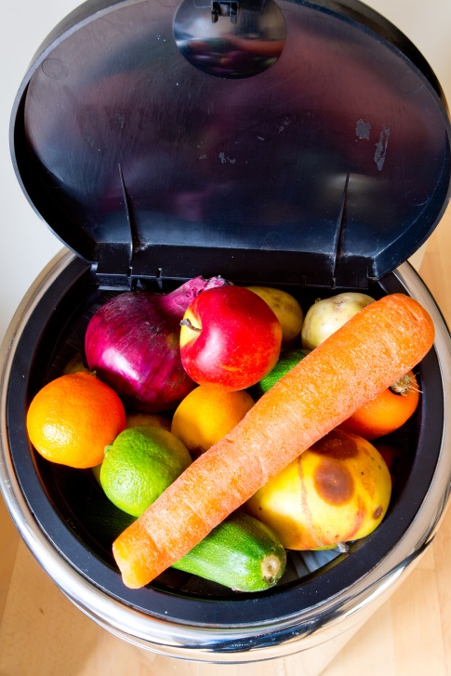
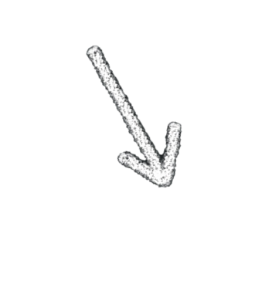
Our society is thriftless
We consume more and more and we buy even more food
Enormous amount of waste is generated
Notes:
Our society works on a very thriftless way. We produce much more food than we could ever consume. That is why whacking amount of waste is generated.

Slide 3
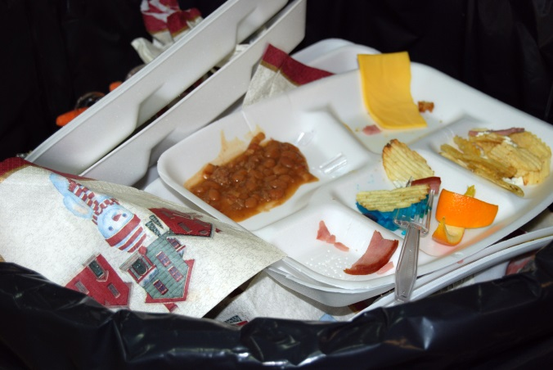
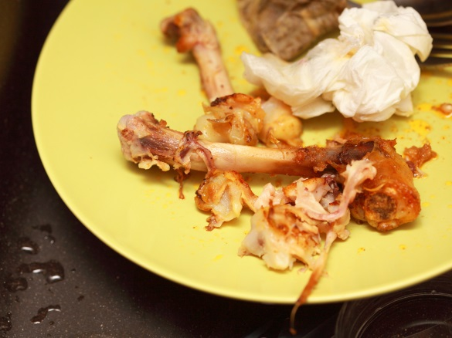
Every year 89 000 000 tonnes of food become waste in Europe.
Notes:
Every year 89 Million tons of food become to waste in Europe that is generated at household and industrial level. That means that we throw out 180 kg food per year as an average per capita. A lot of waste come from the industry but we end-users also generate a huge amount.
This 89 million tons are expected to rise to approximately 126 million tonnes by 2020 if no action is taken.

Slide 4
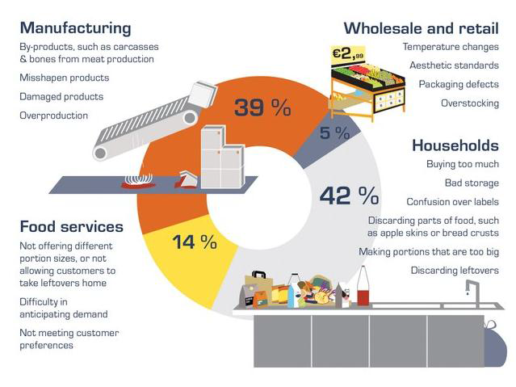
Where and why does food waste generate?
Notes:
There are many reasons why food waste does generate. The figure above shows us the main places and reasons of the origins of food waste. Food waste generates in differentrates at housholds, canteens, retail system and industry but we can see that average people highly couse the issue.

Slide 5
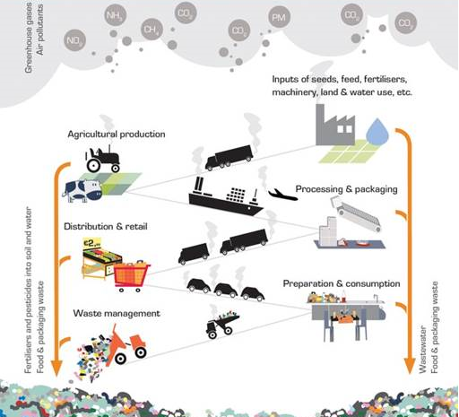
How does food industry impact
the environment?
Notes:
This huge amount of waste coases heavy impact on the environment. That shows us the figure above. Waste generates at every point of the food chain so as pollution.
The European Commission cites that the EU food and drink value chain is responsible for 17% of direct greenhouse gas emissions and 28% of material resource use. Food production and consumption in the EU generate an estimated 20% to 30% of all EU environmental impacts
Some products have a deeper impact in environment than others. For instance,

Slide 6
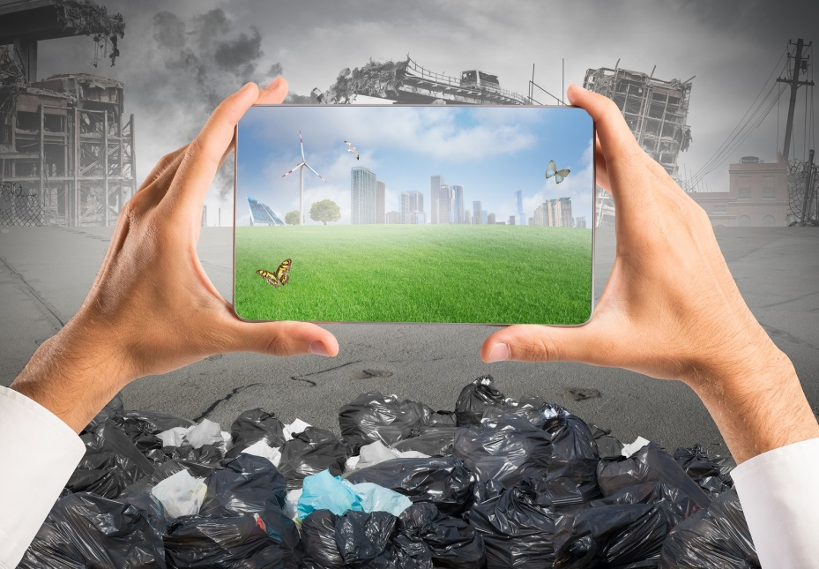
In Europe agricultural production of food accounts for
20-30% of
all environmental impact
10% of
greenhous egas emission
50-80% of
nitrogen load in freshwater
90% of
ammonia emission
Notes:
Agriculture, that is the base of food industry, causes 20-30% of all pollution in Europe. It accounts for:
10% of greenhouse gas emission contributing to climate change (including 80% of methane emission)
90% of ammonia emission impacting air quality
50-80% of nitrogen load in freshwater bodies affecting water quality and aquatic ecosystems.

Slide 7
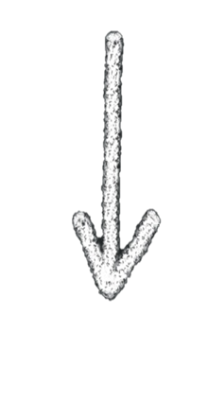
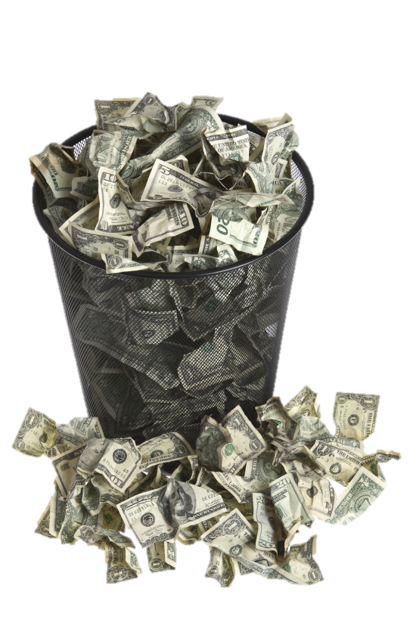
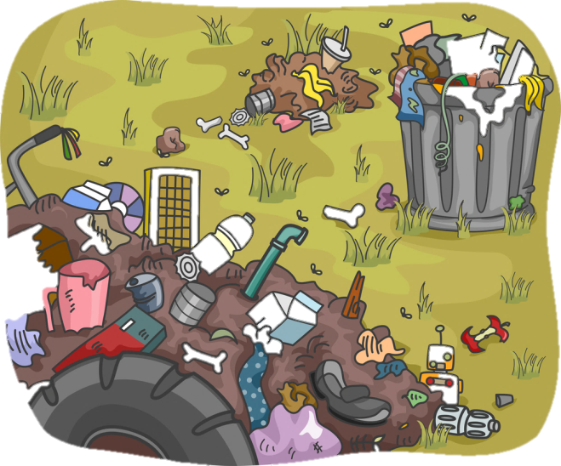
Wasting
Overusing of the environment
Throwing money down the drain
Polluting of the environment
Notes:
We handle with our food in a very lavish way. At the same time we overuse and pollute our environment in the course of food production. Meanwhile, we are throwing money down the drain with two hands, because we buy lots of unnecessary food and we produce much more like than to fill the shelves of the supermarkets.

Slide 8
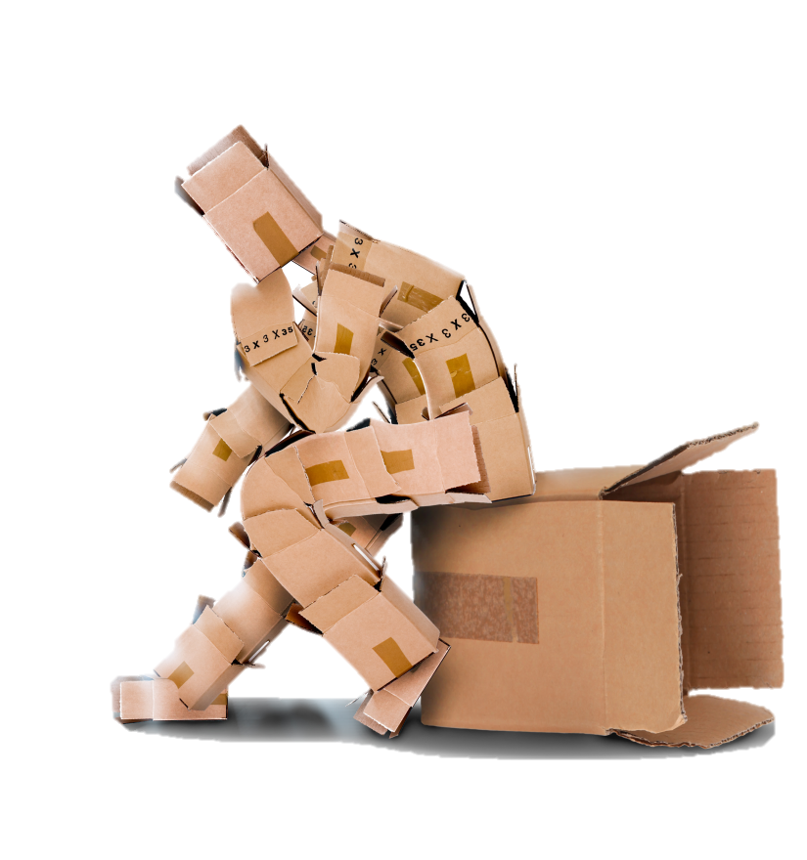
Unrealistic demands
Fresh vegetables, fruits in every season
Foods avaible from every part of the world
Wherever it comes from, no matter how many layers of packaging
Aesthetic counts more
Notes:
Our consumer society has unrealistic demands from food and agriculture. For example we expect that strawberry or tomato could be bought in every season altough they don’t crop all time. It’s natural for us that we can buy food which are grown on a different climate like banana. And we don’t care where the food come from so we buy it from hundreds of kilometers and not from our neighbourhood. The shape and aestethics of fruits and vegetables counts more nowadays, but real plants can’t meet this requirements. Thus some of the food just land in the bins just because of aesthetic matters.

Slide 9
2012: the European Food Banks distributed 388 000 tons of food,
equivalent to 776 million meals, to 5.4 million people in
partnership with 32 000 charitable organisations and social services
Notes:
The overall purpose of this graphic is to provide an array of options to prevent food from being wasted and ending up in landfills. The pyramid also shows the preferable options when avoiding food waste; where avoiding the generation of food waste should always be the priority. Nevertheless, feeding people in need and feeding livestock are good alternatives too, but trying to Reduce is still the most desirable one. Unavoidable food waste should be sent to composting, or to produce fertilizer or renewable energy instead of being disposed of in landfills.

Slide 10
Enough of wasting food!
Our choice only depends on us!
Notes:
We have to stop wasting food and our natural resources. For that we should change in our everyday life. We can do much more with a small attention.

Slide 11
Take part in the European Week for Waste Reduction!
Notes:
Firstly, you should take part in the European Week for Waste Reduction and get some ideas.

Slide 12
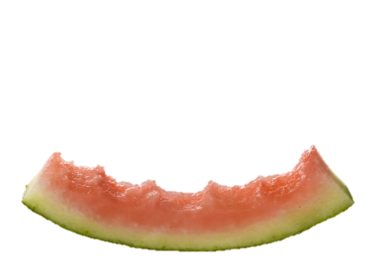
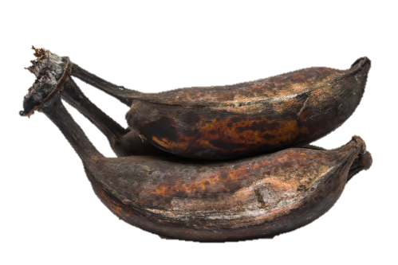
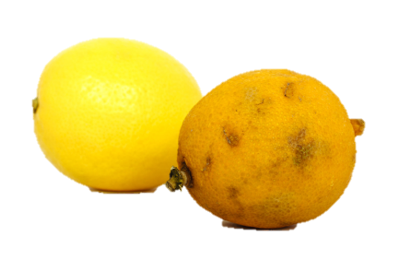
Some useful tips
Write shopping list before shopping!
Do not go for a shopping with empty stomach!!
Plan your weekly menu!
Take care of the appropriate storage of food!
Watch out for the best before and use-by date of the products!
Notes:
Here you can see some useful every-day-life tips, but you can get know more information on the official website of the European Week for Waste Reduction. ewwr.eu
Before shopping:
• Make a shopping list.
Make sure to purchase just the items you really need so as to avoid purchasing unnecessary food that you may not consume in time
• Check your storing places.
Going through the fridge and cupboards allows you to know the food that is still on stock
• Plan your meals.
Setting up a weekly menu will help you to avoid unnecessary food purchasing and to differentiate between “convenient” and “necessary” when filling the shopping cart
When do the shopping:
•Avoid unnecessary food purchasing.
Make sure not to fill in your shopping cart with unnecessary products just because they are under a discount. Special offers might be tempting but before purchasing them ensure that you will consume the total amount of the quantity offered.
• Choose sell in bulk options.
Sell in bulk options have less packaging. They also allow you to choose the right amount of food you need.
• Check out the product’s labels.
Make sure to distinguish between the “use-by” date and the “best-before” date.
“Use-by” dates are the most important dates for people to consider, as these relate to food safety. Food is suitable for consumption before this date, but not after. Most food types concerned are fresh and chilled foods; such as raw meat, poultry, fish, eggs, milk, fruit and vegetables.
“Best before” dates relate to food quality including taste, texture and appearance.
Eating food past its “best before” date is unlikely to be harmful if the product has been stored properly and the packaging is not damaged, but maybe the product is not at its best quality.
• Make your shopping at a good time.
Visiting the supermarket when hungry leads to buying more food than necessary. Having a snack before shopping can be an easy solution to avoid unnecessary food purchasing.
Back at home
Organize your storing places. Check out the distribution of the dry products in the cupboards and arrange the fridge’s assigning.
• Older products first displayed. Older products should always come first in the shelves and food leftovers are likely to be consumed before the new food arrivals. This method would certainly avoid food from being wasted and will definitely help you to save some money.
• Don’t be afraid of using your leftovers! Prepare delicious meals with your leftovers. Find recipes on the internet.

Slide 13
Thank you for your attention!
It’s your turn!

