Slide 1
Sauga basic school and Erasmus+ project management
Erasmus+ project manager in Sauga basic school
Magdalena Donerstak

Slide 2
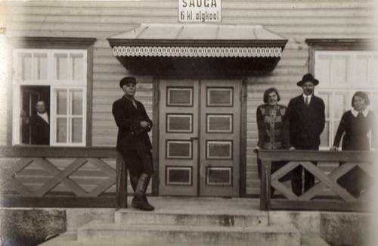
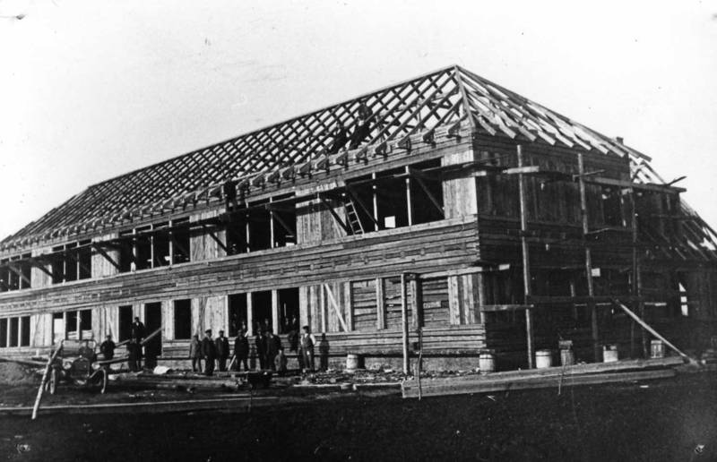
About our school history
Sauga basic school was established in 1820.
Building the school

Slide 3
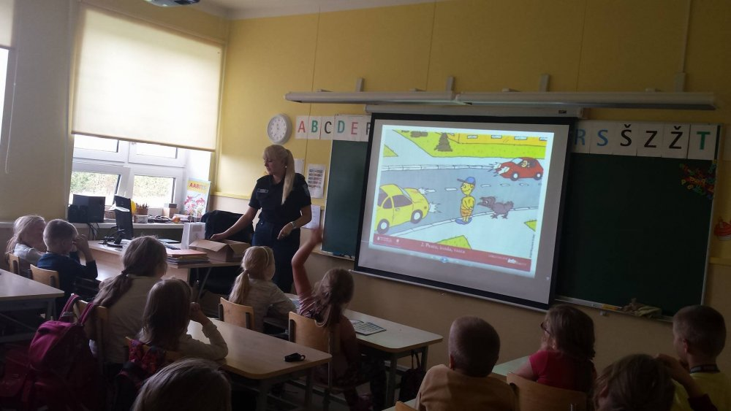
Our school in year 2016
Modern IT technology.
Renovated classrooms.
Cooking class.
Prioritizing learning foreign
languages.
Prioritizing computer lessons.
Police introducing traffic rules to first graders.

Slide 4
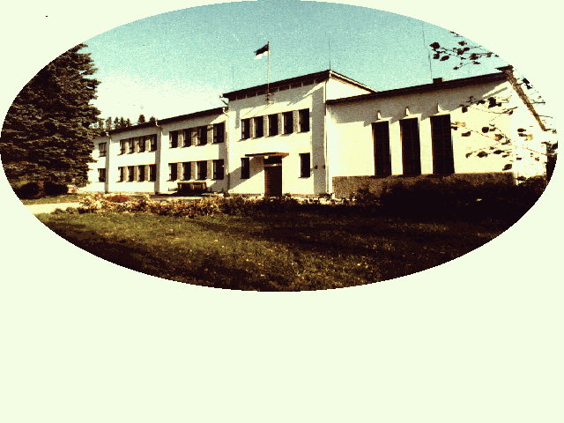
Plans for the future
Renovate schools’ facade.
Renovate the basement in order to move some of the classrooms there.
Be involved in different projects.
Holding on to traditions.
Continually being an eco friendly
school.

Slide 5
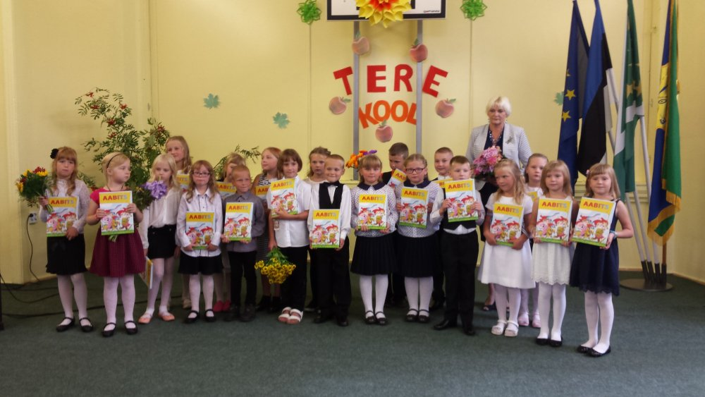
Students in year 2016/2017
This year we have 157 students in our school.
Every year the number of pupils attending Sauga basic school increases.
In the picture there are 20 students who started school this September 2016.
Class 1– 20 students
Class 2A and 2B– 28 students
Class 3 – 30 students
Class 4 – 18 students
Class 5 – 12 students
Class 6 – 10 students
Class 7 – 11 students
Class 8 – 15 students
Class 9 – 13 students

Slide 6
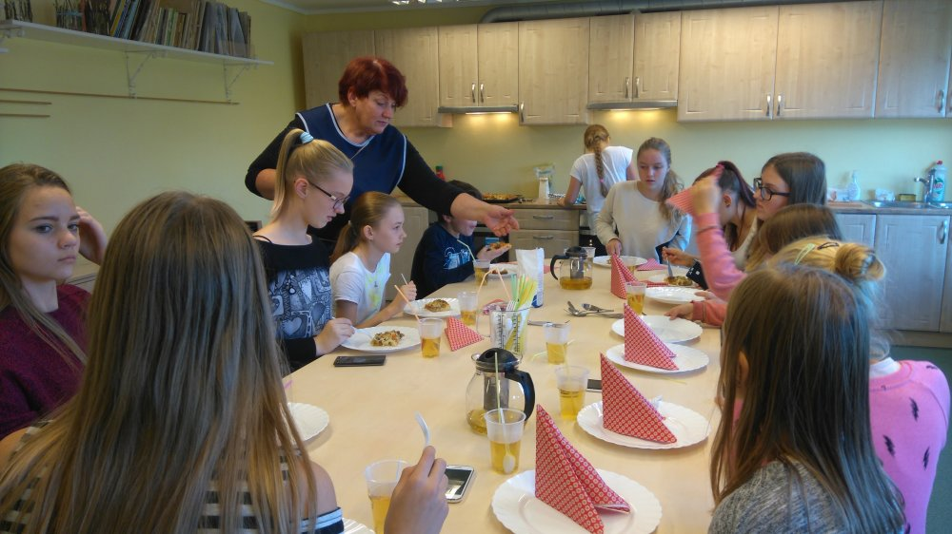
Everyday work in our school
School day starts at 8.25 a.m.
Students have 5 to 7 lessons every day according to the schedule.
School busses leave approximately at 3 p.m.
We have a long day childcare with catering.
Students participate in several hobby
lessons – they can play musical instruments,
sing in a choir, study English etc.
In the picture pupils are taking part of
the cooking course which is one of the most
popular after school hobby lessons.

Slide 7
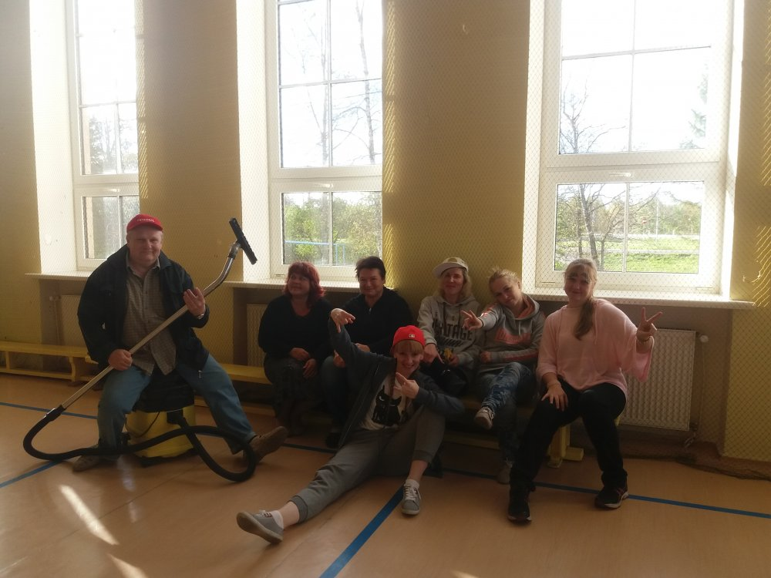
Administration and teachers in our school
There are 4 members of the administration: headmaster, head teacher, youth worker and manager of the economy.
There are 16 teachers teaching
in Sauga basic school.
The school has a speech therapist,
who is also the special need
support teacher.
In the picture there are some of
our teachers on Teachers’ day.

Slide 8
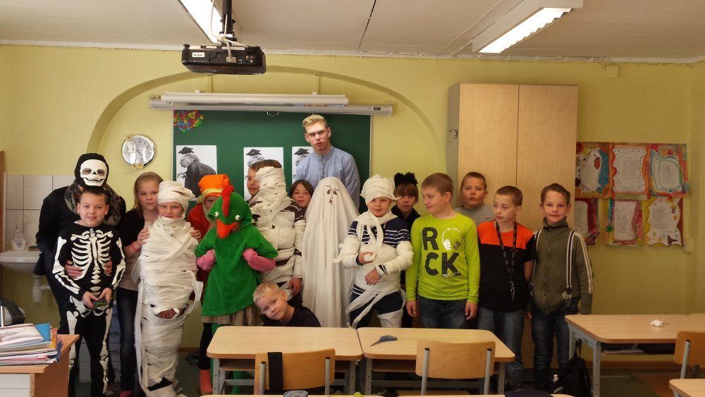
About youth work
Youth worker is part of the administration.
The purpose is to make school life more
interesting.
Organizing different out-of-class
activities such as excursions.
Organizing the work of all the hobby
class teachers.
Organizing celebrations for most of the
holidays as Halloween, Teachers’ Day and
Christmas in the school environment.
Project work management.
Halloween in 2015

Slide 9
Erasmus+ projects in our school
As our school is small all the members of our school will be involved in the project work.
In 2016 to 2018 we will work on two projects.
For that we have created a project team of 21 students.
There are four key teachers involved in a project.
Every Monday we have the administration meeting.
Project manager
Teachers
Project team
Parents
Administration

Slide 10
Project team

Slide 11
Thank you for your attention!

