Slide 1
Lužnica castle
Magdalena Vugec,Lorena Žmegač

Slide 2
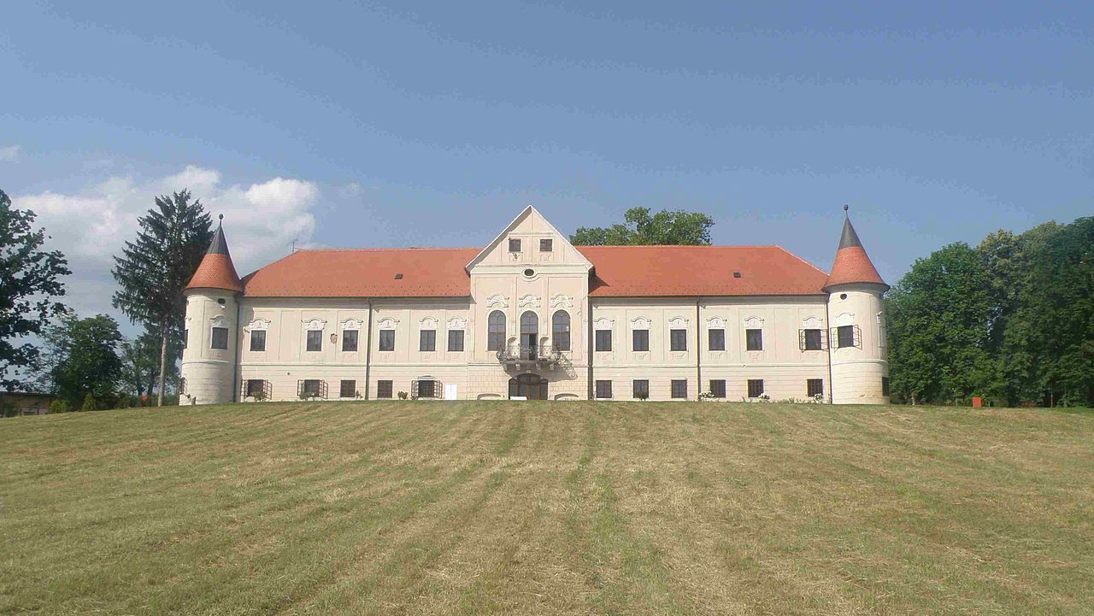
What and where is Lužnica Castel
Lužnica Castle is a castle located in Lužnica
It was built in the second half of the 18th century
It is owned by chatolic order „ Sisters of charity”

Slide 3
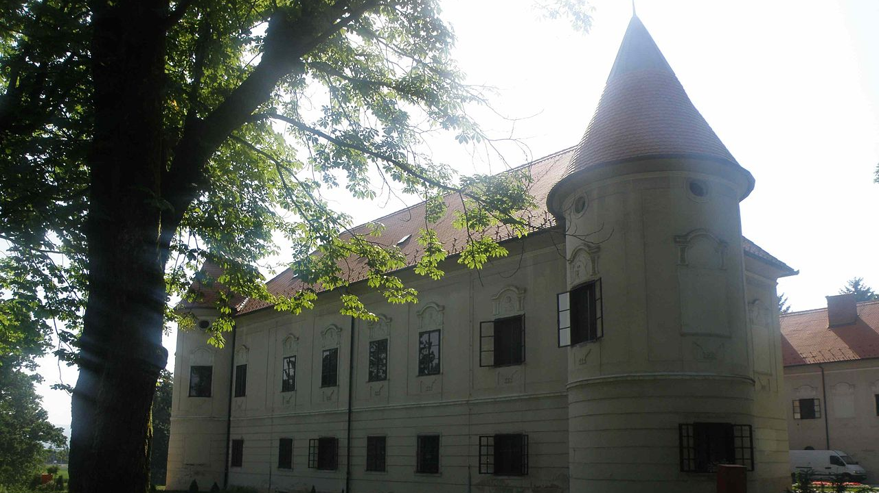
History
The first owner of the Lužnica estate was the noble Čikulin family, originally from Italy.
In the 18.th century family Moscon bought the Lužnica estate and his owner was Maksimilijana Moscon
Her husband Ivan Hyacinthy after he died left the whole estate to Kaptol, wich is part of Zagreb Archdiocese

Slide 4
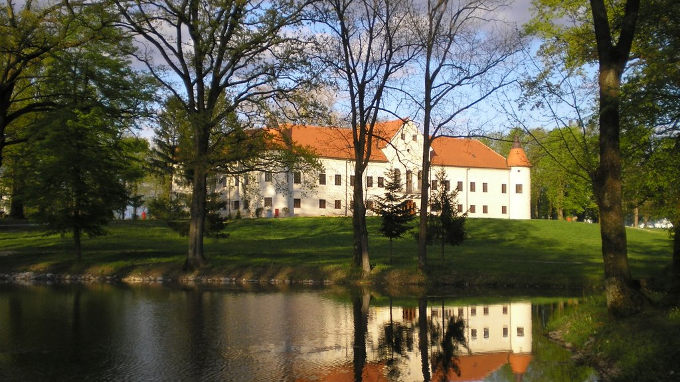
Outdoor look
Lužnica Castle is a one-storey three-winged baroque castle with a prominent central hall
The castle is also adorned with four corner towers of cylindrical shape with conical roofs
The castle is surrounded by a park created at the end of the 18th century, with an area of ​​eight hectares with rich vegetation, a 2,5 kilometer-long promenade, a lake and gazebos.

Slide 5
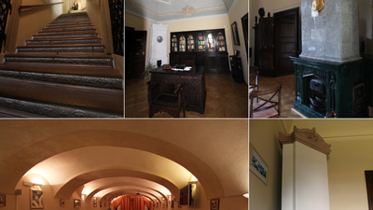
Indoor look
The castle has two floors; ground floor and first floor which in the past were functionally and class divided
The ground floor and basement of the Lužnica castle were used for services and economic needs, while the first floor served as a living space for the castle owner and family.
The two floors were connected by a wooden staircase located in the lobby

Slide 6
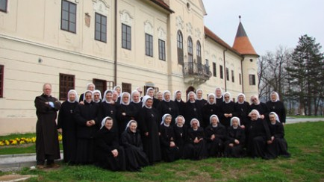
Castel Lužnica today
Today Castel Lužnica is a muzeum and esteat Lužnica was renovated and by Chatlic order Sisters of charity and it is being used as a centar Chatolic center for reunion

