Slide 1
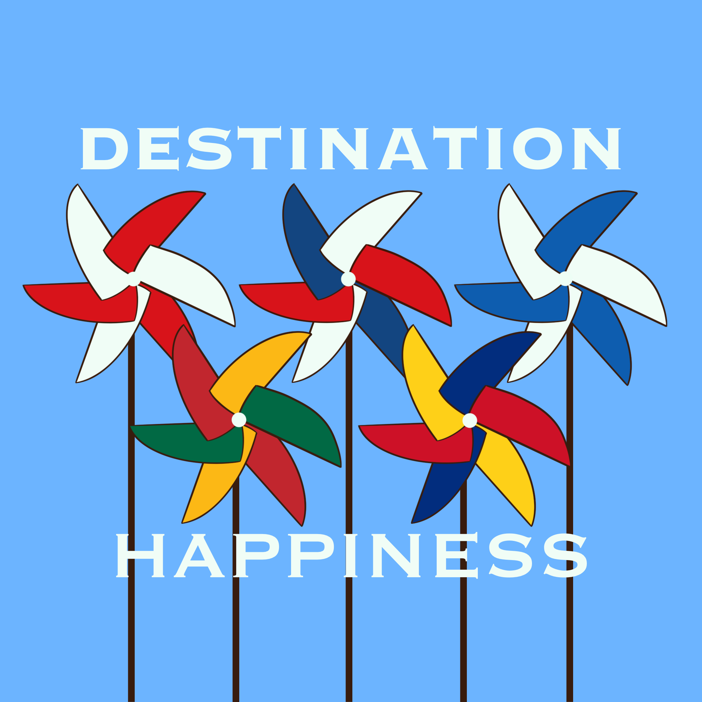
Erasmus+ school partnership project „Destination: Happiness“ An introduction to Sustainable Development Goals
Presented by Rita Lamokovskienė
Jonava Jeronimas Ralys gymnasium
December 7 , 2021

Slide 2
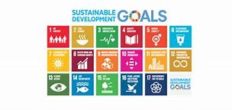

Slide 3
The Sustainable Development Goals (SDGs) or Global Goals are a collection of 17 interlinked global goals designed to be a "blueprint to achieve a better and more sustainable future for all".
The SDGs were set up in 2015 by the United Nations General Assembly and are intended to be achieved by the year 2030.

Slide 4
https://www.youtube.com/watch?v=qfOgdj4Okdw&t=7s
A VIDEO ON SDGs
„Sustainable Development Goals explained with 3 useful tips“

Slide 5
Is sustainable development possible in today’s world in which people are becoming richer and consuming more of the Earth’s natural resources?
Is sustainable development real or is it just theory and a topic for inter-governmental meetings?
Would you be able to sustain yourself?
How important is sustainable development in relation to issues like climate change, poverty, etc.?
What problems does a lack of sustainable development lead to?
Do you think people will be talking about sustainable development 50 years from now?

Slide 6
Look at SDGs more creatively...
Step 1:
Do some research on the SDG goals assigned
Write a short summary for each goal
Write your findings on a clolorful paper
Step 2:
Draw SDG goals together with your partner
Step 3:
Present your findings and your artistic displays to the whole group

Slide 7
The outcomes of the session:
A wall display of SDGs
Students‘ presentations

