Slide 1
Pollution
Erasmus +: Destination Happiness!
Stancu Maria Alexandra

Slide 2
The main causes

Slide 3
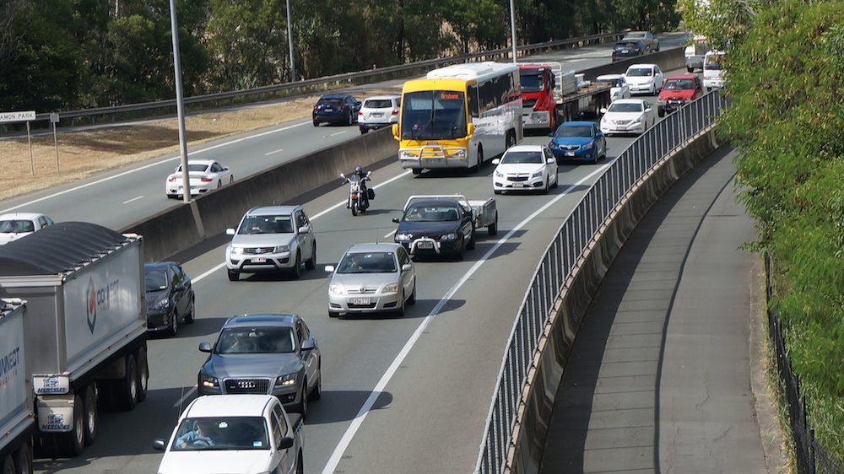
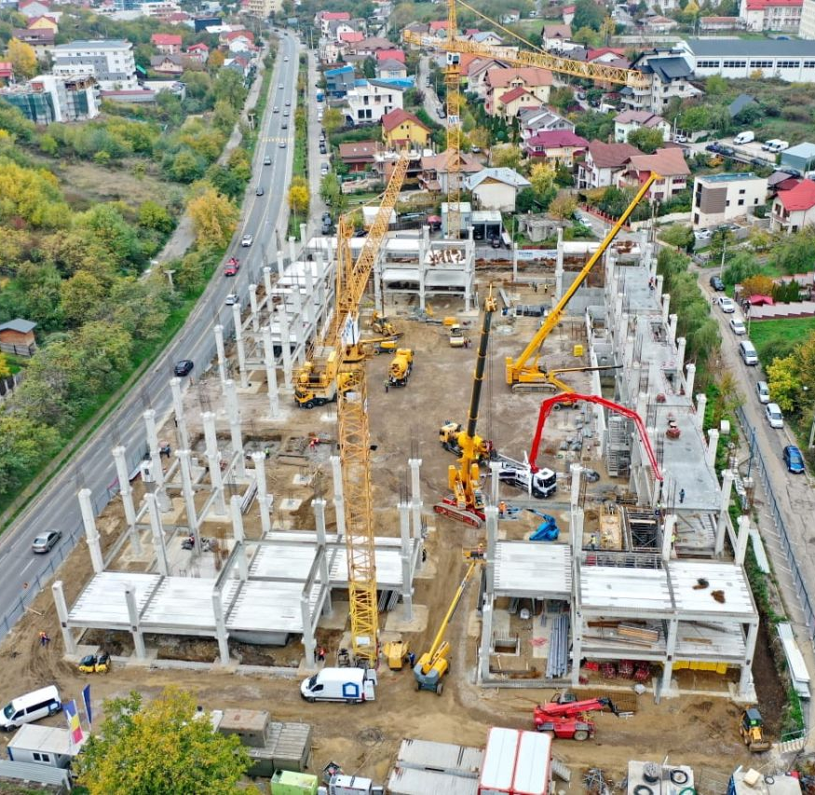
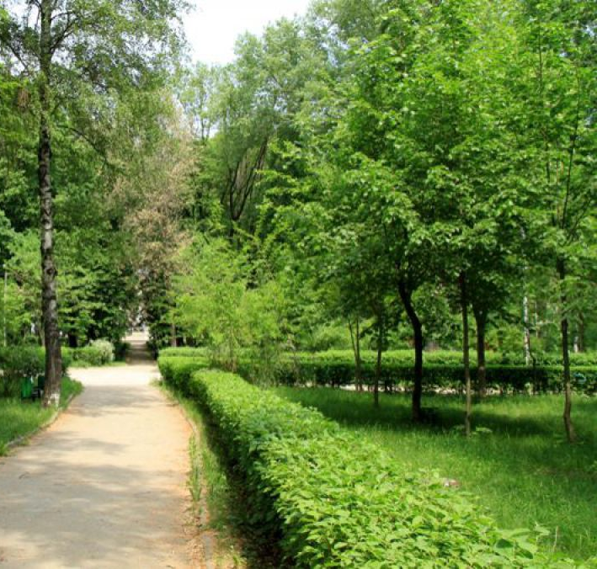
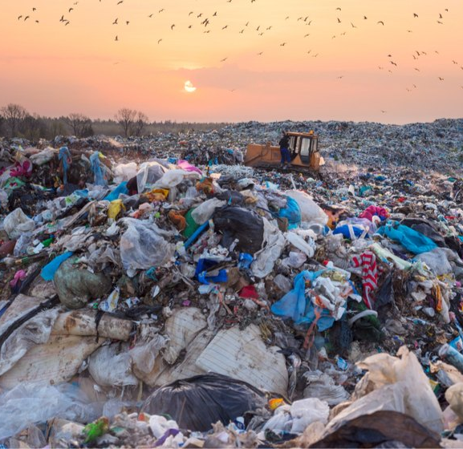
The heavy traffic
The intense building
The lack of green spaces
The lack of recycling centers
In Bucharest, there are a lot of cars that emit a lot of harmful greenhouse gases.
This can cause the soil to erode more quickly. Also, the building process produces a lot of waste.
Due to urbanization, the green spaces have been reduced, causing the quality of the air to decrease.
The waste is kept in landfills, where the trash is burned. This smoke is extremely harmful to the environment.

Slide 4
How the community is affected

Slide 5
Potential health issues
Increased mental disorders
Exposure to high levels of pollution can cause a lot of long-term health issues, such as various respiratory problems, heart problems and infections.
The environment has a huge impact on our lives. The polluted air can be damaging for your brain, making you more prone to mental disorders, such as anxiety, depression, etc.

Slide 6
Solutions to reduce pollution

Slide 7
What can you do?
Recycle as much as you can
Use natural light more, and stop unnecessary lights
Try to replace plastic with glass

Slide 8
The 4 R strategy
Avoid waste by reusing simple items, like your shopping bags or clothes.
Reuse
Recycle
Try to reduce impulse buying and focus more on how sustainable that product is.
Have more garbage bins, where you can sort your items. Then bring them to a recycling center.
At the centre, the products can be transformed into something else, and be used again by you.
Reduce
Recreate

Slide 9
Bibliography
Slide template:
https://slidesgo.com/theme/climate- change#position-1
Image:
https://motorbikewriter.com/ten-tips-riding-safely-heavy-traffic/
https://economedia.ro/5088.html#.YH2yaugzY2w
https://www.wall-street.ro/articol/Social/259722/oficial-groapa-de-gunoi-de-la-chiajna-este-ilegala.html#gref
https://iasi247.ro/lipsa-suprafetelor-verzi-din-iasi-este-un-motiv-de-ingrijorare/
Information:
https://www.wolkat.com/en/news/nieuws-reinventing-recycling
https://www.recyclenow.com/recycling-knowledge/why-recycle
https://www.worldwildlife.org/threats/pollution

