Slide 1
Coping with stress by using TIME MANAGEMENT TIPS
Presented by
Adomas Marčiukaitis and Orestas Pelivanov
Jeronimas Ralys gymnasium

Slide 2
Why do we need time management?
To increase our work output
To save time
To reduce stress
To have more control over our job responsibilities

Slide 3
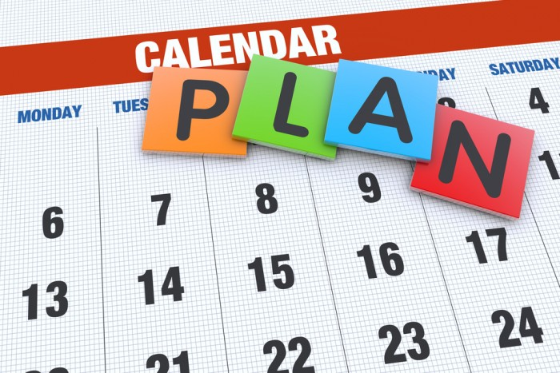
FIRST TIP
Create a daily plan with your daily routine.
In this way it is so much easier to remember all the works you need to do.
Also, it is easier not to get distracted while doing your job.

Slide 4
SECOND TIP
Focus on work.
We found ourselves distracted by other things very often while working, so we recommend you to focus on work to save time.

Slide 5
THIRD TIP
Do not multitask.
Doing many tasks at once bring poor quality to your work.
Also, it is very harder to focus on work while you are multitasking.

Slide 6
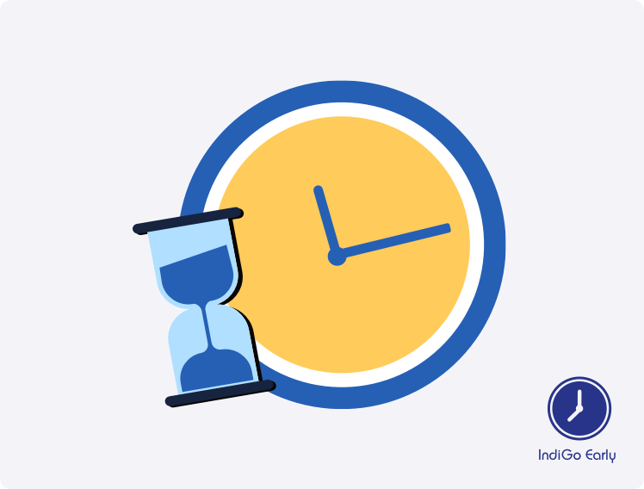
FOURTH TIP
Start doing your work earlier.
The earlier you start your work, the sooner you will finish.
In this case you will have more free time.

Slide 7
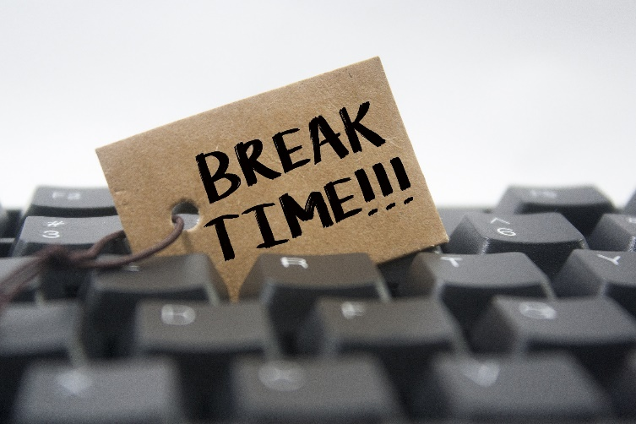
FIFTH TIP
Take small breaks between tasks.
Doing lots of tasks without break makes it hard for you to stay concentrated.
After a break your work performance will surely improve.

Slide 8
Summary
With proper time management people can live an easier and happier life, without that much stress and rushing.

