Slide 1
Green Life in
Bucharest
~ current issues in our community ~
Pavel Eva

Slide 2
The general issues
Air quality; atmosphere protection; climate change
Water
Littering; dangerous chemical substances; soil quality
Protection of nature, biodiversity, and the forest
Production
Consumption
Ecological education; quality of life

Slide 3
The increased level of production & consumption
Consequences: ~ the increase of energy consumption which causes the reduction of limited resources
~ infrastructure issues
~ a high level of water consumption
Solutions: ~ be responsible with the amount of food we buy, how much water and electricity we use on a daily basis
~ find other alternatives for electricity like switching to energy-efficient lighting

Slide 4
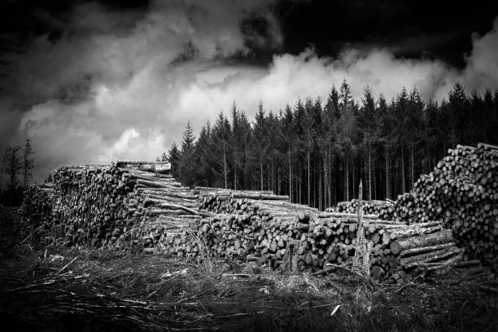
Deforestation
=permanent removal of trees to make room for something besides forest. This can include clearing the land for agriculture or grazing, or using the timber for fuel, construction or manufacturing.
However, in our city and many others, unauthorized takedowns of trees have been going on for a long time, whether in the context of building new neighborhoods, factories or, simply because of the need for more space. These reasons do not make up for the fact that we are throwing away our source of oxygen and the only things that bring you a fresh breath of air in our already crowded city.

Slide 5
Funnel to success ~ steps towards taking action
AWARENESS
getting others attention is the most crucial factor in achieving your goal
DISCOVERY
having enough information on the subject is what makes people trust you and your purpose
EVALUATION
constantly checking your thoughts helps improve them and it also makes the concept more clear in your head
INTENT
the intention to make a change is what motivates you to take action
ACTION
the gesture is where your efforts start to get recognized by others
LOYALTY
your fidelity towards the goal is what determines whether or not you can take on the challenge

Slide 6
Inaction breeds doubt and fear. Action breeds confidence and courage. You just choose which one defines you.

Slide 7
Credits
https://www.interregeurope.eu/fileadmin/user_upload/tx_tevprojects/library/file_1509364323.pdf
https://www.euronews.com/2020/02/12/brussels-threatens-romania-over-illegal-logging-in-primary-forests

Slide 8
Thank you for your time!

